Slide 1
Efficacy of Drug Control Policies in the US

Slide 2
Introduction
Background
Prescription opioid usage and misuse have risen in the US over the last two decades.
numerous states have implemented drug control regulations
Florida, Texas, and Washington are three states that have implemented regulations.
determine if this reduction may be caused by the implementation of the legislation
examine the impact of the policy on drug shipments in Florida and Washington in particular.
Goal of our Study

Slide 3
Data
Prescription Opioid Shipments
Drug Mortality
Data on every pain pill shipment in the US
Collected by Washington Post
From the US Vital Statistics records
Contains data on every death in the US*
Masked for privacy reasons
Needs to be combined with census data

Slide 4
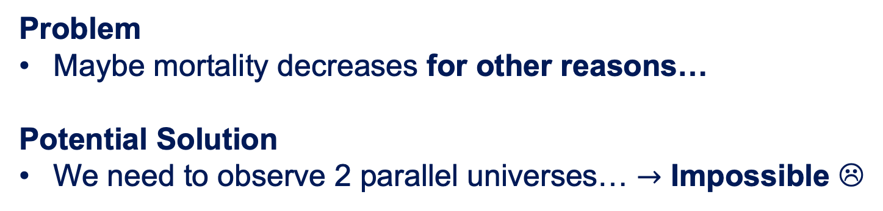
Methodology
Causal Inference
Did the policy actually cause a decrease in mortality?
Problem
Maybe mortality decreases for other reasons…
Potential Solution
We need to observe 2 parallel universes… $→$ Impossible ☹
Actual Solution
Choose comparison states…
that did not implement policy
that behaved similarly before the policy change and
are expected to behave similarly had the policy not been implemented

Slide 5
Methodology
Choosing Comparison States
1
We narrow down our selection based on…
Voting behavior
Geographical proximity
Demographics
2
We pick the final 3 states based on…
The pre-policy trend
Visual inspection
3
State | Comparison Set
Florida | Georgia, Illinois, Mississippi
Texas | Georgia, Illinois, Kansas
Washington | California, Illinois, Kansas

Slide 6
Data Cleaning
Shipments Data
Census Data
Mortality Data
Problem: Big data set
Filtering
Calculating standardized unit (MME)
Grouping by county & year
Problem: Excel files
Clean up to make human-readable spreadsheets machine-readable
Problem: Missing data
Filtering for drug-related deaths
Potential Imputations
Combine for each county and year per state
to obtain mortality rates
Combine to obtain opioids per capita
Notes:
Our analysis is split into two main parts: efficacy of drug policies on 1) prescription drug shipments and 2) number of drug-related deaths, both of which need to normalized by population as Himangshu had previously explained.
To do this, we are working with data sets from three separate sources, each of which with its own problems
Shipment data: Large data set
All of the states data combined was over 60gb. To put that into perspective, just a couple of years ago, your entire iPhone probably only had 64gb of memory
Efficiently explore and only import what we need
2) Excel files
The comments and notes in the files are difficult for machines to read, so we needed to remove them as we ingest the data
Mortality Data
We need to filter out only deaths related to drug abuse, which are under four categories: unintentional drug OD, suicide by overdose, undetermined drug-related causes, or all other drug-induced causes
As Himangshu had alluded to, due to privacy concerns, the US Vital Statistics censors data if the number of deaths per county per year per category of death is under 10.
this means that in our data set, for each county and year, that we do not have data for, we can have up to 40 deaths that we are not accounting for.
While there are statistical methods we could use to impute, or in other words, “make an educated guesses of the data and include them in our data set", we found that the best of our states had ~34% missing data when the majority of our comparison states had over 75% and Texas had over 90. We determined it was too aggressive of an imputation strategy than we felt comfortable so we opted to continue our analysis without imputations
Ultimately, upon much contemplation and careful reviewing, we finally obtained the response variables we want to analyze: opioids per capita and mortality rates.

Slide 7
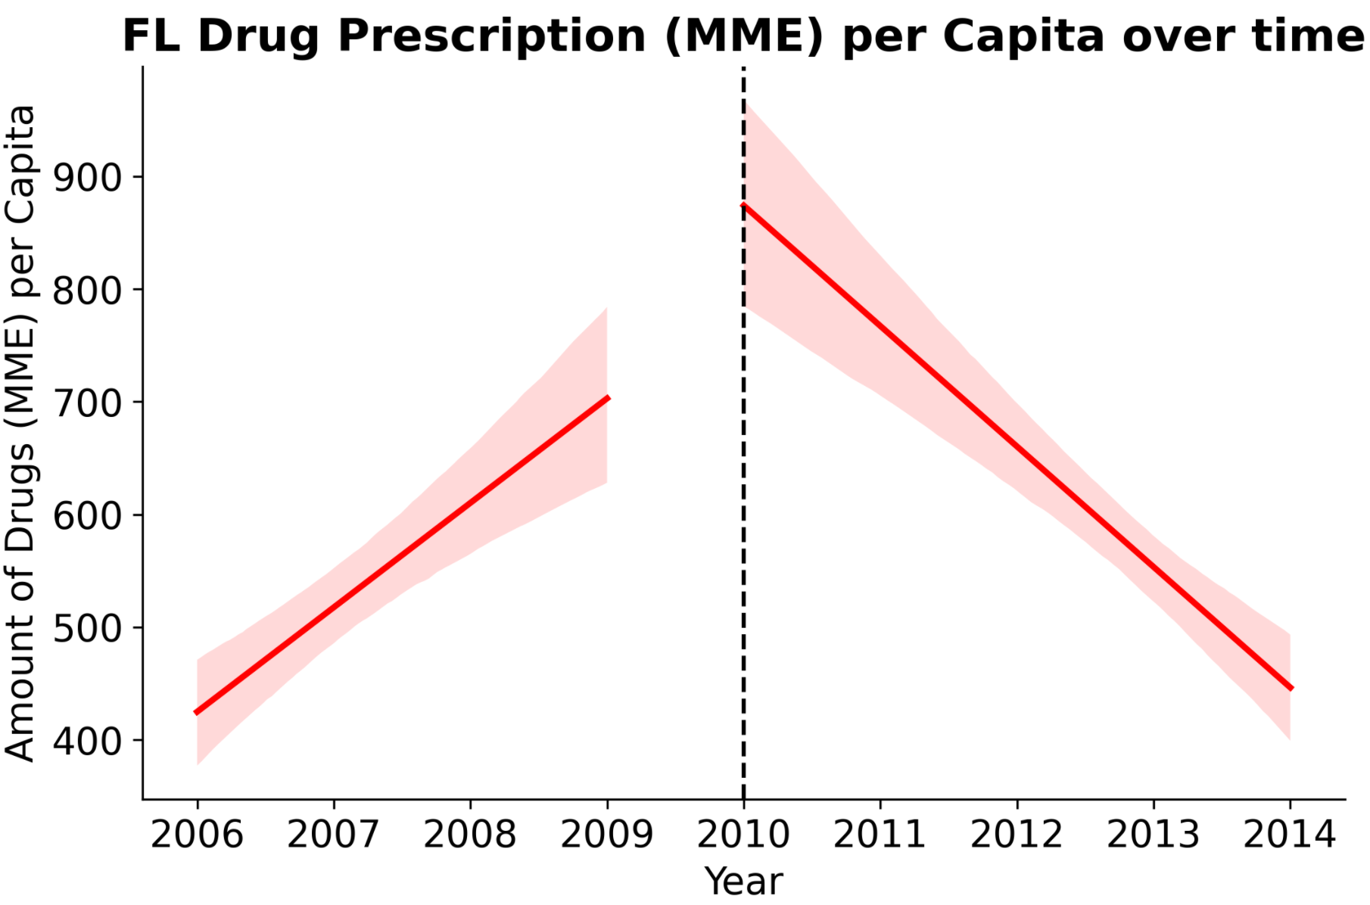
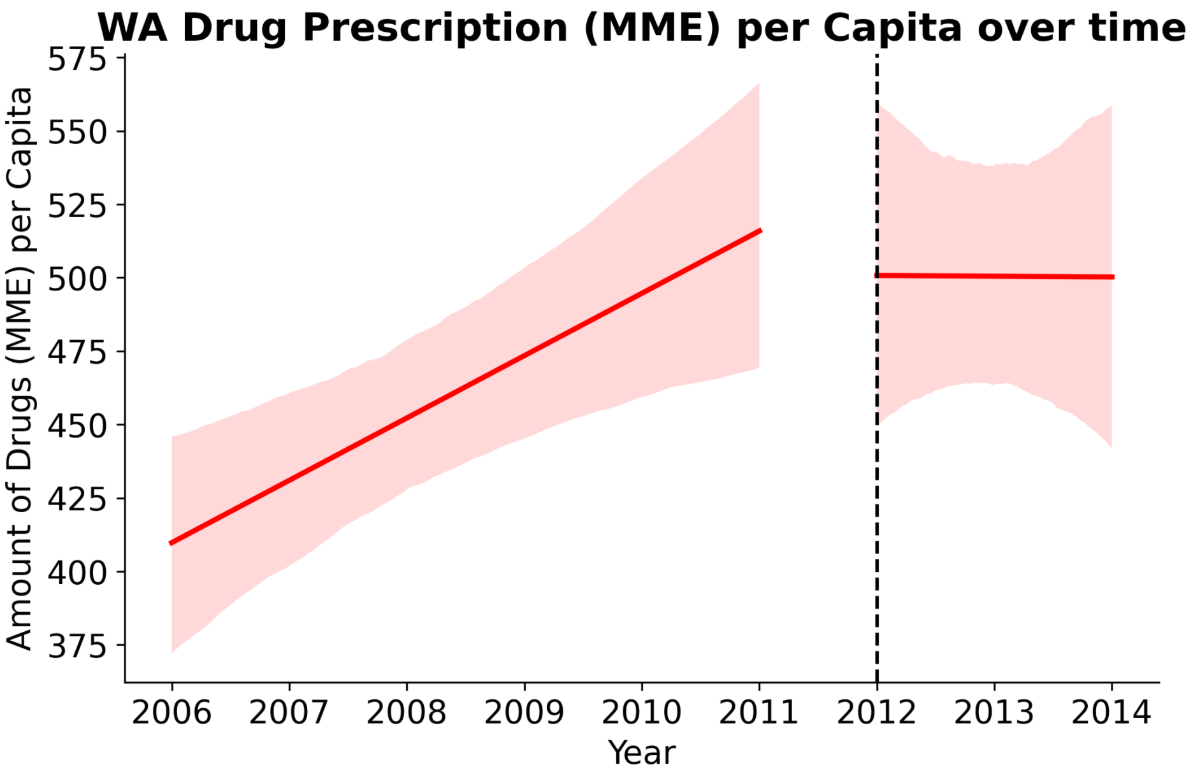
Results: Prescription Opioid Shipments in FL & WA
Florida
Washington
Sharp decline in prescribed drugs
Amount of prescribed drugs stops increasing
Notes:
Here are the results of our shipment analysis, which are best understood by plots.
We can see the pre-policy and post-policy (represented by the dotted line) of the amount of drugs (in morphine milligrams equivalent) per capita. The line we see on the graph is essentially the best estimate of if one straight line had to represent the trend of all our data points and the shaded area around it is our 95% confidence interval. Essentially, we are 95% confident that the actual trend lies within the bounds of the shaded area. So intuitively, the narrower the interval, the more confident we are in our best estimate line.
Simply looking at these two graphs, we can see that there is a sharp decrease in FL and a halt in increase in WA of drug shipments post-policy. There is a definite association between implementing the policy and a change in drug shipment trends!

Slide 8
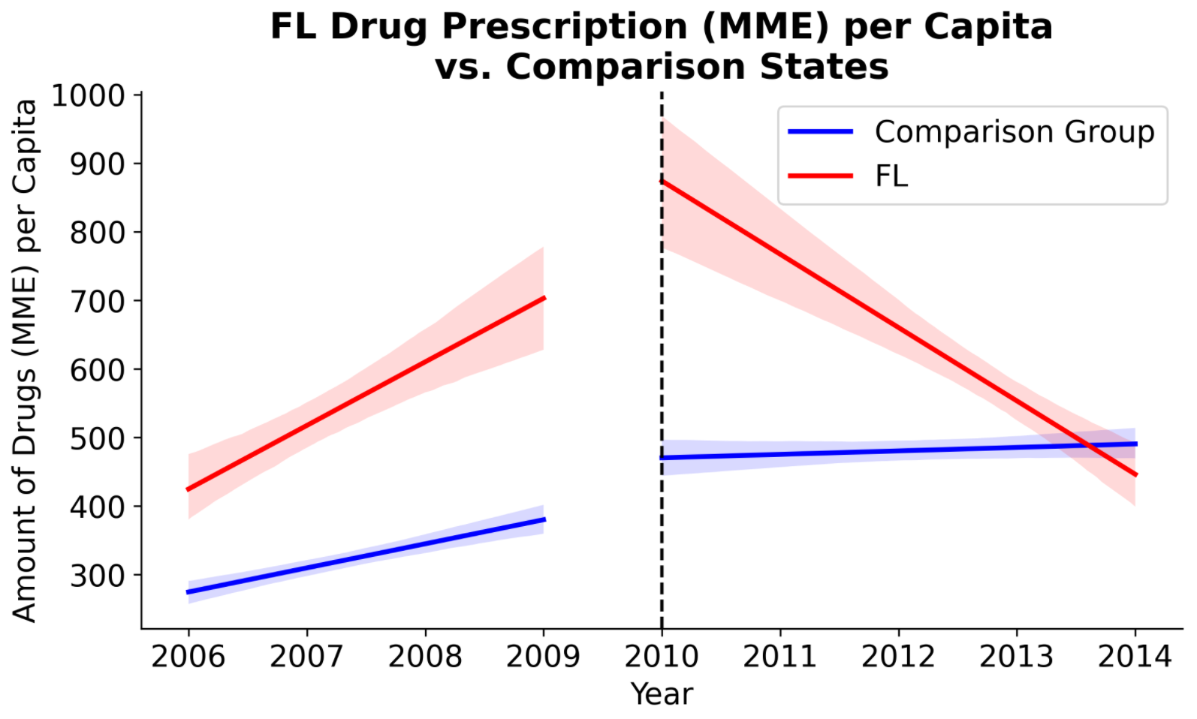
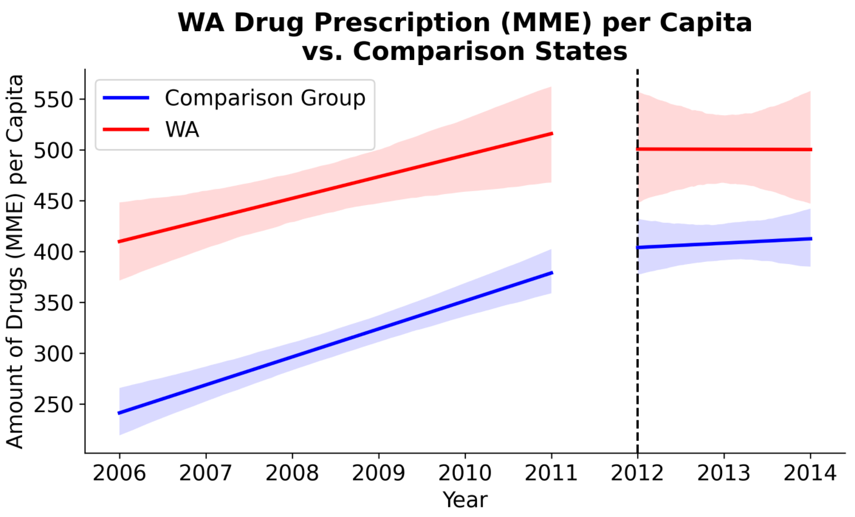
Results: Prescription Opioid Shipments in FL & WA
But did the policy cause this change?
Let’s look at the comparison states…
Notes:
However, asscociation /= causation.
we cannot draw conclusions of causation without also looking at comparison states: had the trends of comparison states, who did not implement the policy also decreased or look similar to our state, then the change in trend might very well be due to other external reasons.
In fact, looking at FL, because the comparison states have a clear upward trend post policy year in contrast to FL’s sharp decrease, we can actually say that the policy was effective.
Looking at WA, however, it appears that the post policy trend of comparison states are very similar, so we cannot draw any conclusions about the efficacy of the policy according to our data. One thing to note is that, because we have only two years of data on WA post policy, our confidence interval is wide and so the trend could easily be increase or decreasing, but given a few more years, we might be able to draw conclusions then.

Slide 9
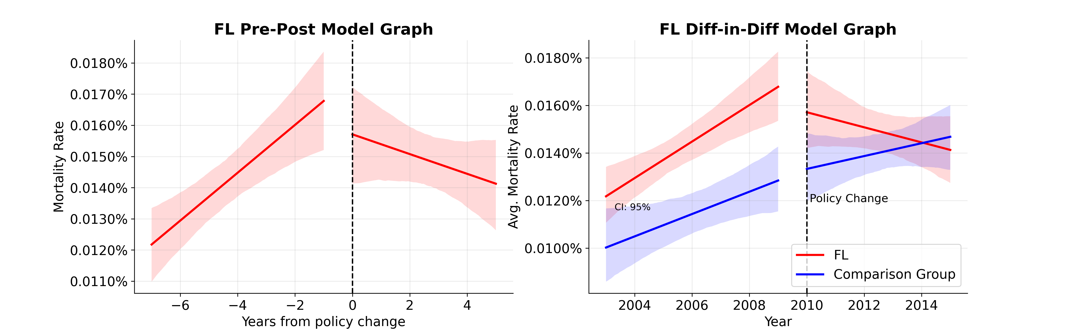
Results – Drug Mortality Rate in FL
Sharp decline in the mortality rate
The trend seems to reverse, but the uncertainty is too high to conclude a causation

Slide 10
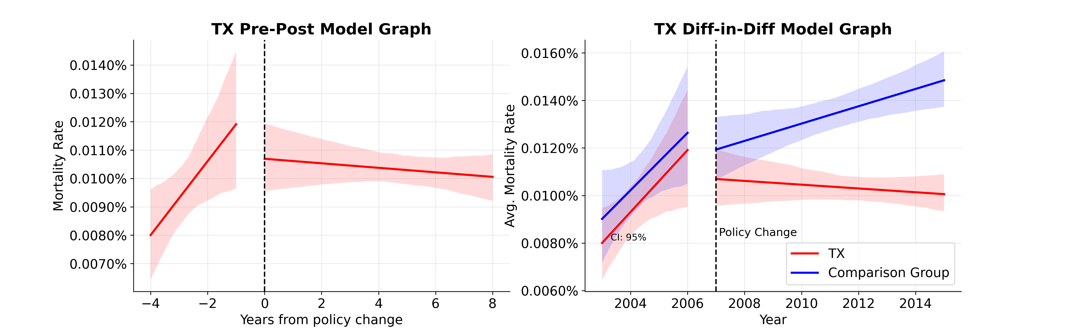
Results – Drug Mortality Rate in TX
Mortality rate stopped increasing
The policy successfully stopped the mortality rate's increase

Slide 11
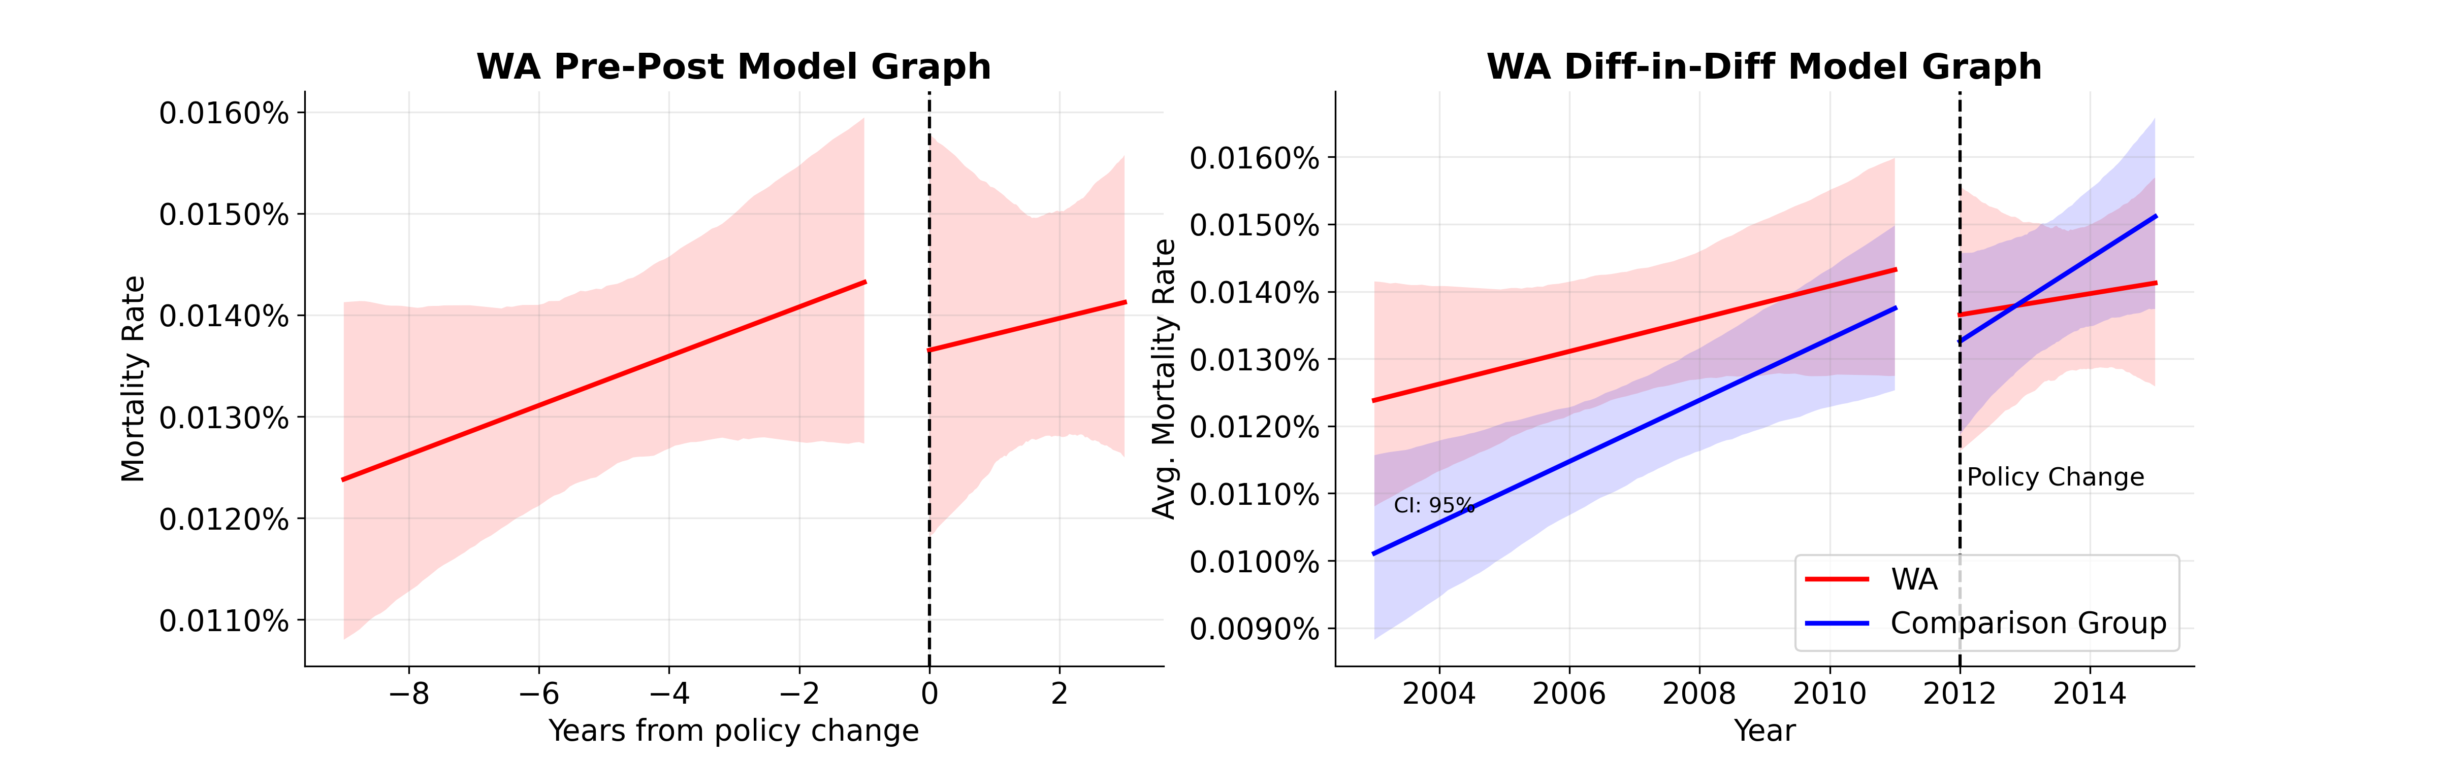
Results – Drug Mortality Rate in WA
Almost no change in mortality
rate's trend
The policy has limited effects and there is no conclusive evidence for any effect

Slide 12
Conclusion & Limitations
Conclusions
Limitations
Prescription per Capita
FL: the policy caused* a decrease in opioids prescription
WA: no conclusive evidence
Mortality Rate
TX: the policy decreased* mortality rates
FL & WA: no conclusive evidence
Choice of comparison states
Assumption: they mimic the trend in FL, WA, and TX had they not implemented policies
Missing data
For several counties/year
Other effects that we did not observe
Drug control policies can be an effective measure for reducing drug-related deaths
Causal Inference is hard!

Slide 13
This is a Title
Model

