Slide 1
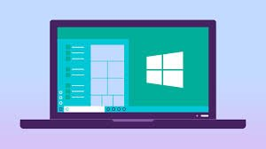
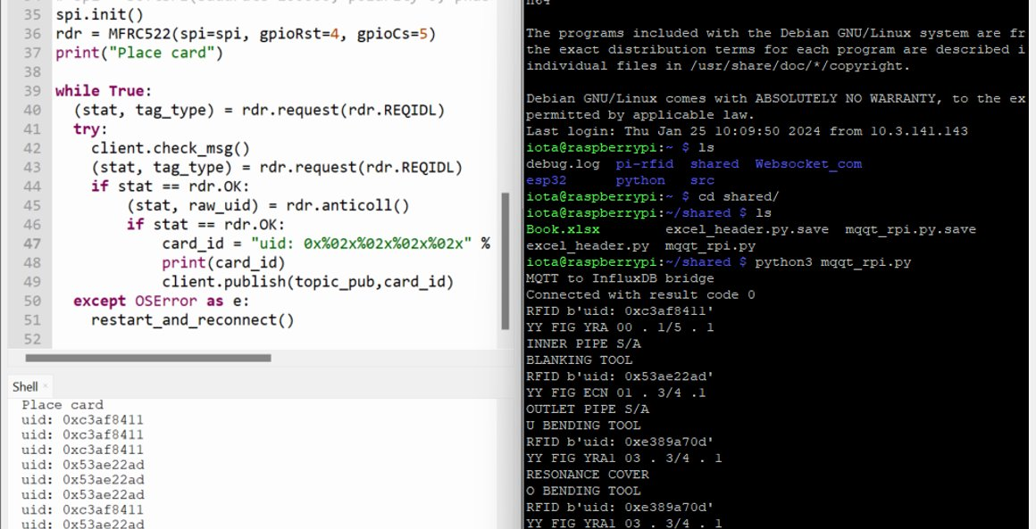
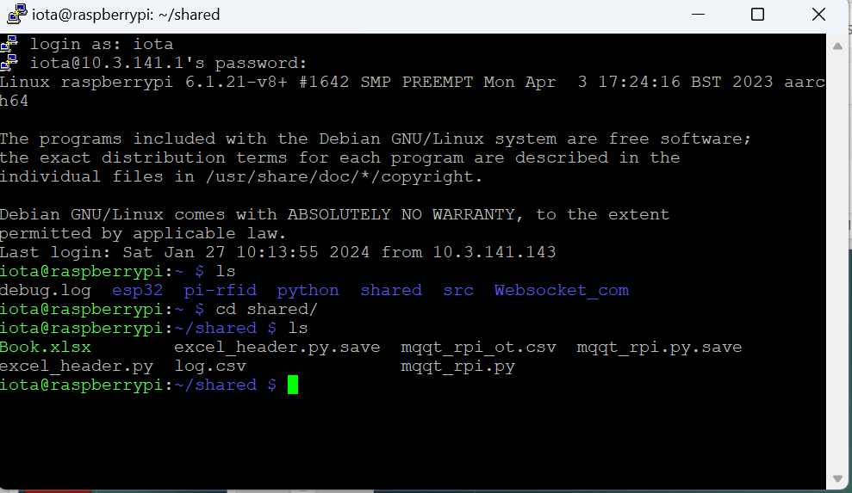
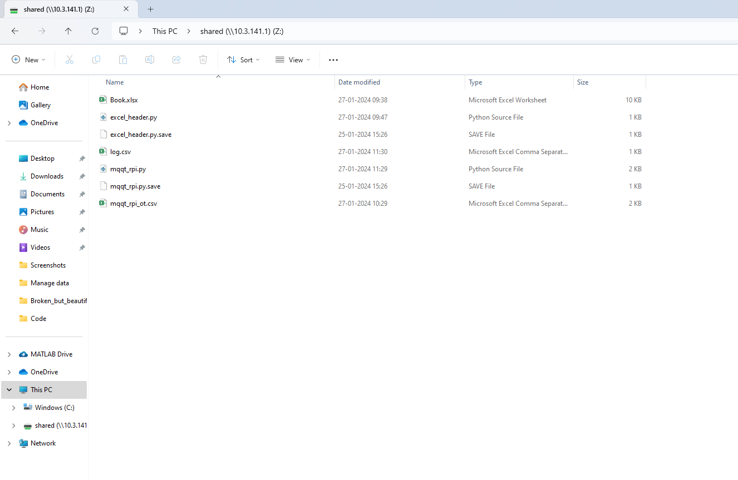
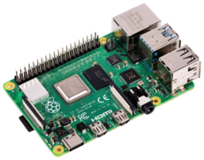
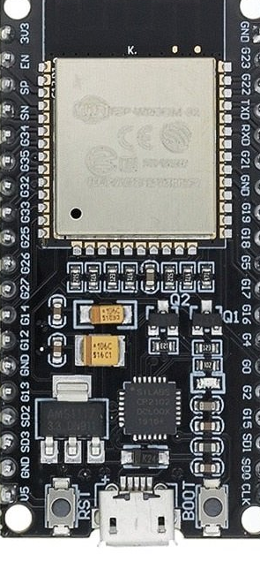
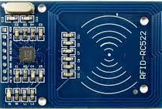

Python Code running on RPi
(Python shell)
Sharing excel file of RPI to our system
RASPBERRY PI
Broker
Topic = ‘RFID DATA’
ESP&RFID READER
ESP&RFID READER​
ESP&RFID READER​
Topic = ‘RFID DATA’
Client id = ‘ESP1’
ESP&RFID READER​
Topic = ‘RFID DATA’
Client id = ‘ESP2’
Micropython Code running on ESP (Thonny IDE)
RFID TAG
Notes:
(

Slide 2
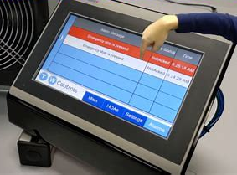
HMI ??
Python Code running on RPi
(Python shell)
Sharing excel file of RPI to our system
RASPBERRY PI
Broker
Topic = ‘RFID DATA’
ESP&RFID READER
ESP&RFID READER​
ESP&RFID READER​
Topic = ‘RFID DATA’
Client id = ‘ESP1’
ESP&RFID READER​
Topic = ‘RFID DATA’
Client id = ‘ESP2’
Micropython Code running on ESP (Thonny IDE)
RFID TAG
Notes:
(

Slide 3
For HMI
Grafana
Node-Red

Slide 4

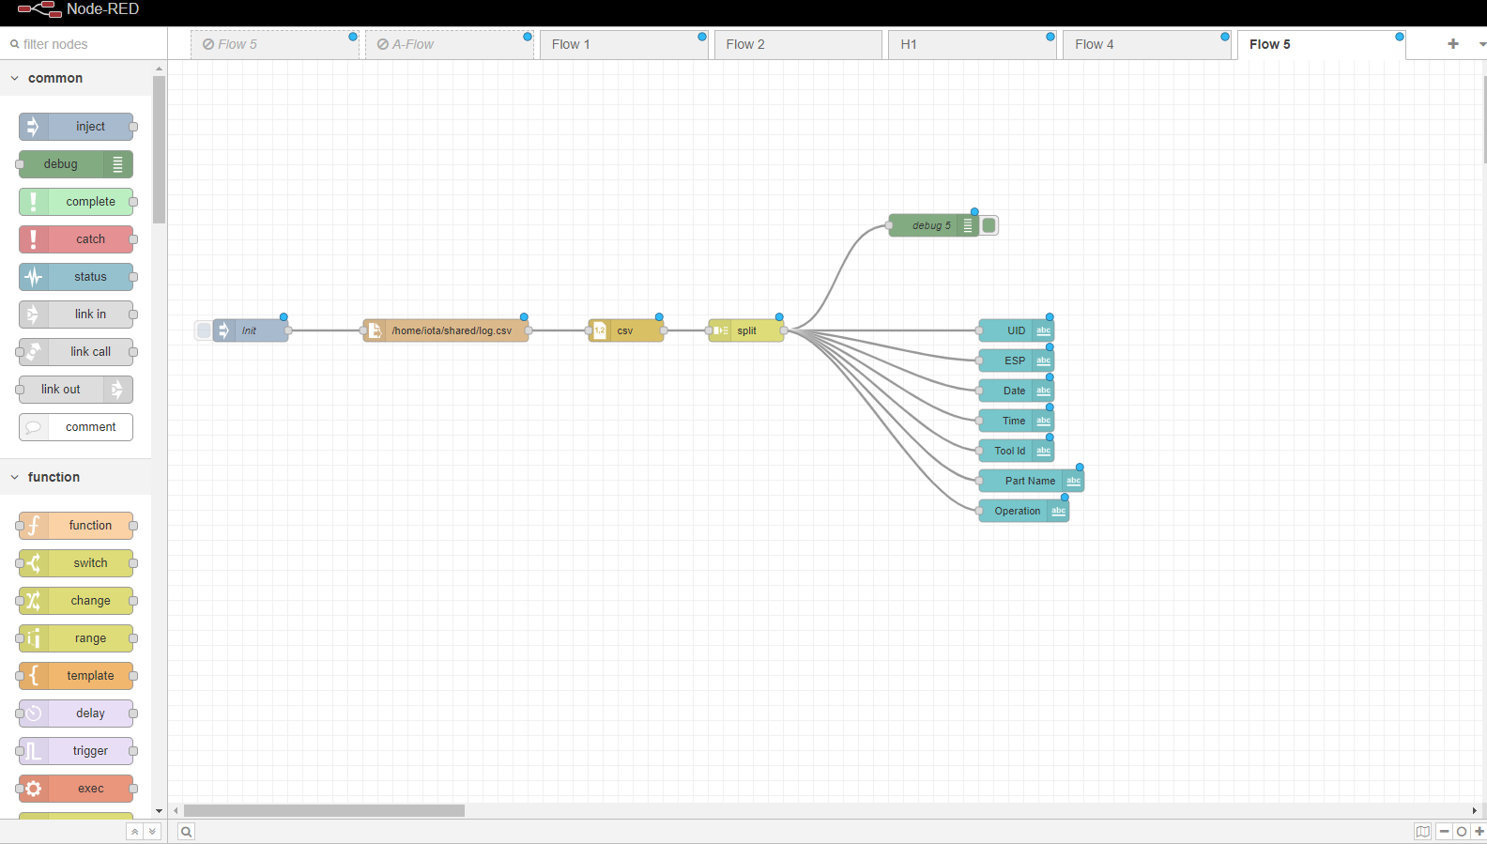

Slide 5
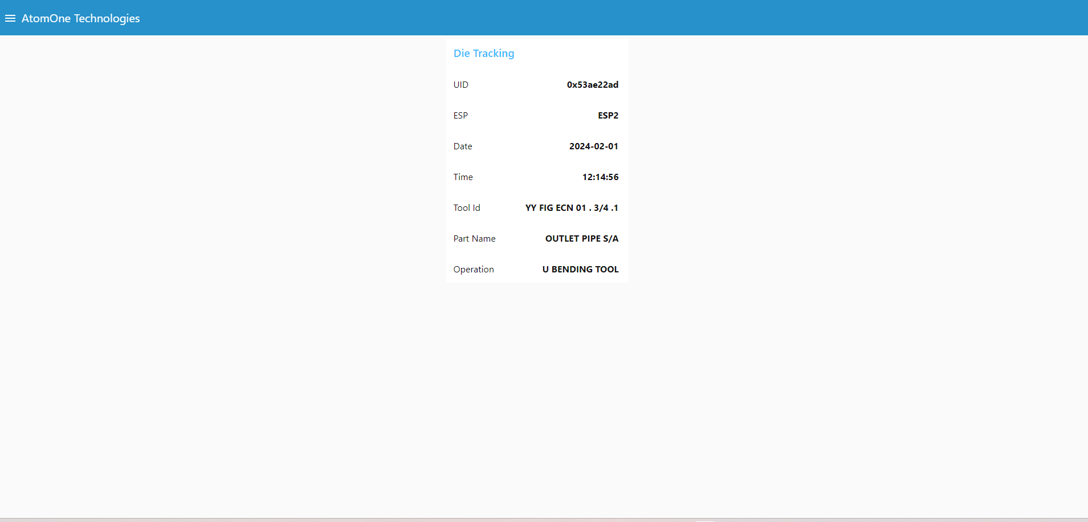

Slide 6
HMI
Python Code running on RPi
(Python shell)
Sharing excel file of RPI to our system
RASPBERRY PI
Broker
Topic = ‘RFID DATA’
ESP&RFID READER
ESP&RFID READER​
ESP&RFID READER​
Topic = ‘RFID DATA’
Client id = ‘ESP1’
ESP&RFID READER​
Topic = ‘RFID DATA’
Client id = ‘ESP2’
Micropython Code running on ESP (Thonny IDE)
RFID TAG
Notes:
(

Slide 7
Next step
We want to eliminate the python code and only want to work with nodered and micropython
Map tool id detail in nodered and directly link with output that are coming from Esp though MQTT.
Display:
Real time data
History data (Also we can apply the filter date wise, tool id )

Slide 8
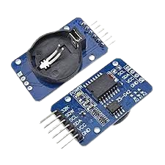
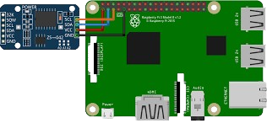
Raspberry Pi: Adding a DS3231 RTC (Real Time Clock)
By changing in the /boot/config.txt file we have add the DS3231 as RPi default clock
Reference: https://www.youtube.com/watch?v=HP82VQxmfgE

Slide 9
Dashboard Background
https://www.youtube.com/watch?v=5_bncoPYHMY
https://discourse.nodered.org/t/background-image-dashboard/58130/2

