Slide 1
If you are looking for any board – specific functions
Datasheet
Schematics
Other reference materials

Slide 2

Firmware for ESP32
Stable firmware builds
Daily firmware builds
Daily firmware builds with SPIRAM support

Slide 3
HTTP | MQTT | Socket
conventional internet protocols | IoT protocols
Typically, too resource-extensive to implement with microcontroller boards

Slide 4
For Communication between ESP 32 & Rpi, Shall we use Wi-Fi ?
Wifi is the networking technology on how you connect two computer together. MQTT is a protocol running on top of TCP/IP which uses Ethernet or Wifi. There is no conflict between the two. Wifi is the road, MQTT is the fridge on the back of a lorry driving on that road.
Wi-Fi is the road, MQTT is the fridge on the back of a lorry driving on that road.
If you don't want to use MQTT then look at another transfer method
Sockets
http

Slide 5
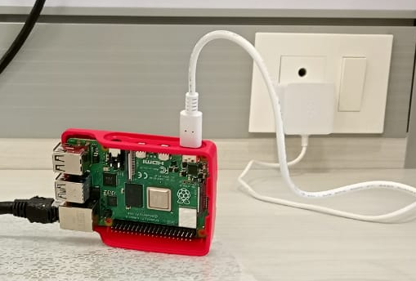

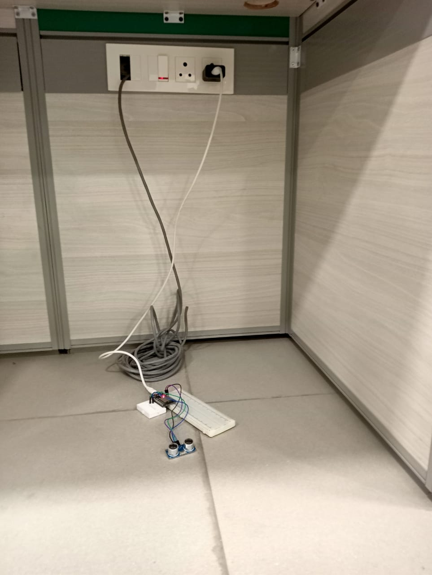
RPI
……………..
Broker
……………..
Subscriber
……………….
RPI-Sub.py
Using MQTT Protocol
ESP 32
…………..
Client
…………..
esp_ultrasonic_with_mqtt.ino

Slide 6
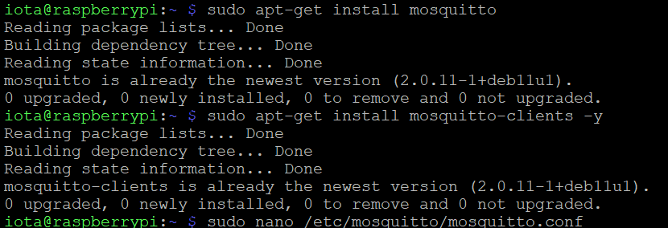
Step 1: Configuring Rpi as an MQTT broker using Mosquitto (the broker)

Slide 7
Step 1: Configuring Rpi as an MQTT broker using Mosquitto (the broker)
Now, let’s set username and password so MQTT clients can access the MQTT broker.

Slide 8
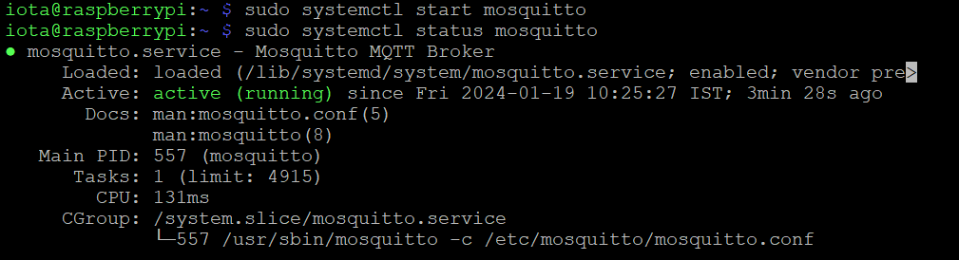
Step 1: Configuring Rpi as an MQTT broker using Mosquitto (the broker)
The Mosquitto broker can be started by executing the following command in the terminal:
sudo systemctl start mosquitto
Let’s ensure the Mosquitto broker is running by executing this command in the terminal:
sudo systemctl status mosquitto

Slide 9
Step 1: Configuring Rpi as an MQTT broker using Mosquitto (the broker)
The Mosquitto broker can be stopped by executing this command in the terminal:
sudo systemctl stop mosquitto
The Mosquitto broker can be restarted by executing this command in the terminal:
sudo systemctl restart mosquitto
The Mosquitto broker can be enabled at boot by executing this command in the terminal:
sudo systemctl enable mosquitto
The Mosquitto broker can be run in background by executing this command in the terminal:
mosquitto -d

Slide 10
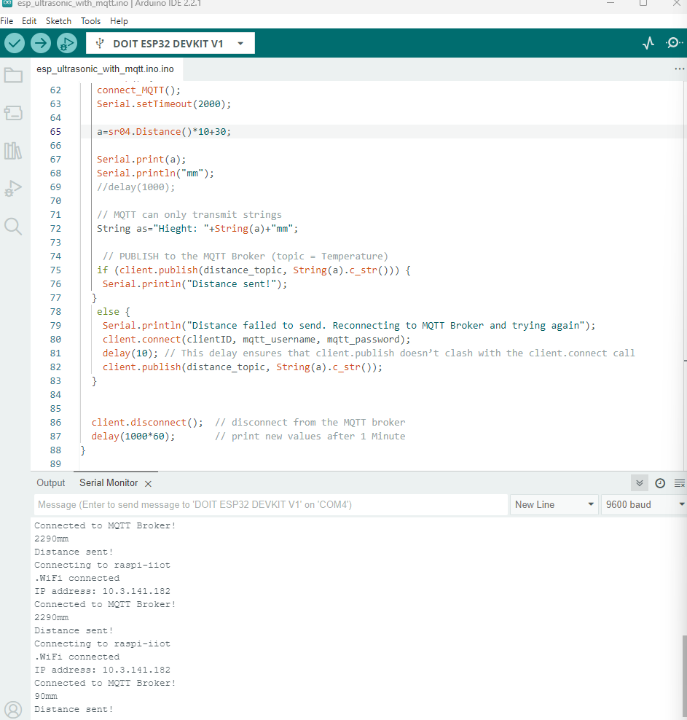
Step 2: Configuring ESP32 as an MQTT publisher

Slide 11
Step 2: Configuring ESP32 as an MQTT publisher
Used some library:
PubSubClient.h (written by Nick O’ Leary)
Wifi.h

Slide 12
Step 3: Configuring the MQTT subscriber on RPi
Install the paho-mqtt library to configure the MQTT client on Rpi
sudo pip install paho-mqtt

Slide 13
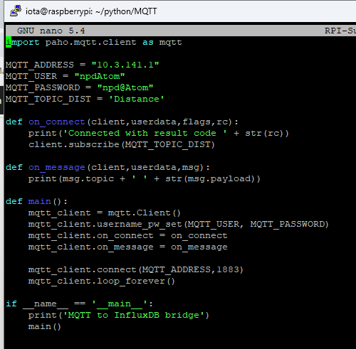
Step 3: Configuring the MQTT subscriber on RPi

Slide 14
Step 4: MQTT subscriber works

Slide 15
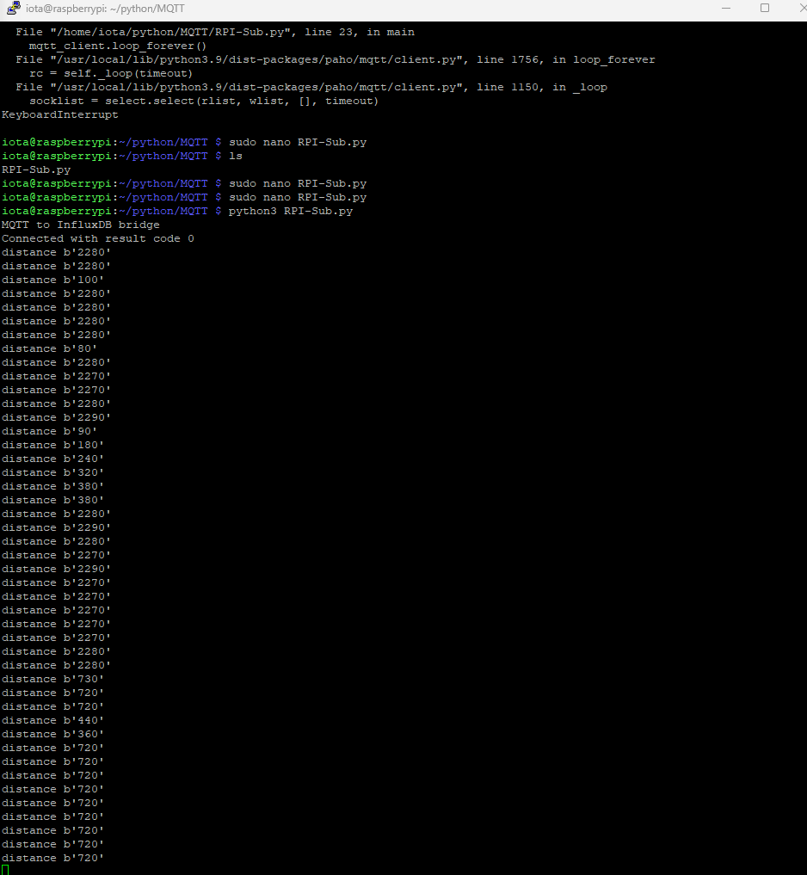
Step 4: MQTT subscriber works

