Slide 1
Regression
Prepared by baharia

Slide 2
Cont.
Regression is a method used to predict a continuous value (a number) based on one or more input variables. At its core, regression is a statistical method used to model the relationship between a dependent variable (the outcome you want to predict) and one or more independent variables (the factors that influence that outcome) In this chapter you will learn how to use linear models in regression problems.
First, we will examine simple linear regression, which models the relationship between a response variable and single explanatory variable. Next, we will discuss multiple linear regression, a generalization of simple linear regression that can support more than one explanatory variable. Then, we will discuss polynomial regression, a special case of multiple linear regression that can effectively model nonlinear relationships.

Slide 3
TYPES OF REGRESSION
There are three types of regression which are common known these types are
  Simple linear regression
  Multiple linear regression
  Polynomial regression

Slide 4
Simple linear regression
simple linear regression. Simple linear regression can be used to model a linear relationship between one response variable and one explanatory variable. Linear regression has been applied to many important scientific and social problems; the example that we will consider is probably not one of them.
Suppose you wish to know the price of a pizza so we will use simple linear regression instead to predict the price of a pizza based on an attribute of the pizza that we can observe. Assume your have the data as follows

Slide 5
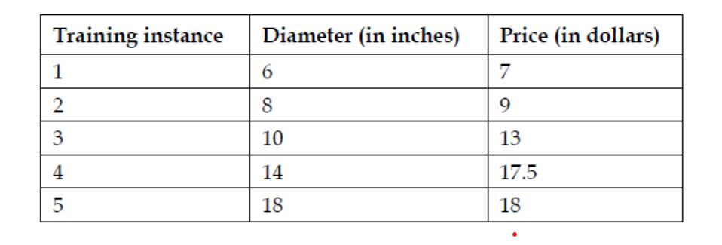
Cont.

Slide 6
Estimator
The sklearn.linear_model.LinearRegression class is an estimator. Estimators predict a value based on the observed data. In scikit-learn, all estimators implement the fit() and predict() methods. The former method is used to learn the parameters of a model, and the latter method is used to predict the value of a response variable for an explanatory variable using the learned parameters. It is easy to experiment with different models using scikit-learn because all estimators implement the fit and predict methods.

Slide 7
Cost function/loss function
A cost function, also called a loss function, is used to define and measure the error of a model
The differences between the prices predicted by the model and the observed prices of the pizzas in the training set are called residuals or training error
Also, recall that our goal is to solve the values of and that minimize the cost function. We will solve first. To do so, we will calculate the variance of x and covariance of x and y.
Variance is a measure of how far a set of values is spread out. If all of the numbers in the set are equal, the variance of the set is zero. A small variance indicates that the numbers are near the mean of the set, while a set containing numbers that are far from the mean and each other will have a large variance
Covariance is a measure of how much two variables change together. If the value of the variables increase together, their covariance is positive. If one variable tends to increase while the other decreases, their covariance is negative. If there is no linear relationship between the two variables, their covariance will be equal to zero;

Slide 8
R-squared
R-squared measures how well the observed values of the response variables are predicted by the model. More concretely, r-squared is the proportion of the variance in the response variable that is explained by the model. An r-squared score of one indicates that the response variable can be predicted without any error using the mode
R-squared (also known as the Coefficient of Determination) is a statistical measure that tells you how well your "line of best fit" actually matches your data.
In simple terms: It measures the quality of your model.
R-squared is always a number between 0 and 1 (or 0% to 100%).
0 (0%): Your model explains none of the variability. It’s essentially useless for prediction.
1 (100%): Your model explains everything. The regression line passes perfectly through every single data point

Slide 9
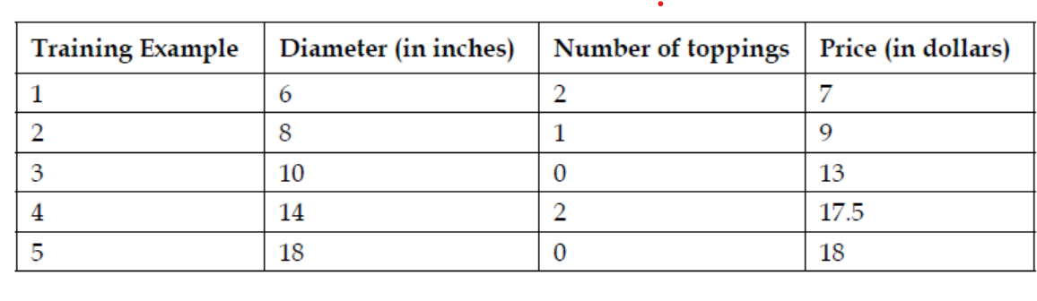
Multiple regression
Multiple Regression is the natural evolution of simple linear regression.
While simple regression uses one independent variable to predict an outcome
Multiple Regression uses two or more independent variables to explain a single dependent variable.

Slide 10
Polynomial regression
In the previous examples, we assumed that the real relationship between the explanatory variables and the response variable is linear. This assumption is not always true.
In this section, we will use polynomial regression, a special case of multiple linear regression that adds terms with degrees greater than one to the model.
The real-world curvilinear relationship is captured when you transform the training data by adding polynomial terms, which are then fit in the same manner as in multiple linear regression
Will use the Quadratic regression, or regression with a second order polynomial

