Slide 1
From the Perceptron to
Artificial Neural Networks
Prepared by BAHARIA

Slide 2
Intro.
In this chapter, we will discuss artificial neural networks, which are powerful nonlinear models for classification and regression that use a different strategy to overcome the perceptron limitations.
If the perceptron is analogous to a neuron, an artificial neural network, or neural net, is analogous to a brain. As billions of neurons with trillions of synapses comprise a human brain, an artificial neural network is a directed graph of perceptrons or other artificial neuron

Slide 3
Feed forward and feedback artificial neural networks
Artificial neural networks are described by three components.
The first is the model's architecture, or topology, which describes the layers of neurons and structure of the connections between them.
The second component is the activation function used by the artificial neurons.
The third component is the learning algorithm that finds the optimal values of the weights

Slide 4
Cont.
here are two main types of artificial neural networks.
Feedforward neural networks are the most common type of neural net, and are defined by their directed acyclic graphs. Signals only travel in one direction—towards the output layer—in feedforward neural networks.
feedback neural networks, or recurrent neural networks, do contain cycles. The feedback cycles can represent an internal state for the network that can cause the network's behavior to change over time based on its input.
Feedforward neural networks are commonly used to learn a function to map an input to an output.
The temporal behavior of feedback neural networks makes them suitable for processing sequences of inputs. Because feedback neural networks are not implemented in scikit-learn, we will limit our discussion to only feedforward neural networks.

Slide 5
Multilayer perceptrons
The multilayer perceptron (MLP) is the one of the most commonly used artificial
neural networks. The name is a slight misnomer; a multilayer perceptron is not a
single perceptron with multiple layers, but rather multiple layers of artificial neurons that can be perceptrons. The layers of the MLP form a directed, acyclic graph.
Generally, each layer is fully connected to the subsequent layer; the output of each artificial neuron in a layer is an input to every artificial neuron in the next layer towards the output. MLPs have three or more layers of artificial neurons

Slide 6
cont
The input layer consists of simple input neurons. The input neurons are connected to at least one hidden layer of artificial neurons.
The hidden layer represents latent variables; the input and output of this layer cannot be observed in the training data.
Finally, the last hidden layer is connected to an output layer. The following diagram depicts the architecture of a multilayer perceptron with three layers. The neurons labeled +1 are bias neurons and are not depicted in most architecture diagrams.

Slide 7
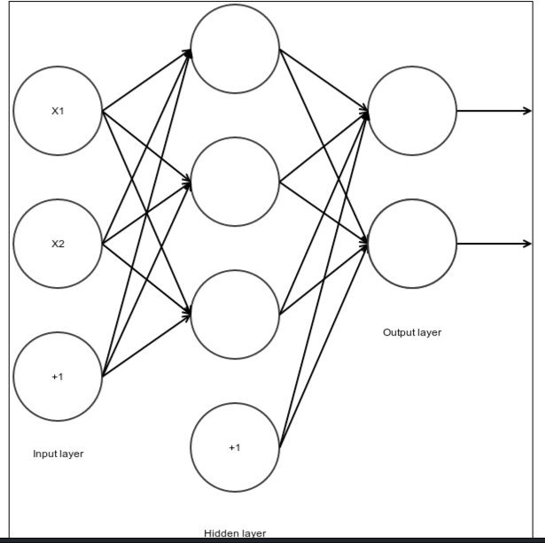

Slide 8
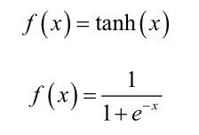
Cont.
The artificial neurons, or units, in the hidden layer commonly use nonlinear activation functions such as the hyperbolic tangent function and the logistic function, which are given by the following equations:

Slide 9
Minimizing cost function
As with other supervised models, our goal is to find the values of the weights that minimize the value of a cost function. The mean squared error cost function is commonly used with multilayer perceptrons. It is given by the following equation, where m is the number of training instances
The back propagation algorithm is commonly used in conjunction with an optimization algorithm such as gradient descent to minimize the value of the cost
function. The algorithm takes its name from a portmanteau of backward propagation, and refers to the direction in which errors flow through the layers of the network.
Back propagation can theoretically be used to train a feedforward network with any
number of hidden units arranged in any number of layers, though computational
power constrains this capability.
Backpropagation is similar to gradient descent in that it uses the gradient of the
cost function to update the values of the model parameters.

Slide 10
Forward propagation
During the forward propagation stage, the features are input to the network and fed through the subsequent layers to produce the output activations. First, we compute the activation for the unit Hidden1. We find the weighted sum of input to Hidden1, and then process the sum with the activation function. Note that Hidden1 receives a constant input from a bias unit that is not depicted in the diagram in addition to the inputs from the input units. In the following diagram, g ( x ) is the activation function
Having computed the activations of all of the hidden units in the first layer, we proceed to the second hidden layer. In this network, the first hidden layer is fully connected to the second hidden layer. Similar to the units in the first hidden layer, the units in the second hidden layer receive a constant input from bias units that are not depicted in the diagram. We proceed to compute the activation of Hidden4
We next compute the activations of Hidden5 and Hidden6. Having computed the activations of all of the hidden units in the second hidden layer, we proceed to the output layer in the following figure. The activation of Output1 is the weighted sum of the second hidden layer's activations processed through an activation function. Similar to the hidden units, the output units both receive a constant input from a bias unit
We calculate the activation of Output2 in the same manner

Slide 11
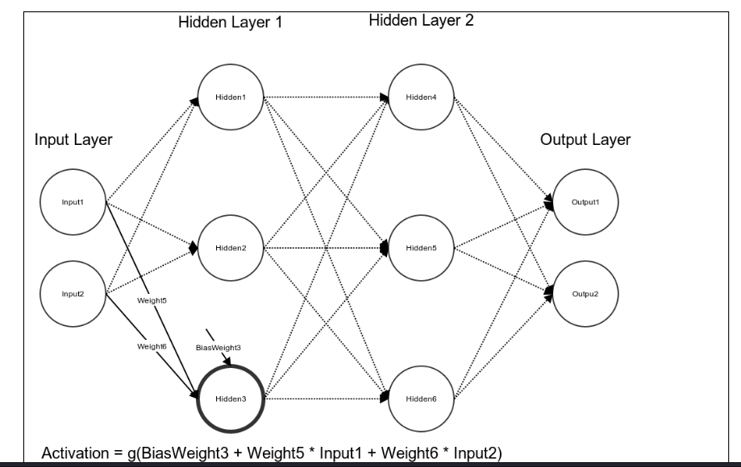
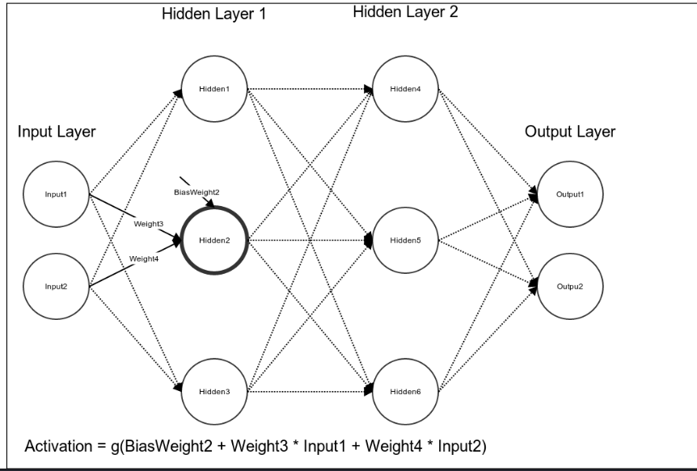
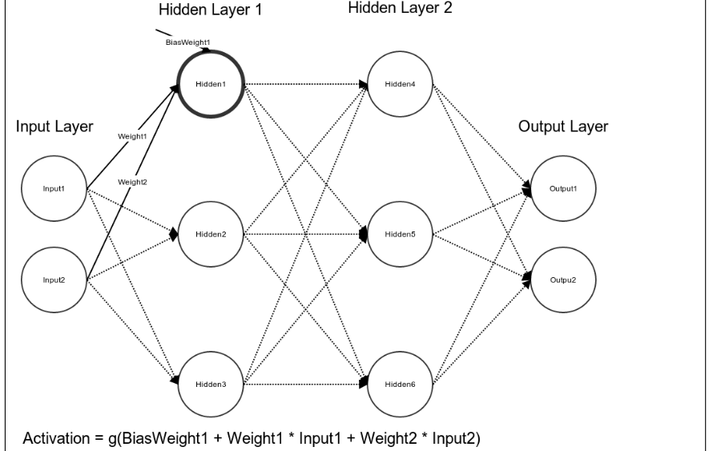
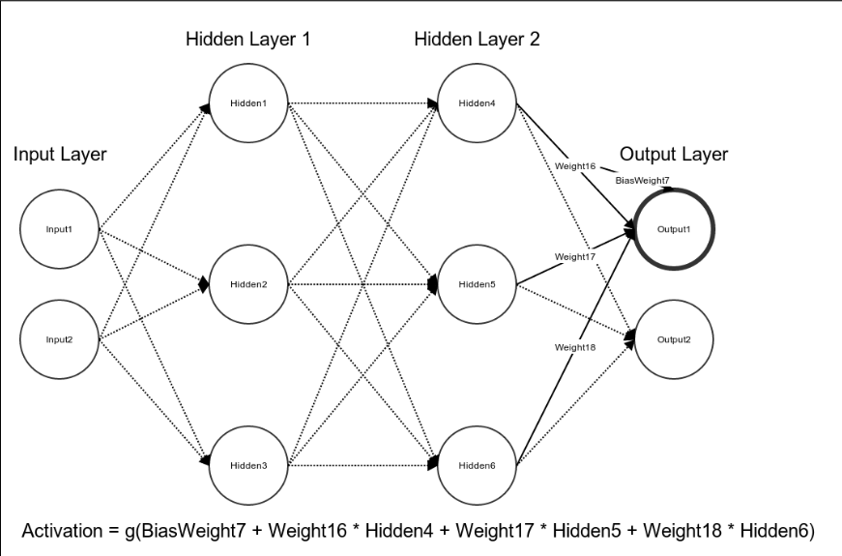
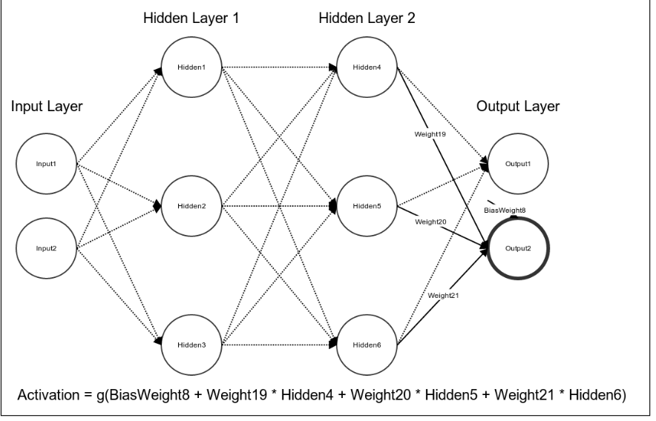
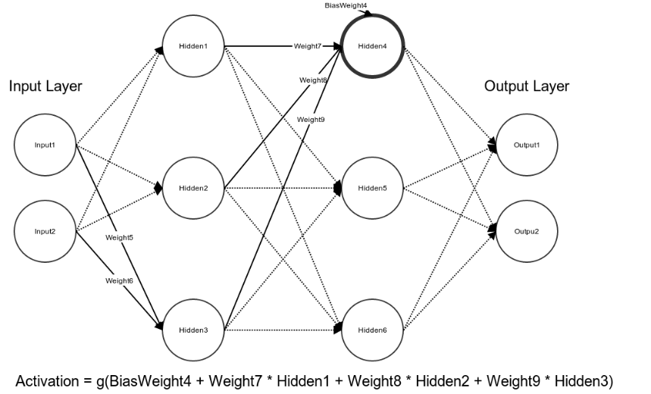

Slide 12


Backpropagation
We can calculate the error of the network only at the output units. The hidden units represent latent variables; we cannot observe their true values in the training data and thus, we have nothing to compute their error against. In order to update their weights, we must propagate the network's errors backwards through its layers. We will begin with Output1. Its error is equal to the difference between the true and predicted outputs, multiplied by the partial derivative of the unit's activation
We computed the errors of the first hidden layer. We can now use these errors to update the values of the weights. We will first update the weights for the edges connecting the input units to Hidden1 as well as the weight for the edge connecting the bias unit to Hidden1. We will increment the value of the weight connecting Input1 and Hidden1 by the product of the learning rate, error of Hidden1, and the
value of Input1.

Slide 13
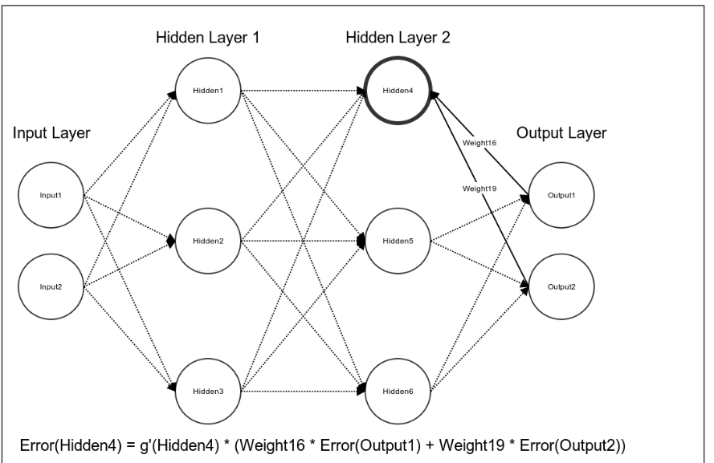
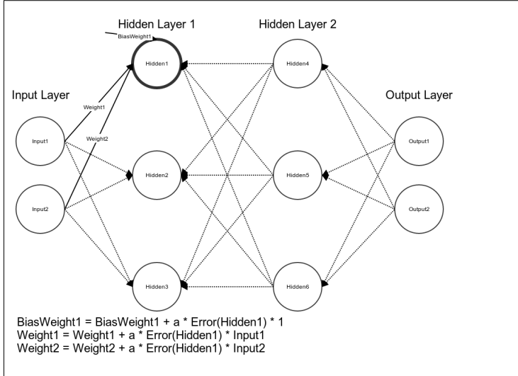
Cont.

Slide 14
      Thanks you

