Slide 1
The Perceptron
Prepared by BAHARIA

Slide 2
Intro and short history
using a link function. In this chapter, we will discuss another linear model called the perceptron. The perceptron is a binary classifier that can learn from individual training instances, which can be useful for training from large datasets. More importantly, the perceptron and its limitations inspire the models that we will discuss in the final chapters.
Invented by Frank Rosenblatt at the Cornell Aeronautical Laboratory in the late 1950's, the development of the perceptron was originally motivated by efforts to simulate the human brain.
A brain is composed of cells called neurons that process information and connections between neurons called synapses through which information is transmitted. It is estimated that human brain is composed of as many as 100 billion neurons and 100 trillion synapses. As shown in the following image, the main components of a neuron are dendrites, a body, and an axon. The dendrites receive electrical signals from other neurons. The signals are processed in the neuron's body, which then sends a signal through the axon to another neuron
An individual neuron can be thought of as a computational unit that processes one or more inputs to produce an output.

Slide 3
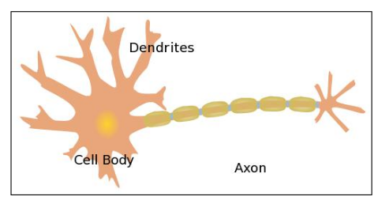
Cont.

Slide 4
Cont.
A perceptron functions analogously to a neuron; it accepts one or more inputs, processes them, and returns an output.
It may seem that a model of just one of the hundreds of billions of neurons in the
human brain will be of limited use. To an extent that is true; the perceptron cannot approximate some basic functions.
However, we will still discuss perceptrons for two reasons.
First, perceptrons are capable of online, error-driven learning; the learning algorithm can update the model's parameters using a single training instance instance rather than the entire batch of training instances. Online learning is useful for learning from training sets that are too large to be represented in memory.
Second, understanding how the perceptron works is necessary to understand some of the more powerful models that we will discuss in subsequent chapters, including support vector machines and artificial neural networks. Perceptrons are commonly visualized using a diagram like the following one

Slide 5
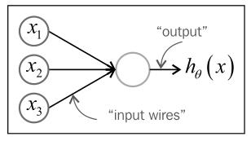
The circles labeled x1 , x2 , and x3 are inputs units. Each input unit represents one feature. Perceptrons frequently use an additional input unit that represents a constant bias term, but this input unit is usually omitted from diagrams. The circle in the center is a computational unit or the neuron's body.
The edges connecting the input units to the computational unit are analogous to dendrites. Each edge is weighted, or associated with a parameter. The parameters can be interpreted easily; an explanatory variable that is correlated with the positive class will have a positive weight, and an explanatory variable that is correlated with the negative class will have a negative weight.
The edge directed away from the computational unit returns the output and can be thought of as the axon.

Slide 6
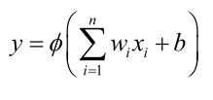
Activation functions
The perceptron classifies instances by processing a linear combination of the explanatory variables and the model parameters using an activation function as shown in the following equation. The linear combination of the parameters and inputs is sometimes called the perceptron's preactivation.
Here, wi are the model's parameters, b is a constant bias term, and φ is the activation function

Slide 7

Cont.
Several different activation functions are commonly used. Rosenblatt's original perceptron used the
Heaviside step function. Also called the unit step function, the Heaviside step function is shown in the following equation, where x is the weighted combination of the features
If the weighted sum of the explanatory variables and the bias term is greater than zero, the activation function returns one and the perceptron predicts that the instance is the positive class. Otherwise, the function returns zero and the perceptron predicts
that the instance is the negative class.

Slide 8

Cont.
Another common activation function is the logistic sigmoid activation function. The gradients for this activation function can be calculated efficiently, when we construct artificial neural networks. The logistic sigmoid activation function is given by the following equation, where x is the sum of the weighted inputs:
The logistic sigmoid function is a mathematical function that takes any real-valued number and maps (or squashes) it into a strict range between 0 and 1.
Because its output always falls between 0 and 1, it is perfectly suited for models where we need to predict a probability (e.g., the probability that an email is spam, or that a patient has a specific disease).

Slide 9
Binary classification with the perceptron
sci-kit-learn provides an implementation of the perceptron. As with the other implementations that we used, the constructor for the Perceptron class accepts keyword arguments that set the algorithm's hyper parameters Perceptron similarly exposes the fit_transform() and predict() methods. Perceptron also provides a partial_fit() method, which allows the classifier to train and make predictions for streaming data.

Slide 10
Limitations of the perceptron
limitations. Linear models like the perceptron with a Heaviside activation function are not universal function approximators; they cannot represent some functions.
Specifically, linear models can only learn to approximate the functions for linearly separable datasets. The linear classifiers that we have examined find a hyperplane that separates the positive classes from the negative classes; if no hyperplane exists that can separate the classes, the problem is not linearly separable.

Slide 11
Cont.
        Thanks you

