Slide 1
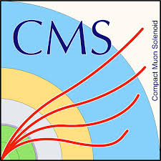


Further optimization of tH(γγ)q
Diphoton mva id in tt through sample mixing
H. Bakshiansohi, A. Giammanco,
G. Krintiras, A. Jafari
31 July 2017
Latest related report in Hγγ working group (27 July)

Slide 2
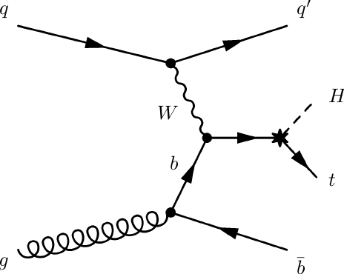
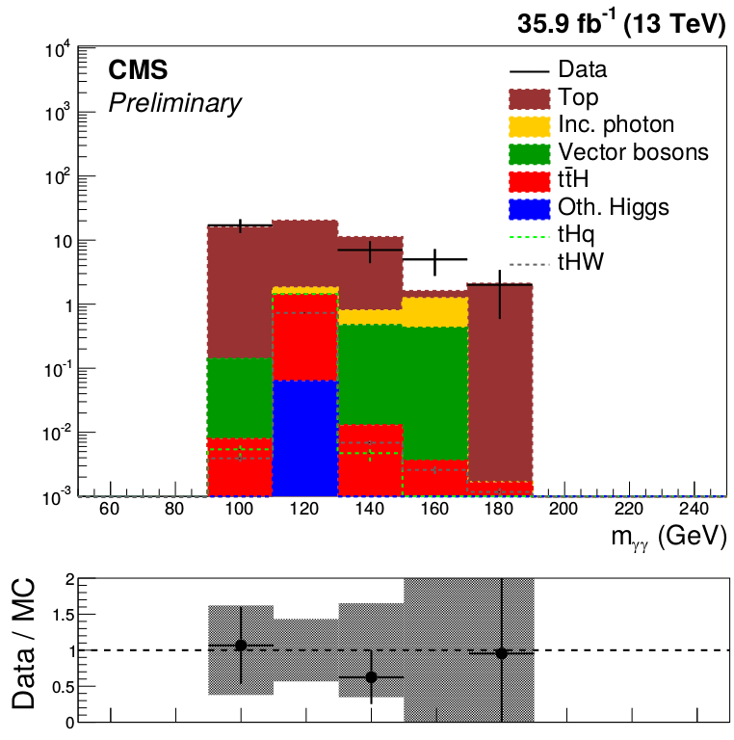
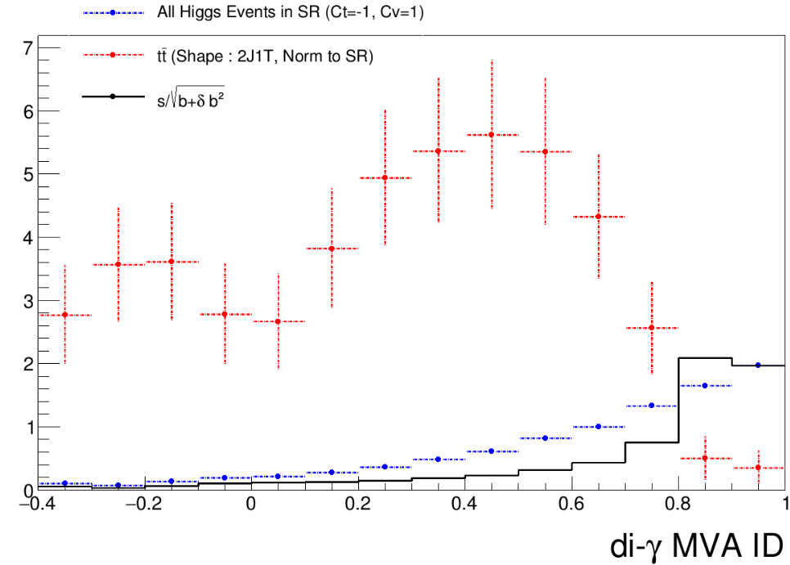
Introduction
In search for tH(γγ)q, the dominant background is tt according to MC
  ttγ and ttγγ are proven to not be able to reproduce the rate properly (older studies)
  Current sample is MG tt
A possibility to reduce it is to increase/optimize the cut on dipthoton mva
(the report)
The lack of statistics in tt MC does not allow it
Studies performed to understand the fake/prompt photon contributions in the sample (latest related report)
  Suggeted to mix the samples to gain statistics
2γ
ℓbυ
Main focus of today's talk!

Slide 3
Fake/prompt cont. in the samples
ttγ + jets
tt MG
diγ2J
diγ2J1T
SR
ttγγ
tt aMC@NLO
Prompt-Prompt: largest con. in ttγγ
Fake-Prompt: largest cont. in ttγ + jets
Fake-Fake: largest cont. in tt

Slide 4
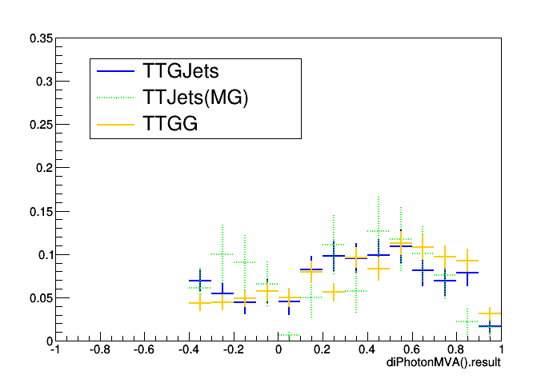
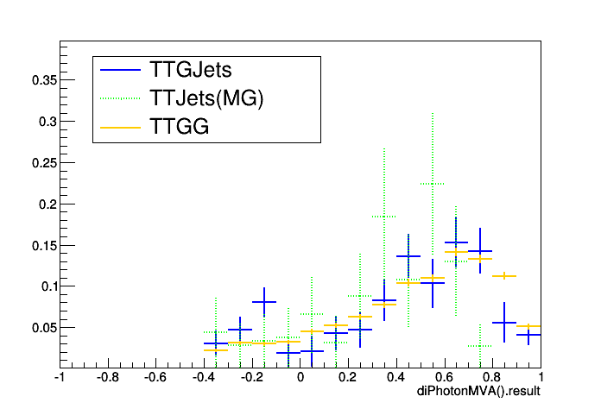
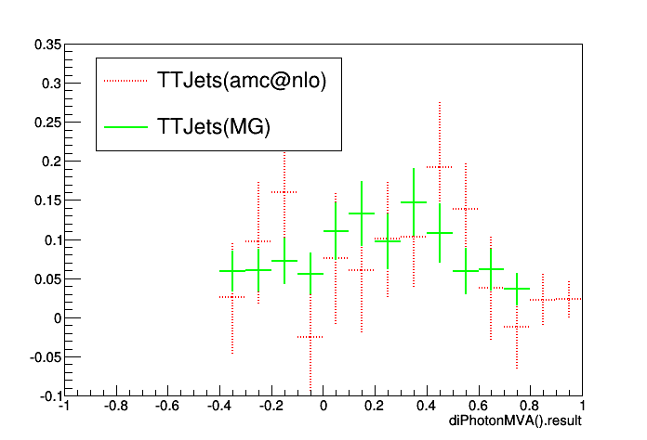
Exp. yields and templates in samples
Yields are evaluated in SR
The contribution predicted by ttγ and ttγγ are off
 | Fake Fake | Fake Prompt | Prompt Prompt | Sum
tt aMC@NLO | 6.5 | 27.5 | 6.8 | 40.1
tt MG | 4.5 | 17.9 | 25.7 | 48
ttγγ | 0 | 0.16 | 2.28 | 2.4
ttγ + jets | 0.10 | 10.7 | 7.8 | 18.6
pp
pf
ff

Slide 5
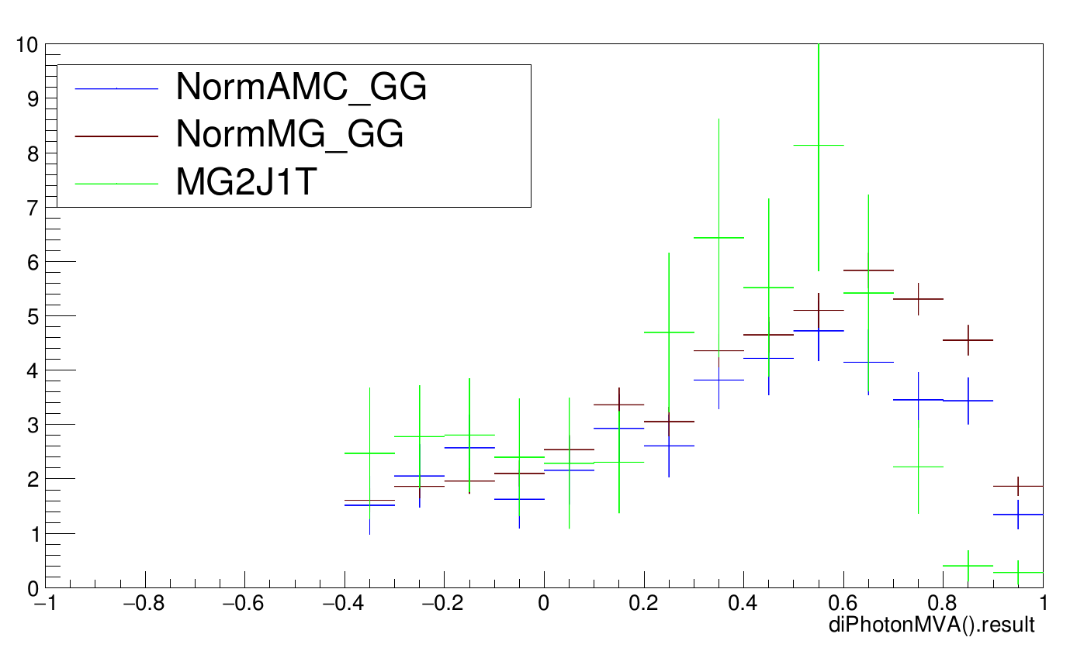
Exp. yields and templates in samples
We substitude in the tt MG sample,
  the PP part by the PP template from ttγγ
  the PF part by the PF template also from ttγγ:
    The shape is similar to ttγ but it has more statistics
The templates will be normalized to tt MG prediction which showed the best agreement with the data in SB
Yields are evaluated in SR
The contribution predicted by ttγ and ttγγ are off
 | Fake Fake | Fake Prompt | Prompt Prompt | Sum
tt aMC@NLO | 6.5 | 27.5 | 6.8 | 40.1
tt MG | 4.5 | 17.9 | 25.7 | 48
ttγγ | 0 | 0.16 | 2.28 | 2.4
ttγ + jets | 0.10 | 10.7 | 7.8 | 18.6
pp
pf
ff

Slide 6
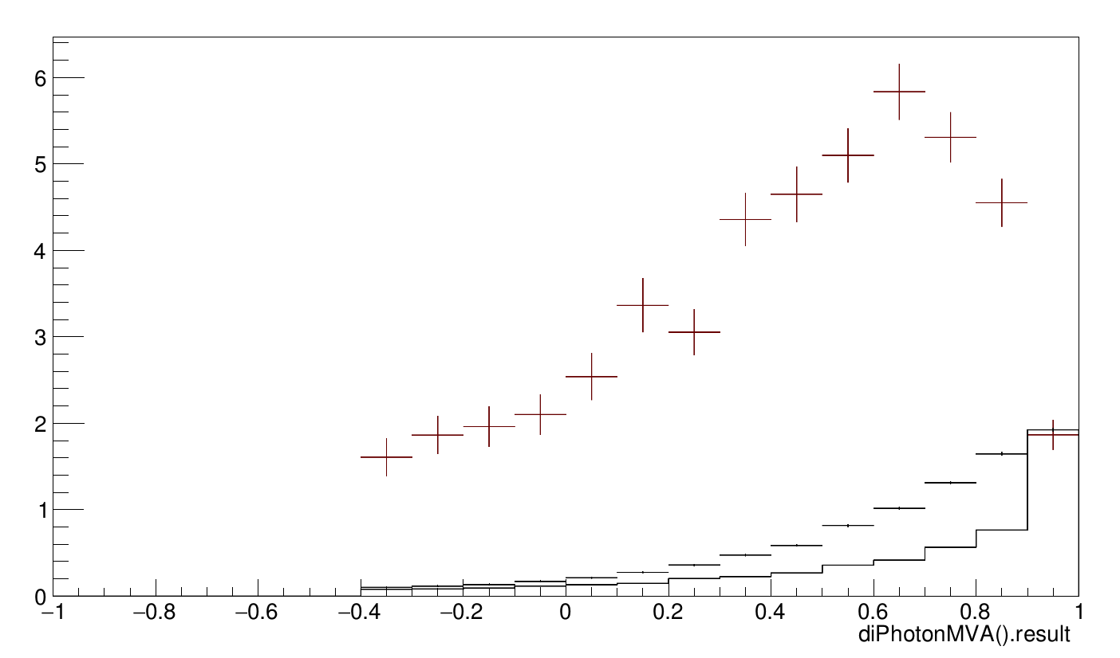
Optimization with new template
Background
Signal
Significance (s/√(b+δb²))
The significance study suggest to increase the cut as much as possible
  Still we want to have enough data statistics
Want to check the limits with the m_{γγ} shape analysis in a control region

Slide 7
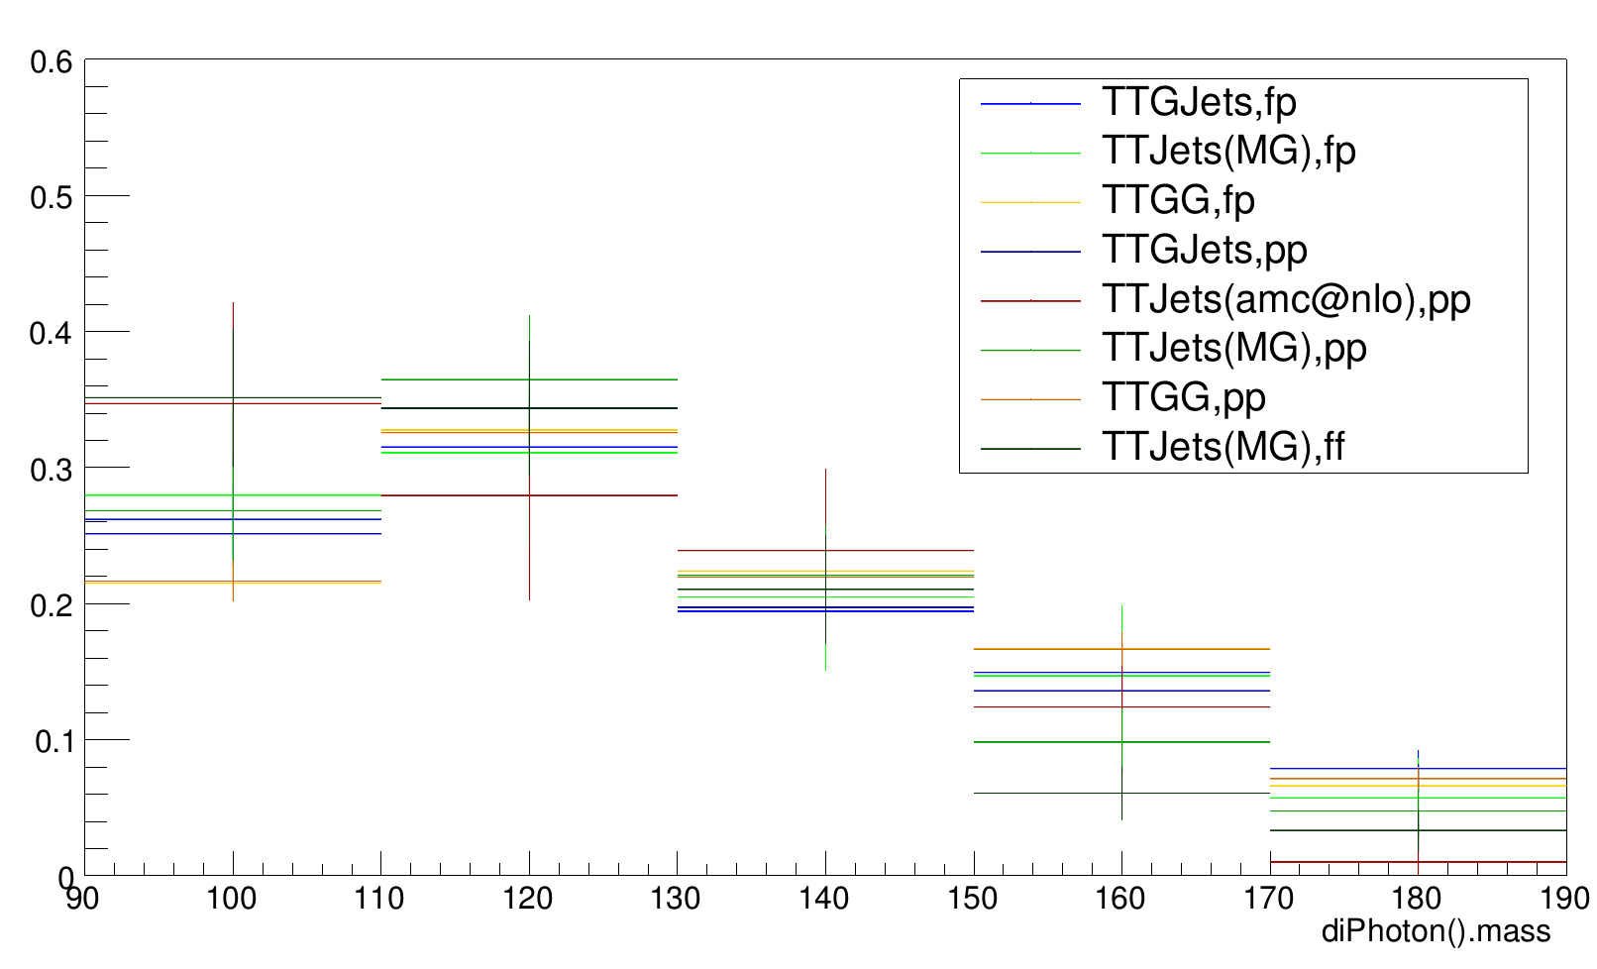
Best choice based on exp. limits in CR
The diphoton mva is not expected to be correlated with m_{γγ}
  Explicitly checked
Hence the control region introduced in this talk can be still used to find the best choice for dipthoton mva cut based on the expected limits

Slide 8
Summary and outlook
A template is constructed with high statistics for diphoton MVA of tt
  The signal-vs-background study is now possible
The significance suggests to increase the cut,
  Want to keep enough statistics for the multipdf …
  Want to check explicitly with expected limits
The control region used for categorization studies is valid here
  Need to evaluate the limits …

