Slide 1
Big Data Programming
Final Project
Yash, Kamal, Hama

Slide 2
One billion hours watched daily
2+ billion users - meaning almost one-third of the internet.
YouTube is the second largest search engine, right after Google. It's bigger than Bing, Yahoo!, and Ask combined.
Source: https://www.youtube.com/about/press/
Download (514 MB)

Slide 3
Pre-Processing
Null Values
Duplicates
Data types
Dates
Categories

Slide 4
We are going to see if there are any patterns with a specific period (month or day of the week) associated category of videos that are trending.

Slide 5
Is there a pattern in videos becoming trending in the US first and later, the trend spread to the rest of these developed nations for example?

Slide 6
Are there channels that have recurring trending videos, and is there a pattern weekly, monthly?
.

Slide 7
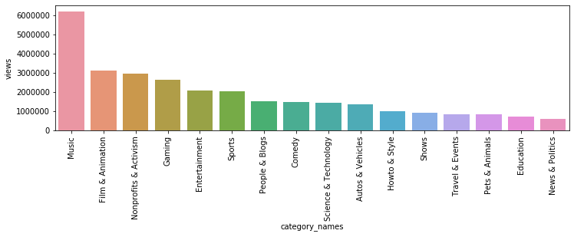

Slide 8
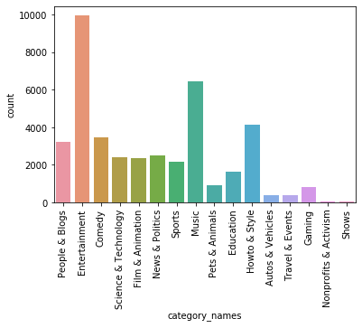

Slide 9
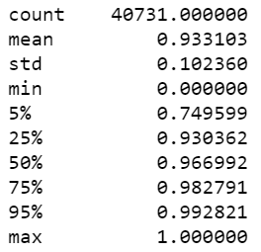
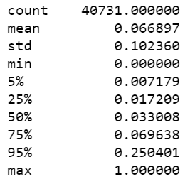
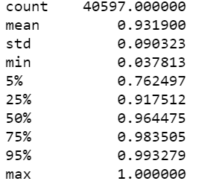
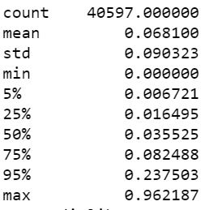
Like dislike Ratio of the videos
-By comparing the US and Canada trending videos.
-The ratio of the likes and dislikes found consistent in both country based on likes and dislikes.
- Viewers likes the video more than dislikes in both country
US like Percentile US Dislikes Percentile Canada Likes Percentile Canada dislikes Percentile

Slide 10
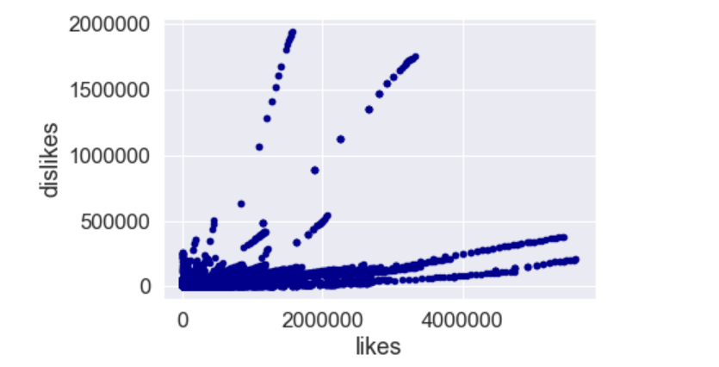
Overall Like Dislike Ratio

Slide 11
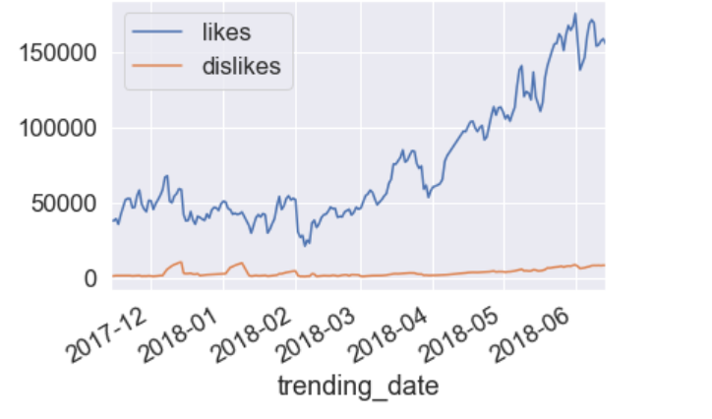
Like and Dislikes Ratio of the USA by date

Slide 12
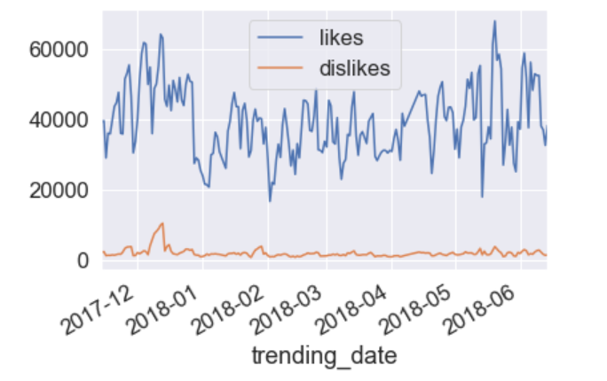
Likes and dislikes ratio of the Canada by date

Slide 13
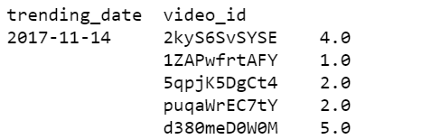
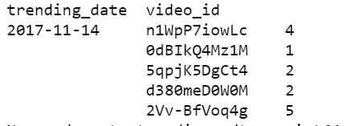
Days to trending status US and Canada Videos
By subtracting Trending date and publish date the days to trending is calculated.
Just took the 5 videos to see the days to trending.
All Videos published in 2017- 11-13
US videos Canada Videos

Slide 14
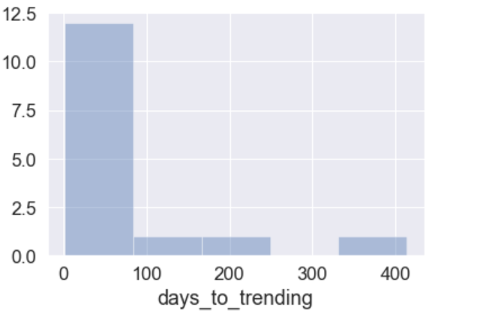
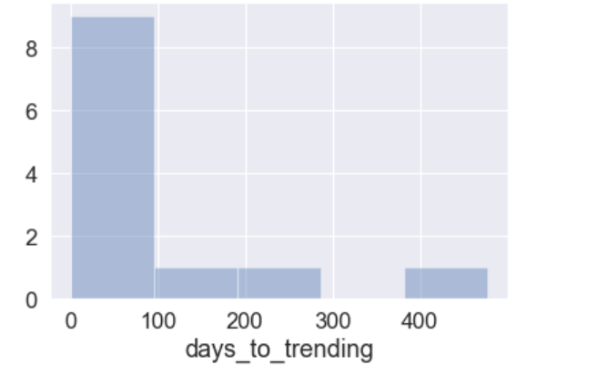
Days To Trending
USA Canada

