Slide 1

Introduction to Docker

Slide 2







About me
Tampa, FL
Gainesville, FL

Slide 3
What is Docker?
Docker is a tool that uses containers to make it easier to run applications.
By using these containers it assures the developer that regardless of the Linux machine, the application will run

Slide 4
What is a container?
A container is a process on your machine that is isolated from the other process on the host machine
Builder
Engine
Orchestration
technology used to build a container
technology used to run a container
technology used to manage many containers

Slide 5
The problem?
Compatibility.
In the lab we want our code and the tools we build to be able to run successfully regardless of the processer
Thus, by using Docker and containers will increase compatibility

Slide 6
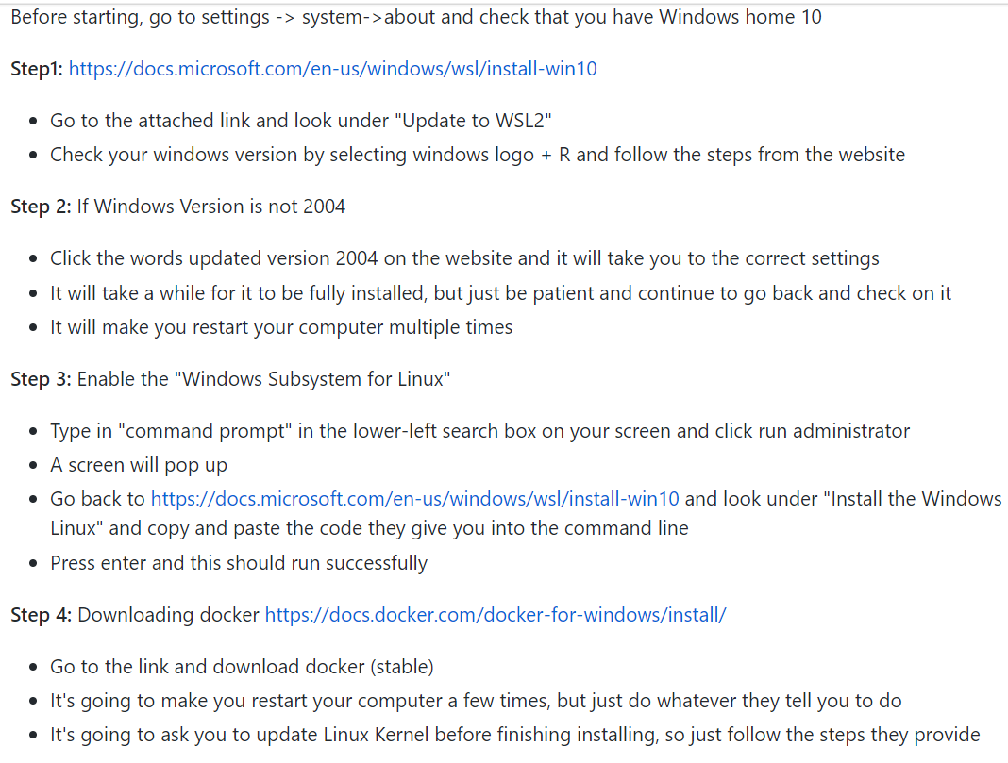
First step installing
For installing in Windows, go to Docker repository and look under issues

