Slide 1
RUMP: A Reproducible and Scalable Untargeted Metabolomics Data Processing Pipeline
Xinsong Du, M.S.
Ph.D. Student, Graduate Assistant
Department of Health Outcomes and Biomedical Informatics
University of Florida, College of Medicine

Slide 2
Outline
What are bioinformatics pipelines?
What is metabolomics research?
Untargeted Metabolomics Data Processing Pipeline with Quality Control
RUMP Pipeline
Simulation Study
Next Steps
Acknowledgement

Slide 3
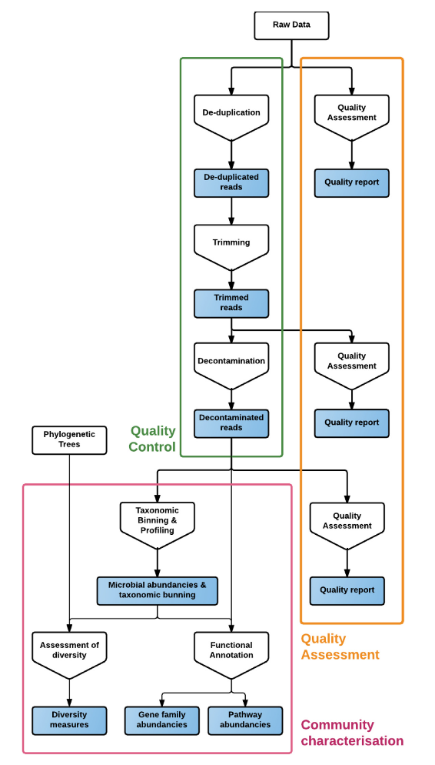
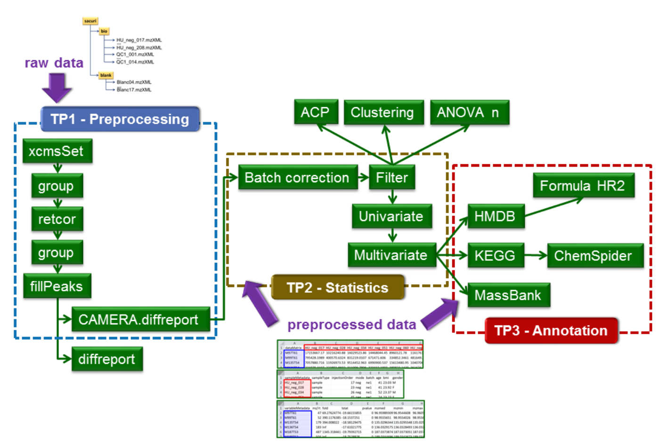
What are bioinformatics pipelines?
Raw Data
Intermediate Result
Intermediate Result
Final Result
Applications
Metabolomics (e.g., W4M)
Genomics (e.g., YAMP)
More examples: https://github.com/danielecook/Awesome-Bioinformatics
Visconti et al. 2018. GigaScience; Giacomoni et al. 2019. Bioinformatics

Slide 4
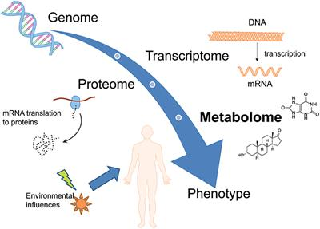
What is Metabolomics Research?
Metabolomics is the systematic study of small molecules (metabolites) within cells, biofluids, tissues or organisms. Targeted and untargeted analysis are two major strategies developed for metabolomics data analysis.
Targeted approach focuses on accurate identification and quantification of selected group of metabolites in biological samples, while
Untargeted method focuses on sample comparison in terms of metabolites
Wikinson et al. 2016. Scientific Data
Notes:
Metabolomics is a powerful approach because metabolites and their concentrations, unlike other "omics" measures, directly reflect the underlying biochemical activity and state of cells / tissues. Thus metabolomics best represents the molecular phenotype.

Slide 5
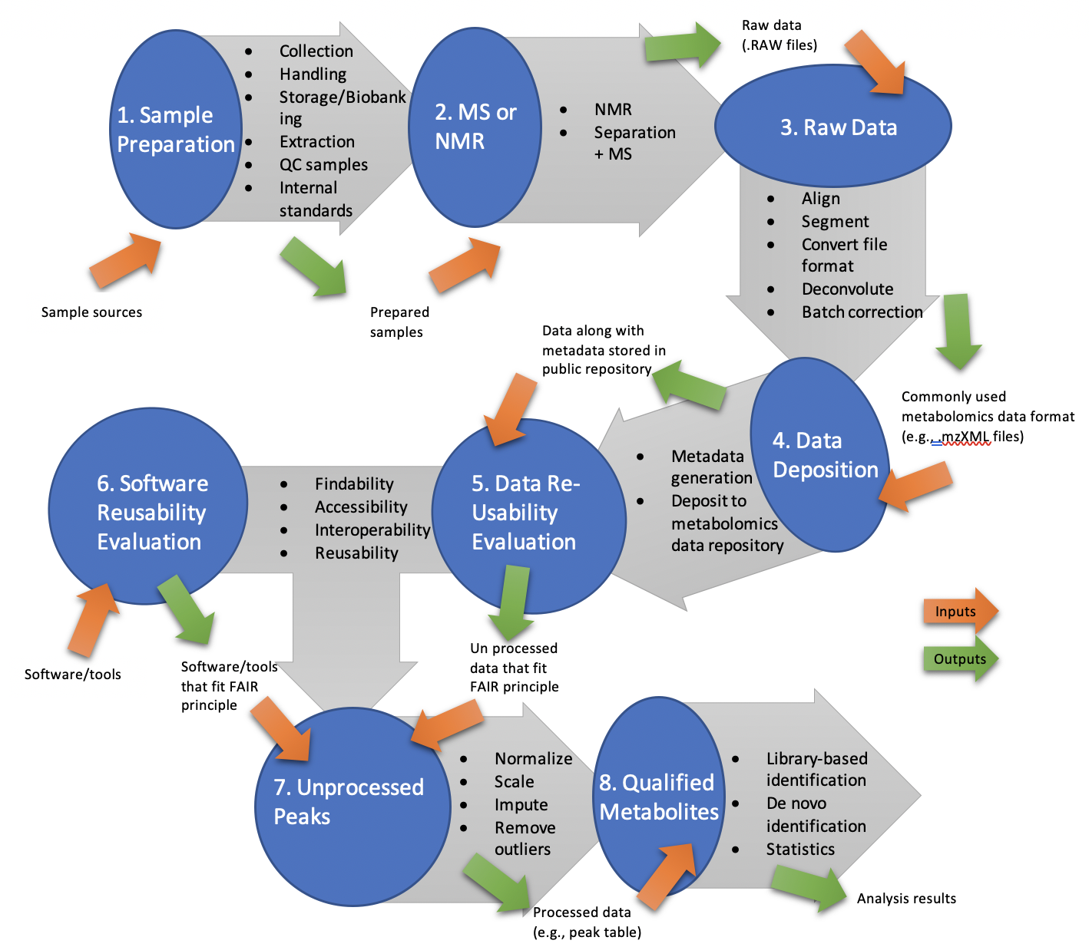
Untargeted Metabolomics Data Analysis Pipeline with Quality Control
FAIR Principle | Data | Software
Findability | Data has a globally unique identifier | Software has a globally unique identifier
Accessibility | Data can be downloaded and used legally | Software can be downloaded and used legally
Interoperability | Data can be used by different labs | Software can be used across different labs
Reusability | Report enough metadata so that others can reuse it | Record reusable command lines in tutorial

Slide 6
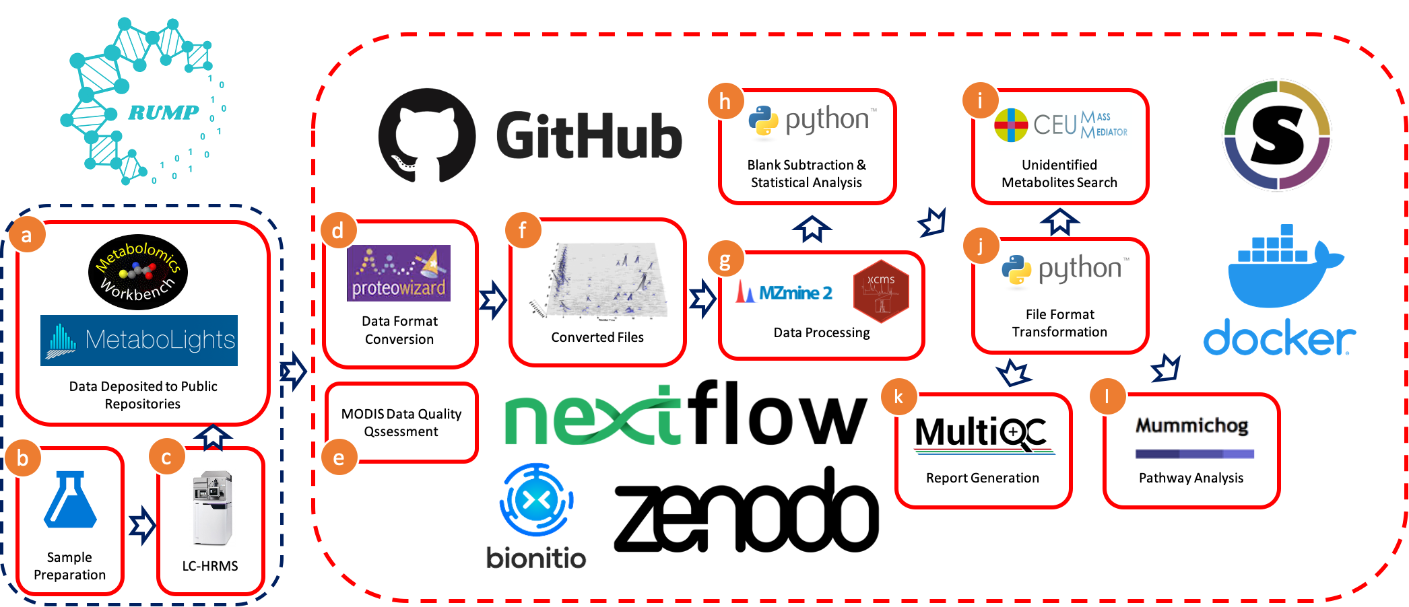
RUMP Pipeline
https://github.com/lemaslab/RUMP

Slide 7









RUMP Pipeline
FAIR Principle | Data | Software
Findability
Accessibility
Interoperability
Reusability | MODIS Ontology

Slide 8
Simulation Study – On Going

Slide 9
Steps of Simulation Study
Find large datasets from Metabolights and Metabolomics Workbench.
Evaluate data quality and calculate quality score using MODIS scoring system.
Select the largest data with a MODIS score no less than 22.
Run the selected data with RUMP and see if we can get the same result with the paper, meanwhile test the consumption of computational resources

Slide 10
Next Steps

Slide 11
Next Steps
Things need to do for base version:
Simulation study
Evaluate MODIS ontology and improve it.
Include MODIS scoring system as the first step of RUMP pipeline.
Include Proteowizard – Msconvert in RUMP for file format conversion.
Things related to further development of RUMP
Update wiki page to include the explanation of every component of RUMP.
More statistical analysis.
Incorporate more tools like XCMS, etc.
GUI

Slide 12

Acknowledgements
Dominick J. Lemas, PhD
Alexander Kirpich, PhD
William R. Hogan, PhD
Timothy J. Garrett, PhD
Luran Manfio,
Ke Xu,
Hailey Ballard,
Nisha Y. Chachad,
Sabrina A. Shams,
Yasmine S. Gillespie,
Thu Kim
Lemas
Lab

Slide 13
Thank you!

