Slide 1
Navigation Networks
Visualizing canvas page use

Slide 2
Technical Overview
Merged Navigation and Pages data
Paired pages that were visited chronologically by the same learner in the same session within 30 minutes
Nodes correspond to pages visited
Node size corresponds to number of visits
Edges correspond to navigation events
Edge weight corresponds to number of events

Slide 3
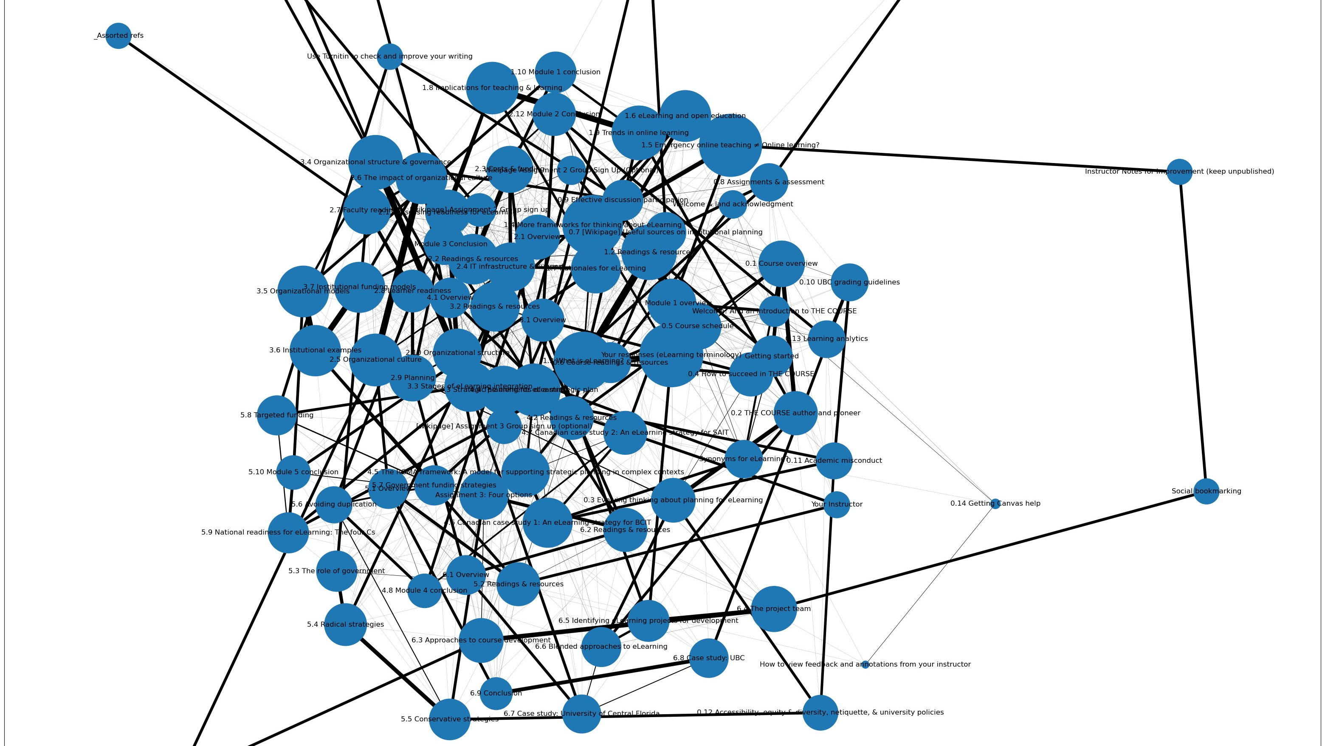
Wildest idea :P

Slide 4
Canvas Site Optimization
Is the canvas page structure efficient?
Things to consider:
Do navigation patterns match the page structure?
Strongly connected pages should be close together

Slide 5
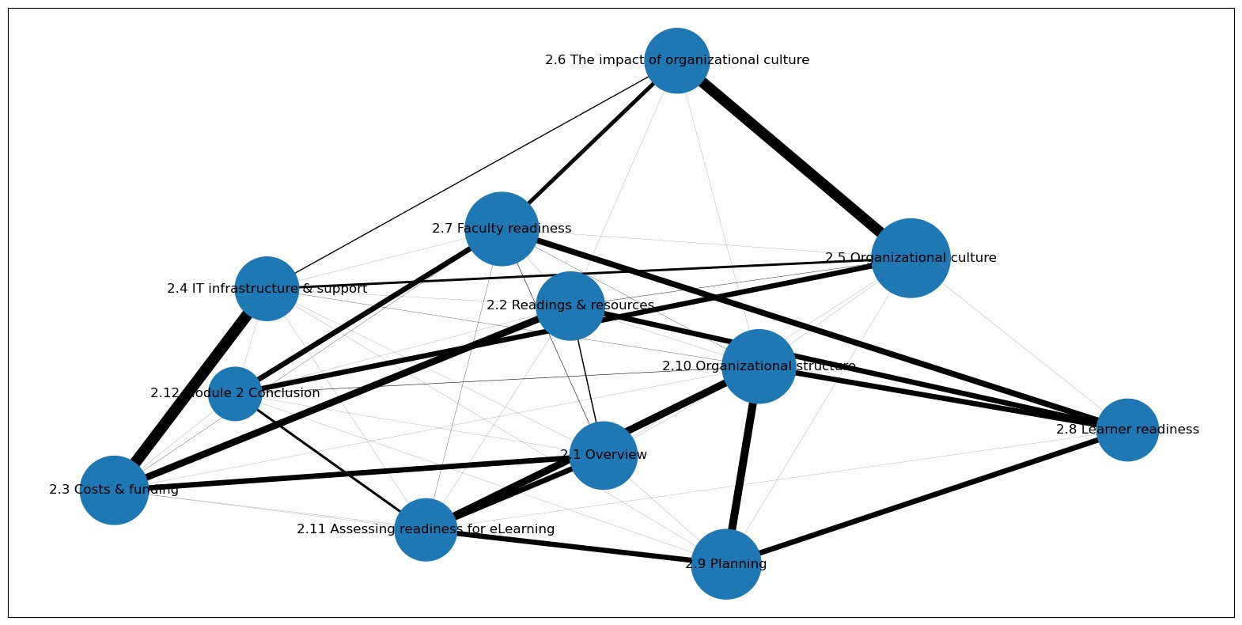

Slide 6
Course Material Optimization
Is the material organized intuitively?
Things to consider:
Is navigation mostly chronological?
Are some pages more popular than others?

Slide 7
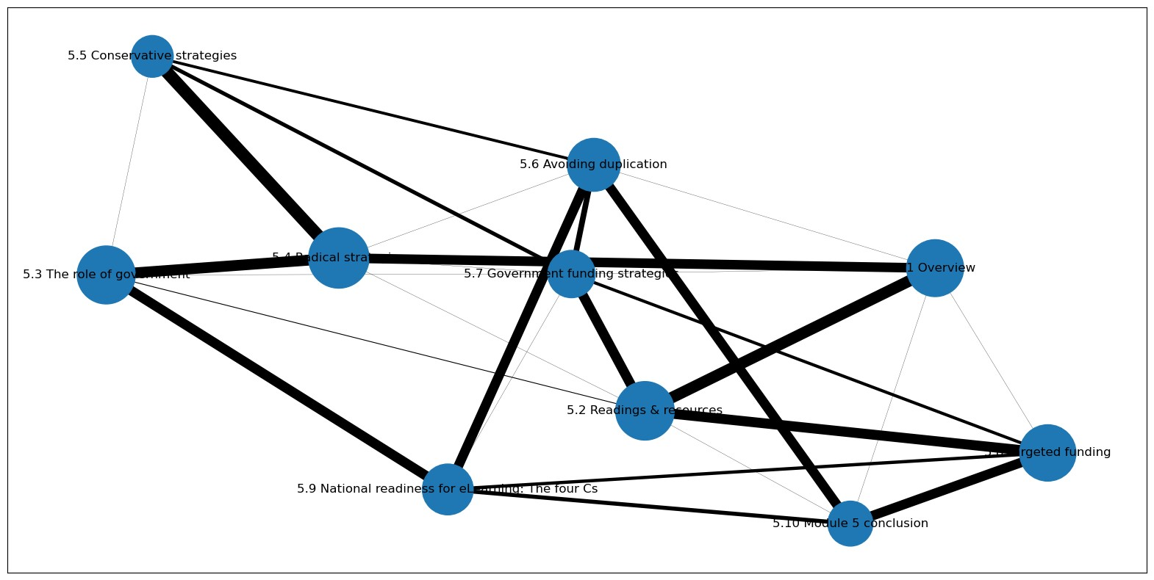

Slide 8
Conclusions
Navigation network graphs reveal how learners interact with a canvas course page
Helps instructors improve canvas course pages and…
Helps instructors improve course material!

