Slide 1
MeMa3 Technical Architecture
And Challenges

Slide 2
Architecture
Small(ish) pieces loosely joined, running (mainly) under Docker (qv): (https://en.wikipedia.org/wiki/Small_Pieces_Loosely_Joined)
Rhasspy, speech recognition (ASR) /dispatching
Mimic3, text to speech (TTS)
Node-Red (glue and 'low-code' programming)
Mosquitto (message broker used mainly in IOT)
Custom Python scripts, 'intent server' and tasks writing to sqlite3 database
(Currently) Some External AI to be turned off

Slide 3
Docker
Quite a lot more to this, but it's a container and image technology that enables processes to have their own (nearly) virtual machine.
For reasons of performance and simplicity may remove this in a future version put the contributing components 'nearer the metal'.

Slide 4
Rhasspy: Port 12101
Think Alexis, Siri or Mycroft, open source home assistant (HA) with voice command
I rejected Mycroft because it's tightly linked to the cloud, Rhasspy gives 'choice'
Very configurable, good community
Programmed 'intents' like Alexa 'skills'

Slide 5
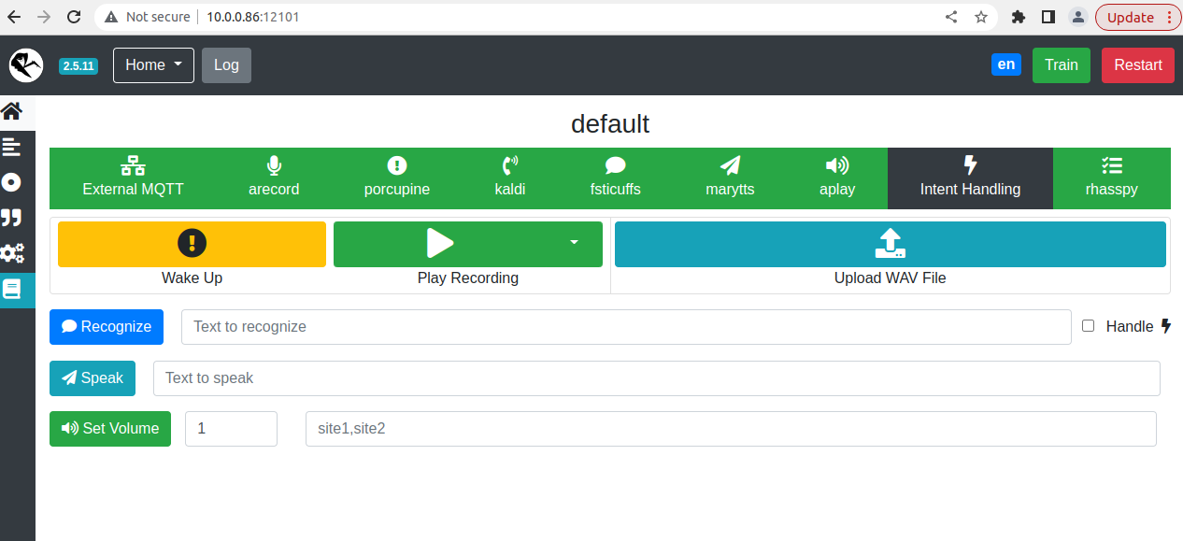

Slide 6
Mimic3: Port 59125
Last Generation Text to Speech
Lots of voices (though I haven't mastered install yet)
SSML Speech Markup language, slowing etc.
Not full integrated with Rhasspy but will be
Used for prompts reading texts etc.

Slide 7
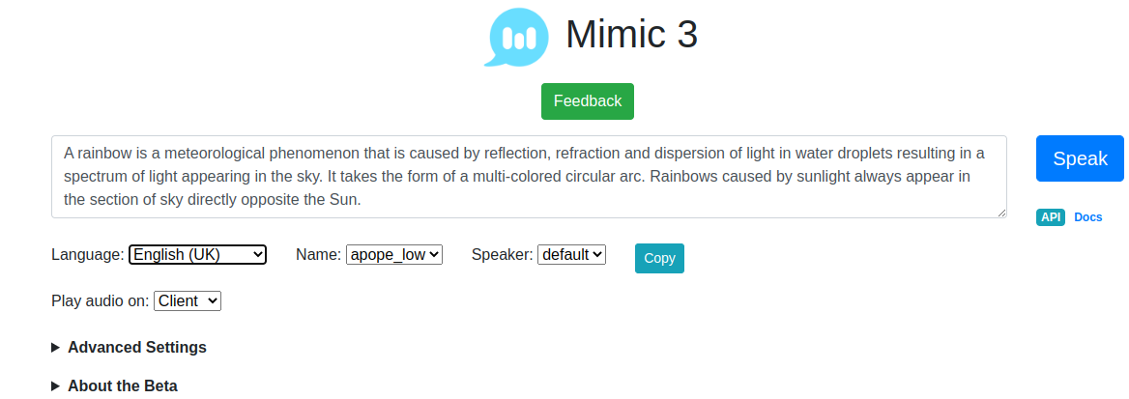

Slide 8
Node-Red Port:1880
Flow-based tool for visual programming
Think Scratch for non-tech adults
Used to glue the small pieces together
Provide quick new facilities
Interacts with mosquitto

Slide 9
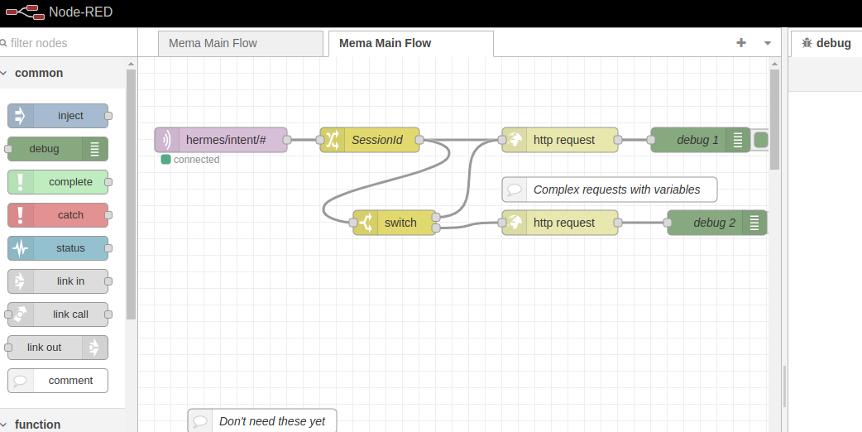

Slide 10
Mosquitto Port 1883
Message broker
(Currently) Listens for 'intent' messages
Publishes them to Node-Red
Node-Red does local processing in a 'flow'
Node-Red pushes them towards the custom bit

Slide 11
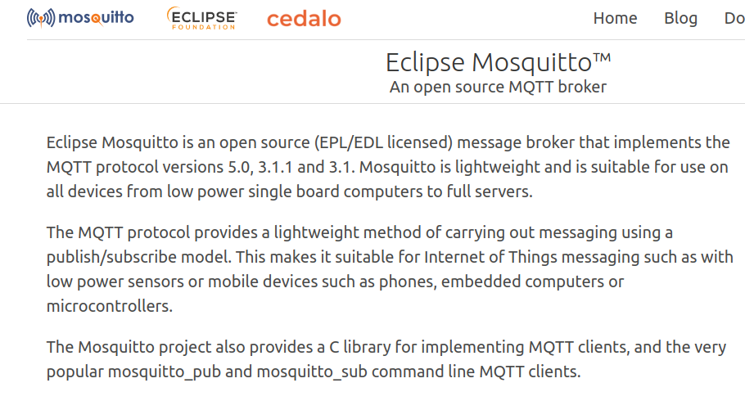

Slide 12
Quick Review
That seems like a lot?
But most of this is 'configured'
Very small amounts of custom work
Mainly integration and problem solving
Maintained/documented by respective projects

Slide 13
Intent Server(1) Port 8000
FastApi and Python based
Takes an Intent (take photo, for example) and dispatches to a specialised program
Dispatch table for intents (can be done in Node-Red) but finer control here
Writes to Sqlite3 database for memories

Slide 14
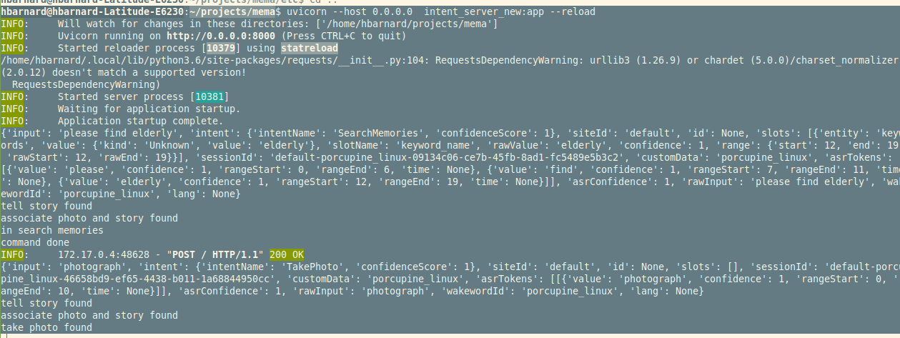

Slide 15
Intent Server (2)
Controls and displays (ugly) custom web interface
Will do technical logging at some stage
Currently about 400 lines of code, so not enormous
Dispatches to small specialised programs that run parametrised command line commands

Slide 16
Task or Intents (1)
Small Python programs that (usually) run an OS level task
For example: arecord -q -f cd -c 2 -D hw:0,0 --duration 30 record 30 seconds of audio
OS tasks are in a configuration file etc/memi.ini so can experiment/debug
Control external AI (transcription etc.) this can be turned off in mema.ini hopefully can be integrated locally 'soon'

Slide 17
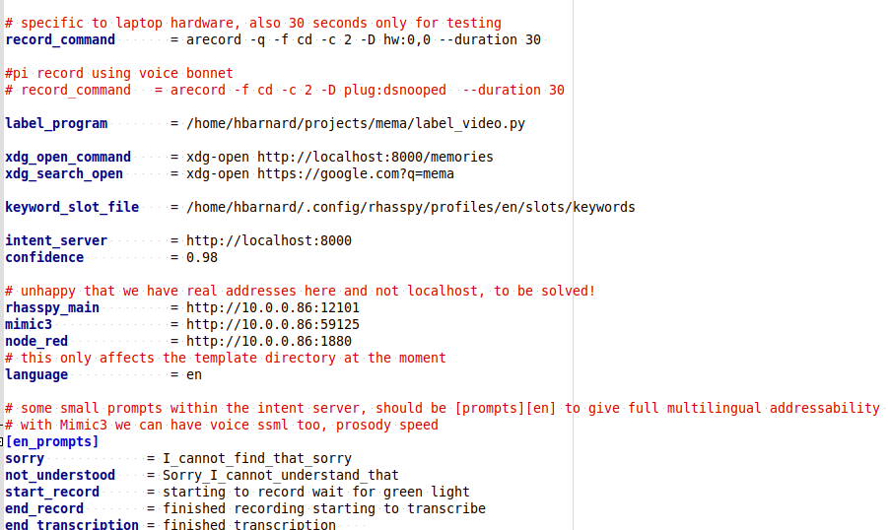

Slide 18
Tasks or Intents (2)
Programs are about 100 lines, in general 'not big' but could do with armouring
Voice prompts and run command line
Return text (if transcription) and a file path for, for example, the audio or photo
Intent server puts it in the database
Video currently a bit problematic

Slide 19
Review
All the components have web style APIs
For example http://<web_address>:59125/process can be used to 'talk', without the rest
http://<web_address>:12101 gives web access to all major Rhasspy configuration
Node-red listens for intents on 1883 (mosquitto) and sends to the Intent server at http://<web_address>:8000

Slide 20
Documentation
Fairly ample in the custom code
Building up on https://github.com/hbarnard/mema/wiki
For standard components, pretty ample documentation and good community, including stackoverflow.

Slide 21
Challenges (1)
Making production version, but that depends on hardware etc.
Make video work
Robust hardware and presentation
Testing with varied voices (Kaldi should be speaker independent) and other ASRs within Rhasspy
Possible integration of Ghost AI (speech to text)

Slide 22
Challenges (2)
Testing versions of the interface with potential users
Testing stability (generally good, been leaving it overnight etc.)
Designing and dealing with granular privacy and 'user accounts', face recognition mooted in Miro notes, for example
Optimising/reliability and refactoring in the Python, need stability first though
Licence given the assorted licences for components

Slide 23
Opportunities
Convergence, since it's component based can benefit from improvements (for example, Ghost AI will probably be integrated, so internal transcription available)
The central part was hacked from an open source voice assistant
So extra privacy-preserving 'in home' opportunities
I pitched this to an NHS hack day about five years ago, lots of interest
Sure there's 'more'

Slide 24
That's It!
Thanks!

