Slide 1
MeMa3 Technical Architecture
And Challenges

Slide 2
Architecture
Small(ish) pieces loosely joined: (https://en.wikipedia.org/wiki/Small_Pieces_Loosely_Joined)
Rhasspy, speech recognition (ASR) /dispatching
Mimic3, text to speech (TTS)
Node-Red (glue and low-code programming)
Mosquitto (message broker used mainly in IOT)
Custom Python, 'intent server' and tasks
(Currently) Some External AI to be turned off

Slide 3
Rhasspy: Port 12101
Think Alexis, Siri or Mycroft, open source home assistant (HA) with voice command
I rejected Mycroft because it's tightly linked to the cloud, Rhasspy gives 'choice'
Very configurable, good community
Programmed 'intents' like Alexa 'skills'

Slide 4
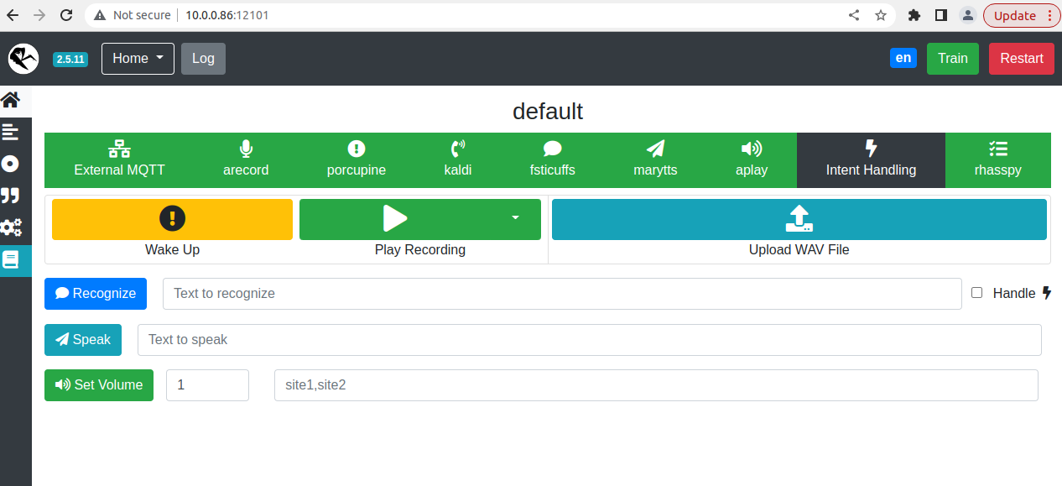

Slide 5
Mimic3: Port 59125
Last Generation Text to Speech
Lots of voices (though I haven't mastered install yet)
SSML Speech Markup language, slowing etc.
Not full integrated with Rhasspy but will be
Used for prompts reading texts etc.

Slide 6
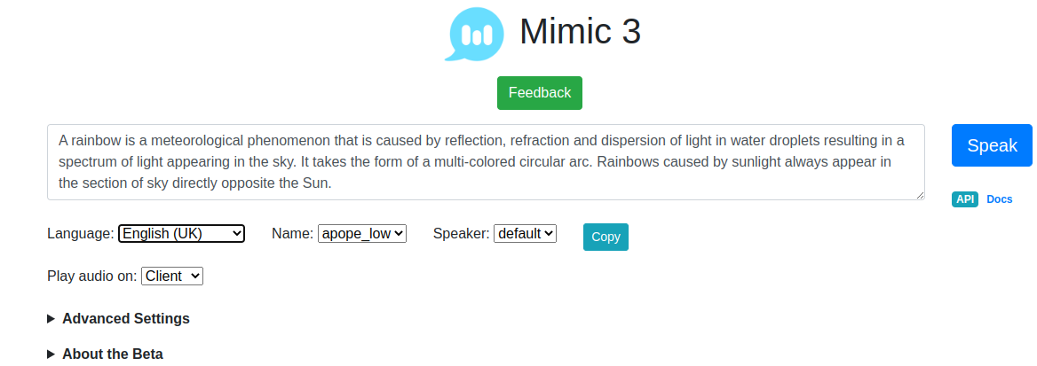

Slide 7
Node-Red Port:1880
Flow-based tool for visual programming
Think Scratch for non-tech adults
Used to glue the small pieces together
Provide quick new facilities
Interacts with mosquitto

Slide 8
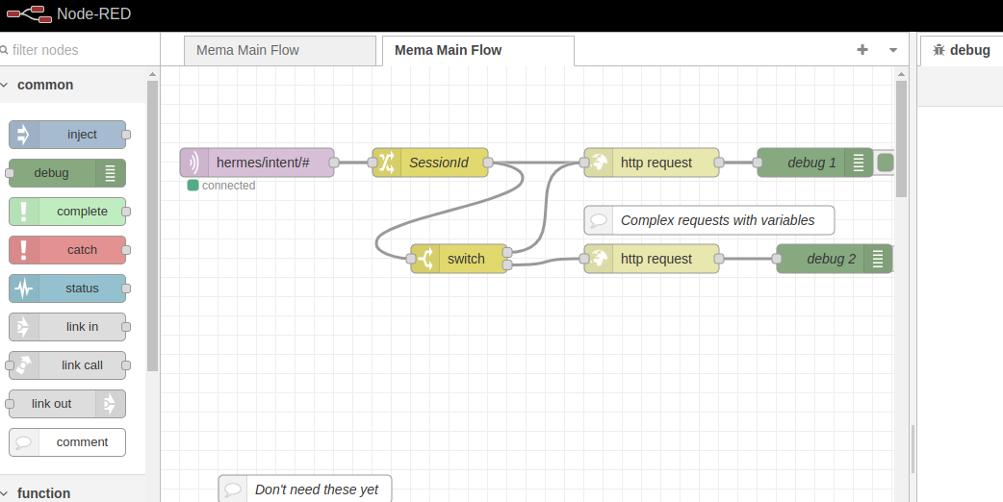

Slide 9
Mosquitto Port 1883
Message broker
(Currently) Listens for 'intent' messages
Publishes them to Node-Red
Node-Red does local processing in a 'flow'
Node-Red pushes them towards the custom bit

Slide 10
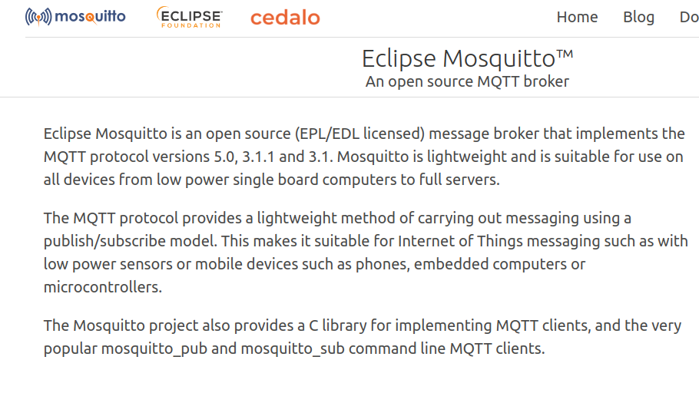

Slide 11
Quick Review
That seems like a lot?
But most of this is 'configured'
Very small amounts of custom work
Mainly integration and problem solving
Maintained/documented by respective projects

Slide 12
Intent Server(1) Port 8000
FastApi and Python based
Takes an Intent (take photo, for example) and dispatches to a specialised program
Dispatch table for intents (can be done in Node-Red) but finer control here
Writes to Sqlite3 database for memories

Slide 13
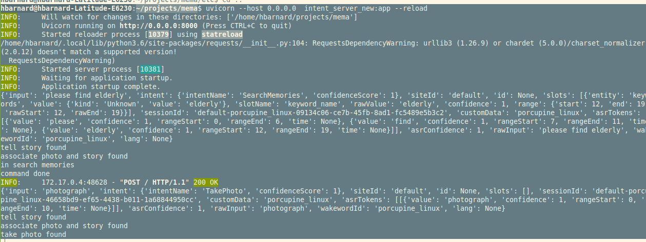

Slide 14
Intent Server (2)
Controls and displays (ugly) custom web interface
Will do technical logging at some stage
Currently about 400 lines of code, so not enormous
Dispatches to small specialised programs that run parametrised command line commands

Slide 15
Task or Intents (1)
Small Python programs that (usually) run an OS level task
For example: arecord -q -f cd -c 2 -D hw:0,0 --duration 30 record 30 seconds of audio
OS tasks are in a configuration file etc/memi.ini so can experiment/debug
Control external AI (transcription etc.) this can be turned off in mema.ini hopefully can be integrated locally 'soon'

Slide 16
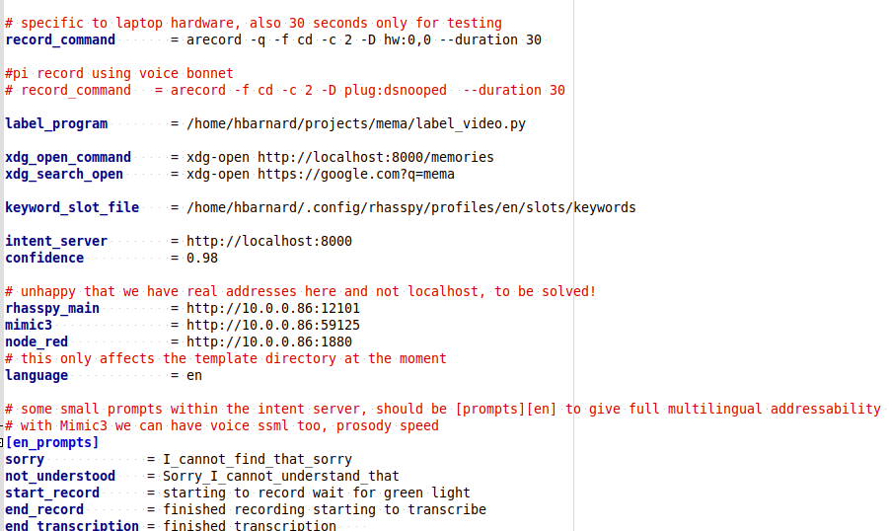

Slide 17
Tasks or Intents (2)
Programs are about 100 lines, in general 'not big' but could do with armouring
Voice prompts and run command line
Return text (if transcription) and a file path for, for example, the audio or photo
Intent server puts it in the database
Video currently a bit problematic

Slide 18
Review
All the components have web style APIs
For example http://<web_address>:59125/process can be used to 'talk', without the rest
http://<web_address>:12101 gives web access to all major Rhasspy configuration
Node-red listens for intents on 1883 (mosquitto) and sends to the Intent server at http://<web_address>:8000

Slide 19
Documentation
Fairly ample in the custom code
Building up on https://github.com/hbarnard/mema/wiki
For standard components, pretty ample documentation and good community, including stackoverflow.

Slide 20
Challenges (1)
Making production version, but that depends on hardware etc.
Make video work
Testing with varied voices (Kaldi should be speaker independent) and other ASRs within Rhasspy
Possible integration of Ghost AI (speech to text)

Slide 21
Challenges (2)
Testing versions of the interface with potential users
Testing stability (generally good, been leaving it overnight etc.)
Designing and dealing with granular privacy and 'user accounts', face recognition mooted in Miro notes, for example
Optimising/reliability and refactoring in the Python, need stability first though
Licence given the assorted licences for components

Slide 22
Opportunities
Convergence, since it's component based can benefit from improvements (for example, Ghost AI will probably be integrated, so internal transcription available)
The central part was hacked from an open source voice assistant
So extra privacy-preserving 'in home' opportunities
I pitched this to an NHS hack day about five years ago, lots of interest
Sure there's 'more'

Slide 23
That's It!
Thanks!

