Slide 1

Lab 15: Switching Noise Board
Haley Basti

Slide 2
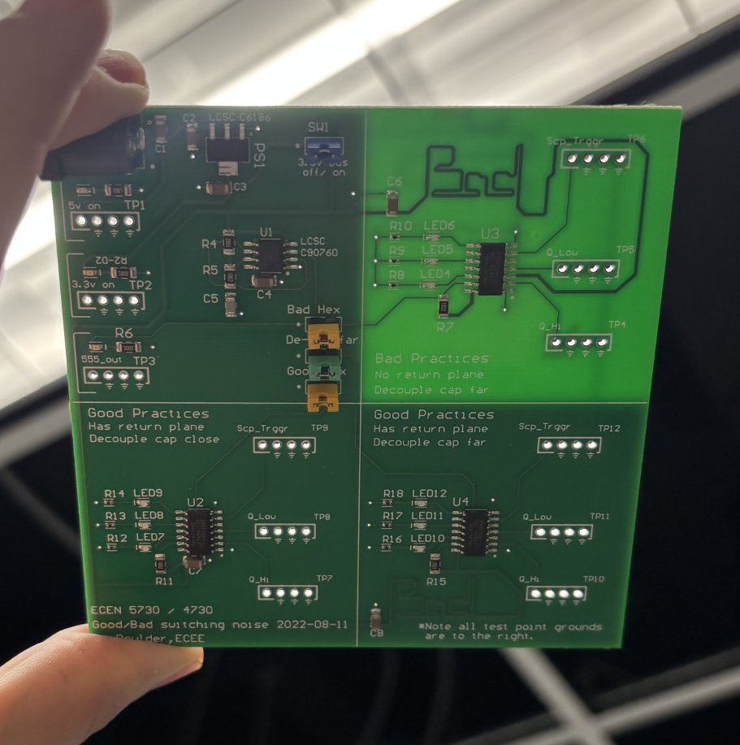
Overview
The goal of this lab was to explore the results of good design practices of a shared return plane and a decoupling capacitor placed close to the DUT, versus two bad ones: having the decoupling capacitor placed far away from the DUT, and one with the same decoupling capacitor placement as well as not having a return plane, as seen in the image to the right.
The rise time as well as voltage rail collapse (peak-to-peak voltage) were the metrics measured in this lab.

Slide 3
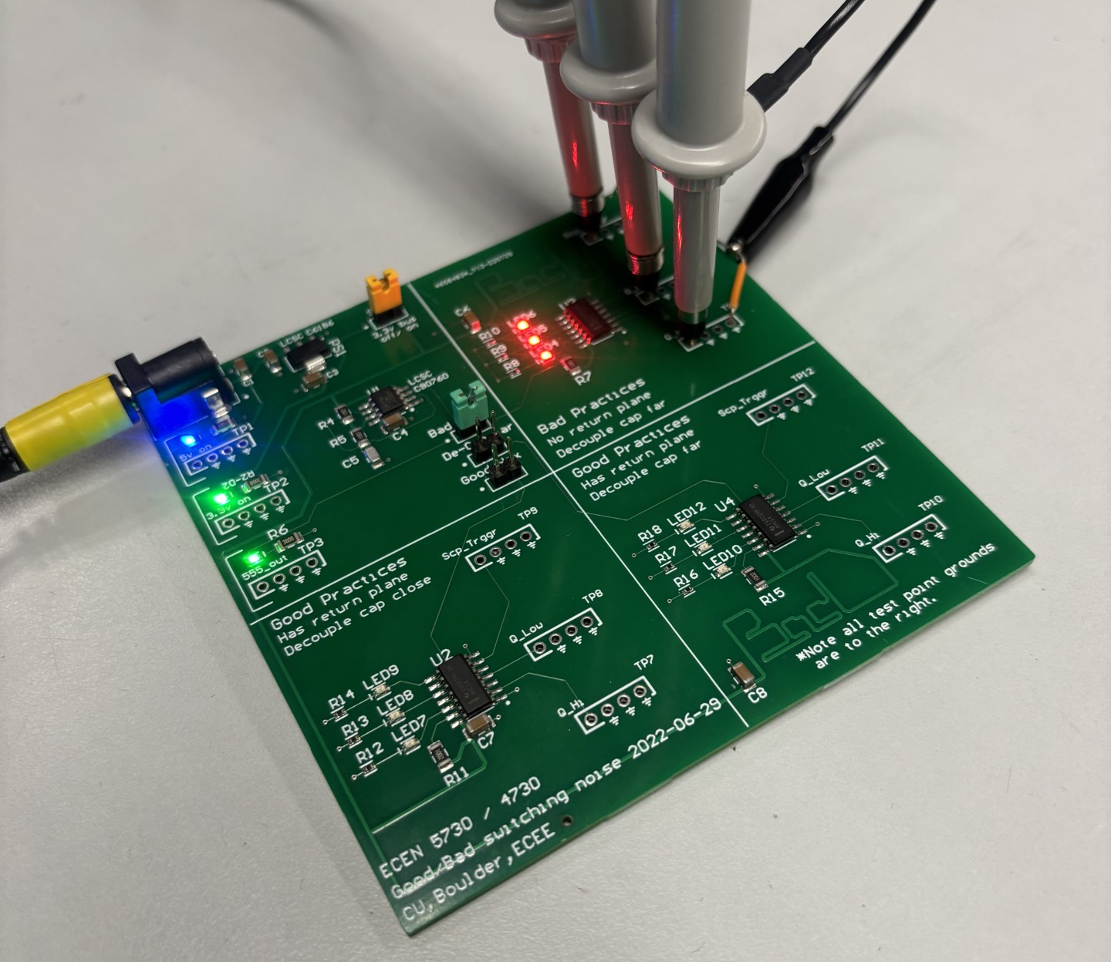
Key findings
Rise times collected during clock switching
Peak-to-peak voltage transition was measured
  Bad_cap was 1.7x slower with a 3.6x rail collapse
  Bad_bad was 2.3x slower with a 4.4x rail collapse
 | Rise time (ns) | Voltage rail collape (mV)
Good | 1.974 | 253.8
Bad – decoupling cap far | 3.303 | 922.1
Bad – no return plane | 4.586 | 1120.6

Slide 4
Summary
This simple design allows us to see the effects of not having a return plane as well as how moving the decoupling capacitor far away can negatively impact the switching noise of the DUT
Future board designs will have a decoupling capacitor close to the power rail as well as a return plane
 | Rise time (ns) | Voltage rail collape (mV)
Good | 1x | 1x
Bad – decoupling cap far | 1.7x | 3.6x
Bad – no return plane | 2.3x | 4.4x

Slide 5
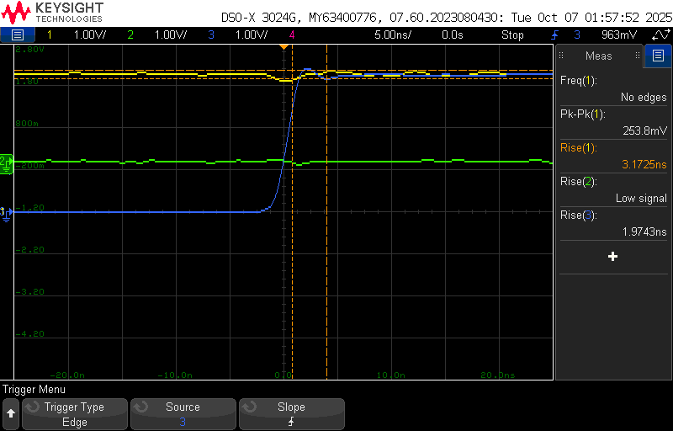
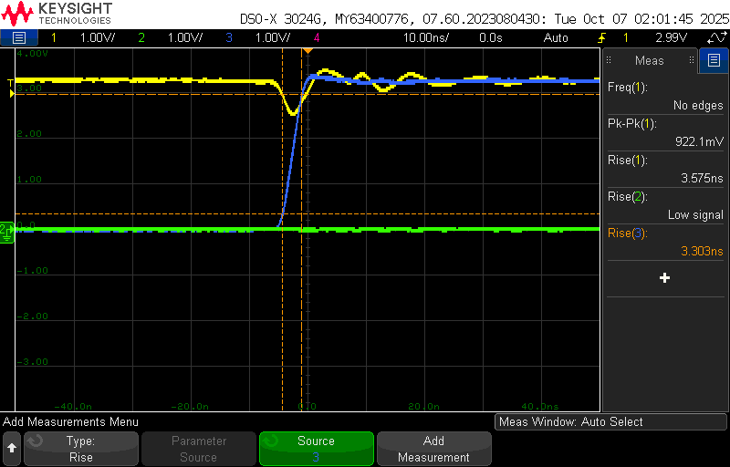
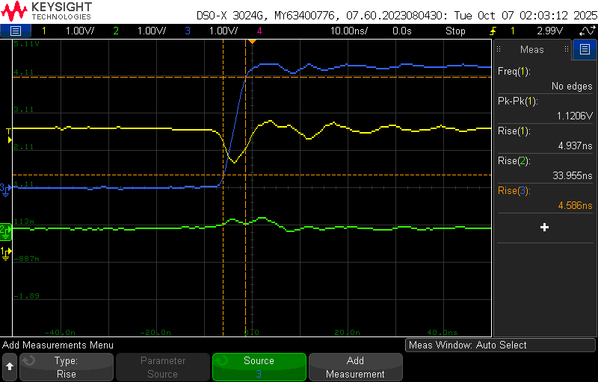
Full Results
Good
Bad - decoupling cap far away
Bad -no return plane
Full Results

