Slide 1

Lab 18:
In-Rush Current
Haley Basti

Slide 2
Overview
The goal of this lab was to view the steady-state and in-rush current supplied to our simple 555 timer circuit from the 5V Arduino power supply. The decoupling capacitors used in the circuit are initially uncharged, but when connected to power quickly pull current in, hence calling it the “in-rush” current.
After a short amount of time, the capacitors reach their full charge, and the circuit reaches its “steady-state”.
A 1Ω resistor was selected because it is small enough to not greatly affect the DC supplied voltage to our circuit passing through it, and it’s ¼ W tolerance should be plenty for this application.

Slide 3
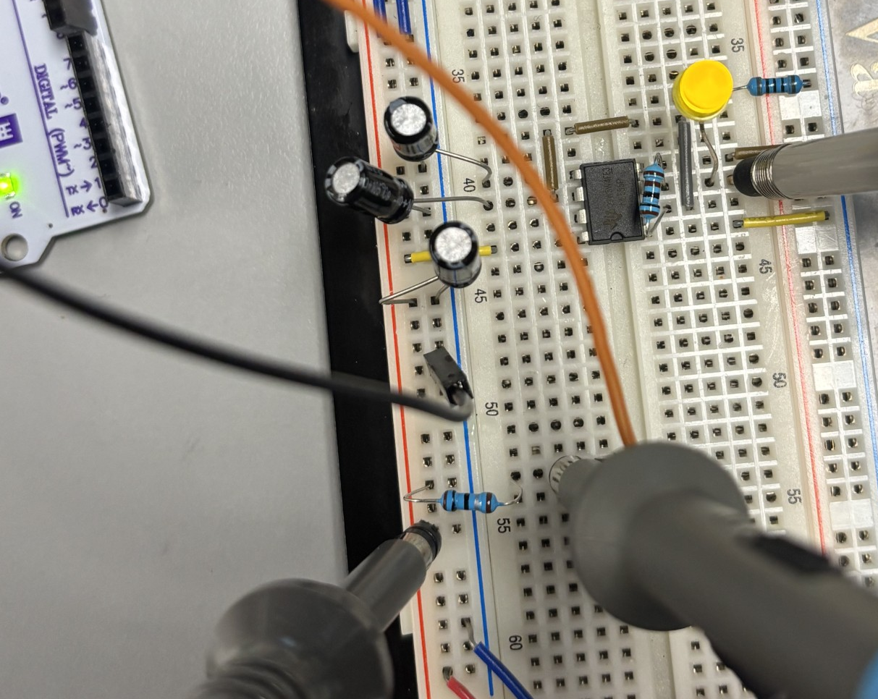
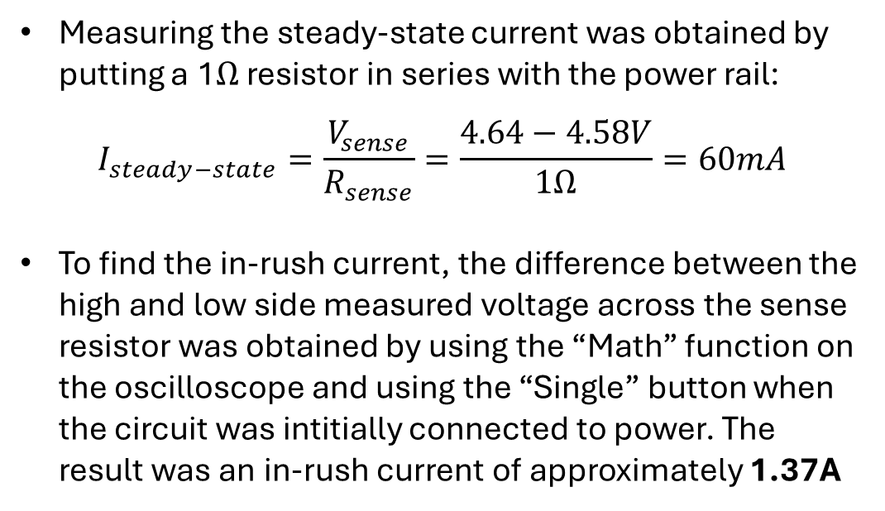
Key findings
Ch1 555 output
Measuring the steady-state current was obtained by putting a 1Ω resistor in series with the power rail:
$$I_{steady−state}=\frac{V_{sense}}{R_{sense}}=\frac{4.64−4.58V}{1Ω}=60mA$$
To find the in-rush current, the difference between the high and low side measured voltage across the sense resistor was obtained by using the “Math” function on the oscilloscope and using the “Single” button when the circuit was intitially connected to power. The result was an in-rush current of approximately 1.37A
5V Vcc from Arduino
Ch4 “High-side” probe
GND
1Ω sense resistor
Ch3 “Low-side” probe

Slide 4
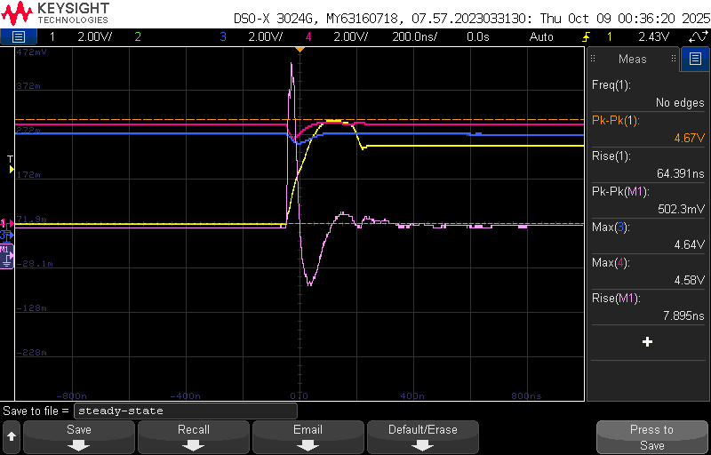
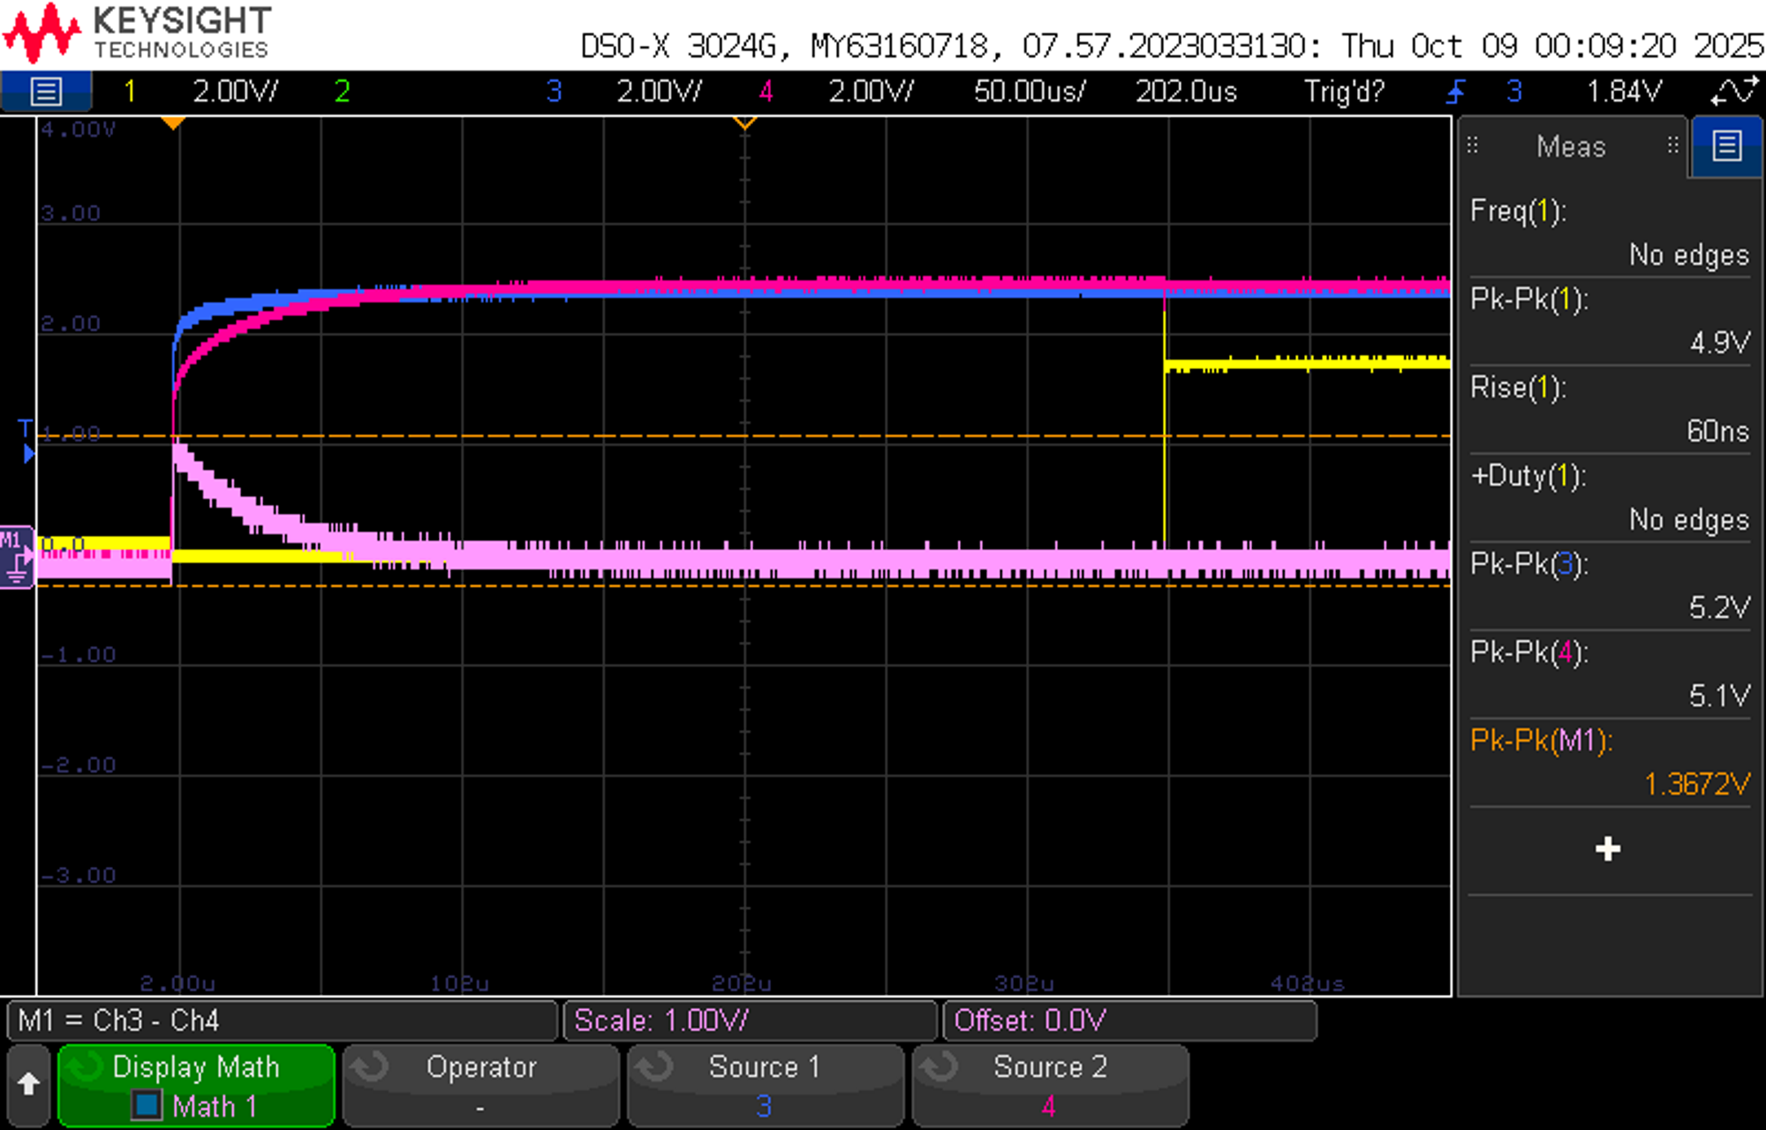
Full Results
Steady-state
In-rush current

Slide 5
Conclusion
The decoupling capacitors placed on the power rail will charge up when initially connected to power and cause an initial spike or “in-rush” current from the Vcc connection. This brief surge in current can potentially damage components whose ratings are not suited to handle this type of current, which is why we must be careful in choosing our components when utilizing decoupling capacitors.

