Slide 1
Agentic Engineering in Practice
Jamie Wang
Developer Advocate
Hemanth Battu
Ecosystem Engineer
Notes:
”””
[Introduce yourselves]
The goal today is to get you all some hands-on experience seeing how Agentic Engineering works and what it can do for you and your teams. The goal is for you all to see how using an agentic coding assistant can fit into your work style and increase your productivity without sacrificing things like ownership and accountability.
“””

Slide 2
Our roadmap:
Module 0: Get to Know Your Tool
Module 1: Requirements Gathering and Spec Creation
Module 2: Implementation
Module 3: Verification
Module 4: Balancing Cost Through Efficiency
Module 5: Justifying an AI Workflow
Notes:
“””
We’ve broken the agentic engineering process into four or five phases, depending on your familiarity with the tools. [If doing module 0: “First, we’ll start with Module 0: Get to Know Your Agentic Tool. We’ll be going through the basics of using an AI coding assistant; in our case, Bob. This will go through the capabilities Bob has and how to use them, and will set you up for the rest of the workshop. From there we have …”]
[If skipping module 0: “We’ll go ahead and start with…”] Module 1, which will be requirements gathering. This means understanding what problem you’re trying to fix and translating that into something actionable. In this process, you should always have verification and validation in mind as an end goal; it’s important to frontload some of that work, so you’re not playing catchup later.
After we’ve gathered our requirements and selected some testable design criteria, it’s time for Module 2: Spec Creation. This is where you develop structure. The goal here is to turn those engineering inputs we gathered as requirements into clear instructions for the agent to follow. Taking what’s in your head, organizing it, and putting that on paper, so to speak, is the key here. We’ll talk about ways to do that when we get there.
After you have your spec, you can proceed to Module 3: Implementation. The actual implementing part is perhaps the simplest part of this step; it’s about letting the agent execute the theory you’ve developed in the spec. The real challenge is balancing how much supervision the agent needs and knowing when to stop, pause, and reevaluate.
Finally, you have Module 4: Verification. This is likely where most developers struggle; we want to avoid the agentic coding “wall”, where you build an insurmountable pile of code that no one can or will ever parse through. Hopefully, though, with the skills you learn today, we can avoid that and instead have a clear vision of what needs to be done to get your code through its final stages of review.
“””

Slide 3
link to Bob

Slide 4
Introduction to Agentic Engineering
Notes:
Note: this intro can be shorter or longer, depending on how much experience people have with working with coding agents vs. AI in general vs. vibe coding etc.
Might be a good idea to get a show of hands

Slide 5
STOP CODING SLOP
PLEASE
Introduction to Agentic Engineering
Notes:
Why does Agentic Engineering actually matter?
At this point I think everyone’s familiar with vibe coding. And I’m not saying I’m a vibe-coding hater (though I am). I do think it has a time and place. But I am saying I look at AI generated slop all day, and it’s a pretty horrible experience. And when you know what you’re talking about, it’s honestly not that hard to spot. Creating good code is still important, especially if you ever want to move past the singular development experience and work on any sort of productive team.
Agentic Engineering, and engineering in general, is about taking the fundamental ability to create something, which is now very easy with the create-things machine that an LLM, and move into deciding what to actually create. To create things with purpose and intention. Vibe coding will spit out a lot of stuff, and some of it may even be good. But there’s no intentionality there, and no control. It’s quantity over quality.
Agentic engineering is about intention and credibility. You, as a person, are responsible for your product, your features, your mission, your roadmap. If you vibe coded an entire project and had no say in how you came to its current status, if you have no idea what you’re creating next, if you have no idea why what you made was made at all, from a technical standpoint, you’re expendable and replaceable, and would probably be better off for it. And if you do know those things, can speak credibly about your product, know how the technical elements you’ve developed work and why, and know what comes next, you might be doing agentic engineering already.
Your code doesn’t have to be functionally perfect. But you should understand why it is the way it is. You should be able to have a sophisticated, intelligent conversation about your project and, critically, its failures. Then you can maybe start to call yourself an engineer.

Slide 6
There are three main vectors by which to judge your agentic engineering process:
PROJECT TRUST: The trustworthiness of the
project being worked on
HUMAN OWNERSHIP: Your ability to
control the state of the project
AGENT AUTONOMY: The agent’s ability to
make independent progress
Introduction to Agentic Engineering
Notes:
“””
Here are the three vectors we want to optimize for. Project trust, human ownership, and agent autonomy. When you allow your agent to make all the decisions for you, your agent autonomy is great, and it feels like it’s getting all the work done by itself. But you lose project trust and human ownership completely. You don’t control your project, and you have no knowledge of how credible your code quality may be.
This is where we get into the main framework of this workshop: Spec Driven Development.
“””

Slide 7
Your goal:
Maximize autonomy without sacrificing trust and ownership
Introduction to Agentic Engineering
Notes:
“””
By using a structured approach and a clear strategy while coding with an agent, you can effectively delegate your work to the agent while remaining involved and in control of its process.
“””
Advantages: Enabling delegation, Controlling blast radius, Creating restart points

Slide 8
PLAN
Basic Workflow of Spec Driven Development
IMPLEMENT
VERIFY
Introduction to Agentic Engineering
Notes:
The techniques in this workshop will, as you may have noticed from the roadmap, generally follow the basic steps of Spec Driven Development, which are essentially a condensed version of the Software Development Lifecycle. We’re going to talk about taking the basic principles of SDD and building out your workflow centered around these three basic steps.

Slide 9
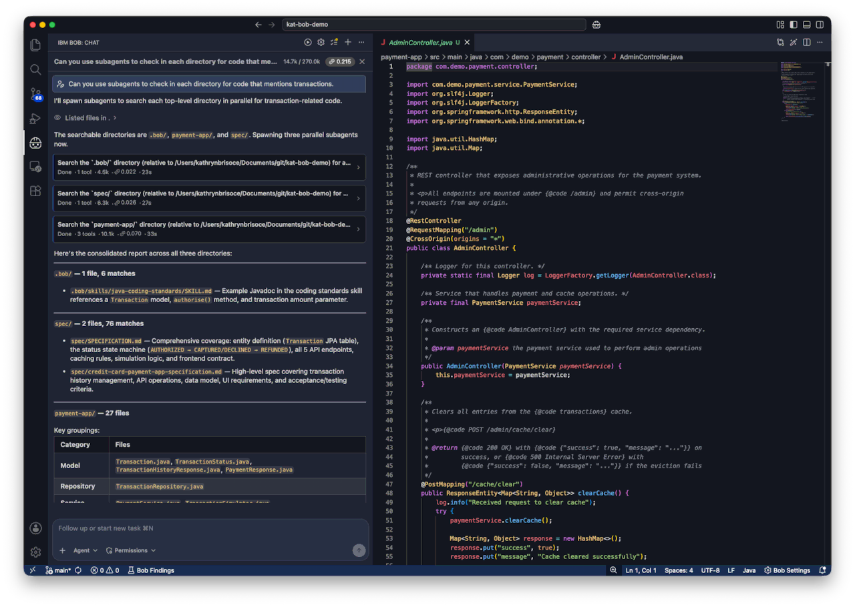
Module 0: Get to Know Your Tool
Notes:
Purpose: Clarify and validate ambiguous product requirements, as the precursor for high-quality spec creation
“””
The goal of requirements gathering is to understand the problem. Real inputs are often vague, partial, or emotional. Before we create a spec, we need to take those wide-reaching issues and pain points and requests and turn them into clear engineering inputs.
“””

Slide 10
IBM Bob IDE Walkthrough
Module 0: Get to Know Your Tool

Slide 11
Module 1: Requirements Gathering and Spec Creation
Notes:
Purpose: Clarify and validate ambiguous product requirements, as the precursor for high-quality spec creation
“””
The goal of requirements gathering is to understand the problem. Real inputs are often vague, partial, or emotional. Before we create a spec, we need to take those wide-reaching issues and pain points and requests and turn them into clear engineering inputs.
“””

Slide 12
Module 1: Requirements Gathering and Spec Creation
Notes:
“””
So what happens when you build on a cracked foundation? [audience participation?: looking for something like the house sinks, the building falls, etc.]
“””

Slide 13
Module 1: Requirements Gathering and Spec Creation
Notes:
“””
[Hopefully: That’s exactly right!] The house falls down. So in order to build a strong, stable house…
“””

Slide 14
Module 1: Requirements Gathering and Spec Creation
Notes:
“””
You need a strong, stable foundation. Your requirements are your foundation.
“””

Slide 15
Your requirements!
Module 1: Requirements Gathering and Spec Creation
Notes:
“””
Requirements gathering is the foundation of any software project. Just like you wouldn't build a house on a cracked foundation, you shouldn't write code without understanding what you're actually trying to accomplish. Skipping requirements gathering is how you end up rebuilding features over and over again. It’s how you build something that technically works but doesn't solve the actual problem. It’s how you stay stuck in that loop forever, chasing criteria you didn’t know existed. You want a strong foundation where you know exactly where you’re headed before you get there. You don’t want to build just any solution; you want to build the right solution. Requirements are how you get there.
“””

Slide 16
Requirements should be…
unambiguous
testable
traceable and necessary
“The account list page must display the first page of results (up to 50 accounts) within 2 seconds.”
Module 1: Requirements Gathering and Spec Creation

Slide 17
Module 1: Requirements Gathering and Spec Creation
Notes:
“””
Requirements gathering is kind of like preparing for a long journey. Part of preparing for that long journey is knowing where you’re going.
“””

Slide 18
Validation Criteria
Module 1: Requirements Gathering and Spec Creation
Notes:
“””
Let’s talk about validation criteria. This is about defining what success looks like before you write a single line of code or even create your spec. Think of validation criteria as your destination. If you don't know where you're going, any road will get you somewhere, but probably not where you wanted to be. In requirements gathering, you have to prepare for exactly the results you want to achieve, rather than retroactively decide what to measure against. When you're making design choices later, you can ask: "Does this help us meet our validation criteria?" If not, you're probably going down the wrong path. These validation criteria should be measurable, testable, and unambiguous. These criteria will then guide you through spec development, implementation, and verification, and should be established earlier rather than later.
“””

Slide 19
The Initial Prompt
"Using my requirements and notes, draft a phased implementation plan. Don't write code yet. The spec should include…"
Module 1: Requirements Gathering and Spec Creation
Notes:
Use the requirements you made and ask the AI to create the spec based on those requirements
It’s a good idea to be as specific as possible here. Go into as much technical detail as you need; from specific libraries to use, constraints to follow, and justification to prove it.

Slide 20
Reviewing and Refining
Module 1: Requirements Gathering and Spec Creation
Notes:
“””
After creating your initial prompt, it’s time to review the results. When Bob generates a plan, you'll see a structured breakdown of the work. Typically, this includes high-level steps, implementation considerations, and dependencies between tasks. Your job at this stage is to decide how you want to approach the completion of your spec.
In my experience, this phase is all about workshopping the responses of the agent to get to a place you’re satisfied with. You could accept the spec as is, and simply trial and error the whole process, which is a valid way to analyze its performance, or you could review and workshop your spec, going back and forth with Bob. In doing so, you want to identify any gaps, unclear steps, or misalignments with your requirements before any code gets written. Your method will depend on your tolerance for rework and your perceived quality of the implementation of your initial prompt.
The bottom line is you need a minimum viable spec where you accept the risks involved with the architectural decisions and their level of specificity.
“””

Slide 21
You are responsible for the code you ship, and you are responsible for the way you ship it.
Balancing autonomy and ownership takes judgement.
Module 1: Requirements Gathering and Spec Creation

Slide 22
Introducing Your Codebase
Module 1: Requirements Gathering and Spec Creation
Notes:
You will be working with our pre-built sample codebase to explore working with an existing project

Slide 23
Module 1 Walkthrough
Module 1: Requirements Gathering and Spec Creation
Notes:
grill-me skill? Could also install in module 0
Fresh session or extend an existing session? Probably fresh
Talk about the non-determinism, and make sure they know the spec won’t be perfect to start—that’s why validation is so important
Tradeoff to optimize minimal rework and enough specificity without going overboard

Slide 24
Module 2: Implementation
Notes:
Purpose: Execute against a clearly defined spec by delegating implementation tasks including code changes, file edits, and supporting steps, to an agentic coding tool
“Moving to implementation, this is where delegation becomes extremely important. Your goal is to have the planning you’ve done in the previous two modules executed with as little hiccups as possible.”

Slide 25
Supervision is a balancing act
Module 2: Implementation
Notes:
The different levels of implementation vary with the degree of supervision you wish to have on your agent
Agent autonomy will depend on your confidence in the system you design to allow your agent to complete tasks autonomously
For consistently great results, you want to implement systems thinking relevant to your use case rather than allowing your agent to freely roam your codebase

Slide 26
Agentic Engineering Progression:
Prompt Engineering
Context Engineering
Loop Engineering
Graph Engineering
let’s talk terminology…
Module 2: Implementation
Notes:
Each of the forms build on top of one of another, but refer to slightly different aspects of improving your agentic engineering workflow

Slide 27
Prompt Engineering
Optimizing your input to tailor the output of your LLM
Exists in a single conversation between you and the agent
Relies on the specificity and clarity of each individual message
Module 2: Implementation
Notes:
basic input and output, conversation style use of agents

Slide 28
Context Engineering
Curating relevant information presented to the model via context
Manages context-window noise and cost
Foundational to further forms of agentic engineering
Module 2: Implementation
Notes:
”how many of you guys have heard of context?”
Context engineering refers to curating the relevant information presented to the model via the context
About managing session memory
Matters both when you’re the one prompting the agent and when you’re creating loops for the agent to prompt itself
Loop and graph engineering build on and use context engineering, but context engineering itself is about managing information and what the agent knows and applies universally

Slide 29
Loop Engineering
Building a system by which the agent iterates and loops through different tasks
Agent prompts itself and decides what to do next from your spec
Though much more autonomous, is still a linear process
Module 2: Implementation
Notes:
loop engineering gets into a much more hands off version of agentic engineering, and what’d we call more advanced techniques
essentially the important part is it’s moving towards the much more hands off side of agentic engineering
example is the ralph loop
spawns subagents to tackle each task, and only maintains the condensed results from each loop in the main context
defines feedback and validation between iterations
one task at a time

Slide 30
Graph Engineering
Developing an agent graph to coordinate work between multiple agents
Each agent performs a designated step within an iteration
Forms a multi-agent pipeline
Enables parallelization
Module 2: Implementation
Notes:
three different types of memory that support graph eng
semantic memory – what do we know?
episodic memory – what already happened?
procedural memory – how should we do this?

Slide 31
Agentic Implementation
Prompt Engineering
Optimizing your input to tailor the output of your LLM
Exists in a single conversation between you and the agent
Relies on the specificity and clarity of each individual message
Context Engineering
Curating relevant information presented to the model via context
Manages context-window noise and cost
Foundational to further forms of agentic engineering
Loop Engineering
Building a system by which the agent iterates and loops through different tasks
Agent prompts itself and decides what to do next from your spec
Though much more autonomous, is still a linear process
Graph Engineering
Developing an agent graph to coordinate work between multiple agents
Each agent performs a designated step within an iteration
Forms a multi-agent pipeline
Enables parallelization
Module 2: Implementation

Slide 32
The amount of autonomy you can give your agent comes from your ability to design a system that allows it to succeed.
Module 2: Implementation

Slide 33
Module 2 Walkthrough
Module 2: Implementation

Slide 34
Module 3: Verification
Notes:
Purpose: Verifying AI‑assisted output against technical, organizational, and risk‑based standards before code is considered complete
“””
This is the point to review the code and test your output. We did all that work to attempt to make this phase as manageable as possible; now it’s time to see how it paid off.
“””

Slide 35
Common failure modes:
Structural Implementation failure
Content The code exists, but should it?
Stylistic Everything works, but you’re not proud of it
Missing functionality | Incomplete abstractions | Pseudocode
Local vs. Global Issues | Missing edge cases | Incorrect dependency
Dead code | Hardcoded values | Outdated libraries
Module 3: Verification
Notes:
structural—implementation method was not right
content—written but not working or not modularized or overengineered or no consistency
stylistic & tightness—working, but maybe there were unused structs or functions. in need of cleaning up
tendencies of LLM code:
dead code
incomplete abstractions
using outdated versions of libraries (b/c of pretraining)
not catching edge cases
being "lazy" - choosing to produce less code instead of correct code
hardcoding
missing the forest for the trees - locally correct, globally wrong
attempting implementation before testing hypotheses
same kinds of issues you’d see in a junior developer

Slide 36
Review — human or AI?
AI accelerates work, but it also amplifies risk.
Module 3: Verification
Notes:
comprehension debt

Slide 37
Module 3: Verification
Notes:
The AI Review Ouroboros
Assessing risk in AI-generated and AI-reviewed code: Blast radius and Use case sensitivity
“””
When AI writes the code and AI reviews the code, you risk creating a closed loop where the same assumptions, blind spots, and mistakes reinforce each other. Having the same AI complete your entire loop can result in code that appears correct, passes automated review, and still contains architectural flaws, missing requirements, or subtle risks.
The importance of these risks will be based on your use case. Some applications tolerate occasional mistakes. Others require a much higher standard of correctness. The more sensitive the use case, the less we should rely solely on AI generation and AI review.
It’s not a matter of if the AI makes mistakes; it’s a matter of when, where, and how. Your job is to ensure those mistakes get caught
“””

Slide 38
Module 3 Walkthrough
Module 3: Verification

Slide 39
Module 4: Balancing Cost Through Efficiency

Slide 40
Getting more done
means…
Using more resources
means…
Driving up costs
yay!
hmmm…
boo :(
it’s normal… but what can we do about it?
Module 4: Balancing Cost Through Efficiency

Slide 41
PLAN
wow, it all comes back around!
IMPLEMENT
VERIFY
Module 4: Balancing Cost Through Efficiency
Notes:
The techniques in this workshop will, as you may have noticed from the roadmap, generally follow the basic steps of Spec Driven Development, which are essentially a condensed version of the Software Development Lifecycle. We’re going to talk about taking the basic principles of SDD and building out your workflow centered around these three basic steps.

Slide 42
Plan: Data Collection Through Benchmarking
What is driving up cost?
Excessive output tokens?
Mass code ingestion?
The model itself?
Module 4: Balancing Cost Through Efficiency

Slide 43
Implement: Cost Saving Methodologies
Potential solutions
The ’caveman’ skill
Offloading tasks to local models
Model routing
Module 4: Balancing Cost Through Efficiency
Notes:
major cost savings of the caveman skill are compressing and simplifying the language of your context, so it’s relevant even if you’re not reading every prompt
significantly reduces input tokens
popular number is 75% token savings, real benchmarked data from the repo says 65% on average, but it’s only output tokens
Overall sessions savings is estimated around 4%-15%, which is not crazy
can also extend time until you hit context limits
use local model to do codebase exploration
model routing (hey, Bob!)

Slide 44
Verify: Rerun Against Your Criteria
Understanding the problem
Measuring the solution
Module 4: Balancing Cost Through Efficiency

Slide 45
Module 4 Walkthrough
Module 4: Balancing Cost Through Efficiency
Notes:
context eng

Slide 46
Module 5: Justifying an AI Workflow
Notes:
data that agentic eng works? how you can measure in your own enterprise; case studies
students gear towards what you might be measured against

Slide 47
Software delivery performance metrics have always been necessary, now more so than ever.
It measure not what you’re doing, but why.
Module 5: Justifying an AI Workflow
Notes:
https://dora.dev/guides/dora-metrics/
Just talked about it briefly on the benchmarking portion of cost savings
Difference is optimizing for quality rather than cost

Slide 48
DORA’s key output metrics are divided into two categories:
Throughput and Instability.
Module 5: Justifying an AI Workflow
Notes:
https://dora.dev/guides/dora-metrics/
Just talked about it briefly on the benchmarking portion of cost savings
Difference is optimizing for quality rather than cost

Slide 49
Throughput measures how much more you can deliver.
Change lead time
Deployment frequency
Failed deployment recovery time
Module 5: Justifying an AI Workflow
Notes:
https://dora.dev/guides/dora-metrics/
Just talked about it briefly on the benchmarking portion of cost savings
Difference is optimizing for quality rather than cost

Slide 50
Instability measures how much better you can deliver.
Change failure rate
Deployment rework rate
Module 5: Justifying an AI Workflow
Notes:
https://dora.dev/guides/dora-metrics/
Just talked about it briefly on the benchmarking portion of cost savings
Difference is optimizing for quality rather than cost

Slide 51
Goodhart’s Law
“When a measure becomes a target, it ceases to be a good measure.”
Module 5: Justifying an AI Workflow
Notes:
don’t force your workflow to fit a metric, build one that already works on principle
avoid gaming the system, so to speak, because you only do a disservice to yourself

Slide 52
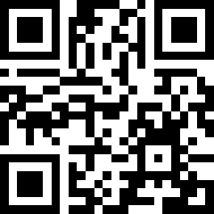
Build the AI development skills employers are looking for.
Learn through hands-on experiences with IBM Bob:
AI-assisted software development
Real-world development workflows
Portfolio-ready projects
Industry-recognized credentials
Scan to explore
IBM Bob in action ↷

