Slide 1

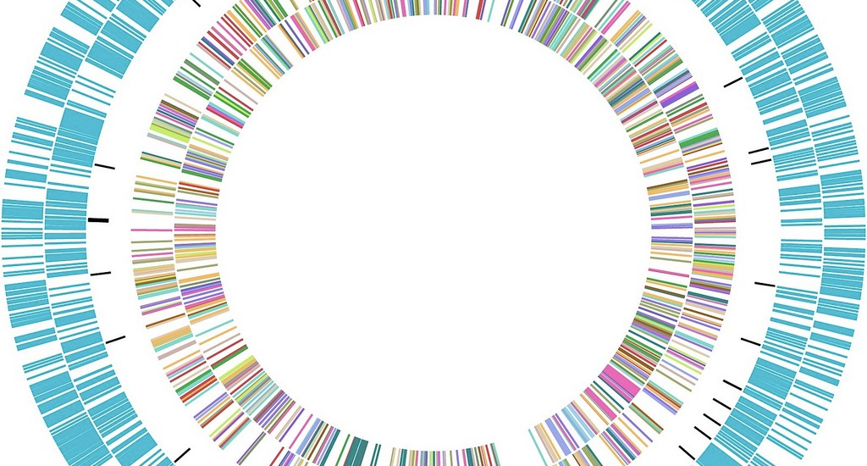

Long-read Sequencing Panel Discussion
Jihe Liu, PhD
Bioinformatics Trainer and Analyst
Harvard Bioinformatics Core
2021-03-10

Slide 2
Long-read Sequencing Overview at Harvard Bioinformatics Core
Our Procedure
My Experience
Ongoing Projects
Initial consult to discuss necessity, platform, budget
Experimental design
Receive data from sequencing core
Analyze data or provide guidance
Identify chimeric RNA
Detect epigenetic modification
Assemble bacterial genome
Map DNA from ancient samples
Circular DNA identification
Genome assembly
Structural variations detection (DEL, INS, INV, DUP, TRANS)
Callers for long-read
Compare to short-read callers

Slide 3
Case Study: Identification of Circular Extrachromosomal DNA
Circular extrachromosomal DNA (normally harboring oncogenes) frequently observed in cancer cells
Computationally challenging to identify full sequence through short-read sequencing
Assembled extrachromosomal DNA with nanopore or PacBio sequencing
Align fastq reads against each other (minimap2)
1st raw assembly (miniasm)
Align fastq reads to raw assembly (minimap2)
Curate the assembly (racon)
Align circular contig to human genome (minimap2)
AC Decarvalho, et al. Nat. Genet. 2018
H Kim, et al. Nat. Genet. 2020

Slide 4
Some Thoughts
Computational tools
No “gold standard” pipeline for many applications yet
Experimental setup
A successful run will need practices, and modification of protocol
Hybrid approach
If data available, hybrid (short-read + long-read) approach for genome assembly and structural variation

