Slide 1

Morgan Stanley App Challenge Mining Seawolves
Burak Firik
Josh Shapiro
Rohan Sundar

Slide 2




Slide 3
App Description
Our App mines Twitter for Analyst recommendations to buy or sell stocks in the capital market. It also analyzes the overall perception or sentiment of the users of twitter towards a particular stock.
The app was coded in Pyhton with PyGTK being used to for an interactive GUI.

Slide 4



Programming

Slide 5

From tweets to twits
StockTwits started as a twitter application
Real-time data
Coined the $TICKER to reference a company in a text-based post

Slide 6
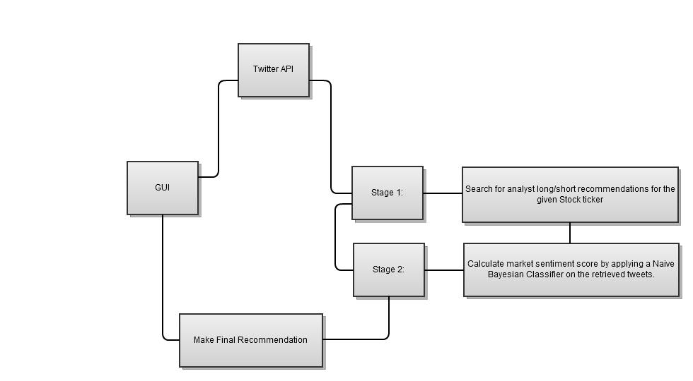

Slide 7
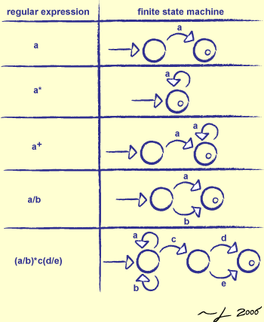
Regular Expression
Source: http://www.cgl.ucsf.edu/Outreach/bmi280/slides/swc/lec/re.html

Slide 8
Market Sentiment Dictionary
RegEx
positive_words = ['buy\b','highs?\b','beats?\b','new\b','good\b','great\b','surprise\b','higher profits?','profits? increase[a-z]*','exceed[a-z]* analysts? expectations?','impressive profitability','analysts? upgrade[a-z]*','bull[a-z]*\b','launch[a-z]*\b','revenues? higher','wins?\b’]
negative_words = ['sell\b','lows?\b','down\b','loss[a-z]*\b','bad\b','analysts? downgrade[a-z]*','low revenues?','bear[a-z]*\b','low expectations?','loses?\b','defaults?\b','avoid\b','sold\b']

Slide 9
MODEL
= number of positive analyst recommendations
= number of negative analyst recommendations

Slide 10
= number of positive words
= number of negative words
= total tweets stage 2 time frame 2

Slide 11
Adjusted for an Arbitrage-free Market
= probability an analyst changes recommendation based on market sentiment
= total tweets stage 1 time frame 1
= time frame 1
= total tweets stage 1 time frame 2
= time frame 2

Slide 12
