Slide 1
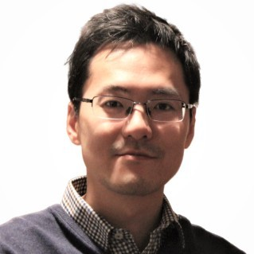




Consultant profile — Peter Huang
RECENT EXPERIENCE
ACHIEVEMENTS
Google Project Management: Professional Certificate
Udacity Self-Driving Car Nano Degree Certificate
SENIOR SOFTWARE ENGINEER, Seeing Machines– (10 months)
Architecting and implementing system health module from customer requirement to production software.
Lead and collaborate with a small team in VN and AU to deliver software release and provide support to customer.
Meet Peter
  SOFTWARE AND SYSTEM ENGINEER
CAPABILITIES
Peter is an innovative and accomplished software and system engineer​. He is passionate about software architecture, leading project team and delivering high quality solution for customers.
Peter demonstrated his research ability, engineering and project management skills through leading various projects from concept to production.
His expertise includes architecting serverless cloud software application, middleware and simulation using MBSE approach. He is also a domain expert in robot planning and navigation.
Senior Software Engineer, Swarm Farm Robotics – (1.5 years)
Researched, developed, architected and release swarmfarm-planning stack, the major backend of Farm Manager App.
The planning software includes algorithms libraries, APIs, tools, in-vehicle service and serverless cloud application, evaluation pipeline and report dashboard, all built from the ground up to fleet production.
The software leverages many AWS cloud services and Container technology, including API Gateway, Lambdas, DynamoDB, S3, Route 53, Cognito, ECR, CloudWatch and Amplify, all deployed via Pulumi​.
SOFTWARE ARCHITECTURE
AWS CLOUD
ROBOTICS & AI RESEARCH
SYSTEM ENGINEERING
PROJECT MANAGEMENT
Lead Software and System Engineer, Bosch Australia – (3 years)
Platform development in Bosch Radar/Video Road Signature – large scale fleet based cloud map creation.
Collaborating with System Engineer in JP to develop eHorizon prototype for L2+ vehicle and demonstrated to OEMs successfully.
Lead research and development of mapping and localization end to end for a multi- million dollar project in automated driving
FIND ME ON LINKEDIN
© Copyright 2023 Endava // Confidential and Proprietary
5

