Slide 1
Git introduction
Haijun Deng

Slide 2
Agenda
General ideas
Basic commands
Working collaboratively
Advanced commands
Underlying
Configuration/Customizing
Comparison with perforce
Related tools

Slide 3

history
Linux kernel
BitKeeper
Linus Torvalds

Slide 4
Requirements (for FREE SOFTWARES)
version control
low cost
simple
security
collaboration

Slide 5
Basic design
backup whole file not incremental
zip and encryption, not flat-text
Store the meta file named as SHA
distributed System
text configuration files
index/stage

Slide 6
General
Version Control System, like Clearcase, perforce and SVN
Distributed Version Control System
Advantages
Free and open source
Fast and small
Implicit backup
Disadvantages
Steep learning curve
Binary files are a big no

Slide 7

Centralized Version Control
perforce is like this

Slide 8
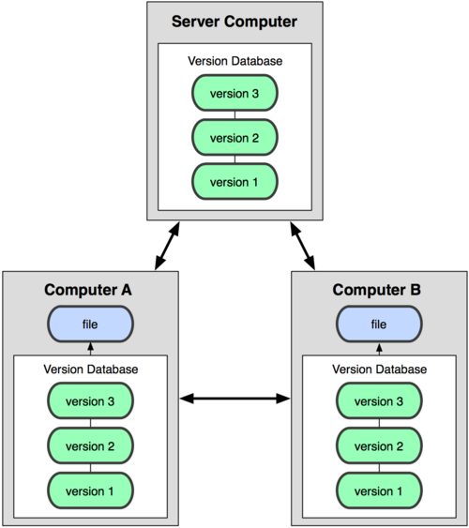
Distributed Version Control

Slide 9
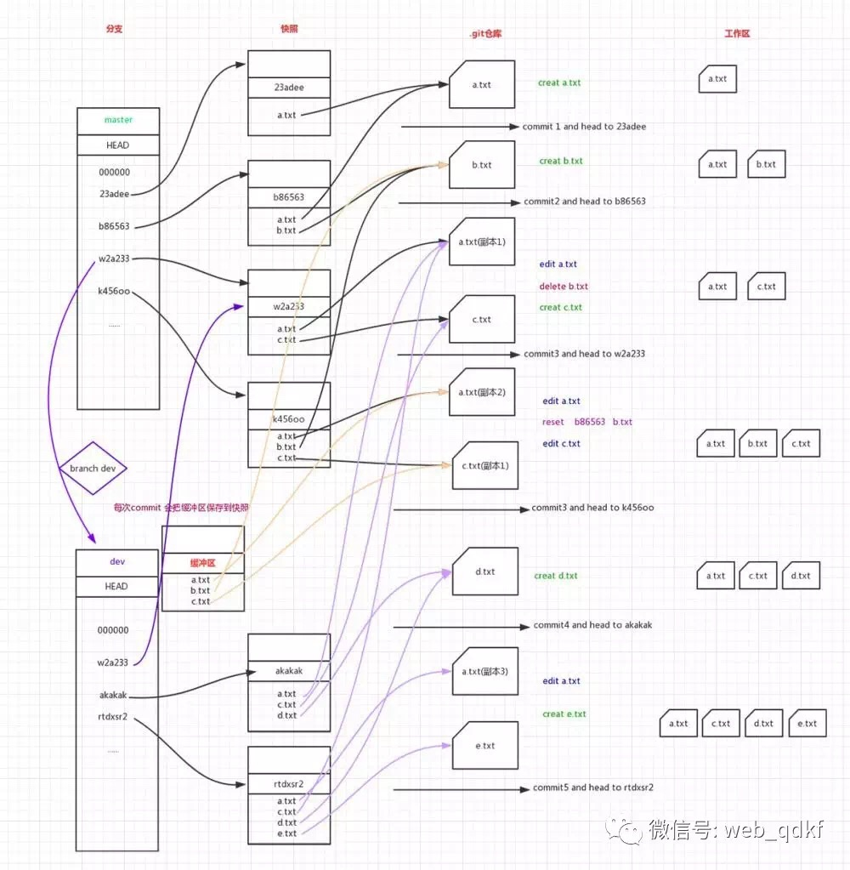
Some important names
blob
tree
head
commit
stage
refs

Slide 10
Basic commands
add
commit
status
log
diff
mv
rm
untracked
modified
staged
resp
add
add
commit

Slide 11
Commands for Working collaboratively
init
clone
push
pull
rebase
fetch
merge
checkout
branch
untracked
modified
staged
repository
remote
add
add
commit
push
clone/fetch/pull

Slide 12
Advanced commands
config
blame
tag
reset
revert
bisect
hash-object
cat-file
gc

Slide 13
Rollback changes
Revert changes un-committed
git checkout -- <filename>
Unstage a Staged File – revert the result of “git add ”
git reset HEAD <filename>
Revert to a commit – revert the result of “git commit ”
git resert <SHA>
Revert changes committed and pushed – revert the result of “git push ”
git revert <SHA> and push again
Undo the rollback
git reflog
Stop tracing a file
git rm –cached <file>

Slide 14
Quick practice
Install git on PC or login build server
Start git bash (only on windows)
Create an empty folder
git init
greate a txt file
git status
git add
git status
git cat-file –p <SHA>

Slide 15
Quick practice - continued
git commit
git status
git gui
git branch
git branch dev master
ls -ltr .git/refs/heads/
git gui
Change on branch dev and commit and check git gui again
Switch back to master branch
Change on branch master and commit and check git gui again

Slide 16
Quick practice - continued
git merge dev
Fix the conflicts
git add .
git commit
git gui

Slide 17
Compare perforce and git
Perforce | git
Get Latest Revision | pull
checkout
shelf | stash
Mark for Add | add
submit | commit + push
rollback | revert
changelist | changelist (not popular)

Slide 18
Git on server
ssh
https
git

Slide 19
Related tools
Github
Stash
jira

Slide 20
Not included
Git merge
Setup git server
Customizing git
Git hooks
Git attributes
Reference
Pro Git https://git-scm.com/book/en/v2

