Slide 1
Git Advanced
Haijun Deng

Slide 2
Agenda
General ideas
Basic commands
Working collaboratively
Advanced commands
Underlying
Configuration/Customizing
Comparison with perforce

Slide 3

history
Free Software
Linux kernel
Linus Torvalds
2005
2.16 (latest)
Junio C Hamano (Now)

Slide 4
Requirements (for FREE SOFTWARES)
version control
low cost
simple
security
collaboration

Slide 5
Basic design
backup whole file not incremental
zip and encryption, not flat-text
Store the meta file named as SHA
distributed System
text configuration files

Slide 6
Advantage vs disadvantage
Advantages
Free and open source
Fast and small
Easy to use
Less dependency to network
Disadvantages
Initial clone is slow
Slow to handle a lot (over several million) of files
Native merge is not so powerful
Additional storage required

Slide 7

Centralized Version Control
Clearcase and perforce

Slide 8
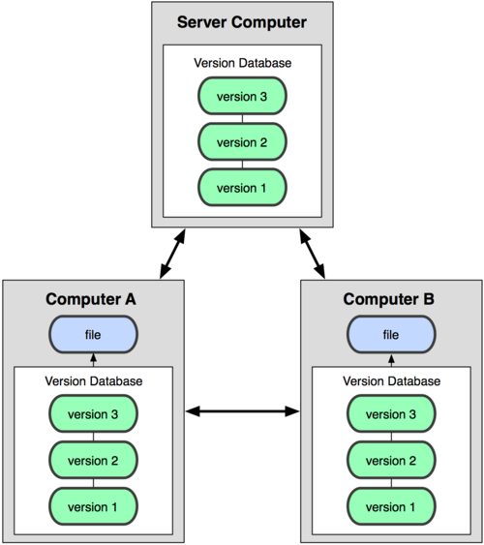
Distributed Version Control
svn and git

Slide 9
Basic commands
add
commit
status
log
diff
mv
rm
checkout –b (create branch)
checkout (switch branch)
untracked
modified
staged
resp
add
add
commit

Slide 10
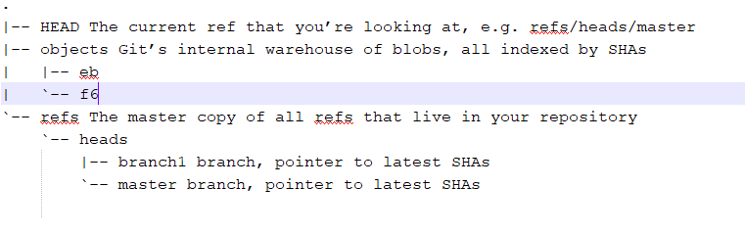
Git dir

Slide 11
Some important names
.git/HEAD
.git/index
head
branch
objects
blob
tree
Commit
tag
stage
.git/refs/heads/master
.git/refs/heads/branch1
.git/objects/<commit>
.git/objects/<older_commit>
.git/objects/<tree>
.git/objects/<old_tree>
.git/objects/<blob>
.git/objects/<blob>
.git/objects/<blob>
.git/objects/<old_blob>
.git/objects/<new_blob>

Slide 12
Behind git commands
.git/HEAD
.git/index
git add
git commit
git checkout
git rm
.git/refs/heads/master
.git/refs/heads/branch1
.git/objects/<commits>
.git/objects/<new_commits>
.git/objects/<tree>
.git/objects/<new_tree>
.git/objects/<blob>
.git/objects/<new_blob>
.git/objects/<blob2>

Slide 13
Commands for Working collaboratively
init (create a local repository from scratch)
clone (create repository from remote)
push (sent changes to remote)
pull = fetch + merge
fetch
merge
rebase
remote (list the remote connections)
branch (list local branch)
branch –r (list remote branch)
branch –a (list all branch)
untracked
modified
staged
repository
remote
add
add
commit
push
clone/fetch/pull

Slide 14
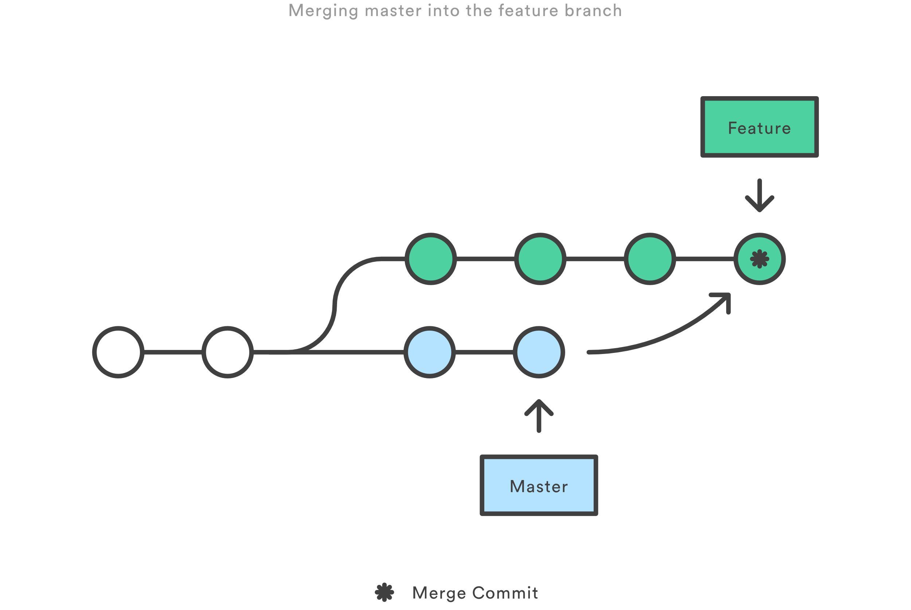
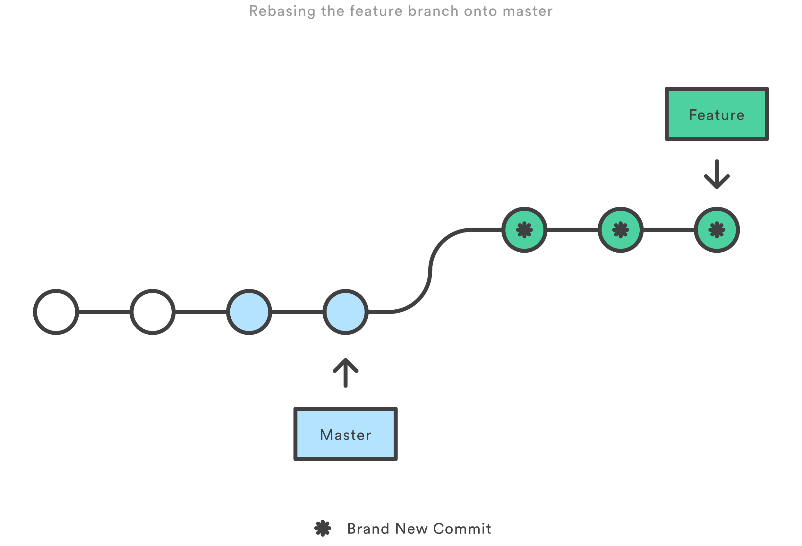
Merge vs rebase
Merge
This creates a new “merge commit” in the feature branch
Benefits: it’s a non-destructive operation
Shorts:
the feature branch will have an extra merge commit
Undo
git reset --hard ORIG_HEAD
Rebase
moves the entire feature branch to begin on the top of the master branch
Benefits: get a cleaner project history
Risks:
re-writing project history can be risky
loses the context provided by a merge commit
The golden rule of rebase
never use it on public branches
Interactive Rebasing
Undo
git reflog
git reset --hard HEAD@{3}

Slide 15
Rollback changes
Revert changes to discard changes in working directory
git checkout -- <filename>
Unstage a staged File – revert the result of “git add ”
git reset HEAD <filename>
Revert to a commit – revert the result of “git commit ”
git revert <SHA> (option 1)
git reset --hard <SHA> (option 2 if no un-committed word)
git stash; git reset --hard <SHA>; git stash pop (option 3 if un-committed word)

Slide 16
Checkout, reset and revert
Head
git checkout HEAD~2
git checkout –
git checkout <current_branch>
git reset HEAD~2
On private branch
git reflog, git reset <object_id>
git revert HEAD~2
On public branch
f1
f2
f1’
f2’
Head
Head
f1
f2
f1’
f2’
f2
f1’
f2’
f2

Slide 17
Git config
git config --global user.name “Haijun Deng"
git config --global user.email haijun.deng@spirent.com
git config --global core.editor emacs
git config --global color.ui false
Configure origin and branch
Customize merge and diff tools
Prepare extMerge and extDiff
git config --global merge.tool extMerge
git config --global mergetool.extMerge.cmd 'extMerge "$BASE" "$LOCAL" "$REMOTE" "$MERGED"'
git config --global mergetool.extMerge.trustExitCode false
git config --global diff.external extDiff
Write in .git/config

Slide 18
Git hooks
Client-Side Hooks
Committing-Workflow Hooks
Email Workflow Hooks
Other Client Hooks
Server-Side Hooks
Example

Slide 19
Git Attributes
Used for these settings, which can be specified for a path, file type
.gitattributes file in one of your directories or in the .git/info/attributes
Use cases:
Provide specific diff tools for specific file type
*.png diff=exif
git config diff.exif.textconv exiftool
diff --git a/image.png b/image.png
index 88839c4..4afcb7c 100644
--- a/image.png
+++ b/image.png
@@ -1,12 +1,12 @@
ExifTool Version Number : 7.74
-File Size : 70 kB
-File Modification Date/Time : 2009:04:21 07:02:45-07:00
+File Size : 94 kB
+File Modification Date/Time : 2009:04:21 07:02:43-07:00

Slide 20
Git ignore
gitignore file specifies intentionally untracked files that Git should ignore
object files
Libraries
executables
How to ignore files
.gitignore file in the current directory and sub(works in all repositories), not for commited
.git/info/exclude (only works in local repository)
An Example
*.html # ignore generated html files,
!foo.html # except foo.html which is maintained by hand
vmlinux* # ignore all files starting with vmlinux, such as vmlinux.so
foo/ # ignore all files and directories under foo
gitignore file examples for different language from github gitignore project at here

Slide 21
More Advanced commands
blame Show what revision and author last modified each line of a file
tag tag specific points in history, e.g. release point
bisect Use binary search to find the commit that introduced a bug
hash-object Compute object ID
cat-file Provide content or type and size information for repository objects
gc Cleanup unnecessary files
reflog read reference log, every changes in local repository
cherry-pick pick up one or more existing commits from other branch

Slide 22
Compare perforce and git
Perforce | git
Get Latest Revision | pull
checkout
shelf | stash
Mark for Add | add
submit | commit + push
rollback | revert
changelist | changelist (not popular)

Slide 23
Quick practice
Install git on PC or login build server
Start git bash (only on windows)
Create an empty folder
git init
greate a txt file
git status
git add
git status
git cat-file –p <SHA>

Slide 24
Quick practice - continued
git commit
git status
git gui
git branch
git branch dev master
ls -ltr .git/refs/heads/
git gui
Change on branch dev and commit and check git gui again
Switch back to master branch
Change on branch master and commit and check git gui again

Slide 25
Quick practice - continued
git merge dev
Fix the conflicts
git add .
git commit
git gui

Slide 26
reference
https://github.com/git/git
https://www.atlassian.com/git/tutorials/what-is-git
Pro-Git https://git-scm.com/book/en/v2

