Slide 1
Docker Introduction
Deng Haijun 11/20/2016

Slide 2
Agenda
Container introduction
Docker introduction
Docker installation
Docker commands
Docker images
Docker tools
Docker shortcoming

Slide 3
Container in words
Seems like vm
Light-weight vm
Based on the following Linux Tech
namespace http://coolshell.cn/articles/17010.html
cgroup http://coolshell.cn/articles/17049.html
aufs http://coolshell.cn/articles/17061.html
DeviceMap http://coolshell.cn/articles/17200.html
For DevOps

Slide 4
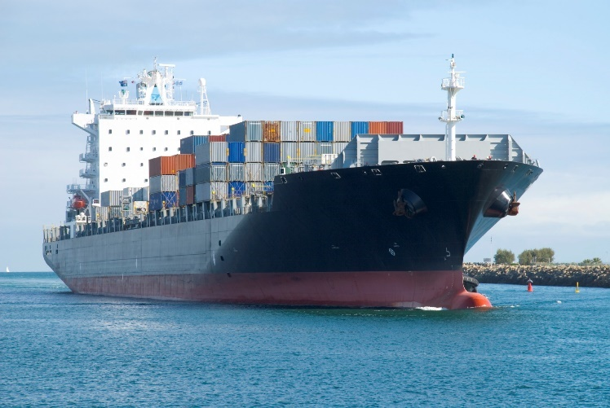
Comparison
OS is a large ship
VM is a “barge”
container is “container”
program is goods

Slide 5
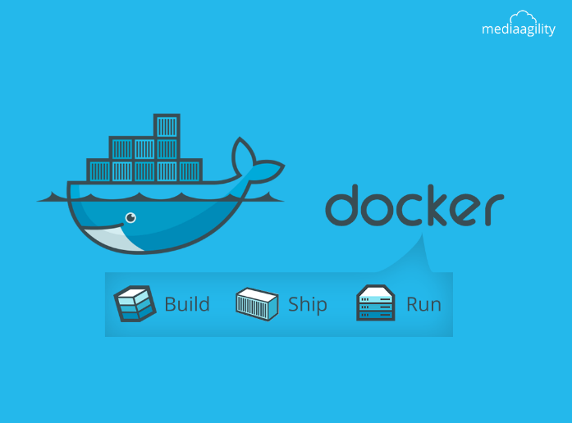
Docker
a brand of container
Like Redhat to Linux
Provide “ports”, "ship", “container”, like Maersk

Slide 6
Installation
On Windows 10
On Older Windows
\\10.61.0.16\departments\STC\software\docker
On MAC
On Linux

Slide 7
Demo via Kitematic
Search
Create (pull and run)
Start
Stop
Exec

Slide 8
Run cmds in containers
Run system commands
hostname, id, and ps –ef
and try rpm and ifconfig
Open and Save files
Open web pages via nginx container
Process Tree
dockerd -> (1) docker-containerd -> (n) docker-containerd-shim

Slide 9
Port and Volume mapping
Port mapping with -p
Volume mapping with -v
Example
docker run --name my-nginx -p 80:1080 -v /home/c_practice/docker_web:/usr/share/nginx/html/my:ro -d nginx

Slide 10
Resource Management
Limit CPU to use
docker run -it --rm --cpuset=0,1 nginx --cpu 2
Limit memory to use
docker run -it --rm -m 128m nginx
Limit Block devices to use
Limiting read/write speed
Please read docker run –help for more

Slide 11
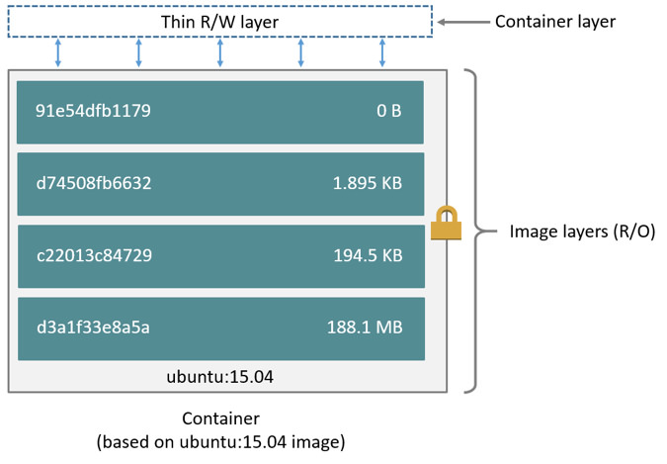
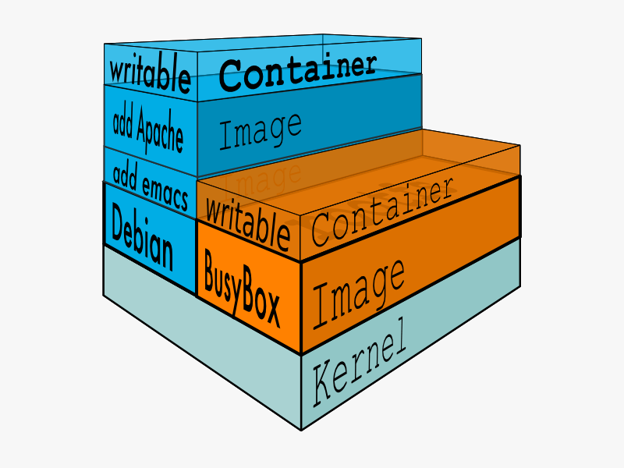
Containers and Images
image references a list of read-only layers that represent filesystem differences
When you create a new container, you add a new, thin, writable layer on top of the underlying stack
Stored at /var/lib/docker/aufs/
Mount at /sys/fs/aufs/si_*

Slide 12
Repository and Registry
Repository is a group of images with different tags
You can think them as one group of rpms, like STC
Registry is a warehouse to store Repository
You can think them as the file server, such as maingard

Slide 13
Docker Commands
Images, repository related commands
pull, images, rmi, build, push, commit
Container related commands
run, start, stop, ps, rm, pause, unpause, update, logs
Registry, Configuration and Logging
Login, logout, history, version

Slide 14
Build image from scratch
Write a Dockerfile
FROM docker/whalesay:latest
RUN apt-get -y update && apt-get install -y fortunes
CMD /usr/games/fortune -a | cowsay
Build an image from your Dockerfile
docker build -t docker-whale .
Learn about the build process
Run your new docker-whale

Slide 15
Docker Hub
a cloud-based registry service
Create your own account at https://hub.docker.com/ before you start
Search and learn repository

Slide 16
Local Registry
Start a registry container
docker run -d -p 5000:5000 --restart=always --name registry registry:2
Create Repository on local registry
docker tag ubuntu localhost:5000/ubuntu
Upload images to local registry
docker push localhost:5000/Ubuntu
Get images from local registry
docker pull localhost:5000/ubuntu

Slide 17
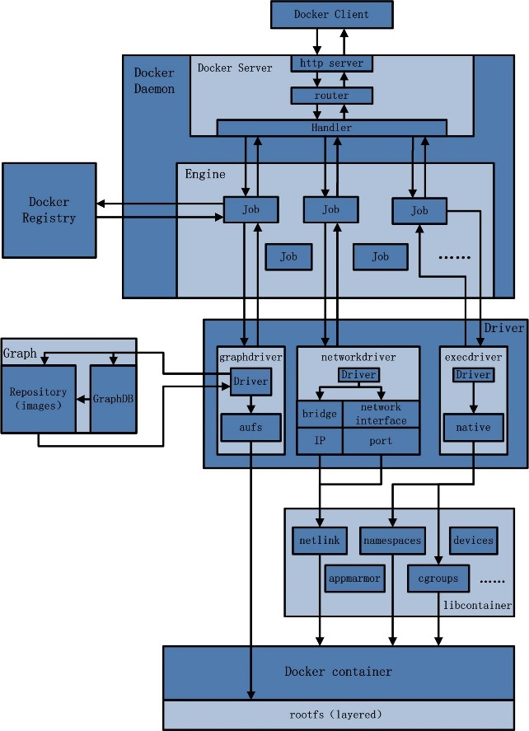
Docker Architecture

Slide 18
Docker Kitematic
An open source project built to simplify and streamline using Docker on a Mac or Windows.
Kitematic automates the Docker installation and setup process and provides an intuitive graphical user interface (GUI) for running Docker containers.

Slide 19
Docker Compose
Compose is a tool for defining and running multi-container Docker applications.
With Compose, you use a Compose file to configure your application’s services.
Then, using a single command, you create and start all the services from your configuration.

Slide 20
Compose file example
version: '2'
services:
web:
build: .
ports:
- "5000:5000"
volumes:
- .:/code
- logvolume01:/var/log
links:
- redis
redis:
image: redis
volumes:
logvolume01: {}

Slide 21
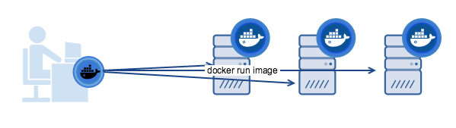
Docker Machine
Install and run Docker on Mac or Windows
Provision and manage multiple remote Docker hosts
Provision Swarm clusters

Slide 22
Docker Machine Commands
create Create a machine
ls List machines
start Start a machine
stop Stop a machine
rm Remove a machine
inspect Inspect information about a machine

Slide 23
Docker Swarm
A swarm is a cluster of Docker Engines where you deploy services.
The cluster management and orchestration features embedded in the Docker Engine
When you run the Engine in swarm mode, you orchestrate services.
Node, Services and tasks

Slide 24
Docker Swarm Commands
init initialize a swarm
join Join a swarm as a node and/or manager
join-token Manage join tokens
update Update the swarm
leave Leave the swarm (workers only)

Slide 25
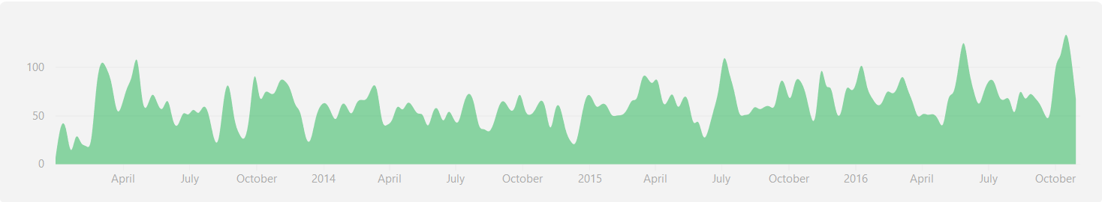
Docker Source Code
Open Source stored on github at https://github.com/docker/docker
Write in go language
Still in hot state

Slide 26
Docker Shortcoming
More and more complex
Security concern
Not accepted in industry
Standardization

Slide 27
Docker Vs CoreOS Rocket
Rocket was started by CoreOS at 2014
Sampler than Docker
Only executable not daemon
Support less host OS

Slide 28
Discussion
Q&A
Thanks

