Slide 1
Git Advanced
Haijun Deng

Slide 2
Agenda
General ideas
Basic commands
Working collaboratively
Advanced commands
Underlying
Configuration/Customizing
Comparison with perforce
Related tools

Slide 3

history
Linux kernel
BitKeeper
Linus Torvalds

Slide 4
Requirements (for FREE SOFTWARES)
version control
low cost
simple
security
collaboration

Slide 5
Basic design
backup whole file not incremental
zip and encryption, not flat-text
Store the meta file named as SHA
distributed System
text configuration files
index/stage

Slide 6
General
Version Control System, like Clearcase, perforce and SVN
Distributed Version Control System
Advantages
Free and open source
Fast and small
Implicit backup
Disadvantages
Handle a lot (over several million) of files
Binary files are a big no

Slide 7

Centralized Version Control
perforce is like this

Slide 8
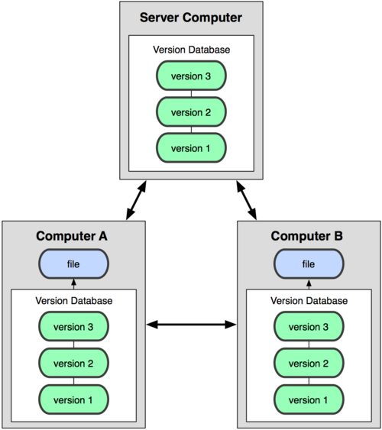
Distributed Version Control

Slide 9
Basic commands
add
commit
status
log
diff
mv
rm
checkout –b (create branch)
checkout (switch branch)
untracked
modified
staged
resp
add
add
commit

Slide 10
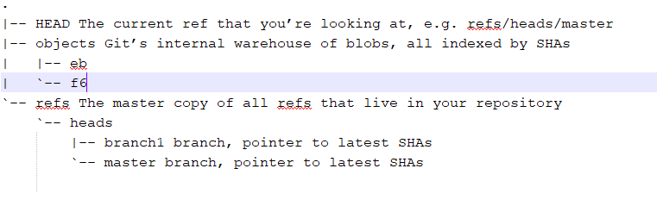
Git dir

Slide 11
Some important names
.git/HEAD
.git/index
head
branch
commit
tree
blob
stage
.git/refs/heads/master
.git/refs/heads/branch1
.git/objects/<comments>
.git/objects/<older_comments>
.git/objects/<tree>
.git/objects/<old_tree>
.git/objects/<blob>
.git/objects/<blob>
.git/objects/<blob>
.git/objects/<old_blob>
.git/objects/<new_blob>

Slide 12
Behind git commands
.git/HEAD
.git/index
git add
git commit
git checkout
git rm
.git/refs/heads/master
.git/refs/heads/branch1
.git/objects/<comments>
.git/objects/<new_comments>
.git/objects/<tree>
.git/objects/<new_tree>
.git/objects/<blob>
.git/objects/<new_blob>
.git/objects/<blob2>

Slide 13
Commands for Working collaboratively
init (create a local repository from scratch)
clone (create repository from remote)
push (sent changes to remote)
pull = fetch + merge
fetch
merge
rebase
remote (list the remote connections)
branch (list local branch)
branch –r (list remote branch)
branch –a (list all branch)
untracked
modified
staged
repository
remote
add
add
commit
push
clone/fetch/pull

Slide 14
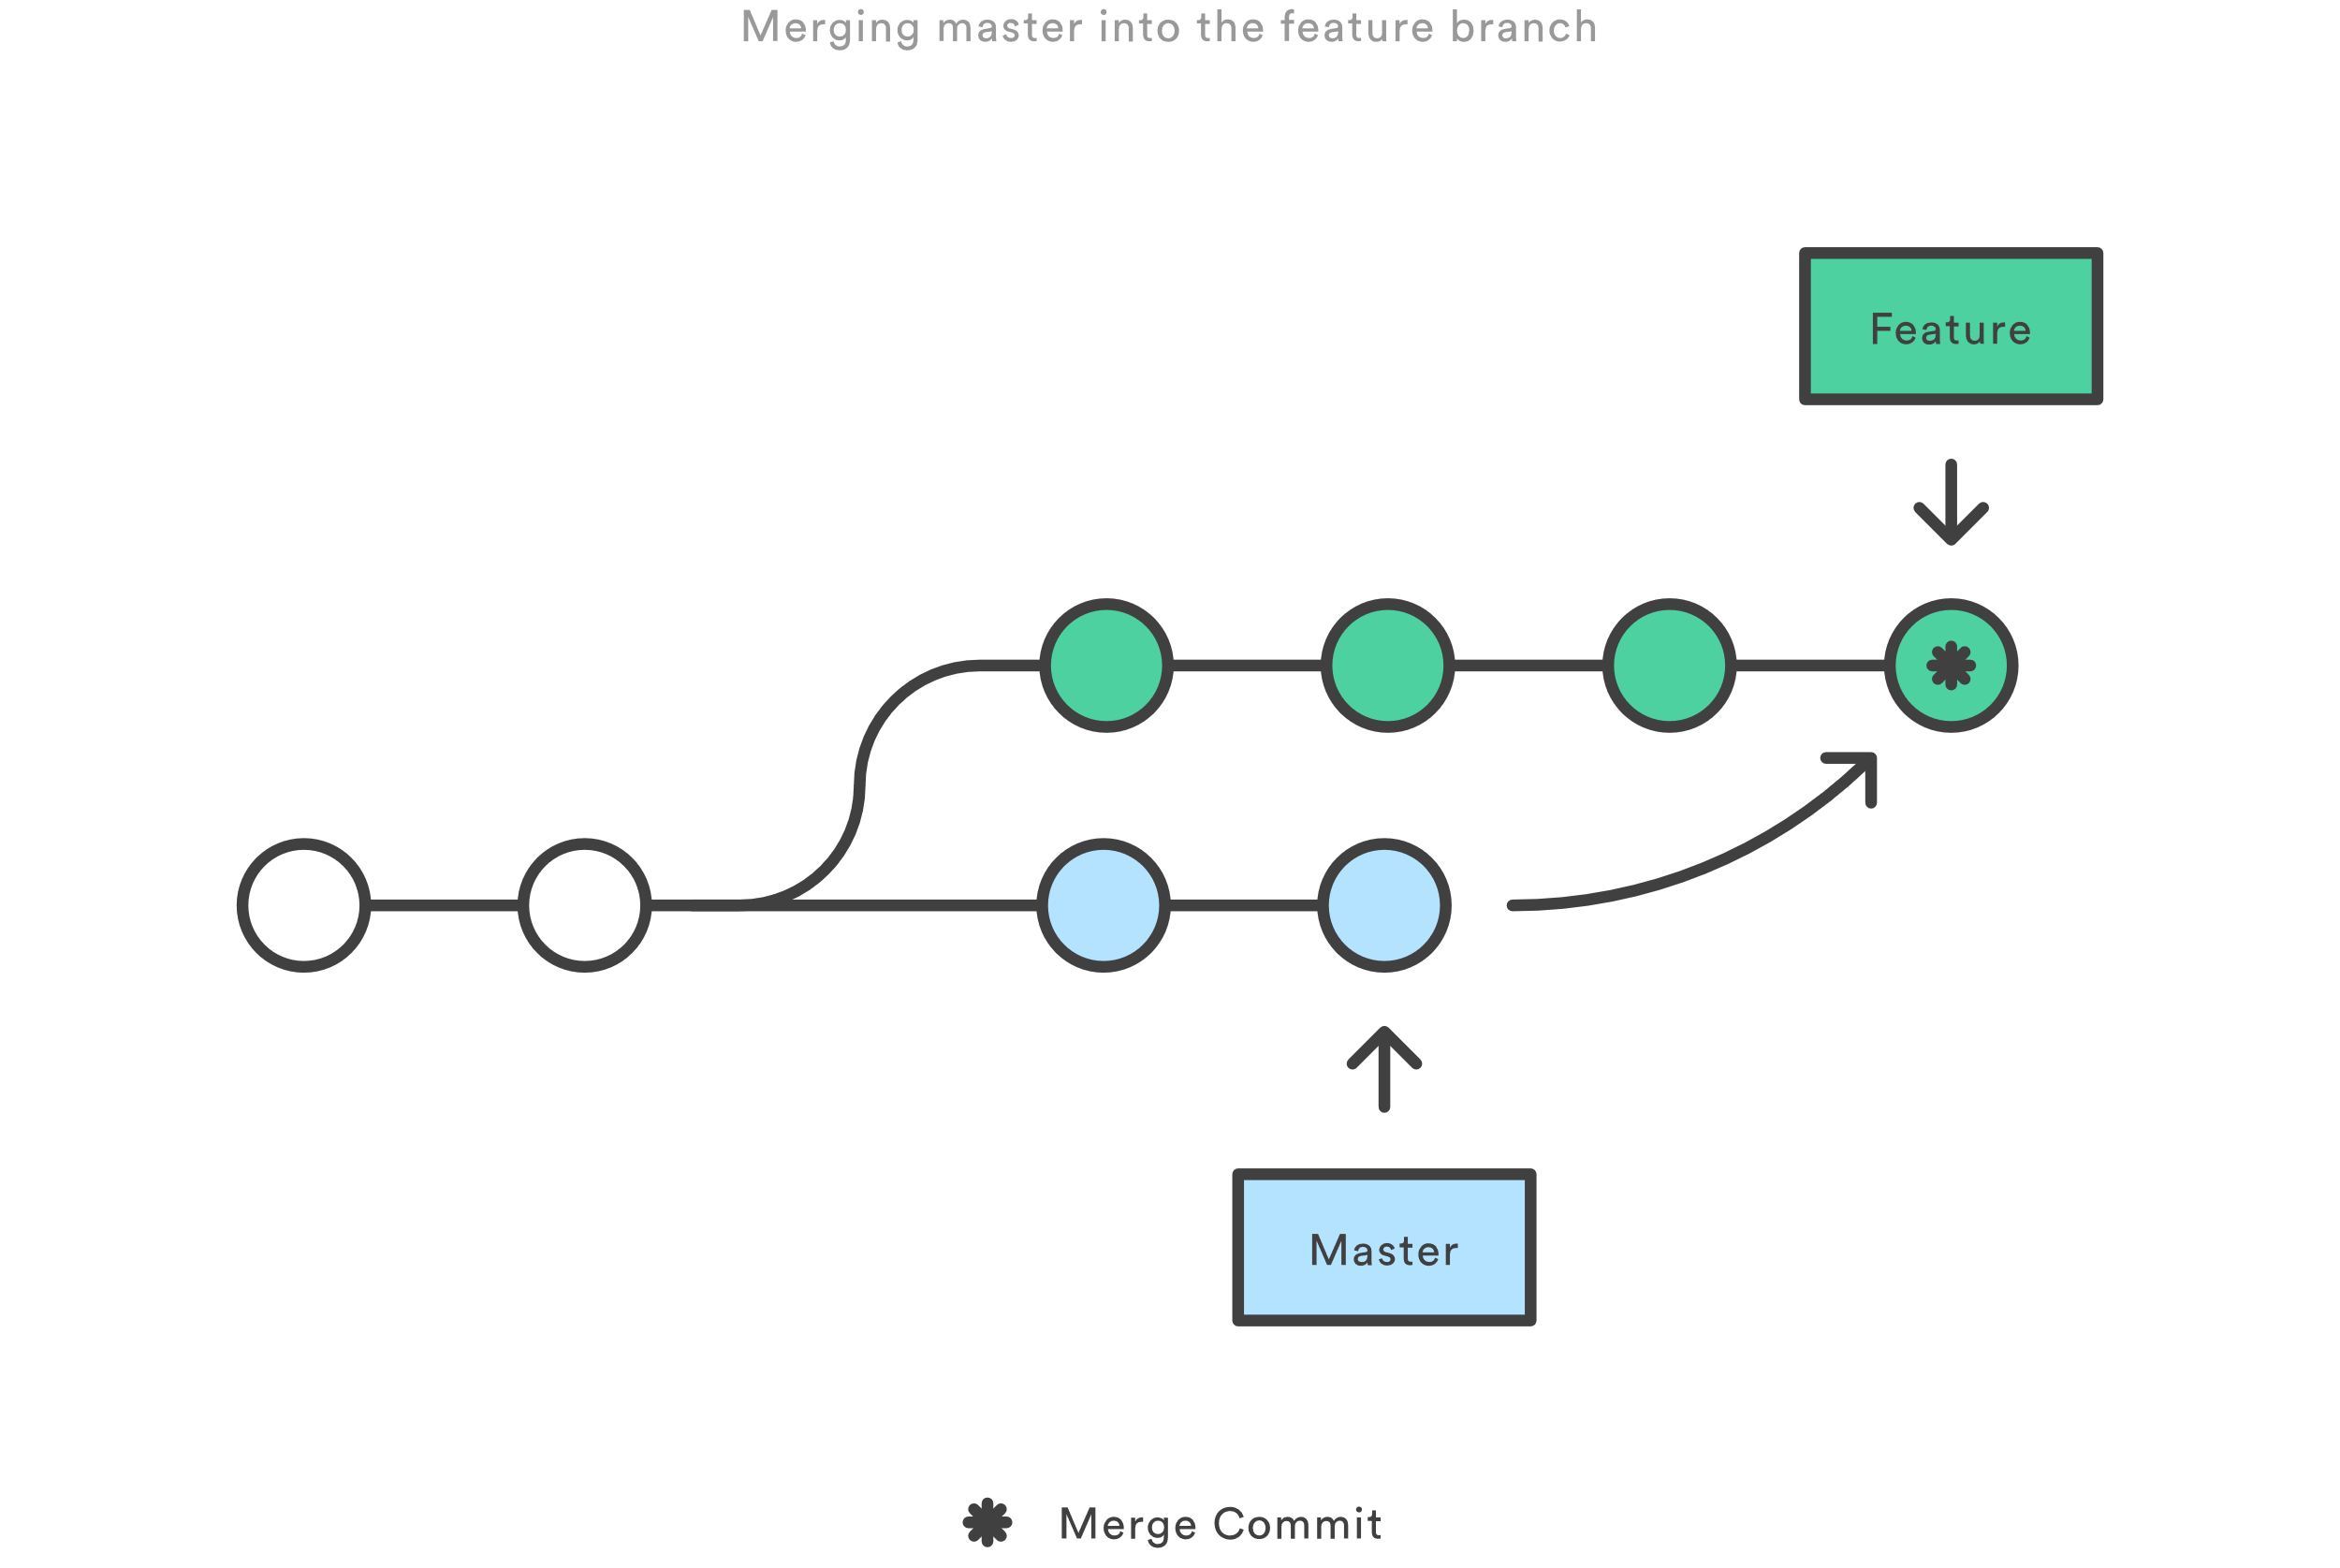
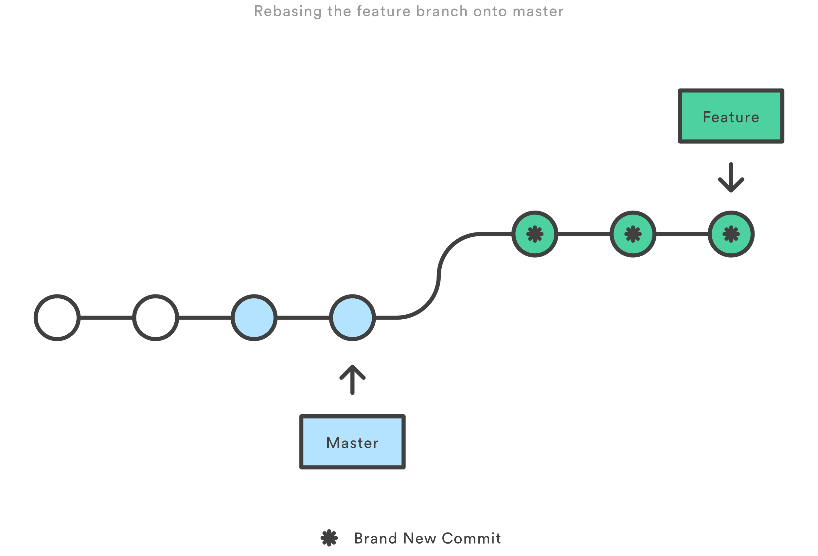
Merge vs stage
Merge
This creates a new “merge commit” in the feature branch
Benefits: it’s a non-destructive operation
Shorts:
the feature branch will have an extraneous merge commit
Rebase
moves the entire feature branch to begin on the tip of the master branch
Benefits: get a much cleaner project history
Risks:
re-writing project history can be risky
loses the context provided by a merge commit
The golden rule of rebase
never use it on public branches
Interactive Rebasing

Slide 15
Advanced commands
config
blame
tag
reset
revert
bisect
hash-object
cat-file
gc

Slide 16
Rollback changes
Revert changes un-committed
git checkout -- <filename>
Unstage a Staged File – revert the result of “git add ”
git reset HEAD <filename>
Revert to a commit – revert the result of “git commit ”
git resert <SHA> (option 1)
git reset --hard <SHA> (option 2 if no un-committed word)
git stash; git reset --hard <SHA>; git stash pop (option 3 if un-committed word)
Revert changes committed and pushed – revert the result of “git push ”
git revert <SHA1> <SHA2> <SHA3> (revert 3 comments)
git revert <SHA1>. .<SHA3> (revert comments between SHA1 and SHA3)
git revert HEAD~2. .HEAD (revert head 2 comments)
git revert –m 1 <SHA1> (revert a merge)

Slide 17
Checkout, reset and revert
Head
git checkout HEAD~2
git reset HEAD~2
git revert HEAD~2
f1
f2
f1’
f2’
Head
Head
f1
f2
f1’
f2’
f2
f1’
f2’
f2

Slide 18
Git hooks
Client-Side Hooks
Committing-Workflow Hooks
Email Workflow Hooks
Other Client Hooks
Server-Side Hooks
Example

Slide 19
gitignore
gitignore file specifies intentionally untracked files that Git should ignore
object files
Libraries
executables
How to ignore files
.gitignore file in the directory (works in all repositories)
.git/info/exclude (only works in local repository)
An Example
*.html # ignore generated html files,
!foo.html # except foo.html which is maintained by hand
vmlinux* # ignore all files starting with vmlinux, such as vmlinux.so
foo/ # ignore all files and directories under foo
gitignore file examples for different language from github gitignore project at here

Slide 20
Quick practice
Install git on PC or login build server
Start git bash (only on windows)
Create an empty folder
git init
greate a txt file
git status
git add
git status
git cat-file –p <SHA>

Slide 21
Quick practice - continued
git commit
git status
git gui
git branch
git branch dev master
ls -ltr .git/refs/heads/
git gui
Change on branch dev and commit and check git gui again
Switch back to master branch
Change on branch master and commit and check git gui again

Slide 22
Quick practice - continued
git merge dev
Fix the conflicts
git add .
git commit
git gui

Slide 23
Compare perforce and git
Perforce | git
Get Latest Revision | pull
checkout
shelf | stash
Mark for Add | add
submit | commit + push
rollback | revert
changelist | changelist (not popular)

Slide 24
Git on server
ssh
https
git

Slide 25
Related tools
Github
Stash
jira

Slide 26
Not included
Git merge
Setup git server
Customizing git
Git hooks
Git attributes
Reference
Pro Git https://git-scm.com/book/en/v2

