Slide 1
C++11: An Overview
C++11 Features Every C++ Developer Should Use

Slide 2
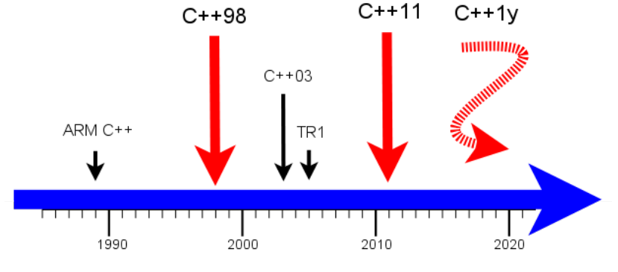
Overview
History & Timeline
The past: C++98, first ISO Standard
C++03: technical corrigendum of C++98
TR1: technical report 1
The present: C++11, current* ISO Standard
core language
multithreading
standard library
The future: C++1y(14, 17)

Slide 3
Features new to C++ 11
C++ features that should be a norm nowadays
auto
nullptr
Range-based for loops
override and final
Strongly-typed enums
Smart pointers
Lambdas
non-member begin() and end()
static_assert and type traits
Move semantics

Slide 4
Deduction of the type with auto
Simple and less code is better
The compiler determines the type:
auto myString = "my String"; // C++11
auto myInt = 5; // C++11
auto myDouble = 3.14; // C++11
Get a iterator on the first element of a vector:
vector<int> v;
vector<int>::iterator it1 = v.begin(); // C++98
auto it2 = v.begin(); // C++11
Definition of a function pointer:
int add(int a, int b){ return a+b; };
int (*myAdd1)(int, int) = add; // C++98
auto myAdd2 = add; // C++11
myAdd1(2, 3) == myAdd2(2,3);
Notes:
Was used for storage duration specification before but now is a sort of placeholder for a type
Using auto usually means less code (unless your type is int which is one letter shorter). Think of iterators in STL that you always had to write while iterating over containers. It makes obsolete creating typedefs just for the sake of simplicity.

Slide 5
Deduction of the type with decltype
Simple and less code is better
The compiler determines the type of an expression:
decltype("str") myString= "str"; // C++11
decltype(5) myInt= 5; // C++11
decltype(3.14) myFloat= 3.14; // C++11
decltype(myInt) myNewInt= 2011; // C++11
int add(int a,int b){ return a+b; };
decltype(add) myAdd= add; // (int)(*)(int, int) // C++11
myAdd(2,3) == add(2,3);

Slide 6
decltype VS auto
Difference
//const 与auto和decltype
const int a(4);
auto aa(a);//int
const auto aa2(a);//const int 可以通过加上const使得aa2被顶层const修饰
decltype(a) ad (4);//const int
const decltype(a) ad2(4);//const 也可以加但是多余
const int*a1(&a);
auto a1a(a1);
//const int * auto能够识别底层const
decltype(a1) a1d;//const int *
//constexpr 与auto和decltype
constexpr int b(4);
auto ba(b);//int
decltype(b) bd (4);//const int
//bd并不解释为decltype int 类型而是 const int类型。这正说明decltype是const一种特殊情况
// &与auto和decltype
const int &d(4);
struct my2 {
auto da(d);//auto变量不能放到结构体里面
};
auto da(d);//int 通过表达式结果的类型推断
struct my {
decltype(d) dd;
};
cout << sizeof(my) << endl;//4
decltype(d) dd(4);//const int & decltype与表达式的类型密切相关
//[] 与auto和decltype
int e[5];
auto ea(e);//int * 编译器最终将[]解析成指针同时auto又是通过表达式结果的类型推断
decltype(e) ed;//int ed[5]
//() 与auto和decltype
int f();
auto fa(f);//int (*fa)()
decltype(f) fd;//int fd();
//Forwarding function
template< typename LHS, typename RHS>
auto AddingFunc(const LHS &lhs, const RHS &rhs) -> decltype(lhs+rhs)
{return lhs + rhs;}

Slide 7
The null pointer literal nullptr
Removal implicit conversion to integral types
Implicit conversions exists
nullptr to null pointer value of any pointer type
nullptr to any pointer-to-member types
nullptr to bool (as false)
0 is still a valid null pointer value for backward compatibility
void foo(int* p) {}
void bar(std::shared_ptr<int> p) {}
int* p1 = NULL;
int* p2 = nullptr;
if(p1 == p2) { }
foo(nullptr);
bar(nullptr);
bool f = nullptr;
int i = nullptr; // error: A native nullptr can only be converted to bool or, using reinterpret_cast, to an integral type

Slide 8
Range-based for loops
No worry about indexes, iterators or number of elements anymore
"foreach" paradigm of iterating over collections
C-like arrays
Initializer lists
Anything for which the non-member begin() and end() functions are overloaded
std::map<std::string, std::vector<int>> map;
std::vector<int> v;
v.push_back(1);
v.push_back(2);
v.push_back(3);
map["one"] = v;
for(const auto& kvp : map)
{
std::cout << kvp.first << std::endl;
for(auto v : kvp.second)
{
std::cout << v << std::endl;
}
}
int arr[] = {1,2,3,4,5};
for(int& e : arr)
{
e = e*e;
}
D1 x;
D2 y;
B* px = &x;
B* py = &y;
for (auto& e : { px, py })
std::cout << e->fun() << "\n";

Slide 9
Override and final
A way to describe your intentions
override, to indicate that a method is supposed to be an override of a virtual method in a base class
final, to indicate that a derived class shall not override a virtual method
class B
{
public:
virtual void f(int) {std::cout << "B::f" << std::endl;}
};
class D : public B
{
public:
virtual void f(int) override final {std::cout << "D::f" << std::endl;}
};
class F : public D
{
public:
virtual void f(int) override {std::cout << "F::f" << std::endl;} // error };

Slide 10
Strongly-typed enums
Fix drawbacks of "Traditional" enums
"Traditional" enums
Name collisions(export their enumerators in the surrounding scope)
Implicitly converted to integral types
Cannot have a user-specified underlying type
Strongly-typed enums
enum class keywords
No longer export their enumerators in the surrounding scope
No longer implicitly converted to integral types
Can have a user-specified underlying type
enum class Options {None, One, All};
Options o = Options::All;
Notes:
introducing compatibility problems
cannot be forward declared

Slide 11
Smart pointers
Similar BOOST smart pointers
unique_ptr
shared_ptr
weak_ptr
void foo(int* p)
{
std::cout << *p << std::endl;
}
std::unique_ptr<int> p1(new int(42));
std::unique_ptr<int> p2 = std::move(p1); // transfer ownership
if(p1)
foo(p1.get());
(*p2)++;
if(p2)
foo(p2.get());
auto p = std::make_shared<int>(42);
Notes:
unique_ptr: should be used when ownership of a memory resource does not have to be shared (it doesn't have a copy constructor), but it can be transferred to another unique_ptr (move constructor exists).
shared_ptr: should be used when ownership of a memory resource should be shared (hence the name).
weak_ptr: holds a reference to an object managed by a shared_ptr, but does not contribute to the reference count; it is used to break dependency cycles (think of a tree where the parent holds an owning reference (shared_ptr) to its children, but the children also must hold a reference to the parent; if this second reference was also an owning one, a cycle would be created and no object would ever be released).

Slide 12
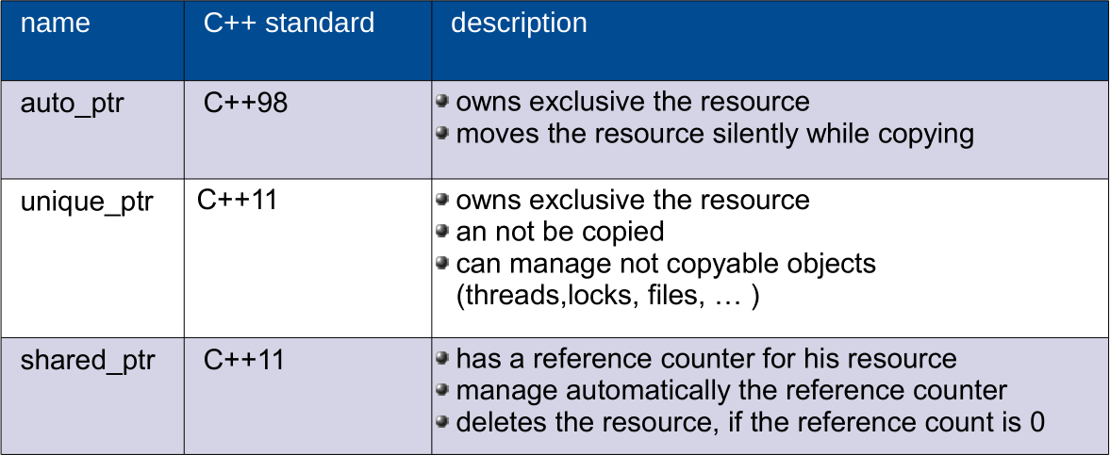
Smart pointers
lifecycle management
Notes:
unique_ptr: should be used when ownership of a memory resource does not have to be shared (it doesn't have a copy constructor), but it can be transferred to another unique_ptr (move constructor exists).
shared_ptr: should be used when ownership of a memory resource should be shared (hence the name).
weak_ptr: holds a reference to an object managed by a shared_ptr, but does not contribute to the reference count; it is used to break dependency cycles (think of a tree where the parent holds an owning reference (shared_ptr) to its children, but the children also must hold a reference to the parent; if this second reference was also an owning one, a cycle would be created and no object would ever be released).

Slide 13
Lambdas
Anonymous functions
A powerful feature borrowed from functional programming
Can be used wherever a function object or a functor or a std::function is expected
Lambda functions
are functions without name
define their functionality right in place
can be copied like data
Lambda functions should be
concise
self explaining
std::vector<int> v;
v.push_back(1);
v.push_back(2);
v.push_back(3);
std::for_each(std::begin(v), std::end(v), [](int n) {std::cout << n << std::endl;});
auto is_odd = [](int n) {return n%2==1;};
auto pos = std::find_if(std::begin(v), std::end(v), is_odd);
if(pos != std::end(v))
std::cout << *pos << std::endl;
Notes:
▪ Lambda functions
▪ are functions without name.
▪ define their functionality right in
place.
▪ can be copied like data.
▪ Lambda functions should be
▪ concise.
▪ self explaining.

Slide 14
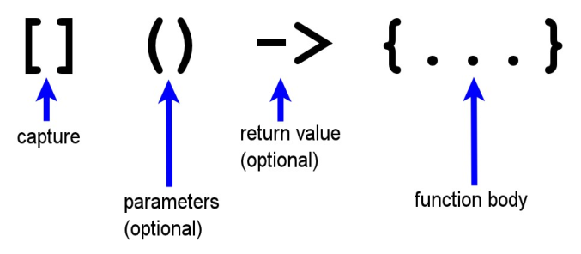
Lambdas
Syntax
[]: captures the used variables per copy of per reference
(): is required for parameters
->: is required for sophisticated lambda functions
{}: may include expressions and statements

Slide 15
Lambdas
Much more
starting a thread:
thread t1([]{cout << this_thread::get_id() << endl;});
thread t2([]{veryExpensiveFunction();});
Lambda functions are first-class functions(https://en.wikipedia.org/wiki/First-class_function)
argument of a function:
auto myLambda= []{return "lambda function";};
getLambda(myLambda);
return value of a function:
function< string() > makeLambda{
return []{return "2011";};
};

Slide 16
Non-member begin() and end()
Promoting uniformity, consistency and enabling more generic programming
Work with all STL containers/C-like arrays
Overloadable
int arr[] = {1,2,3};
std::for_each(std::begin(arr), std::end(arr), [](int n) {std::cout << n << std::endl;});
auto is_odd = [](int n) {return n%2==1;};
auto pos = std::find_if(std::begin(arr), std::end(arr), is_odd);
if(pos != std::end(arr)) std::cout << *pos << std::endl;
Notes:
can be extended to work with any type

Slide 17
static_assert and type traits
static_assert performs an assertion check at compile-time
More useful when used together with type traits
// add is supposed to work only with integral types
template <typename T1, typename T2>
auto add(T1 t1, T2 t2) -> decltype(t1 + t2)
{
return t1 + t2;
}
// However, there are no compiler errors if one writes
std::cout << add(1, 3.14) << std::endl;
std::cout << add("one", 2) << std::endl;
// to detect the tricky bug in compiling time
template <typename T1, typename T2>
auto add(T1 t1, T2 t2) -> decltype(t1 + t2)
{
static_assert(std::is_integral<T1>::value, "Type T1 must be integral");
static_assert(std::is_integral<T2>::value, "Type T2 must be integral");
return t1 + t2;
}
// a 64-bit architecture
static_assert(sizeof(long) >= 8,"no 64-bit code");

Slide 18
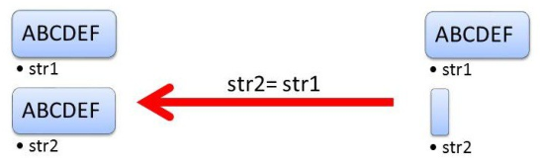
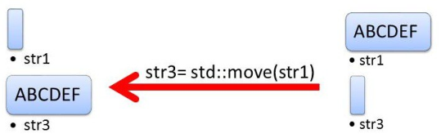
Move semantics
move
Copy
string str1("ABCDEF");
string str2;
str2 = str1;
Move
string str1{"ABCDEF"};
string str3;
str3 = std::move(str1);

Slide 19
Move semantic
For better performance
Cheap moving of a resource instead of expensive copying:
vector<int> myBigVector;
....
vector<int> myBigVector2(move(myBigVector));
Not copyable but moveable objects can be given to or by a function by value
Examples: unique_ptr, files, mutexe, promise and future
STL push_back/emplace_back

Slide 20
Rvalue references
Temporary objects
rvalue references are special references that can be bind to a rvalue
rvalues are
temporary
objects without name
objects, of which can not be determined an address
rvalue references are defined with 2 and symbols (&&):
MyData myData;
MyData& myDataLvalue= myData;
MyData&& myDataRvalue( MyData());
The compiler can bind lvalue references to an lvalue, rvalue references to an rvalue
Special action can be given for rvalues
Use case: move semantic and perfect forwarding*
Notes:
Perfect forwarding (forward)
Enables to write function templates, which can forward their
argument to a further function preserving the lvalue/rvalue items of
the arguments.
▪ Stroustrup: „ . . . a heretofore unsolved problem in C++.“
▪ Use case: factory function or constructor
▪ Example: factory function with one argument
template <typename T, typename T1>
T createObject(T1&& t1){
return T(forward<T1>(t1));
}
int myFive2= createObject<int>(5); // Rvalue
int five=5;
int myFive= createObject<int>(five); // Lvalue

Slide 21
Constructor: Delegation&Inheritance (using)
Save time of copy&paste
// The constructors #2 and #3 invoke the constructor #1
class MyHour{
int myHour_;
public:
MyHour(int h){ // #1
if (0 <= h and h <= 23 ) myHour_= h;
else myHour_= 0;
}
MyHour(): MyHour(0){}; // #2
MyHour(double h): MyHour(static_cast<int>(ceil(h)){};// #3
};
struct Base{
Base(int){}
Base(string){}
};
struct Derived: public Base{
using Base::Base;
Derived(double){}
};
int main(){
Derived(2011); // Base::Base(2011)
Derived("C++11"); // Base::Base(C++11)
Derived(0.33); // Derived::Derived(0.33)
}

Slide 22
Requesting methods (default)
Control on default behavior of compiler
Requesting special methods and operators from the compiler:
default - and copy - constructor;
assignment operator, operator new;
destructor
// #1 suppresses the automatic generation of #2
class MyType{
public:
MyType(int val) {} // #1
MyType()= default; // #2
virtual ~MyType();
MyType& operator= (MyType&)
};
MyType::~MyType()= default;
MyType& MyType::operator(MyType&)= default;

Slide 23
Suppress function invocations (delete)
Control on default behavior of compiler
// Not copyable classes
class NonCopyClass{
public:
NonCopyClass()= default;
NonCopyClass& operator =(const NonCopyClass&)= delete;
NonCopyClass (const NonCopyClass&)= delete;
};
// A function only accepting double
void onlyDouble(double){}
template <typename T> void onlyDouble(T)= delete;
int main(){
onlyDouble(3); // Error: use of deleted function »void onlyDouble(T) [with T
= int]
};

Slide 24
More to talk
Small tricks
Unified initialization using {}
const expressions (constexpr)
Raw string literales (r“(raw string)“)
Suppress the interpretation of the string
Defined with r“(raw string)“ or R“(Raw String)“
Are practical helper for paths and regular expressions
Design of classes(in-class member initialization)
Extended data concepts(unicode support, user defined literales)
Not need a space while using “>>” with containers!(vector<vector<int>>x;)

Slide 25
And more
Uniform Initialization Syntax
Clean up the mess from C
class MyHourC c {0,0}; // C++11 only. Equivalent to: C c(0,0);
int* a = new int[3] { 1, 2, 0 }; // C++11 only
class X {
int a[4];
public:
X() : a{1,2,3,4} {} //C++11, member array initializer
};
// C++11 container initializer
vector<string> vs={ "first", "second", "third"};
map singers =
{ {"Lady Gaga", "+1 (212) 555-7890"},
{"Beyonce Knowles", "+1 (212) 555-0987"}};
// in-class initialization of data members
class C
{
int a=7; //C++11 only
public:
C();
};

Slide 26
And more
Standard Library
Smart pointers(replace auto_ptr with unique_ptr)
New containers
tuple and array
hash tables(unordered_set, unordered_map, unordered_multiset, and unordered_multimap)
Threading Library(thread, mutex, condition, future, promise, etc)
New C++ Algorithms(all_of(), any_of() and none_of())
Regular expressions

