Slide 1

Lab Book 3.0 Circuits and Compact Models
Student: Hugo Beltrán Sanz, B1

Slide 2
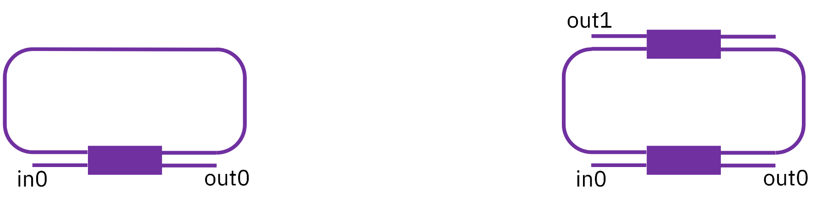
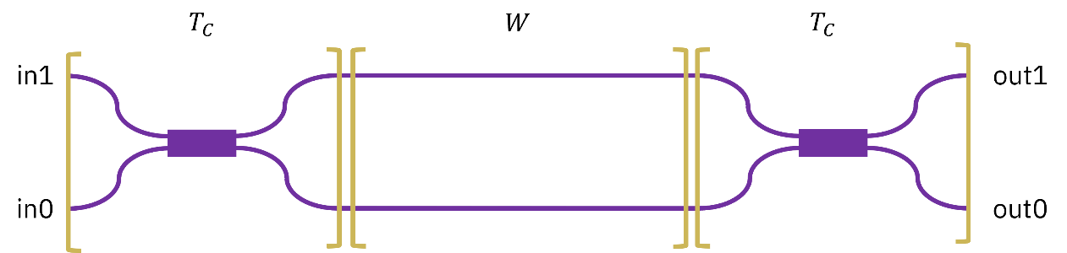
Instructions General
SCRIPTS
From GitHub →
Fork the repo: https://github.com/cccanvas-upv/cifoin-lab3.git
Clone the repo using VSCode
Run the Jupyter Notebook:
CIRCUITS_&_COMPACT_MODELS.ipynb
Devices to be studied:
Mach-Zehnder Interferometer (MZI)
Ring Resonators (RR)

Slide 3
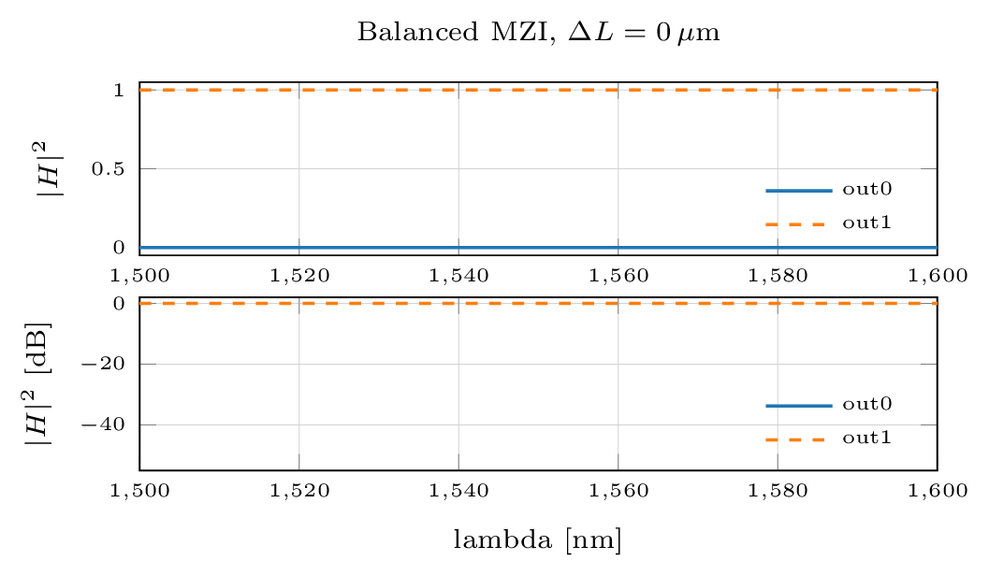

Learning outcome #1a - Perfectly balanced MZI
Physical interpretation
With ΔL = 0, both arms accumulate the same propagation phase. The differential phase is not swept by wavelength, so the circuit behaves as a fixed splitter/recombiner rather than as a periodic filter.
$$Δφ\left(λ\right)=2π⋅n_{\text{eff}}\left(λ\right)⋅\frac{ΔL}{λ} = 0$$
Numerical check
The simulation gives P(out0) ≈ 0 and P(out1) ≈ 1 over the full band. The absence of oscillations confirms that the coupler convention and the phase reference are internally consistent.

Slide 4
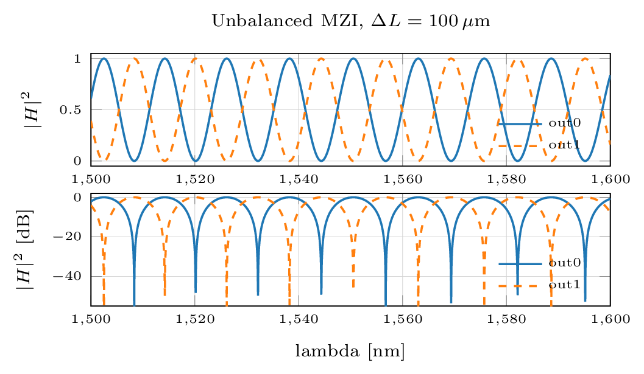
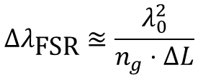
Learning outcome #1b - Unbalanced MZI
Key equation
$$Δλ_{\text{FSR}}≊\frac{λ_{0}^{2}}{n_{g}⋅ΔL}$$
Using λ0 = 1.55 µm, ng = 1.939990 and ΔL = 100 µm:
FSRth = 12.384 nm
FSRsim = 12.402 nm
The relative error is about 0.15%, which is consistent with wavelength-grid discretization and numerical notch detection.
Physical result
The outputs are complementary because the same phase condition that is constructive at one port is destructive at the other. In the ideal lossless case, Pout0 + Pout1 = 1.

Slide 5
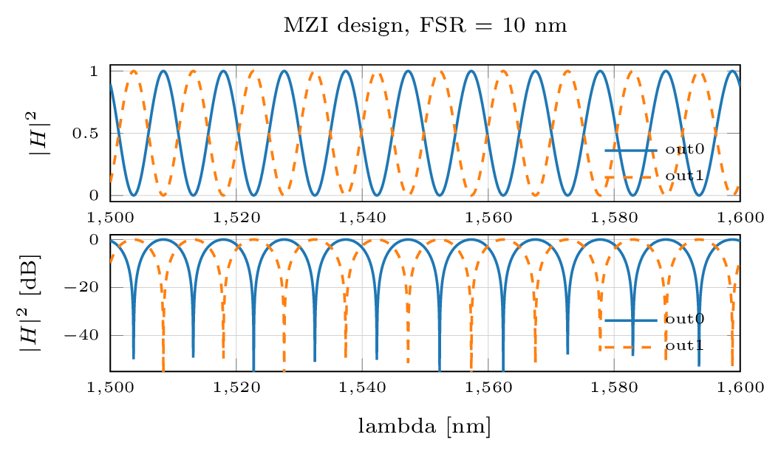
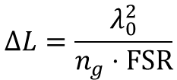
Learning outcome #2 - MZI design for FSR = 10 nm
Design equation
$$ΔL=\frac{λ_{0}^{2}}{n_{g}⋅\text{FSR}}$$
For λ0 = 1.55 µm, ng = 1.939990 and
FSR = 0.010 µm:
ΔL = 123.841 µm
Simulation check
The simulated FSR is 9.973 nm. The residual error is 0.27%, dominated by finite wavelength sampling rather than by the compact model itself.
The result is physically consistent: increasing ΔL from 100 µm to 123.841 µm reduces the FSR from ≈12.4 nm to ≈10 nm.

Slide 6
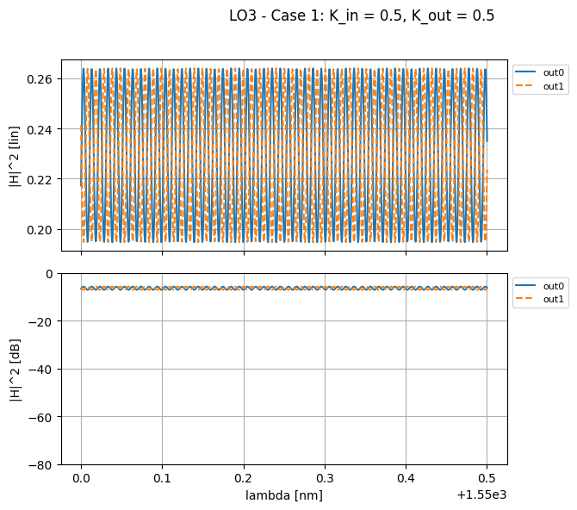
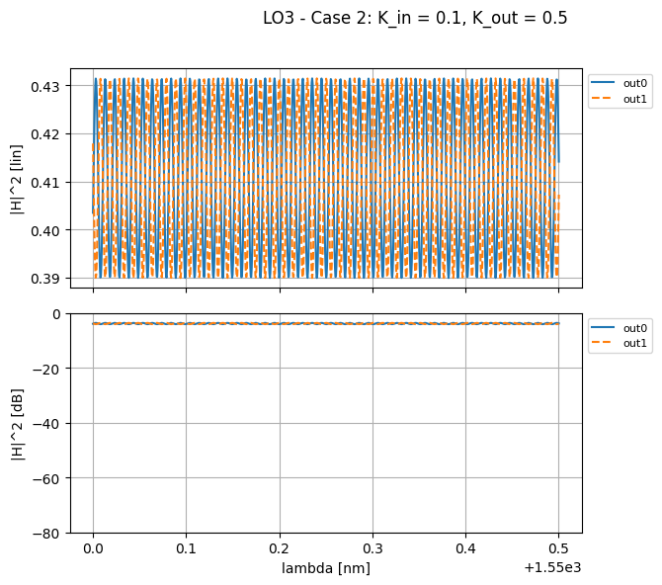
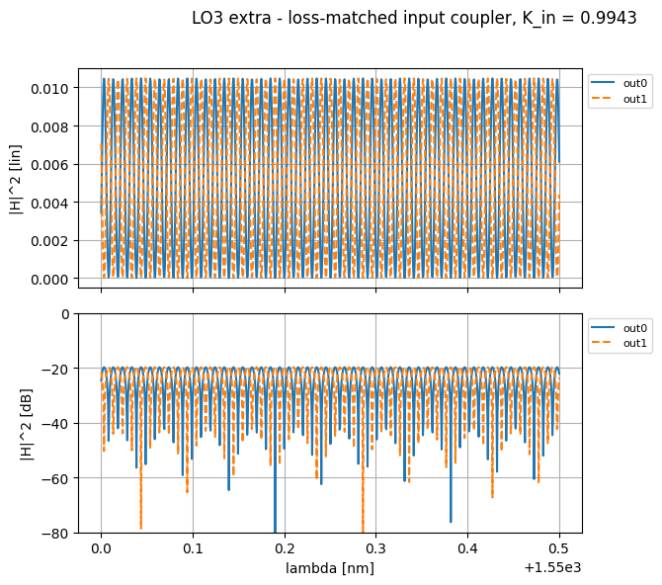

Learning outcome #3 - Delay imbalance with loss
Interpretation
Results
Destructive interference requires phase opposition and comparable amplitudes. With unequal loss, Emin = |A1 − A2| cannot vanish, so visibility and extinction ratio collapse.
Case 1: ER = 1.32 dB, V = 0.151. Case 2: ER = 0.44 dB, V = 0.051. Loss matching gives Kin = 0.994258 and restores deep cancellation, confirming that the limitation is amplitude imbalance.
$$V=\frac{P_{\max{−}}P_{min}}{P_{\max{+}}P_{min}}$$

Slide 7
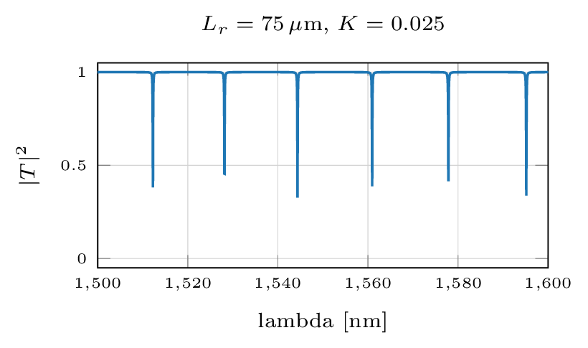
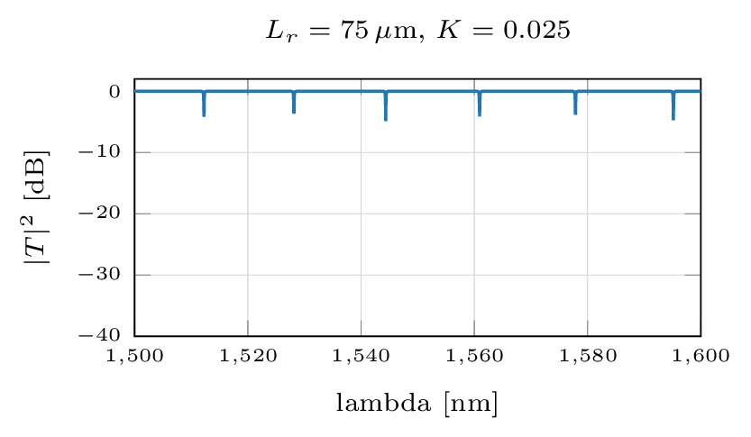
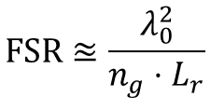

Learning outcome #4 - SiN all-pass ring resonator
Model and result
$$φ=2π⋅n_{\text{eff}}⋅\frac{L_{r}}{λ}$$
Lr = 75 µm, K = 0.025, α = 4 dB/cm. Theory: FSR = 16.512 nm. Simulation: FSR = 16.579 nm. Through-port ER = 4.86 dB.
$$\text{FSR}≊\frac{λ_{0}^{2}}{n_{g}⋅L_{r}}$$
The linear and logarithmic plots show the same resonance locations; the logarithmic view reveals notch depth.

Slide 8
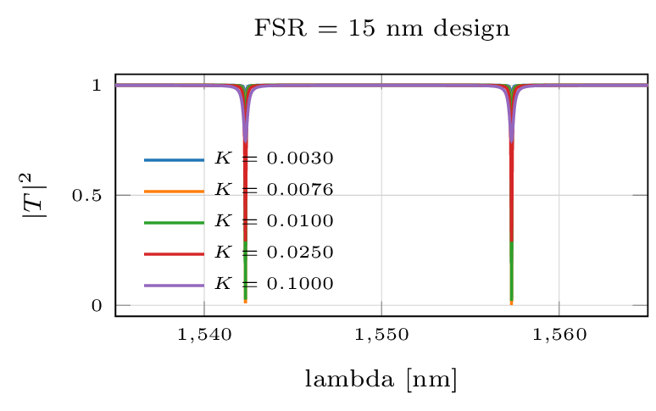
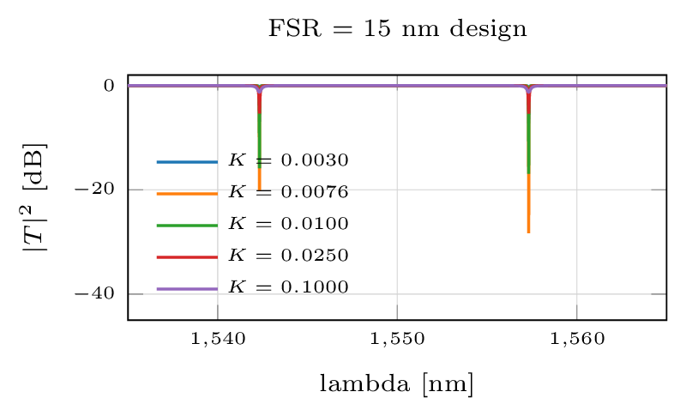


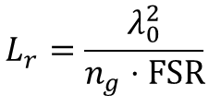
Learning outcome #5 - Ring FSR design and critical coupling
Design
Critical coupling
$$L_{r}=\frac{λ_{0}^{2}}{n_{g}⋅\text{FSR}}$$
$$K_{\text{crit}}=1−a^{2}$$
$$a={10}^{−α⋅\frac{L_{r}}{20}}$$
Lr = 82.561 µm gives a simulated FSR of 14.96 nm, close to the target value.
For α = 4 dB/cm, Kcrit = 0.00758. The deepest sampled notch reaches ER = 28.32 dB near this value.

Slide 9
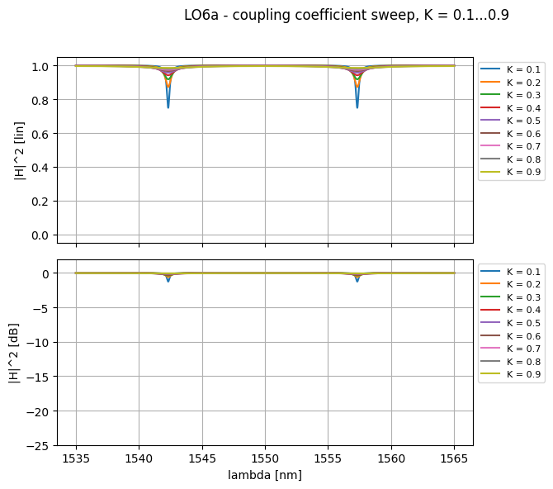

Learning outcome #6a - Coupling sweep
Reference condition
$$K_{\text{crit}}=\text{0.00758}$$
The sweep uses K = 0.1…0.9, so every case is strongly overcoupled. Increasing K moves the ring farther away from the critical-coupling condition.
Observed trend
ER decreases from 1.26 dB at K = 0.1 to 0.05 dB at K = 0.9. More coupling does not mean a deeper notch; the optimum is the balance between external coupling and intrinsic round-trip loss.
Overcoupled: K > Kcrit

Slide 10
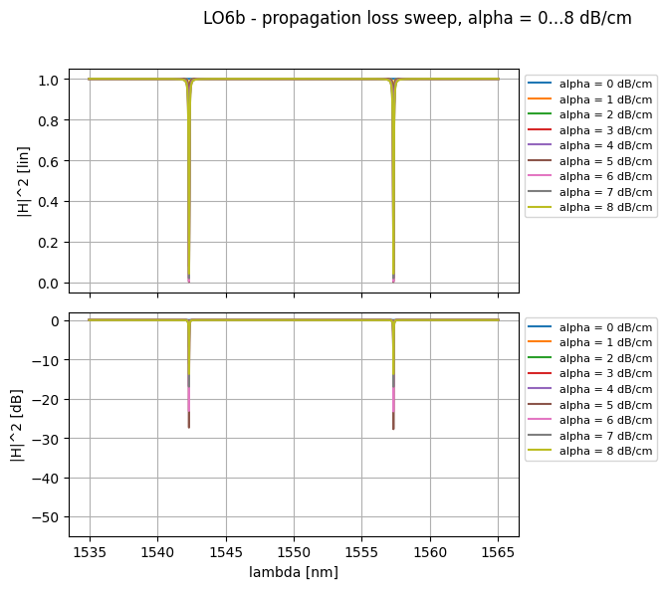

Learning outcome #6b - Loss sweep
Mechanism
$$K_{\text{crit}}=1−{10}^{−α⋅\frac{L_{r}}{10}}$$
With K fixed at 0.01, increasing α raises Kcrit. The device evolves from overcoupled to near-critical and then undercoupled.
Observed trend
The deepest sampled notch appears at α = 5 dB/cm, with ER = 27.78 dB. This is the point where Kcrit is closest to the fixed coupling coefficient.
Beyond that point, intrinsic loss dominates and the extinction ratio decreases again.

Slide 11
Global consistency check
Case
Prediction
Simulation
Assessment
Balanced MZI
No differential phase sweep
Pout0≈0, Pout1≈1
Consistent
Unbalanced MZI
FSR ≈ 12.384 nm
FSR ≈ 12.402 nm
0.15% error
MZI design
FSR = 10 nm
FSR ≈ 9.973 nm
0.27% error
Lossy MZI
Visibility collapses with imbalance
V = 0.151 / 0.051
Consistent
Ring RR
FSR ≈ 16.512 nm
FSR ≈ 16.579 nm
0.41% error
Critical coupling
Deepest notch near Kcrit
ER ≈ 28.32 dB
Consistent
Main conclusion
Length controls periodicity, while coupling and loss control contrast. The agreement between analytical estimates and simulated responses validates the compact-model implementation.

Slide 12

Thank you

