Slide 1
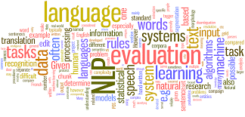
“Not-So-Civil” Civil Discourse
By: Heather Berginc

Slide 2

Data-Set
Comments from online News Articles
Approved or Rejected
“likes”, “wow”, “disagree”…

Slide 3

Motivation
Bullying or inappropriate language
Automating the process
Clarify and calculate inappropriate language

Slide 4
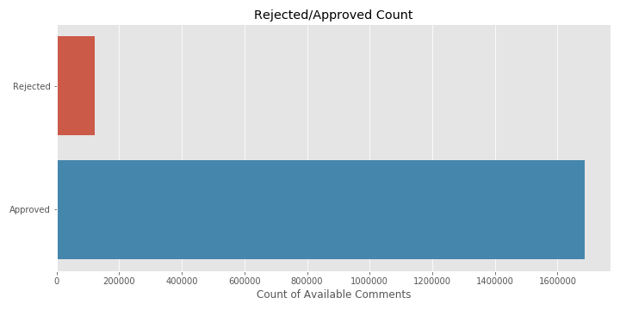
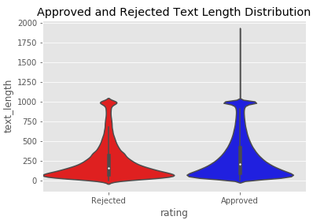
Original Visualization
1.8 Million
Total Comments
Severe Imbalance with Rating Class
Fairly Unbiased Comment Length

Slide 5
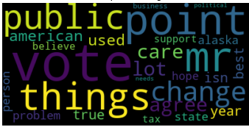
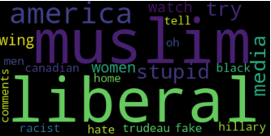
Approved Text
Rejected Text

Slide 6
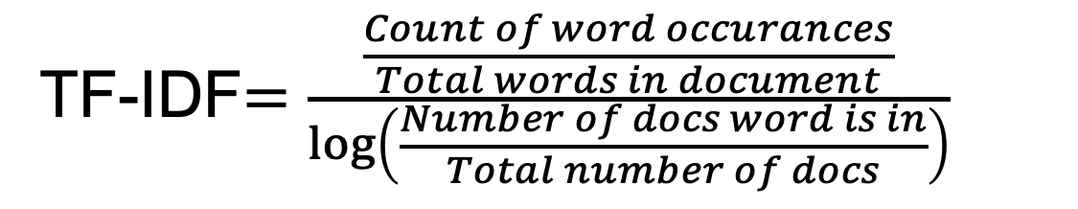
Text Factorization
Term Frequency and Inverse Document Frequency (TF-IDF)
All terms are now between zeros and one

Slide 7
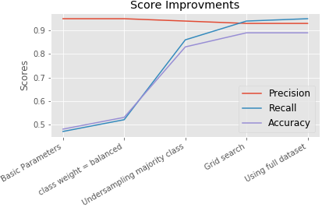
Modeling Process
Random Forest Classifier
Biggest Improvement: Under-sampling majority class
Now: 126,000 comments
*Over-sampling had same desired affect as under sampling but increased AUC by 0.01.

Slide 8
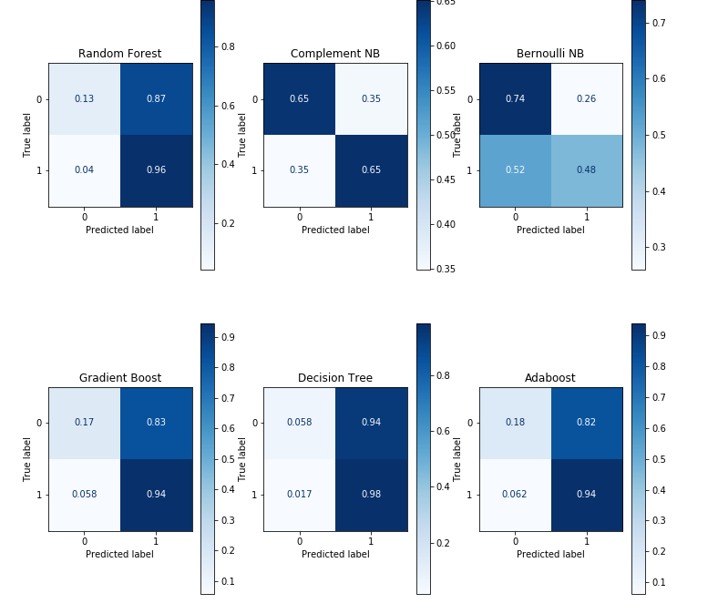
Looking specifically at accuracy,
note the consistent issue positively predicting the majority class “approved”and not disregarding much of the minority class.
Acc: 0.89
Acc: 0.65
Acc: 0.49
Acc: 0.88
Acc: 0.92
Acc: 0.88

Slide 9
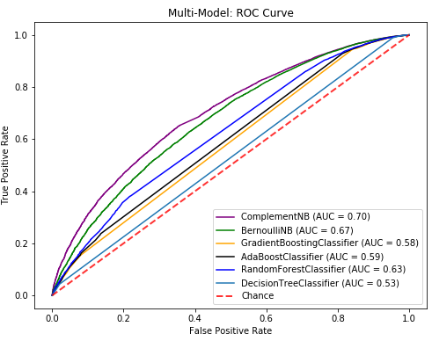
ROC Curve or Accuracy Score
Complement Naive Bayes is our best predictor of TN
Skewed Class Distribution:
  ROC curve shows more information about target feature
  Accuracy works great for more balanced classes

Slide 10
Falsely Approved Text Examples
Example 1:
“Scumbag lawyers representing scumbag lazy bums. The world would be a better place without all of them.”
Example 2:
Two trump supporters were standing on a beach in Florida. One says to the other one, "What do you think is closer, New York City or the Moon?" The other one replies, "Duh, you can see the Moon from here."

Slide 11
Falsely Rejected Text Examples
Example 1:
“Smarmy Smiles and Selfies will only carry the Justin so far and its starting to wear thin. He can see NO conflict of interest, WOW liberal arrogance on display big time.”
Example 2:
I remember. My mother was one of those. She'd be disgusted with her party today.

Slide 12
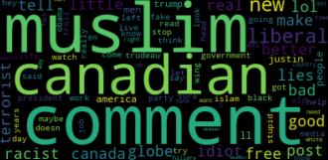
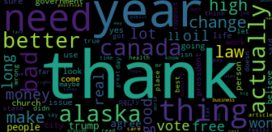
Summary
Model Positives:
- Specific detection of positive terms.
- Better than random guessing at Approval and Rejected
Model Negatives:
- Does not understand Context like Jokes or Sarcasm
- Over predicts Approval
- Rejects Comments unfairly when using specific terms

Slide 13
Future Directions
Optimize Text Vectorization
  The combinations of parameters with TFIDF and model parameters are endless. Exploring the combination could proof fruitful.
Gather More “Rejected” Data
  The importance of Machine Learning context of natural language should be possible with enough data and the right parameters

