Slide 1
MATH299O:Probability and Bridge
Lecture 2: Bidding and Declarer Play Basics

Slide 2
Class Overview
Lecture Notes
Quick Syllabus Overview
Review of Declarer Play
Example hand as a class
Two example hands in small groups
Introduction to bidding
Homework assignment on declarer and bidding due next week

Slide 3
Bridge Declarer Play
Review of last week
Play goes clockwise, with the highest card winning
When all four people play, that is considered a “trick”
Must “follow suit” meaning you have to play the same suit as someone else if you can
If you are out of a suit, playing any card in the trump suit will win the trick
The dummy puts their hand down for everybody to see, declarer gets to play their cards for them
Whoever wins the trick plays first to the next one
Example hand using BridgeBase
Concept of Counting Tricks

Slide 4
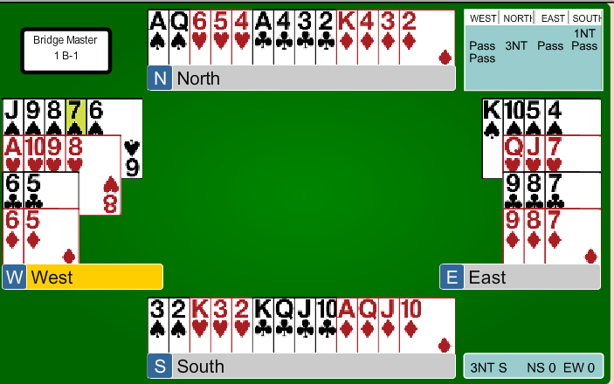
Class Example Hand 1

Slide 5
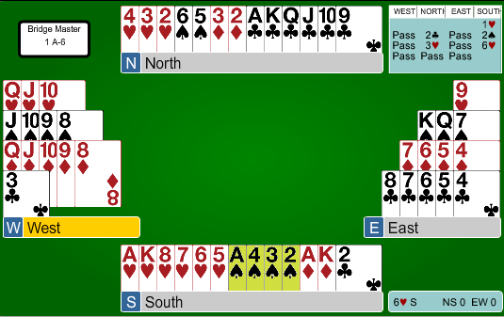
Class Example Hand 2

Slide 6
Bridge Bidding
People invent different bidding systems in order to best find the right contract
Standard American
2/1 (most popular in the United States)
Precision
Polish Club
Strong Club
Many others, but less popular
You can think of bidding as a language between you and your partner
Use bids instead of words to describe the cards in your hand
Above systems are linked on Wikipedia for those interested in reading more about the differences

Slide 7
Why is the auction important?
Decides declarer, dummy, and defenders
Decides which suit is trump
Decides how many tricks are necessary to make the contract
Two Important Questions:
So why don’t we stay as low as possible, promising to take the fewest tricks?
How do we evaluate our hand for how strong it is?

Slide 8
Concept of Points
High Card Points (HCP)
Ace = 4
King = 3
Queen = 2
Jack = 1
Distribution Points
Add a point for each card in a suit that is longer than 4 cards
For example give yourself an extra point if you have a 5 card suit, two points for a 6 card suit
Total Points = High Card points + Distribution Points

Slide 9
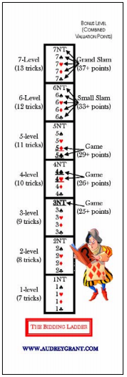
The Bidding Ladder
Amount of tricks you promise to take is the level of the contract plus 6.
Bonuses awarded for Game
3NT, 4♥,4♠, 5♣, 5♦
Additional bonuses award for small slam (12 tricks)
6♣, 6♦, 6♥, 6♠, 6NT
Biggest bonus for grand slam (13 tricks)
Once you take a bid on the bidding ladder, the next person must bid higher if they want to compete. For example, if you say 1♦, the next person must say at least 1♥, they cannot say either 1♣ or ♦.
If you have nothing to say, you “pass”

