Slide 1
MATH299O: Probability and Bridge
Lecture 3: Introductory Probability

Slide 2
Class Schedule
Defense Hand
Probability
Probability Homework on ELMS
Next Week: Bridge Scoring
Calculator will be useful next week

Slide 3
Practice Hand for the Defense
Contract is 3NT
West should lead the ♦Q
Defense should pay attention to see if there is something they can do to prevent declarer from taking 9 tricks.
Declarer, always remember to count your tricks!
Reminder on How to Play
Play goes clockwise, with the highest card winning
When all four people play, that is considered a “trick”
Must “follow suit” meaning you have to play the same suit as someone else if you can
If you are out of a suit, playing any card in the trump suit will win the trick
The dummy puts their hand down for everybody to see, declarer gets to play their cards for them
Whoever wins the trick plays first to the next one

Slide 4
The Hold-Up Play
Things to think about:
Step 1: Count our tricks
Step 2: Where can we get more tricks?
Step 3: What can go wrong?
North (Dummy)
♠4
♥543
♦543
♣KQJ1098
West
♠QJ109
♥QJ109
♦QJ109
♣5
East
♠87653
♥876
♦87
♣A76
Contract: 3NT-South
West is on lead.
South (Declarer)
♠AK2
♥AK2
♦AK62
♣432

Slide 5
Probability Concepts Overview
Random Variables
Intersection / Union
Expectation
Combinations
A priori vs A Posteriori

Slide 6
Random Variables
A random variable is simply an expression whose value is the outcome of a particular experiment.
Example: Rolling a Dice
Let us denote the roll of a dice by X.
x₁ , x₂ , x₃ , x₄, x₅, x₆ are the possibilities of each event (getting a 1,2,3,4,5, or 6).
We can assign a probability to each event
In this case, with an un-biased die, it is 1/6 for each possible outcome.
Finding a Probability
P(X <= 4) is asking the probability that the roll of the dice is less than or equal to 4.
There are four possible successes and two failures for a probability of 4/6 = 2/3

Slide 7
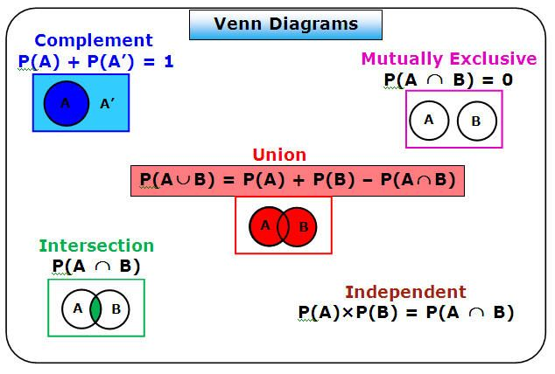
Intersection / Union
A U B, A OR B: This can be described as adding all the possibilities, but being sure not to double count.
A ∩ B, A AND B: Only when condition A and B are both met.
A U B = P(A) + P(B) - P(A ∩ B), best way to think about it is a Venn Diagram

Slide 8
Intersection / Union Example
Example 1: Consider Event A to be when the roll of a six-sided die is even, and Event B to be when the roll of a six-sided die is less than or equal to 4.
Find P(A), P(B), P(A U B), P(A ∩ B)
P(A) = {2,4,6}/{1,2,3,4,5,6} = 3/6 = 1/2
P(B) = {1,2,3,4} / {1,2,3,4,5,6} = 4/6 = 2/3
P(A ∩ B) = {2,4}/{1,2,3,4,5,6} = 2/6 = ⅓
P(A U B) = { 1,2,3,4,6} / {1,2,3,4,5,6} = 5/6
P(A U B) = P(A) + P(B) - P(A ∩ B) = 3/6 + 4/6 - 2/6 = 5/6 - MATH CHECKS OUT!

Slide 9
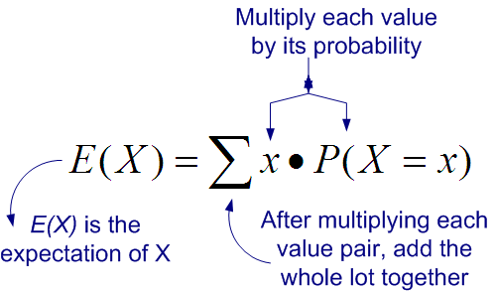
Expectations
Expectation is a weighted average
You need to list all the different possible outcomes.
Associate each outcome with a probability.
Multiply then add as shown by the equation
Main Bridge Uses
Scoring Analysis
Trick Analysis

Slide 10
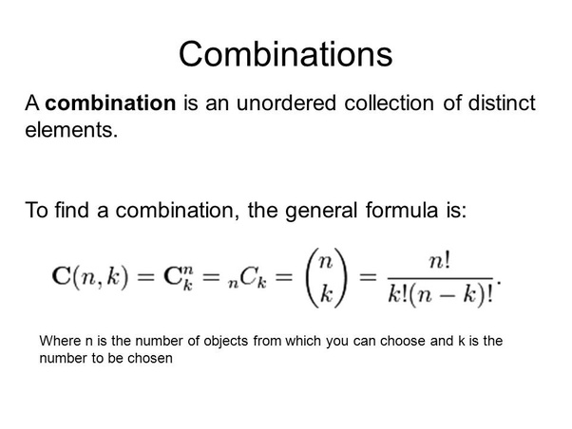

Slide 11
Combinations (Example)
Example: You have 10 marbles, 6 blue and 4 red. You must choose 5 marbles.
How many ways can you choose 5 marbles out of the 10?
C(10,5)
How many ways can you choose 3 blue marbles and 2 red marbles?
C(6,3) + C(4,2)
What is the probability that you have chose 5 blue marbles and 0 red marbles?
(C(6,5) + C(4,0))/C(10,5)

Slide 12
A Priori versus A Posteriori probability
A priori vs A posteriori probability
A priori - can be thought of as the probability before any information is known
A posteriori - updated probability due to some event
Example - Monty Hall Problem
Bridge Example
Each defender originally has 13 vacant spaces when the hand starts
Using clues from the bidding and play, we can fill up these vacant spaces
If West showed 5 hearts, and East showed three hearts in the auction, we know now that West has only 8 cards left for the other suits while East still has 10 cards left.
This requires us to update the probabilities of the ways a suit can be split.

Slide 13
Bridge Club
Bridge Club
Monday 6:30-8:00pm, 4172 A.V Williams
Free Pizza!

