Slide 1
Lecture 4
Bridge Bidding and Scoring

Slide 2
Class Overview
Probability homework announcement
Practice bridge hand
Duplicate Bridge Scoring

Slide 3
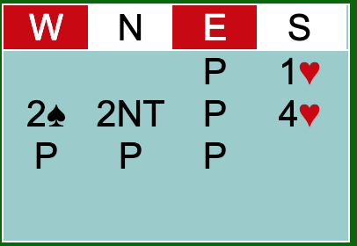
Bridge Hand from Collegiate Tournament (2/17)
What the bids mean:
1♥ : I have 12 or more points and 5+ ♥s
2♠: I have 6-10 points and 6+♠s
2NT: I have 10-12 points and 2 or fewer ♥s
4♥: I have a lot of ♥s so we should be good

Slide 4
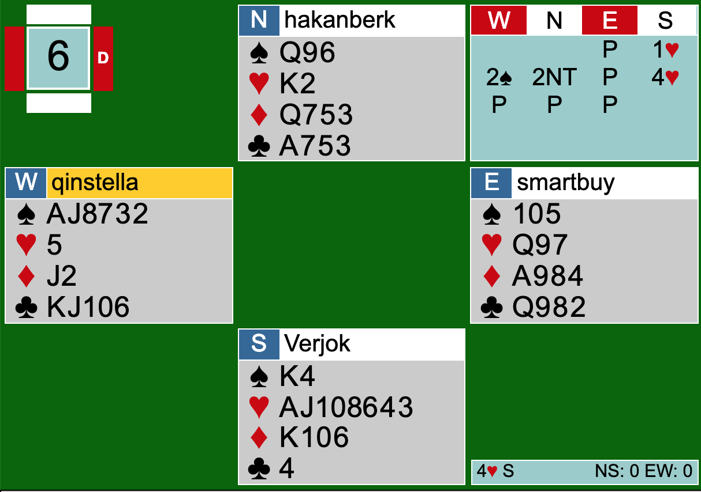
Full Hand from our match versus Berkeley

Slide 5
Vulnerability
Red = Vulnerable
White = Non-Vulnerable
More risk for more reward
Game and slam bonuses are higher
Go larger minus scores when going down
-50 for each trick you miss your contract when non-vulnerable
-100 for each trick you miss your contract when vulnerable

Slide 6
How does duplicate scoring work? (Making the contract)
Trick Score
30 for each trick for hearts and spades
20 for each trick for clubs and diamonds
40 for first trick in notrump, and 30 for each subsequent trick
Bonus Score
50 for partscore (contract lower than game )
300 for non-vulnerable, 500 for vulnerable game
500 for non-vulnerable small slam, 750 for vulnerable small slam
1000 for non-vulnerable grand slam, 1500 for vulnerable grand slam
When you bid slam, you also get to add the game bonus as well.
Overtricks
30 for hearts, spades, notrump
20 for clubs or diamonds

Slide 7
Sample Calculations
1NT = 40 trick score + 50 for partscore = 90
1♥ = 30 trick score + 50 for partscore = 80
2♠ = 1♠ with an overtrick (8 tricks taken) = 30 + 30 trick score + 50 partscore = 110
4♠ non-vulnerable =120 trick score (30 + 30 + 30 + 30) + 300 non-vulnerable game bonus = 420 total points
6NT vulnerable = 190 trick score (40+30+30+30+30+30) + 500 vulnerable game bonus + 750 vulnerable bonus = 1440 total points

Slide 8
Definition of Game
How was game decided to be 3NT, 4H, 4S, 5C, 5D?
It is when the trick score is equal to 100 or more
Notice for 3NT, 40 +30 +30 = 100
For 4H,4S we have 30+30+30+30 = 120
For 5C, 5D we have 20+20+20+20+20 = 100

Slide 9
How to Compare Scores to Opponents (Matchpoints)
In a duplicate bridge game, every pair will play the same boards at different times throughout the session lasting usually 24 boards.
If you are North-South your scores are compared against all the other North-South scores. If you are East-West your scores are compared against all the oher East-West players. You stay the same cardinal direction for the entirety of the event.
For every score you beat, you get 1 matchpoint, every tie is 0.5 matchpoints, every lost is 0 points.
Final score is presented as a percentage with total matchpoints earned / total matchpoints possible.

Slide 10
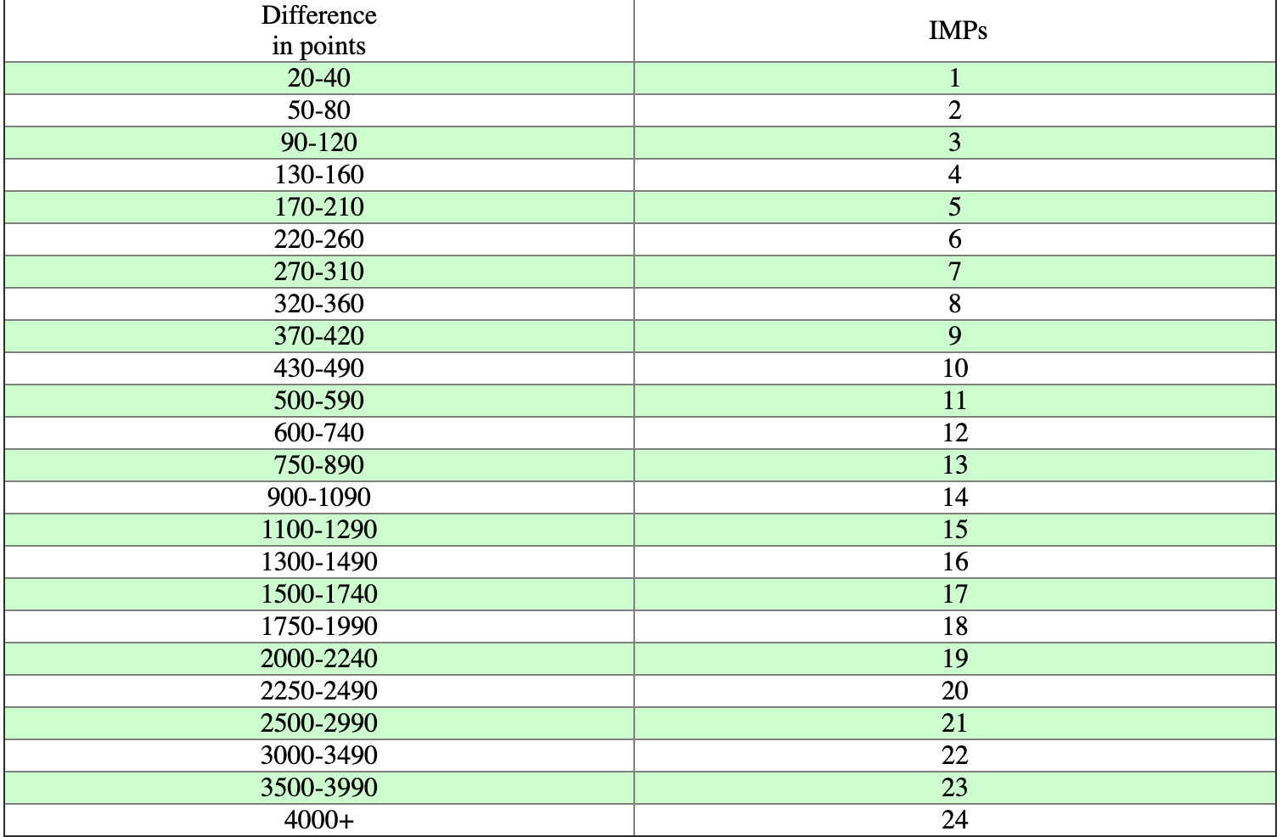
How to Compare Score to Opponents (IMPs)
Used in team events (4 players, 2 pairs) for head-to-head matches.
One pair plays North-South facing the other team’s East-West, the other pair plays East-West and plays against the other team’s North-South
For each board, you subtract the difference in points and use the scale to the left to determine IMPs.

Slide 11
Importance of Vulnerability in IMP Scoring
Say you are trying to decide whether or not to bid 3NT when vulnerable in an IMP event. You have to consider what the opponents might do to help your decision.
If you bid 3NT and you make it, you get 600 points. If the opponents only bid 2NT and make 3, they will receive 150 points. 600-150 = 450 which is 10 IMPs.
If you bid 3NT and you go down, you lose 100 points. If the opponents only bid 2NT and make 2, they receive 120 points. -100-120 = -220 points = 6 IMPs.
To find the break-even point we use the equation 10(x)-6*(1-x) = 0, where x is the probability you make 3NT.

Slide 12
DOUBLES (X)
Tricks Missing | Not Vulnerable | Vulnerable
1 | 100 | 200
2 | 300 | 500
3 | 500 | 800
4 | 800 | 1100
5 | 1100 | 1400
Doubles can be used to punish the opponents when you do not think they can make their contract.
If you get doubled and go down, the scores to the right will be negative.
If you make it, you double your trick score. If your trick score is now greater than 100, you can add the game bonus.

Slide 13
Homework
Quiz on ELMS includes a reading on bridge sacrifices.

