Slide 1
Introduction to Python
Based on slides by Charles Severance
Textbook: Using Google App Engine, Charles Severance

Slide 2
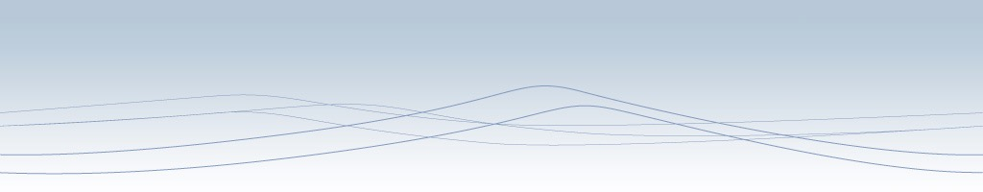




Unless otherwise noted, the content of this course material is licensed under a Creative Commons Attribution 3.0 License.
http://creativecommons.org/licenses/by/3.0/.
Copyright 2009,2010,2011, Charles Severance

Slide 3
Program Steps or Program Flow
Like a recipe or installation instructions, a program is a sequence of steps to be done in order
Some steps are conditional - they may be skipped
Sometimes a step or group of steps are to be repeated
Sometimes we store a set of steps to be reused over and over as needed several places throughout the program

Slide 4
Sequential Steps
x = 1
Program:
x = 1
print (x)
x = x + 1
print (x)
Output:
1
2
print x
x = x + 1
print x
When a program is running, it flows from one step to the next. We as programmers set up “paths” for the program to follow.

Slide 5
Conditional Steps
x = 5
X < 10 ?
Yes
Program:
x = 5
if x < 10:
print ('Smaller')
if x > 20:
print ('Bigger')
print ('Finish')
print 'Smaller'
Output:
Smaller
Finish
X > 20 ?
Yes
print 'Bigger'
print 'Finish'

Slide 6
Repeated Steps
n = 5
No
Yes
n > 0 ?
Output:
5
4
3
2
1
Blastoff!
Program:
n = 5
while n > 0 :
print (n)
n = n – 1
print (‘Blastoff!')
print n
n = n -1
print 'Blastoff'
Loops (repeated steps) have iteration variables that change each time through a loop. Often these iteration variables go through a sequence of numbers.

Slide 7
Stored (and reused) Steps
hello():
def
Program:
def hello():
print ('Hello')
print ('Fun')
hello()
print ('Zip')
hello()
print 'Hello'
Output:
Hello
Fun
Zip
Hello
Fun
print 'Fun'
hello()
print 'Zip'
hello()
We call these little stored chunks of
code “subprograms” or “functions”.

Slide 8
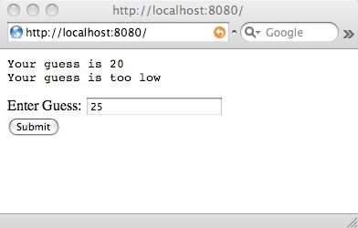
print ('Your guess is', guess)
answer = 42
if guess < answer :
print ('Your guess is too low')
if guess == answer :
print ('Congratulations!')
if guess > answer :
print ('Your guess is too high')

Slide 9
Rules for Python Variable Names
Must start with a letter or underscore _
Must consist of letters and numbers and underscores
Case Sensitive
Good: x usf _food food16 FOOD
Bad: 42secret :usf value-7
Different: usf Usf USF

Slide 10
Reserved Words
You can not use reserved words as variable names / identifiers
and del for is raise
assert elif from lambda return
break else global not try
class except if or while
continue exec import pass yield
def ﬁnally in print

Slide 11
Assignment Statements
variable = expression
Evaluate the expression to a value and then put that value into the variable
x = 1
spam = 2 + 3
spam = x + 1
x = x + 1

Slide 12
Python standard data types
Every variable and constant in Python as a “type” and Python knows the type
Numbers
String
List
Tuple
Dictionary

Slide 13
Types and Conversion
If you do something that is not allowed for a particular type, you will get an error
We can ask Python which type a variable is using the built-in type() function
>>> txt = 'guess=25'
>>> print (type(txt))
<type 'str'>
>>> pos = txt.find('=')
>>> print (pos)
5
>>> print (type(pos))
<type 'int'>
>>>

Slide 14
Integer division in Python 3
3/2 = ?
3//2 = ?
3/2.0 = ?
3//2.0 = ?

Slide 15
Input Statements
input('Prompt') - displays the prompt and waits for us to input an expression - this works for numbers AND FOR STRINGS!!!
raw_input is not supported in Python3
>>> x = input('Enter ')
Enter 123
>>> print (x)
123

Slide 16
String Data
Modern programs work with string data ('Fred', 'Ann Arbor', ...) far more often than numeric data (1, 2, 3.14159)
Python has great support for working with strings

Slide 17
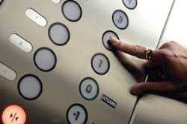
Indexing Strings
We can look at each character in a string by “indexing” the string with square brackets “[“ and “]”
The first character in a string is [0]
python
>>> txt = 'guess=25'
>>> print (txt[0])
g
>>> print (txt[1])
u
>>>
guess=25
01234567

Slide 18
Slicing Strings
We can extract a range of characters in a string using two numbers and a colon (:) in the square brackets
The second value means “up to but not including”
python
>>> txt = 'guess=25'
>>> print (txt[2:4])
es
>>> print (txt[2:5])
ess
>>>
guess=25
01234567

Slide 19
Slicing Strings
When we slice strings, we can omit the first or second number and it implies beginning and end of the string respectively
python
>>> txt = 'guess=25'
>>> print (txt[:5])
guess
>>> print (txt[6:])
25
>>>
guess=25
01234567

Slide 20
Concatenating Strings
We use the “+” operator to concatenate two strings
If we want a space between the strings, we need to add the space
>>> think = 'happy' + 'thoughts'
>>> print (think)
happythoughts
>>>
>>> think = 'happy' + ' ' + 'thoughts'
>>> print (think)
happy thoughts
>>>

Slide 21
The Python String Library
Python has a number of powerful string manipulation capabilities in the string library (an example of the store and reuse pattern)
>>> txt = 'guess=25'
>>> print (txt.find('='))
5
>>> print (txt.find('pizza'))
-1
>>>
guess=25
01234567

Slide 22
The Python String Library
Other capabilities in the string library include : lowercase(), rfind(), split(), strip(), rstrip(), replace(), and many more
http://docs.python.org/library/stdtypes.html

Slide 23
Breaking the Rules...
>>> txt = 'abc' + 'def'
>>> print (txt)
abcdef
>>> num = 36 + 6
>>> print (num)
42
>>> huh = 'abc' + 6
Traceback (most recent call last):
File "<stdin>", line 1, in <module>
TypeError: cannot concatenate 'str' and 'int' objects
>>>

Slide 24
Strings in Python 3
You can no longer mix text and data!!

Slide 25
Converting Integer to String
>>> txt = 'abc' + 'def'
>>> print (txt)
abcdef
>>> num = 36 + 6
>>> print (num)
42
>>> huh = 'abc' + str(6)
>>> print (huh)
abc6
>>>
If we convert the integer to a string using the built-in str() function - the types match for the concatenation (+) operation.

Slide 26
Parsing a String
>>> txt = 'guess=25'
>>> pos = txt.find('=')
>>> sub = txt[pos+1:]
>>> print (sub)
25
>>> print (type(sub))
<type 'str'>
>>> ival = int(sub)
>>> print (ival)
25
>>> print (type(ival))
<type 'int'>
>>>
Sometimes we want to break a string into pieces and do something with those pieces in several steps
guess=25
01234567

Slide 27
The try / except Structure
Sometimes we know a line of code may cause traceback - perhaps because it is processing user input that may be flawed
You surround a dangerous section of code with try and except.
If the code in the try works - the except is skipped
If the code in the try fails - it jumps to the except section

Slide 28
The program stops here
$ cat notry.py
astr = 'fourtytwo'
istr = int(astr)
print 'First', istr
astr = '123'
istr = int(astr)
print 'Second', istr
$ python notry.py
Traceback (most recent call last):
File "notry.py", line 2, in <module>
istr = int(astr)
ValueError: invalid literal for int() with base 10: 'fourtytewo'
All
Done

Slide 29
When the first conversion fails - it just drops into the except: clause and the program continues.
$ cat tryexcept.py
astr = 'fourtytwo'
try:
istr = int(astr)
except:
istr = -1
print 'First', istr
astr = '42'
try:
istr = int(astr)
except:
istr = -1
print 'Second', istr
$ python tryexcept.py
First -1
Second 42
When the second conversion succeeds - it just skips the except: clause and the program continues.

Slide 30
In class
Create a guessing game that plays until the correct answer is given.
Can you avoid hardcoding the “secret number”?
Can you get it to work if the input is in the form “guess = 42”?
Can you get it to work if someone enters a name instead of a number?

