Slide 1
The Request/Response Cycle
Or, what happens when you type something into the address bar

Slide 2
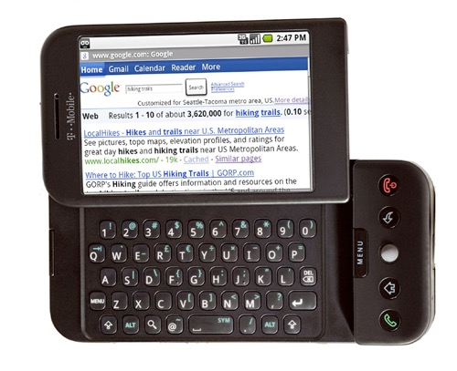


Internet
HTTP
Request
Python
HTML
JavaScript
Response
GET
Data Store
AJAX
Templates
memcache
CSS
POST
Cookies
MVC

Slide 3
What is HTML?
HTML stands for Hypertext Markup Language
Markup languages are not the same as programming languages, they use tags to annotate documents.
In HTML the tags indicate where headings, images, lists, links, line breaks, and other components should go.

Slide 4
.html files
When your computer opens a .html file, it knows to open it in an Internet browser (Chrome, Firefox, Safari, etc.)
The browser can read this file and know how to display it on the screen.
Screen readers and other assistive devices can also utilize the HTML tags to present the information is special ways.

Slide 5
The Document Object Model (DOM)
Basis of HTML5 is “New features should be based on HTML, CSS, the DOM, and JavaScript…”
DOM provides common tree-like structure that all pages should follow
Computer Scientists love trees (the mathematical kind) because you can test them.

Slide 6
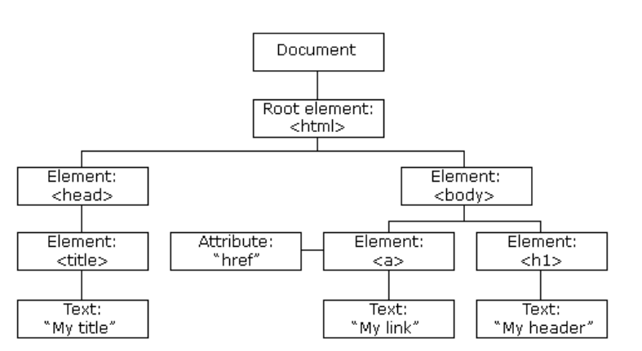
HTML is built on the DOM
http://www.w3schools.com/js/js_htmldom.asp

Slide 7
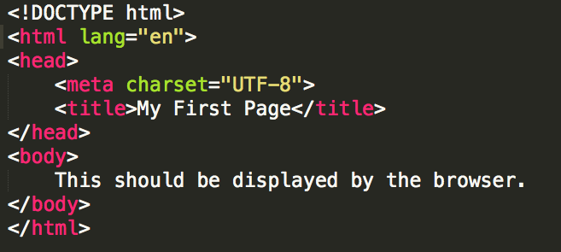
Example

Slide 8
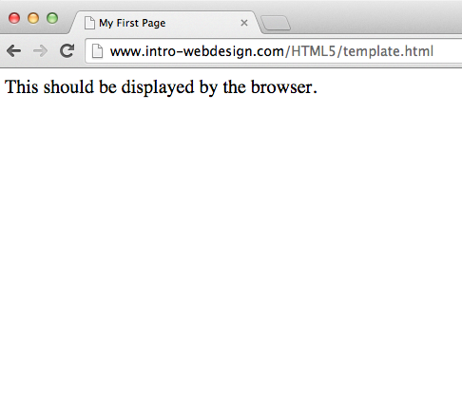

Slide 9
HTML5 Tags and Syntax
My first big disappointment to you.

Slide 10
Finally, some tags…
Tags have a beginning and an end
Some tags have attributes (src, href, etc..)
<h1>Hello World</h1>
Start tag
Closing tag
<img src=‘’x.gif” />
Self-closing tag

Slide 11
Common Tags
Headings (block)
<h1>, <h2>, <h3>, <h4>, <h5>, <h6>
These tags have syntax and semantics
Paragraphs (block)
<p> …. </p>
Should only contain inline elements
Divs (block)
<div>...</div>
Generic section that is larger than a paragraph

Slide 12
More tags
Ordered lists
<ol>
<li> Item One </li>
<li> Item Two </li>
</ol>
Unordered lists
<ul>
<li> Item One </li>
<li> Item Two </li>
</ul>
Line breaks
<br/>

Slide 13
Attributes
Attributes provide additional information about an element
Always specified in the start tag
Attributes come in name/value pairs

Slide 14
Images
Images (inline)
<img src = “myPicture.jpg alt = “Image of Colleen”/>
Images rarely work the first time
Show a broken link, too big, too small, etc.

Slide 15
Images
<img src=”logo.jpg”
alt="company logo"
title = "AAA1 LLC"
class = "thumbnail"/>
Image filename
Info for screen readers, broken links
Displays on hover
Extra formatting (height, width, position, etc.)

Slide 16
More Attributes
As you learn the tags, you learn their specific attributes. Some apply to any tag
class – applies special properties to groups of elements
id – specifies a unique id to one element on the page
style – specifies a certain visual style (avoid this one!!!)
accesskey – a shortcut key to activate an element
tabindex – the order that the tab butotn brings elements into focus

Slide 17
Hyperlinks
Creating a linked document

Slide 18
Absolute reference
<a href="http://www.intro-webdesign.com/">Web Design</a>
Closing
tag
Where to go on click
Opening tag
Clickable text

Slide 19
Relative References
<a href=“page2.html">Second Page</a>
Local file in the same folder
<a href=“docs/page2.html">Second Page</a>
Local file in a different folder
<a href=“#history">History section</a>
Segment in this same file that has been identified as history section

Slide 20
Using Images as the Link
The “clickable” component doesn’t have to be text.
<a href="http://www.redcross.org">
<img src = "http://www.redcross.org/images/redcross-logo.png"
alt = "Red Cross logo"/>
</a>
<a href="http://www.redcross.org">
<img src = ”imgs/redcross-logo.png” alt = "Red Cross logo"/>
</a>

