Slide 1
Is Pitchfork Getting Soft? An analysis using scrapy and pandas
Henry Harris

Slide 2
Overview
What is Pitchfork? What are they getting soft on?
How do we get the data that we want?
What problems did I run into?
What about those other libraries?
Show me some results!
Where to go from here?

Slide 3
Field trip
https://pitchfork.com/

Slide 4
What are we trying to find?
Is there any sort of trend in Pitchfork review scores with respect to time, whether it be over a long period or even just recently?
Besides that, let’s just grab all of the data we can and explore

Slide 5
Overview
What is Pitchfork? What are they getting soft on?
How do we get the data that we want?
What problems did I run into?
What about those other libraries?
Show me some results!
Where to go from here?

Slide 6
Scrapy (scræ-pē? scrā-pē? scræ-pī? scrā-pī?)
“Scrapy is an application framework for crawling web sites and extracting structured data which can be used for a wide range of useful applications, like data mining, information processing or historical archival.”
Spiders, Requests, Responses, etc.

Slide 7
Field trip pt. 2
See Sublīme

Slide 8
Overview
What is Pitchfork? What are they getting soft on?
How do we get the data that we want?
What problems did I run into?
What about those other libraries?
Show me some results!
Where to go from here?

Slide 9
Problems while gathering the data? Psh no way…
Scrapy breaks a lot and doesn’t tell you why
Webpages are inconsistent
Some reviews cover multiple albums, each given its own scoreWeb
The Tyler, the Creator problem
Regex, pandas.Series.str, MapCompose and Join
Sunday’s pandering reviews

Slide 10
Overview
What is Pitchfork? What are they getting soft on?
How do we get the data that we want?
What problems did I run into?
What about those other libraries?
Show me some results!
Where to go from here?

Slide 11
What about the other guys?
bs4/lxml + requests
Not a framework
Lack of automatic multiprocessing
Conclusion: bs4/requests should be the go-to combo for small and straightforward projects, but not for scraping 20,000+ pages

Slide 12
Overview
What is Pitchfork? What are they getting soft on?
How do we get the data that we want?
What problems did I run into?
What about those other libraries?
Show me some results!
Where to go from here?

Slide 13
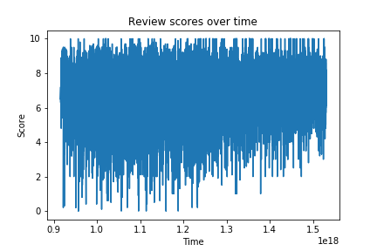
Huzzah!

Slide 14
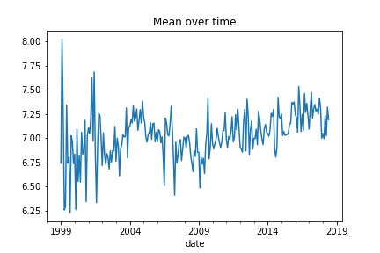
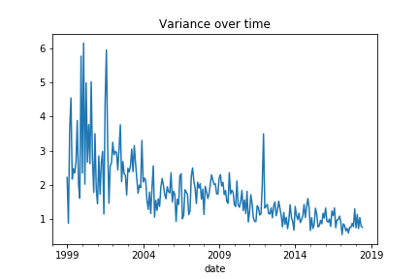
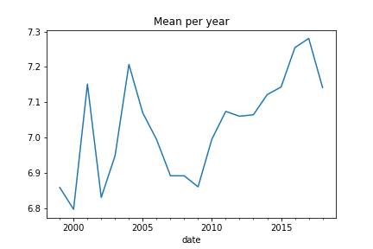
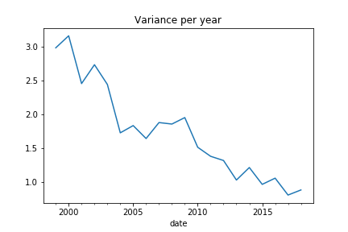
No but seriously…

Slide 15
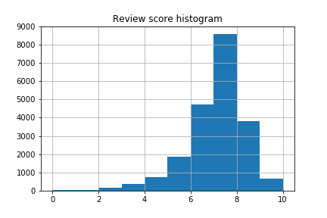
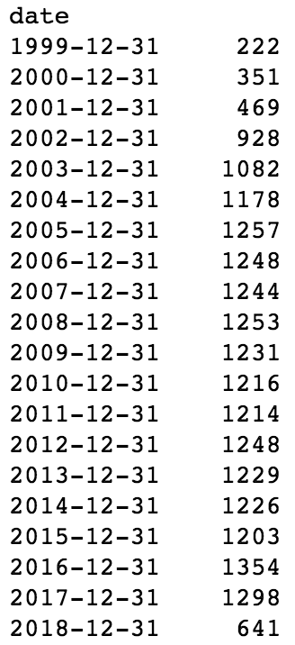
More fun stats!
Reviews per year
Notable darlings: Kendrick Lamar (8.92), Fleet Foxes (8.8), Vampire Weekend (8.67)
Notable roasts: Mumford and Sons (2.05), Alt-J (4.43), Kings of Leon (4.79)
3.4 per day!

Slide 16
Overview
What is Pitchfork? What are they getting soft on?
How do we get the data that we want?
What problems did I run into?
What about those other libraries?
Show me some results!
Where to go from here?

Slide 17
Where to go next?
Lots of other features to look at: Best new music, reviewers, artist score progression over time
Is it worthwhile to try and predict anything?
The texts!

