Slide 1
Emoji checker backend 🎭
Sprint 1: conceptual model and backlog

Slide 2
😍 The product 😍
Purpose:
Provide a back-end service that sends messages to registered research subjects via SMS based on a schedule set by an administration app. The back-end also receives, authenticates, and stores survey responses in a database.
Platform:
AWS EC2 and RDS instances
AWS Simple Notification Service for SMS sending

Slide 3
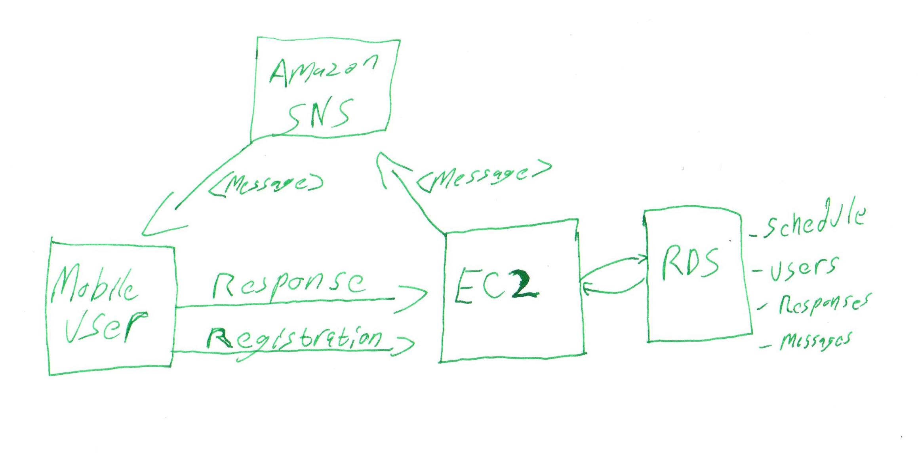
🧐 Conceptual model 🧐

Slide 4
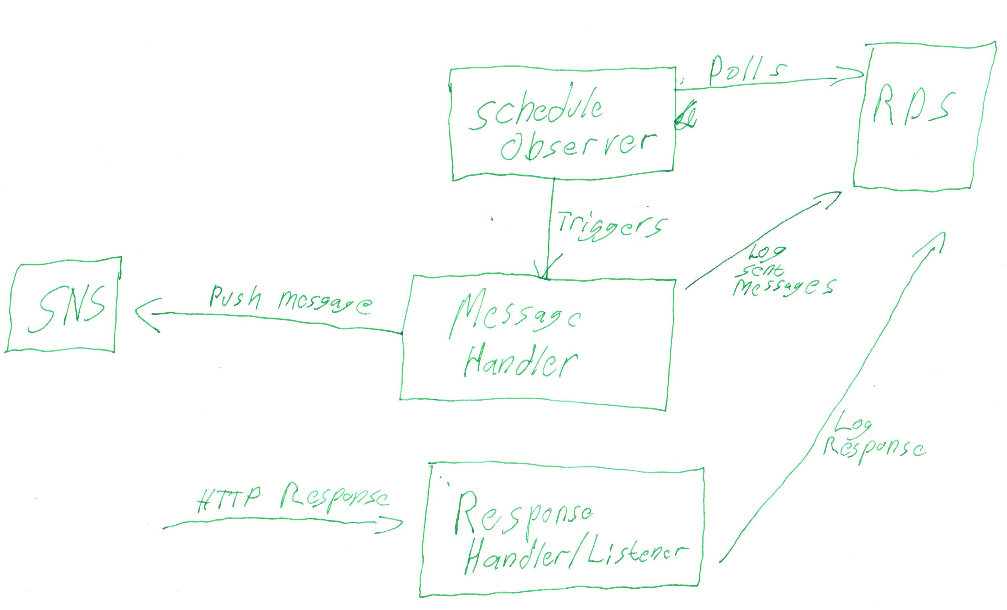
🧐 Conceptual model 🧐

Slide 5
🤔 Challenges 🤔
Interfacing with the mobile app 👀
Schedule implementation
Testing SMS messages
Limited to 100 free a month 😢

Slide 6

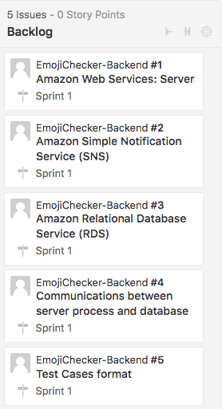
Backlog
What is the architecture going to be like?
The server holds the database and notification service.

Slide 7
backlog
Designing a notification system.
Should be able to send messages to users who sign up for the app.

Slide 8
backlog
Design a database to store user information.
Contains emoji responses.
Accessible to administration team.

Slide 9
backlog
How is the scheduling going to work?
Design ways for the database and push notification service to be in sync.

Slide 10
backlog
Design ways to create smaller test cases for use in backend development.
Does not require the use of the entire application

