Slide 1
simSIMD
Timur Kelin
Development and Simulation Framework for Application Specific Vector Processor
Cambridge 2019

Slide 2
Contents
Overview
System Component: EU
System Component: DM
System Component: XBAR
System Component: Streaming Units
System Component: Scalar Infrastructure
Program Execution

Slide 3
Contents
“Design by Simulation” Strategy
Hardware Considerations
Structure of the Simulator Software
Tests and Examples
ToDo’s and Plans
References

Slide 4
Overview

Slide 5
Objectives
Develop a framework for application specific vector processor with exemplar building blocks and make simulation software.
Simplify the architecture development of the hardware which performs operations on the data structures of finite length (vectors)
Typical applications and their data vectors
Signal processing: OFDM symbols, code blocks
Image and Video processing
Cryptography: cipher blocks
Networking: data packets

Slide 6
Objectives
Framework also provides unified approach for the development of the functional components: Execution Units (EU) and Data Memories (DM) as well as for their interconnect and interoperation
Specific set and configuration of the functional units are identified by the target application

Slide 7
Objectives
Elaborate development and simulation methodology of the hardware architecture from system specifications (algorithms) and throughput requirements
Follow top-down development and optimization strategy
Area: improvement of the utilization rate of the processing blocks and storage elements (RAMs)
Throughput: datapath is elaborated at the architecture development stage
Dynamic Power
Minimization non-recurring engineering (NRE) resources and risks

Slide 8
Objectives
Benefits of using SystemC
Short update-simulation-analysis cycle which allows for simulation driven development and optimization of the architecture
Cycle accurate simulation for the vector core to obtain realistic timing and throughput estimates at the earlier stages
High level of abstraction for Vector Core preferences, runtime configuration and status to stay focused on the architectural tasks
Large ecosystem of C/C++ libraries for data manipulation and processing allows for top-down development approach: from high level processing functions down to elementary arithmetic operations
Integration into the existing simulation workflows
Open source

Slide 9
Exemplar Applications
TBD

Slide 10
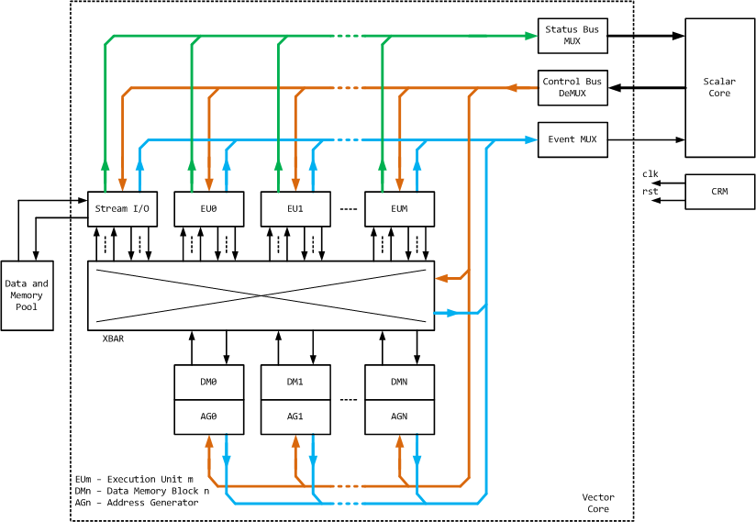
Block Diagram of the Simulated System

Slide 11
Components in Brief
2 major parts: Vector Core and Scalar/Control Core
Vector Core functions
Perform vector computations in accordance to the configuration supplied from the Scalar Core
Generate events at the different stages of the execution of the vector operations
Events are delivered to the Scalar Core
Allow for synchronization of the control threads inside Scalar Core with the Vector Core
Update of the statuses of the vector operations
Allow for data dependent processing
Sequencing of the vector operations

Slide 12
Components in Brief
Vector Core components
Data Memories (DM): temporary storage of the vectors.
A set of Address Generators (AG) associated with each DM allows for flexible addressing and fetching the elements of the vector.
Execution Units (EU): perform successive processing of the elements of the vectors.
These parts of the Vector Core is specific for target application

Slide 13
Components in Brief
Streaming Devices: interfacing Vector Core with the external devices
ADC (source) or DAC (sink)
Preceding or subsequent processing blocks
Interface to the external storage (DMA)
In simulation Streaming I/O Devices address common Data and Memory Pool
XBAR: Network-On-Chip (NOC) for routing the vector streams between Execution Units (EU), Data Memories (DM) and/or Streaming Devices
DMs, EUs and Streaming Devices have a unified interface for the connection to XBAR

Slide 14
Components in Brief
Functions of the Scalar Infrastructure
Respond to the events and status data from the Vector Core components
Control the execution flow in the Vector Core
Synchronize vector processing threads
Generate and deliver configuration data to the Vector Core components

Slide 15
Components in Brief
Scalar Infrastructure components
Scalar Core: processes the events and statuses from Vector Core, and generates configurations for the components of the Vector Core.
It can be implemented as a programmable general purpose CPU subsystem or an FSM depending on the complexity of the control procedures
Event MUX: delivers events which were generated by the Vector Core components to the Scalar Core

Slide 16
Components in Brief
Scalar Infrastructure components (cont’d)
Config De-multiplexer: delivers commands and data supplied from to the Scalar Core to the Vector Core components.
Broadcasting commands are supported for the execution control
Status MUX: delivers the status data, which was sent by the Vector Core components in response to the request commands from the Scalar Core, to the Scalar Core

Slide 17
Major development steps
Decompose processing algorithm down to the level of vector transactions between functional blocks and storage elements
Develop functional blocks which have specified interface with XBAR and Scalar Infrastructure
Assemble the functional blocks and storage elements with the Core framework
Develop Scalar CPU SW and/or Control FSM

Slide 18
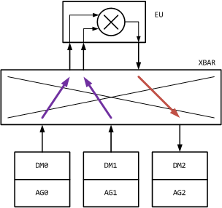
Exemplar Data Flow
Compute Hadamard product (element-wise multiplication) of 2 vectors
Elements of A reside in DM0
Elements of B reside in DM1
Elements of the product C are placed into DM2

Slide 19
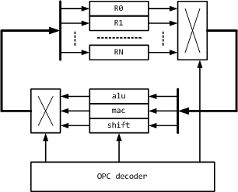
Similarity to a General Purpose CPUs
Registers R0..RN in the register file (RF) are scalars
Controls from OPCode Decoder
RF Output MUX
Processing Unit
RF Input MUX
Parallel operation of the computational blocks [4]

Slide 20
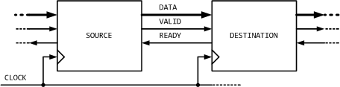
VALID-READY Channel
Decentralized coordination of the data transfers through the stages of the processing pipeline
Main rule: Data is transferred at the active clock edge when both VALID and READY are asserted
SOURCE and DESTINATION can be stages of the processing pipeline or DM/EU modules

Slide 21
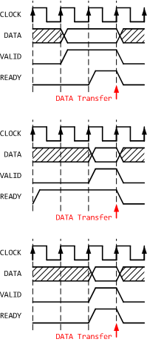
VALID-READY Channel
VALID before READY handshake
READY before VALID handshake
VALID with READY handshake
*Refer to [2],[3] for more details

Slide 22
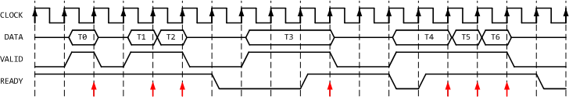
VALID-READY Channel
SOURCE retains the state of VALID and DATA signals until the transaction is acknowledged by the DESTINATION with its READY output asserted
READY signal may change its state at any time. DESTINATION may implement a multi-cycle processing or use a shared resource which availability is changed from cycle to cycle

Slide 23
VALID-READY Channel
At the DM/EU interface DATA signal which is transferred in 1 clock cycle contains 4 data slots
Contents of 1 slot
Flag which identifies that the data field is valid
Data field of type “complex double” representing 1 element of the vector or 1 sample
Other application-specific data structures are possible e.g. fixed-point types, pixel colours, etc.

Slide 24
VALID-READY Channel
VALID signal is extended to 4 states (2 bits) to support of vectors transfers of finite length
IDLE – Inactive state
HEAD – first data transaction if the number of data transactions is more than 1
BODY – intermediate data transaction if the number of data transactions is more than 2
TAIL – last data transaction or data transaction with a single element
Extended application-specific set of states is possible

Slide 25
VALID-READY Channel
In the simulation DM/EU modules are connected to the XBAR via VALID-READY sc_channel.
It monitors if both SOURCE and DESTINATION respect VALID-READY protocol.

Slide 26
VALID-READY Channel
VALID output of the SOURCE must have no combinatorial dependency from its READY input. Otherwise a combinatorial loop is created
READY output of the DESTINATION can be generated with combinational logic from its VALID and/or DATA inputs.

Slide 27
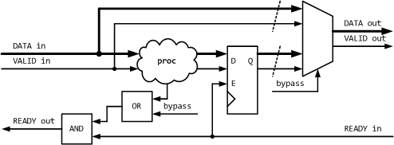
VALID-READY Channel
In RTL DATA and VALID outputs of the SOURCE stage should normally be the outputs of the registers
It is acceptable to implement bypass mux after these registers if the DESTINATION is connected via the VALID-READY channel

Slide 28
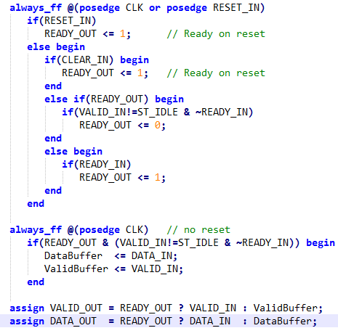
VALID-READY Channel
Breaking combinatorial path of the READY signal is described in [2] Sections 2.1.2, 2.1.3
SV outline:

Slide 29
VALID-READY Channel
When merging streams, a processing stage should rely on all the upstream SOURCES to generate VALID output and wait for an acknowledge from the DESTINATION stage
Time alignment buffers can be used to supply vector elements from all the SOURCES at a single clock cycle
There are 2 ways of splitting streams:
DESTINATION which stalls is nominated to be a master and VALID signal to other DESTINATION s is AND’ed with the READY signal from the master DESTINATION.
For DMs and EUs this feature is implemented as a function of XBAR.
Supply VALID signal and process READY signal individually for each DESTINATION, latching the acknowledges for the given transaction.
This requires dedicated source ports in the DM/EU interface.

Slide 30
VALID-READY Channel
To constrain combinational paths through the XBAR, both input and output signals of VALID, DATA and READY in DM or EU should routed through the FFs.
Full-bandwidth elastic buffers described in [2] Section 2.1.2 can be used from both input and output sides.
Elastic buffer should be extended to support 4-state VALID signal
These buffers add to the datapath a delay of 2 clock cycles per single DM or EU.

Slide 31
System Components OVERVIEW

Slide 32
Common Preferences
config_slots: number of the slots to store runtime configuration
status_slots: number of the slots to store runtime execution status
fifo_depth: depth of the FIFO buffer to store configuration indexes for the deferred execution
See “Program Execution” section

Slide 33
Common Runtime Configuration
zzz

Slide 34
System Component: DM

Slide 35
Overview
DM serve as a storage in the vector processing
Vector buffering and time alignment
Permutation
Constant vector storage (ROM)
Each DM consists of 2 major components
Storage: RAM or ROM blocks
A set of address generators for addressing memory blocks as well as write and read side multiplexers
Currently simulator supports
1RW RAM: single port
1R1W RAM: single Read port and single Write port
Other configurations can be developed
Examples and tests
dm2dm: Verifies basic operation of the DM RAM blocks
dm_init: Verifies initialization of the DM block from .mat file

Slide 36
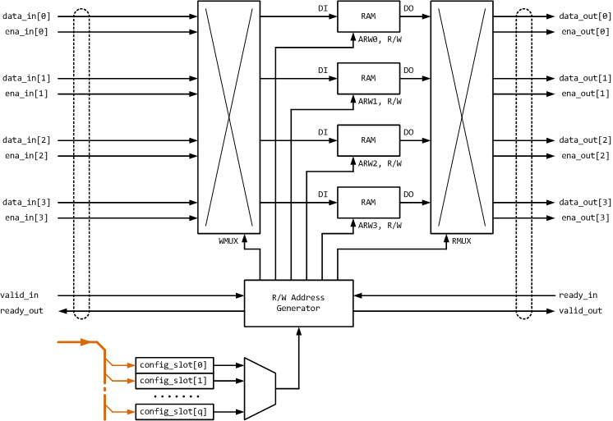
1RW DM Block Diagram

Slide 37
DM Components
Storage RAM blocks
4-way RAM equals to the number of data slots
Each RAM has separate address bus ARW[3:0]
A set of address generators (AGs) for addressing memory blocks as well as write and read side multiplexers
AG is selected by the configuration being executed
AG generates the addresses for each RAM block as well as for the write and read side multiplexers on the basis of the current state of the sample counter
Additional data registers and controls are required for more sophisticated muliplexing
E.g. 1 RAM block provides data for multiple data slots which are intended for a single transaction

Slide 38
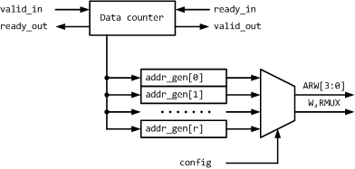
AG Unit for 1RW DM

Slide 39

1R1W DM Block Diagram

Slide 40
DM Preferences
config_slots: number of the slots to store runtime configuration
status_slots: number of the slots to store runtime execution status
fifo_depth: depth of the FIFO buffer to store configuration indexes for the deferred execution
See “Program Execution” section
size: total size of DM RAMs
ag_modes: a set of the address generators which are available to the current block DM in the runtime
init: DM initialization parameters which are set before the execution

Slide 41
DM Runtime Configuration
op_mode: operational mode of the DM (read, write, read+write)
smp_num, wr_smp_num, rd_smp_num: number of samples to be read or written
ag_conf.mode, wr_ag_conf.mode, rd_ag_conf.mode: address generator from the set, specified in the preferences, which is used to generate address for the corresponding transaction
ag_conf.param, wr_ag_conf.param, rd_ag_conf.param: runtime parameters of the address generator

Slide 42
RAM Aggregation
RAM aggregation is the way of addressing smaller size RAM blocks in a way as if it’s a larger RAM block
This further increases RAM utilization rate and as a result reduces silicon area
This is done through the specific aggregation layer containing address decoders and data MUXs.
Multiport RAMs can be independently addressed in the same way.
RAMs inside the DM blocks are substituted with the interfaces to the aggregation layer. This concept is used for both SystemC simulator and SV RTL.
Specific fields are assigned in the DM configuration space for the aggregation control

Slide 43
Aggregation Block Diagram
zzz

Slide 44
RAM Aggregation Evaluation
RAM aggregation is a very application-specific feature and is likely to be evaluated at the later stages of the development of the core architecture
List of the DM blocks with their sizes is stable
Timing diagrams with the processing margins are available
RAM Aggregation has limited support in the generic simulation framework
RAMs are addressed via the SC interfaces
Should be developed in the app. specific SLS

Slide 45
Debug Interface
zzz

Slide 46
System Component: xbar

Slide 47
System Component: streaming units

Slide 48
System Component: Scalar Infrastructure

Slide 49
Program execution

Slide 50
General Considerations
Efficient operation of the Vector Core from the perspective of the HW utilization and throughput:
Vectors are processed back to back, and
Multiple processing chains or threads run concurrently
The configuration of the Vector Core should be placed inside the correponding components before the processing of the new vector starts.
Pick up new configuration upon the completion of the current vector
Start the processing of the new vector without involving Scalar Infrastructure and thus with less delay

Slide 51
General Considerations
Utilization rate and throughput of the Vector Core set the requirements on:
The partitioning of the target processing task
The set of the Vector Core components
The throughput and the performance of the Scalar Infrastructure

Slide 52
Synchronization between Cores: Scalar Core to Vector Core
The processing in the Vector Core is managed by the commands from the Scalar Core
put configuration to a component of the Vector Core
get status of a component of the Vector Core
run configuration with exec_id which is broadcasted into all the components of the Vector Core

Slide 53
Synchronization between Cores: Scalar Core to Vector Core
Configuration
Each Vector Core component can have a number of slots to store the configuration.
Compulsory fields in a configuration slot
exec_id: the configuration becomes active when the block receives "run" command with the matching exec_id. The block picks up the configuration from the slot and starts its execution.
status_slot: the execution status is updated at the slot which is pointed by status_slot
This field is not applicable for XBAR
events: the block issues specific events during the execution of the configuration.
This field is not applicable for XBAR

Slide 54
Synchronization between Cores: Scalar Core to Vector Core
Compulsory fields in a configuration slot (cont’d)
config_next: when the execution of the current configuration is complete i.e.
DM/EU received or transmitted vector TAIL
XBAR identified that all the blocks have completed their processing
the block picks up the configuration from the slot which is pointed by config_next and starts its execution.
This forms a processing chain
Invalid or inexistent config_next completes the chain
Looped chains are possible

Slide 55
Synchronization between Cores: Vector Core to Scalar Core
Status
EU/DM components can have a number of slots to store the results of the vector processing.
Reflect runtime state of the component.
This state is communicated to Scalar Core on request
Data fields inside the status slot are specific to a particular block
Events
Components of the Vector Core can notify Scalar Core on the progress of the execution of the configuration.
Full set of events is specific to DM/EU.

Slide 56
Synchronization between Cores: Vector Core to Scalar Core
Events (cont’d)
The subset of events to be issued for the vector being processed is selected in the configuration
XBAR can issue an event when all the connected components are finished the processing of the vector.
This is useful when the components are executing looped chains
In the simulator the events are implemented with transfers through the FIFO channels with polling and readout on the side of the Scalar Core.

Slide 57
Execution Model Command sequencing under the control of the Scalar Core
Scalar Core configures DMs and EUs, which are employed in the processing chains
Multiple processing chains can run concurrently
Scalar Core configures routing through the XBAR
Same exec_id is programmed for all the DMs, EUs and XBAR configuration
Scalar Core issues run command with the specific exec_id

Slide 58
Execution Model Command sequencing under the control of the Scalar Core
Scalar Core waits for the TAIL event from the blocks which are employed in the processing chain
Scalar Core reads and processes blocks’ status
Scalar Core issues run command for the new chain which has been previously configured
Repeat
This behavior is tested in vri_test1..3

Slide 59
Execution Model Command sequencing under the control of the Vector Core
Configuration Chaining
Cycle stationary (data independent) execution can be handled by the Vector Core without the need for the intervention from the Scalar Core
Events from DMs/EUs/XBAR can be issued in the process of the chain execution to notify the Scalar Core.
The status of the blocks, which have completed the processing, can be read out.
Any of the configuration slots of the blocks, which completed the processing, can be reconfigured
The blocks, which completed the processing, can execute another configuration
FFT with 1 EU and 2 DMs for ping-pong is a good application example of this mode
This behavior is reflected in vri_test4

Slide 60
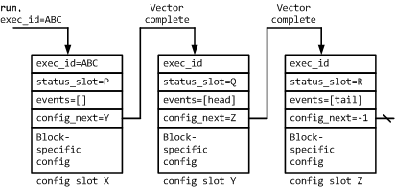
Execution model: Example of the Configuration Chaining
Succession of the operations in the processing chain:
Processing chain is initiated when the block receives run command with exec_id=ABC
Configuration slot X becomes active. A vector is processed. Block status is updated in the slot P. No events are generated.
Configuration slot Y becomes active. A vector is processed. Block status is updated in the slot Q. Event is generated when vector HEAD marker is received.
Configuration slot Z becomes active. A vector is processed. Block status is updated in the slot R. Event is generated when vector TAIL marker is received.
The processing chain is complete.

Slide 61
Execution Model Deferred Execution
Deferred Execution allows writing configuration and issuing run command to DMs, EUs and XBAR while they are busy with the processing.
This relaxes performance constraints on Scalar Core
Configuration chaining prevails over the deferred execution
DM or EU operation
If DM or EU is busy with processing a chain at the moment they receive run command, then the valid exec_id is placed into the FIFO buffer to be processed after the chain execution is complete.
This behavior is reflected in vri_test6

Slide 62
Execution Model Deferred Execution
XBAR
If XBAR receives run command for a configuration which connects DMs/EUs and at least one of them is busy, then it postpones the execution until all of the DMs and EUs for the requested configuration become idle.
This behavior is reflected in vri_test5, 6
Request for changing or running a configuration which is already active is illegal.

Slide 63
Execution Model Data Exchange and Data Dependent Execution
Components of the Vector Core can exchange small amounts of data on their own without involving Scalar Core or communication through XBAR
This data can be used as a Processing Parameter, or
A configuration pointer and/or execution trigger
Simple data transfers should not involve Scalar Core
Relaxes throughput constrains for Scalar Infrastructure
This exchange can be done via common register files or FIFOs on the top of the EUs
HW semaphores
Currently this feature is outside of the scope of the simulation framework but it can be implemented as a specific feature of the simulated application.

Slide 64
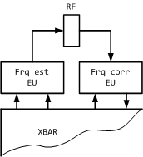
Execution Model Data Exchange and Data Dependent Execution
Exemplar task: frequency offset estimation in one chain and frequency offset correction in another
Estimation task processes a vector and produces a resulting scalar value
Estimation task upon the completion sends its result to the correction task
Correction task uses the scalar value in its processing

Slide 65
“Design by Simulation” Strategy

Slide 66
Hardware Considerations

Slide 67
Structure of the Simulator Software

Slide 68
Data Dump
Data Dump

Slide 69
Simulator Preferences
Preferences are supplied to the simulator via boost property tree or JSON string

Slide 70
Top-level Sections
“core”: array of configurations of the vector core components
“scalar”: placeholder for scalar core preferences [TBD]
“pool”: array of the specifications of the Common Data and Memory Pool segments.
“clock”: clock frequency specification
“time”: specification of the simulation time and resolution
“trace”: specification of the VCD trace and waveform translation
“dump”: an array of data dump specifications for the different points of the simulated system
“report”: controls for SystemC logging and reporting
Please refer to the examples for the specification details

Slide 71
Specification of the Core Component

Slide 72
Pool Segment Specification
“name”:
“size”:
“init”:
“base”:
“file”:
“var”:

Slide 73
Frequency Specification
“frequency”: specifies clock frequency of the processor

Slide 74
Time Specification
“resolution”: specifies simulation time resolution. See [3] section 5.11.3
“finish”: specifies simulation time. See [3] section 4.3.4.2

Slide 75
VCD Trace Specification
“file”: Specification of the name for VCD file. File extension is added.

Slide 76
Data Dump Specification
"buf_regex": regex for the name of the dump buffer. Please refer to the source code for the buffer names.
"time_start": start time of the dump.
"time_end": end time of the dump. “finish” corresponds to the end of simulation time.
"size_res": size of the dump vector for which memory is allocated.
"size_max": max size of the dump vector. If the size of the dump vector exceeds size_max field then the simulator reports an error.
"file": name of the dump file. Dumps are saved in the mat format and can be processed with Matlab or Octave.

Slide 77
Logging and Reporting Specification
“log_file”: name of the log file
“handler”: handler and formatter for report messages. “unchanged” – don’t change handler (integration); “default” – native SystemC handler. “simd” – compact messages.
“bearing”: array of bearings for different message types and severity levels. Please refer to section 8.3 in [5]

Slide 78
TESTS and Examples

Slide 79
vri_test
Verifies system integration and overall functionality
Vector transfers
Block configuration, status and events transfers
Verifies operation of VALID-READY interface and XBAR functionality
Verifies execution modes and command sequencing
Under the control of the Scalar Core
Under the control of the Vector Core
siggen: Streaming block which simulates VALID-READY source
Configurable random VALID or always VALID
Generates random DATA with checksum at TAIL
sigana: Streaming block which simulates VALID-READY destination
Configurable random READY or always READY
Receives DATA and verifies the checksum
Assertions inside VALID-READY channel
Inspection of the VCD trace
Tests 01..07 run continuously in the random order for 1 ms

Slide 80
vri_test
Clean
make EXAMPLE=basic/vri_test clean
Build
make EXAMPLE=basic/vri_test all
Run
./build/Release/out/simsimd
Inspect the result:
In gtkwave File->Open New Window->trace.vcd

Slide 81
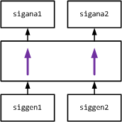
vri_test / test01
Verifies basic operation
Scalar core configures vector core components
st_gen1->st_ana1, st_gen2->st_ana2
Scalar core initiates 2 concurrent vector transfers
Wait for transfer completion by polling the events from XBAR and EUs

Slide 82
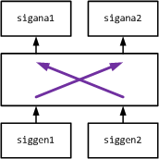
vri_test / test02
Verifies operation of the “always ready” destination
Scalar core configures vector core components
st_gen1->st_ana2 with READY=1, st_gen2->st_ana1
Scalar core initiates 2 concurrent vector transfers.
Wait for transfer completion by polling the events from XBAR and EUs

Slide 83
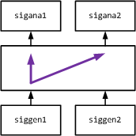
vri_test / test03
Verifies data multicasting
Scalar core configures vector core components
st_gen1->st_ana1, st_ana2. st_ana1 set as master, st_ana2 has READY=1
Scalar core initiates 2 concurrent vector transfers.
Wait for transfer completion by polling the events from XBAR and EUs

Slide 84
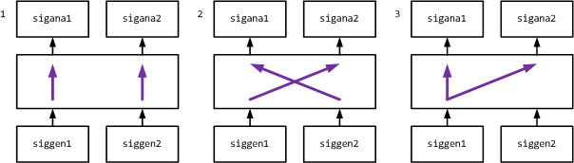
vri_test / test04
Verifies automatic stepping through the EU and XBAR configuration slots
Scalar core configures vector core components to execute 3 configuration slots in a succession.
1. st_gen1->st_ana1, st_gen2->st_ana2
2. st_gen1->st_ana2, st_gen2->st_ana1
3. st_gen1->st_ana1, st_ana2. st_ana1 set as master, st_ana2 has READY=1
Scalar core initiates vector transfers which correspond to slot 1.
Scalar core waits for the completion of the transfers which correspond to slot 3 by polling the corresponding events

Slide 85
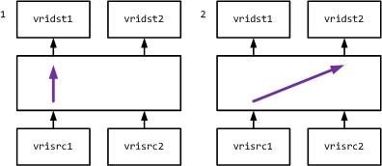
vri_test / test05
Verifies deferred execution in XBAR
Scalar core configures vector core components in slot 1
st_gen1->st_ana1
Scalar core initiates vector transfers which correspond to slot1.
Without waiting for completion Scalar core configures vector core components in slot 2
st_gen1->st_ana2
Scalar core initiates vector transfers which correspond to slot 2. Vector core defers the execution of slot 2 until slot 1 is complete and st_gen1 becomes available.
Scalar core waits for the completion of the transfers which correspond to slot 2.

Slide 86
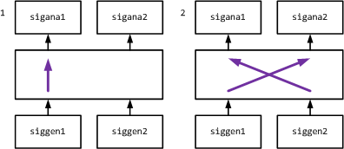
vri_test / test06
Verifies deferred execution in XBAR and EUs
Scalar core configures vector core components in slot 1
st_gen1->st_ana1
st_gen2->st_ana2
Scalar core initiates vector transfers which correspond to slot1.
Without waiting for completion Scalar core configures vector core components in slot 2
st_gen1->st_ana2
st_gen2->st_ana1
Scalar core initiates vector transfers which correspond to slot 2. Vector core defers the execution of slot 2 until slot 1 is complete and EUs become available.
Scalar core waits for the completion of the transfers which correspond to slot 2.

Slide 87
vri_test / test07
Verifies execution priorities
Scalar core configures vector core components to execute configuration slots 1 and 2 in a succession.
1. st_gen1->st_ana1
2. st_gen1->st_ana2
Scalar core initiates vector transfers which correspond to slot 1.
Without waiting for completion Scalar core configures vector core components in slot 3
st_gen1->st_ana1
Scalar core initiates vector transfers which correspond to slot 3. Vector core defers the execution of slot 3 until slots 1 and 2 are complete and EUs become available.
The resulting succession of transfers:
st_gen1->st_ana1
st_gen1->st_ana2
st_gen1->st_ana1

Slide 88
dm2dm
Verifies operation of the DM RAM blocks
dm_ram_1rw – Single port RAM with non-simultaneous read and write operations from a single address
dm_ram_1r1w – simple dual-port RAM with simultaneous one read and one write operations to different locations
The test checks
Integration into the vector core structure
Operational modes of address generator
AG register and configuration
Test runs continuously with the constraint random vector sizes and VRI parameters for 1 ms

Slide 89
dm2dm
Clean
make EXAMPLE=basic/dm2dm clean
Build
make EXAMPLE=basic/dm2dm all
Run
./build/Release/out/simsimd
Inspect the result:
In gtkwave File->Open New Window->trace.vcd

Slide 90
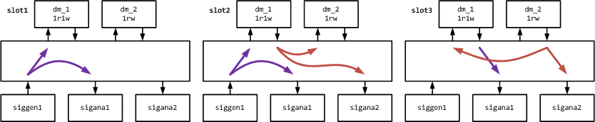
dm2dm
Scalar core configures vector core components to execute configuration slots 1..3 in a succession.
1. st_gen1->dm1 (lower half), st_ana1
2. st_gen1->dm1 (upper half), st_ana1; dm1 (lower half)->dm2, st_ana2
3. dm1 (upper half)->st_ana1; dm2-> dm1 (lower half),dm2
Scalar core initiates vector transfers which correspond to slot1.

Slide 91
dm_init
Verifies initialization of the DM block from .mat file
.mat file is generated with Matlab
The test checks
Integration of matIO library
DM initialization functionality
Test runs continuously with the constraint random VRI parameters for 100 us

Slide 92
dm_init
Clean
make EXAMPLE=basic/dm_init clean
Build
make EXAMPLE=basic/dm_init all
Generate initialization .mat file
Execute ./examples/basic/dm_init/mat/dm_init.m
which generates file
./examples/basic/dm_init/mat/dm_init.mat
Run
./build/Release/out/simsimd
Inspect the result:
In gtkwave File->Open New Window->trace.vcd

Slide 93
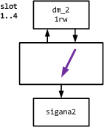
dm_init
4 regions of dm1 block are initialized from the file before the simulation starts
Initialize with the data accepted by st_ana
Scalar core configures vector core components to execute configuration slots 1..3 in a succession.
dm1-> st_ana1, Initialized region 1
dm1-> st_ana1, Initialized region 2
dm1-> st_ana1, Initialized region 3
dm1-> st_ana1, Initialized region 4
Scalar core initiates vector transfers which correspond to slot1.

Slide 94
transp
Verifies operation of the Transparent EU blocks
Synchronous input-to-output transfer: via the register
Asynchronous input-to-output transfer: wires
The test checks
Integration into the vector core structure
Operational of the basic EU block
Asynchronous operation inside EU
Test runs continuously with the constraint random vector sizes and VRI parameters for 100 us

Slide 95
transp
Clean
make EXAMPLE=basic/transp clean
Build
make EXAMPLE=basic/transp all
Run
./build/Release/out/simsimd
Inspect the result:
In gtkwave File->Open New Window->trace.vcd

Slide 96
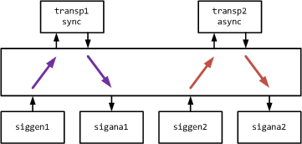
transp
Scalar core configures vector core components to execute single configuration.
st_gen1->transp1->st_ana1 (synchronously transparent EU)
st_gen2->transp2->st_ana2 (asynchronously transparent EU)
Scalar core initiates vector transfers which correspond to slot1.

Slide 97
adder
Verifies operation of the EU blocks with multiple inputs and EU chaining
The test checks
Integration into the vector core structure
Operational of the Adder EU block chained to another adder
Test runs continuously with the constraint random vector sizes and VRI parameters for 100 us

Slide 98
adder
Clean
make EXAMPLE=basic/adder clean
Build
make EXAMPLE=basic/adder all
Run
./build/Release/out/simsimd
Inspect the result:
In gtkwave File->Open New Window->trace.vcd

Slide 99
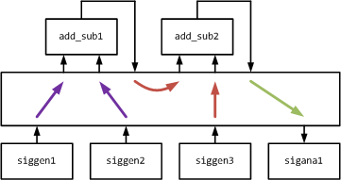
adder
Scalar core configures vector core components to execute configuration slots 1..2 in a succession:
1. SUB( ADD( st_gen1, st_gen2 ), st_gen3) -> st_ana1
2. SUB( ADD( st_gen2, st_gen1 ), st_gen3) -> st_ana1
Scalar core initiates vector transfers which correspond to slot1.

Slide 100
adder_stream
Verifies operation of the Streaming I/O Devices addressing common Data and Memory Pool
The test checks
Initialization of the Data and Memory Pool from the .mat file
Streaming device interface to the vector core and to the Pool
Test runs continuously with the constraint random VRI parameters and streaming device timings for 1 ms

Slide 101
adder_stream
Clean
make EXAMPLE=basic/adder_stream clean
Build
make EXAMPLE=basic/adder_stream all
Generate initialization .mat file
Execute ./examples/basic/adder_stream/mat/seg_init.m
which generates file
./examples/basic/adder_stream/mat/seg_init.mat
Run
./build/Release/out/simsimd
Inspect the result:
In gtkwave File->Open New Window->trace.vcd

Slide 102
adder_stream
Create 3 segments in the Pool:
seg_rd0 with 2 regions initialized from file
seg_rd1 with 2 regions initialized from file
Uninitialized seg_wr0
Scalar core configures vector core components to execute configuration slots 1..2 in a succession.
In either slot
2 Data Vectors are read from the Pool with the input stream interfaces st_inp1 and st_inp2
Data Vectors are processed with add_sub1 and add_sub2 blocks. See the adder test for more details
Resulting vector from the output of the add_sub2 via the output stream interface st_out1 is written to the Pool

Slide 103
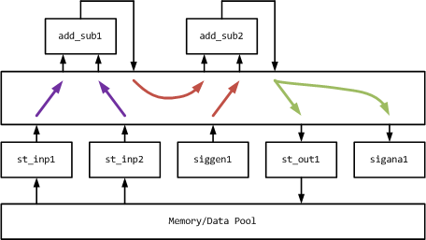
adder_stream
Scalar core initiates vector transfers which correspond to slot1.

Slide 104
adder_cache
Example of the basic system design with the synchronized operation of the Data Memories, Computational Units and Streaming I/O Devices
The test checks
Overall system integration
Development complexity
Test runs continuously with the constraint random VRI parameters and streaming device timings for 1 ms

Slide 105
adder_cache
Input Vectors, which reside in the Data Pool, are written into the DM blocks at the operational rate of the Input Stream Interfaces.
Execution Units process data at a full rate from the memory blocks and the Output Vector is written into the destination memory block.
The Output Vector from the destination memory block is written to the Data Pool at the operational rate of the Output Stream Interface
This arrangement decouples the utilization rate of the Execution Units from the throughput of the Stream Interfaces. Execution Units can be used in other processing chains while not busy processing the Input Vectors.
These operations are controlled from the Scalar Core

Slide 106
adder_cache
Clean
make EXAMPLE=basic/adder_cache clean
Build
make EXAMPLE=basic/adder_cache all
Generate initialization .mat file
Execute ./examples/basic/adder_cache/mat/seg_init.m
which generates file
./examples/basic/adder_cache/mat/seg_init.mat
Run
./build/Release/out/simsimd
Inspect the result:
In gtkwave File->Open New Window->trace.vcd

Slide 107
adder_cache
Create 3 segments in the Pool:
seg_rd0 with 2 regions initialized from file
seg_rd1 with 2 regions initialized from file
Uninitialized seg_wr0
4 configuration slots are configured:
2 Data Vectors are read from the Pool with the input stream interfaces sti_1 and sti_2 and written into memory blocks dm_1 and dm_2 respectively
Data Vectors are read from dm_1 and dm_2 and processed with add_sub1 and add_sub2 blocks. See the adder test for more details. The resulting vector from the output of the add_sub2 is written into the memory block dm_3.
The resulting vector is read from dm_3 and written into the pool segment seg_wr0 with the output stream interface sto_1. Simultaneously 2 Data Vectors are read from the Pool with the input stream interfaces sti_1 and sti_2 and written into memory blocks dm_1 and dm_2 respectively
The resulting vector is read from dm_3 and written into the pool segment seg_wr0 with the output stream interface sto_1.
Slot execution sequence: 1-2-3-2-3-2-3-..-2-4

Slide 108
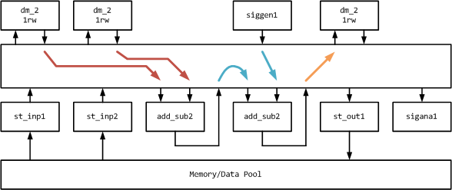
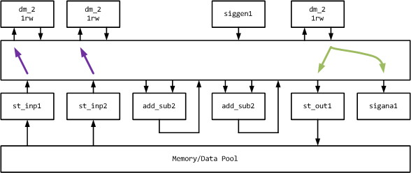
adder_cache
Slot 2
Slot 3

Slide 109
ToDo’s and Plans

Slide 110
Runtime Statistics
For the specific application collect runtime usage data for the resources which were allocated in the preferences
Access to DMs and EUs. Are they actually used?
Which blocks need supporting command sequencing under the control of the Vector Core
Range of the execution indexes
Internals of the DMs and EUs:
Configuration and status slots , bitwidth of the fields
Execution modes
Depth of the FIFO for the execution indexes
EU operational modes
DM AG modes
Events which were issued and processed

Slide 111
Runtime Statistics
Logging of the of the XBAR state
Switching matrix
For the particular application not all of the switching routes are used.
Matrixes for data/valid and for ready can be different if data transfers to multiple destinations are used
Configuration slots, bitwidth of the fields
Execution modes
Events which were issued and processed

Slide 112
RTL Code and Testbench Generator
Generate RTL code on the basis of the initial preferences and runtime statistics
Generate vector core and parameters for XBAR, DMs and EUs
Use VRI interfaces or modules
Data injection
Data pickup
VRI protocol assertions
Generate testbench
Verifies system integration of the vector core

Slide 113
Common Pool of Address Generators for DMs
Additional cross-bar switch (AG -> 4way DMs) can make the area savings negligible

Slide 114
Debug Interface for the Vector Core
Debug Interface for the Vector Core

Slide 115
FXP
FXP

Slide 116
References

Slide 117
Source Code and Documentation
Simulation framework for Application Specific Vector Processor:
https://github.com/timurkelin/simsimd
simSCHD and simSIMD Co-simulation environment:
https://github.com/timurkelin/cosim

Slide 118
Books, Papers and Presentations
[1] Bridging dream and reality: Programmable
baseband processors for software-defined radio,
D.Liu, A.Nilsson, E.Tell, D.Wu, J.Eilert
IEEE Communications Magazine 47 (9), 134-140
[2] Microarchitecture of Network-on-Chip
Routers, A Designer’s Perspective
Dimitrakopoulos G.; Psarras A.; Seitanidis I.
2015, 175p., Springer

Slide 119
Standards and Datasheets
[3] AMBA 4 AXI4-Stream Protocol Specification,
Version: 1.0, (c) 2010 ARM
[4] SHARC Processor Programming Reference,
Revision 2.2, (c) 2013 Analog Devices, Inc.
[5] IEEE Std 1666-2011, IEEE Standard for
Standard SystemC Language Reference Manual

Slide 120
Patents (for reference only)
EP2751670B1: Digital signal processor
EP2751671B1: Digital signal processor and baseband communication device
US20060271764A1: Programmable digital signal processor including a clustered SIMD microarchitecture configured to execute complex vector instructions
US20060271765A1: Digital signal processor including a programmable network
US20070198815A1: Programmable digital signal processor having a clustered SIMD microarchitecture including a complex short multiplier and an independent vector load unit
US20140244970A1: Digital signal processor and baseband communication device
US20140281373A1: Digital signal processor and baseband communication device
US20140344549A1: Digital signal processor and baseband communication device
US20140351555A1: Digital signal processor and method for addressing a memory in a digital signal processor
US20140359252A1: Digital signal processor
US20140372728A1: Vector execution unit for digital signal processor
US7299342B2: Complex vector executing clustered SIMD micro-architecture DSP with accelerator coupled complex ALU paths each further including short multiplier/accumulator using two's complement
US7415595B2: Data processing without processor core intervention by chain of accelerators selectively coupled by programmable interconnect network and to memory
US8874968B1: Method and system for testing a processor designed by a configurator
US9557996B2: Digital signal processor and method for addressing a memory in a digital signal processor

