Slide 1
AI的发展趋势
An Overview of the Development Trends of AI

Slide 2
Machine Learning
1. Machine learning is a subset of AI that involves teaching machines to learn and make decisions based on data.
2. It is expected to be the key driver of AI development in the next decade.
3. Applications include image and speech recognition, fraud detection, and personalized marketing.

Slide 3
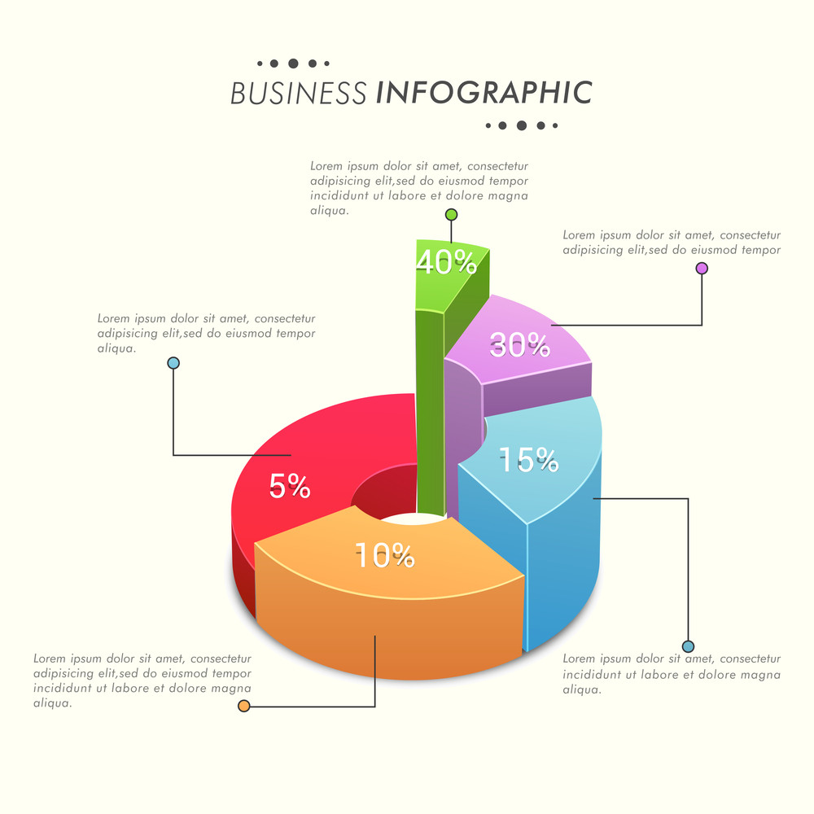
Big Data
1. The growth of big data is fueling the development of AI.
2. The ability to gather, store, and analyze massive amounts of data is critical for the success of AI algorithms.

Slide 4
Natural Language Processing
1. Natural language processing (NLP) involves teaching machines to understand and process human language.
2. It is an important area of AI research due to the increasing use of chatbots and voice assistants.
3. Potential applications of NLP include language translation, sentiment analysis, and content generation.

Slide 5
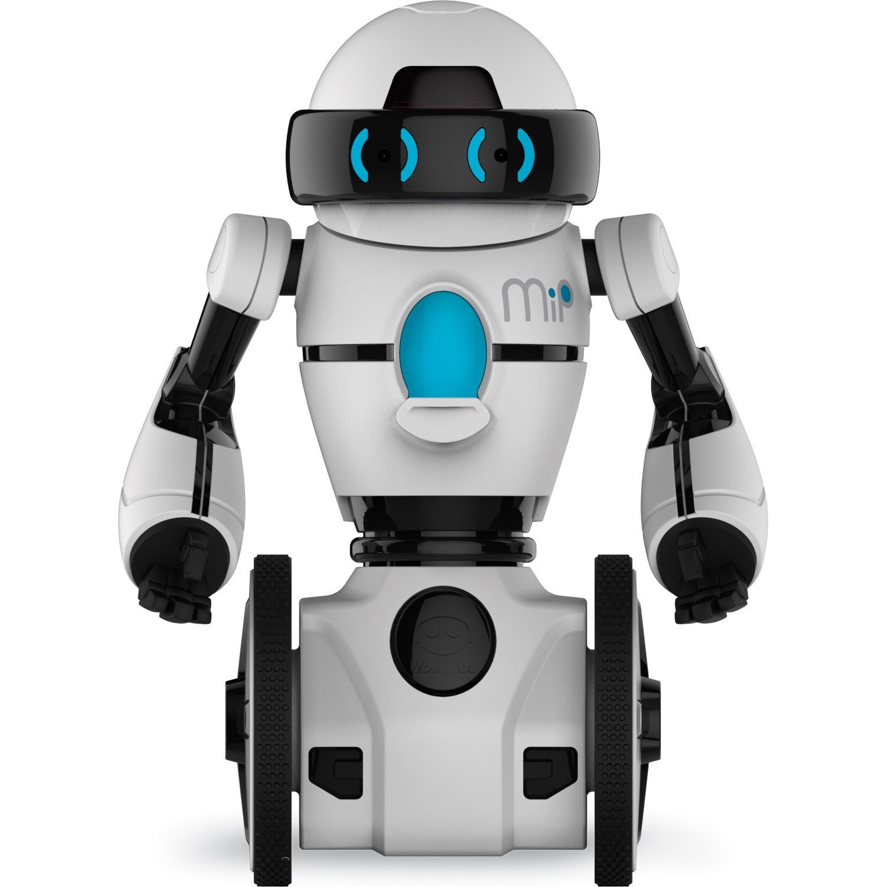
Robotics
1. The integration of AI and robotics is expected to revolutionize many industries, including manufacturing, healthcare, and transportation.
2. Advancements in the field of robotics are increasing the range of tasks that machines can perform, such as assisting with surgery and performing complex tasks in hazardous environments.

Slide 6
谢谢观看

