Slide 1
wdwd

Slide 2
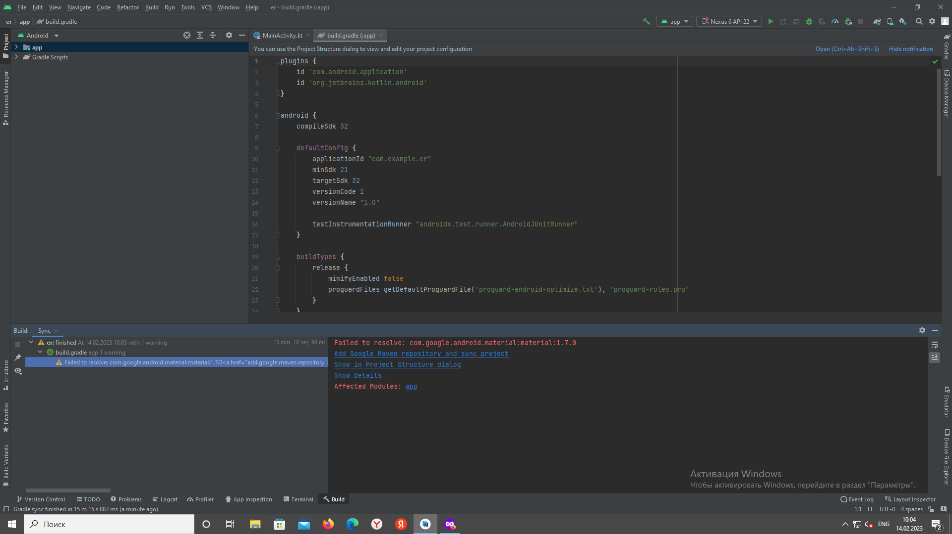
dgdg

