Slide 1
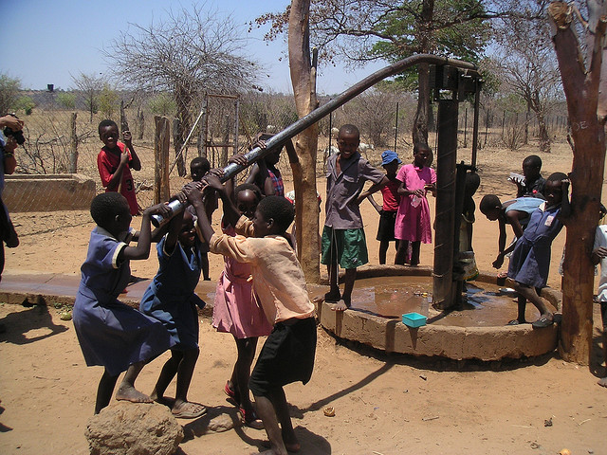
Workshop: Ensure clean, potable water to communities in Tanzania

Slide 2
ML workshop
This is a 3 – hour long workshop
Follow along in the Jupyter Notebook at github.com/hbiserinska/workshop
We will be walking through an end-to-end project today

Slide 3
Schedule
Kick off
Introduction
Tutorial
Conclusion
Meet up
&
greet
15 min
Classification algorithms
Pipeline of a Data Science project
30 min
Data Cleaning
Exploratory data analysis
Classification techniques
90 minutes
Summary
Additional resources
15 minutes

Slide 4
Supervised Learning algorithms
Supervised learning
Unsupervised learning
Classification
Clustering
Regression
Anomaly detection

Slide 5
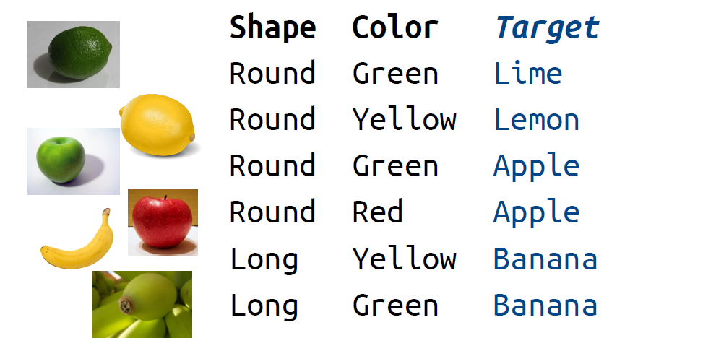
Classification
In this type of task, the computer program is asked to specify which of n categories some input belongs to.
Input (X)
Output (Y)
Multiclass classification

Slide 6
Classification
In this type of task, the computer program is asked to specify which of n categories some input belongs to.
Input [X₁, X₂]
Output (Y)
Multiclass classification

Slide 7
Classification
In this type of task, the computer program is asked to specify which of n categories some input belongs to.
Input [X₁, X₂, X₃]
Output (Y)
Radius Texture Аrea
14.68 20.13 684.5
16.13 20.68 798.8
19.81 22.15 1260
13.54 14.36 566.3
13.08 15.71 520
9.504 12.44 273.9
Malignant
Malignant
Malignant
Benign
Benign
Benign
Binary classification

Slide 8
Key Classification Algorithms
Decision Tree
Random Forest
XGBoost
Logistic Regression
Support Vector Machine
Naïve Base
Neural Networks

Slide 9
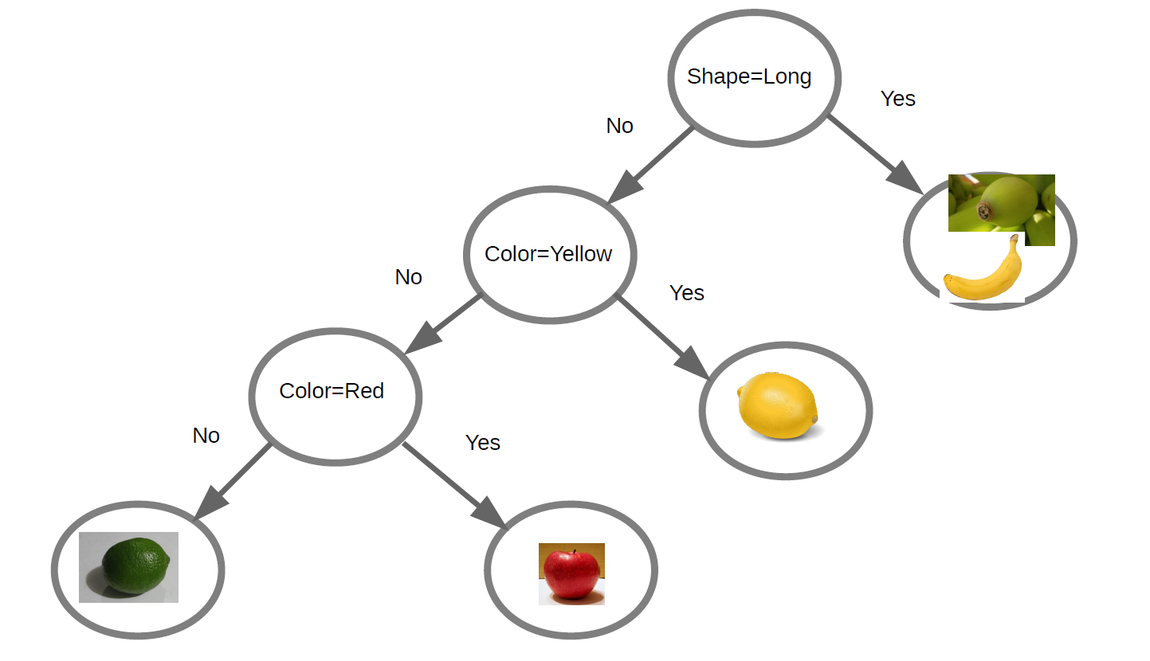
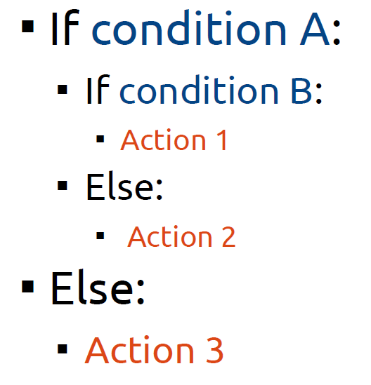
Decision Tree

Slide 10
Which question to ask first?
It's best to ask important questions first.
Which questions are important?
The ones which help us classify:
if we had to classify data based only on one question, which question would do best?

Slide 11

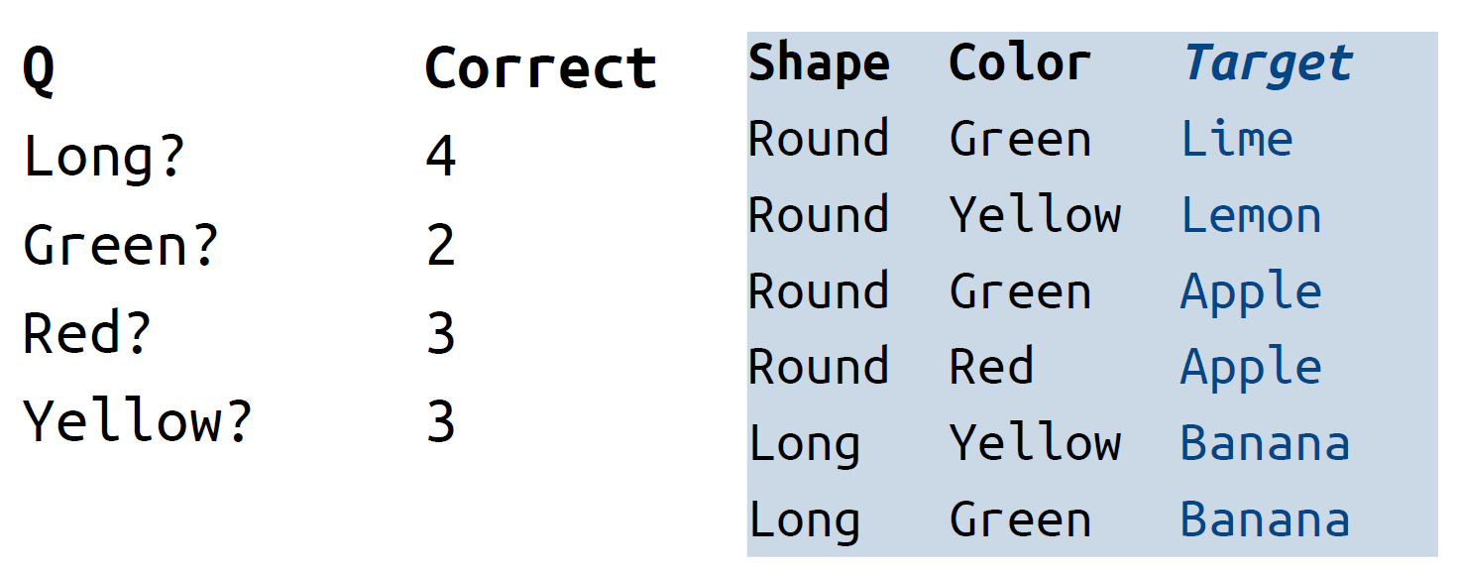
Step by step
Long?
Yes
No
Lime
Lemon
Apple
Apple
Apple
Apple
Apple
Apple
Banana
Banana
Banana
Banana
Red?
Yes
No
Lime
Lemon
Apple
Banana
Banana
Banana
Banana
Banana
Banana
Banana
Apple
Apple

Slide 12
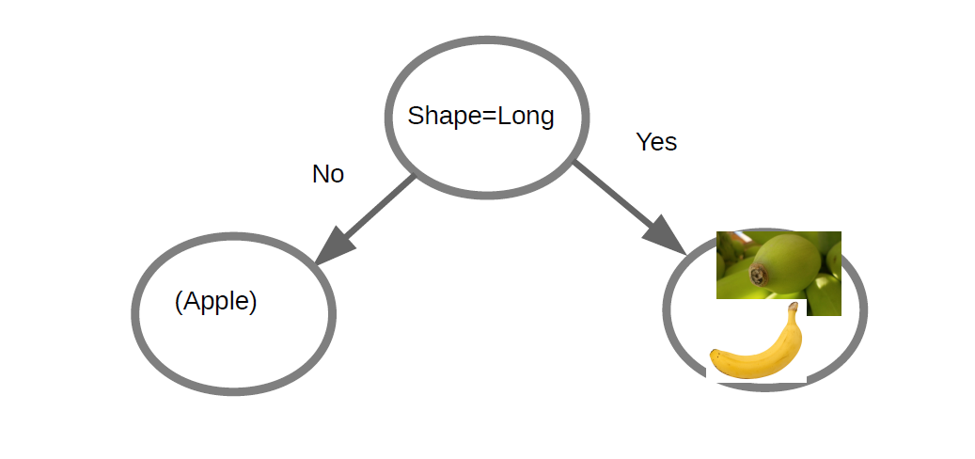

Slide 13
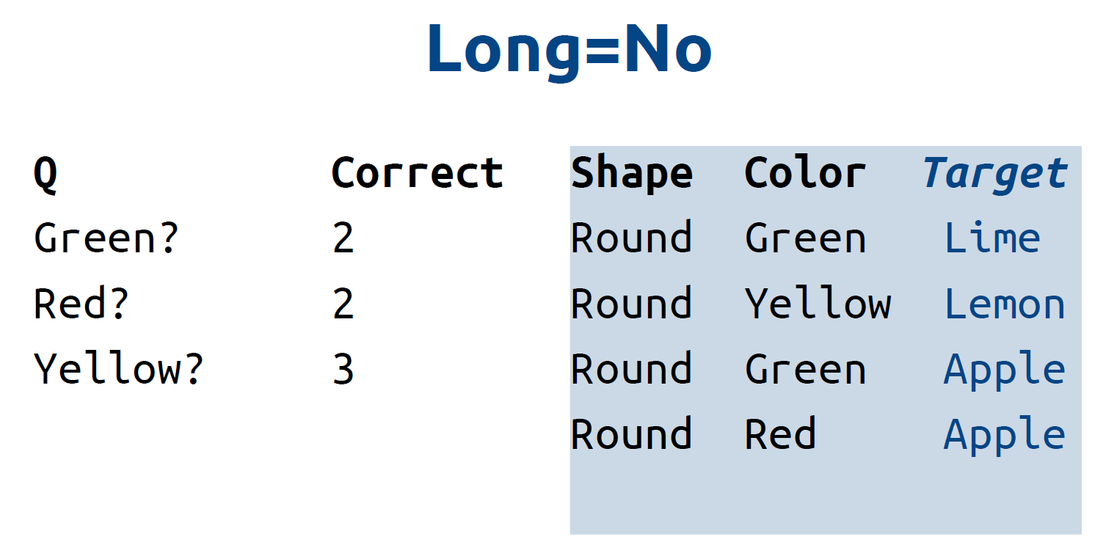

Slide 14
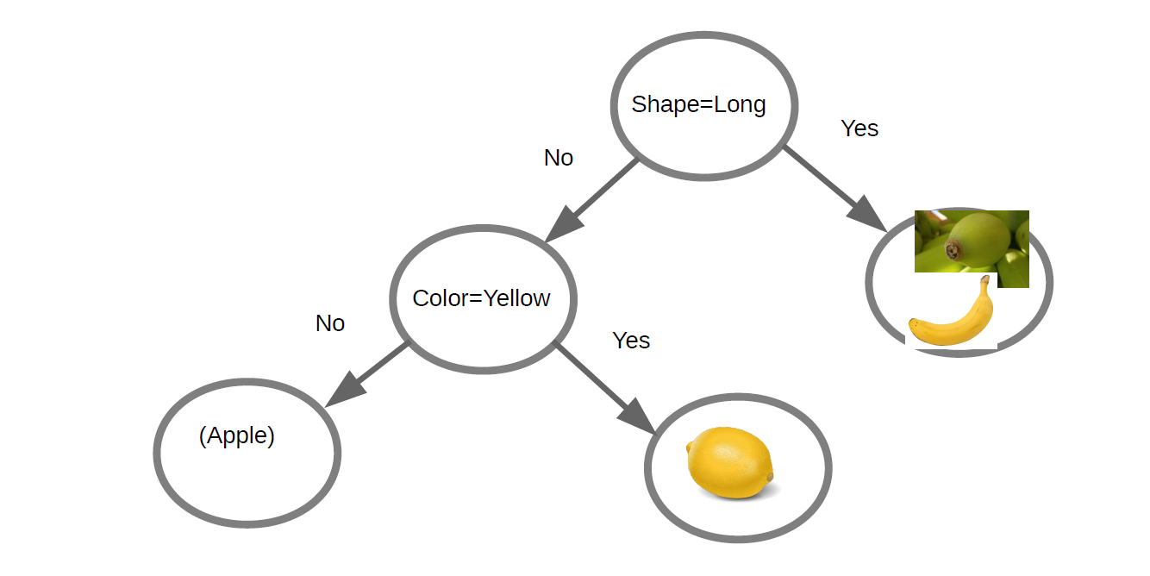

Slide 15
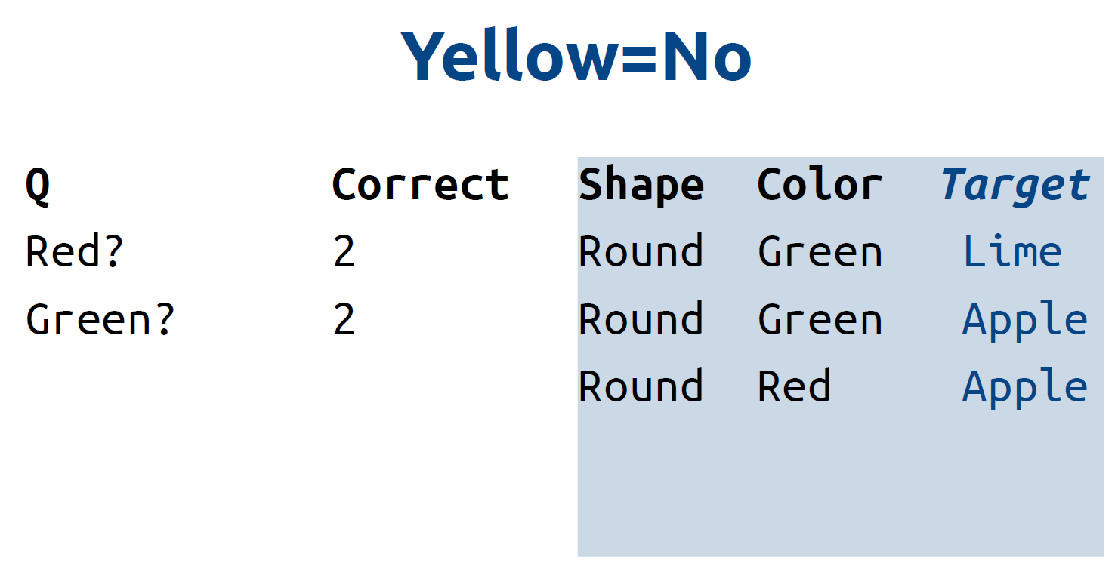

Slide 17
Random Forest
10 trees are better than one!
Sample examples n times
Build n trees
Each tree (using a random subset of features)
Prediction: average answers;
Majority vote

Slide 18
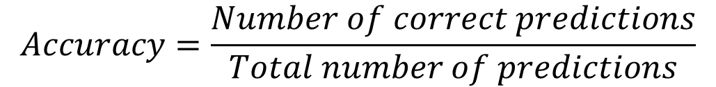
Performance measures (P)
To evaluate the abilities of a machine learning algorithm, we must design a quantitative measure of its performance.
The performance measure P is specific to the task T.
For Classification tasks, we often measure the accuracy of the model - is the fraction of predictions our model got right.
$$Accuracy=\frac{Number of correct predictions}{Total number of predictions}$$

Slide 19
When the Accuracy is not a good choice?
Binary classifier {5, not 5}
Dataset with all numbers from 0 to 9
Performance measure – Confusion Matrix
! only about 10% of the images are 5s, so if you always guess that an image is not a 5, you will be right about 90% of the time => high accuracy => but not a good 5s detector

Slide 20


Confusion Matrix
A much better way to evaluate the performance of a classifier
Non 5s
$$Precision=\frac{TP}{TP+FP}$$
We want to avoid non spam email to end up in the spam box
5s
We want to avoid missing a tumor sign when examining a patient
$$Recall=\frac{TP}{TP+FN}$$

Slide 21
Project Life-Cycle
Look at the big picture
Get the data
Discover and visualize the data to gain insights
Prepare the data for Machine Learning algorithms
Select a model and train it
Present your solution

Slide 22
Jump to Jupyther notebook
https://github.com/hbiserinska/workshop

Slide 23
1. Look at the big picture
Frame the Problem
The first question to ask is what exactly is the objective.
- Predict if a water pump is: functional, needs repair, non functional
How does the company expect to use and benefit from this model?
- Plan the maintenance, reduce the time to organize.
The next question to ask is what the current solution looks like (if any). It will often give you a reference performance, as well as insights on how to solve the problem.
N/A
First, you need to frame the problem: is it supervised or unsupervised? Is it a classification task, a regression task, or something else?
- Supervised learning, Classification task

Slide 24


Practical advice
Books, datasets, learning platforms and tools
Create a GitHub account
Work on competitions & upload your solutions.
Ask the people you worked with to write a recommendation on your LinkedIn page.
Build your portfolio of models created with public datasets & upload on GitHub.
5. DataCamp https://www.datacamp.com/
6. Coursera Andrew Ng Machine Learning course - https://www.coursera.org/learn/machine-learning
7. Book: Hal Daumé III - A Course in Machine Learning (http://ciml.info/)
8. Create a great resume - enhancv.com
9. Jobs: https://dev.bg/company/jobs/data-science/

Slide 25
Hristina Biserinska
Data Scientist
hbiserinska@gmail.com
+359 888 859 291
https://www.linkedin.com/in/biserinska/
https://www.melontech.com/

Slide 26
Image credits
Red apple http://upload.wikimedia.org/wikipedia/commons/2/24/Redapple.jpg
Banana http://upload.wikimedia.org/wikipedia/commons/8/8a/Banana-Single.jpg
Lime http://upload.wikimedia.org/wikipedia/commons/5/55/Lime_closeup.jpg
Lemon https://openclipart.org/image/300px/svg_to_png/189589/lemon-citrina.png
Green apple http://upload.wikimedia.org/wikipedia/commons/5/55/GreenApple.png
Green Banana http://pixabay.com/en/green-bananas-tip-garden-banana-108109/
Green lemon http://pixabay.com/static/uploads/photo/2013/12/15/11/33/lemon-228857_640.jpg
Supervised & Unsupervised learning, MNIST dataset, Confusion Matrix – Author: Aurélien Géron, Book: Hands-on Machine Learning with Scikit-Learn, Keras, and TensorFlow
Pump image courtesy of flickr user christophercjensen
Github - https://logos-world.net/github-logo/
Kaggle - https://www.kaggle.com/

