Slide 1
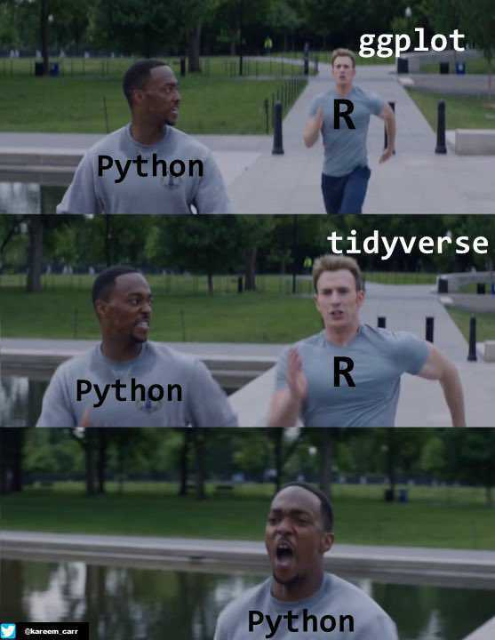
Introduction to Data Visualization
Visualizing Nested Proportions & Associations + Introduction to ggplot (R)
Halil Bisgin, Ph.D.

Slide 2
Nested Proportions
We may want to drill down further and break down a dataset by multiple categorical variables at once.
We could be interested in the proportions of seats by party and by the gender of the representatives.

Slide 3
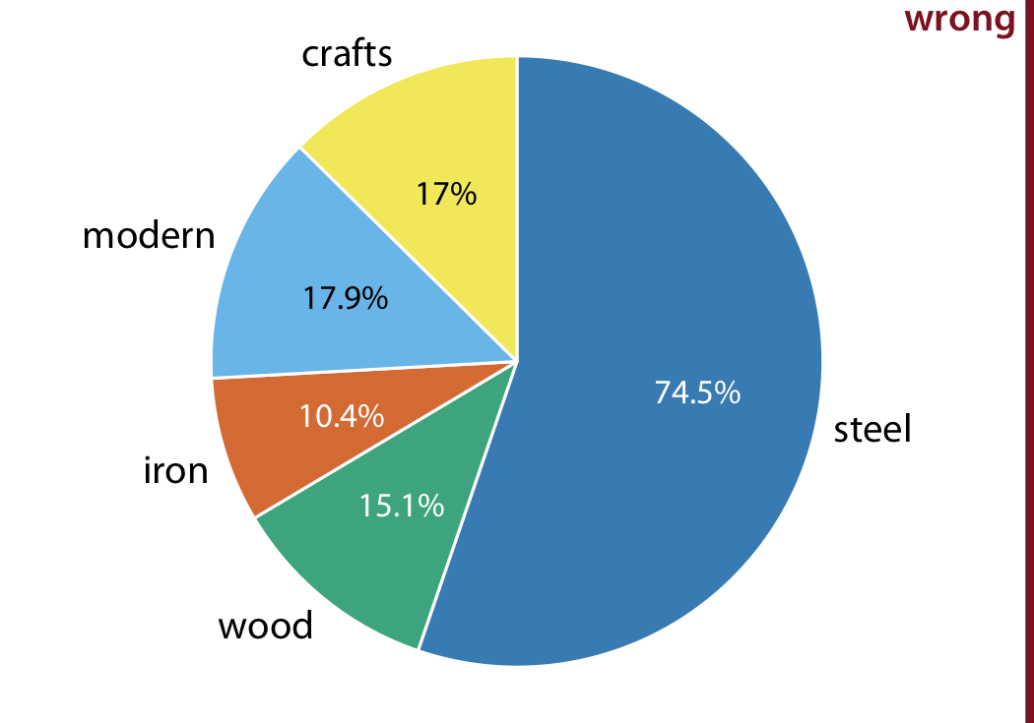
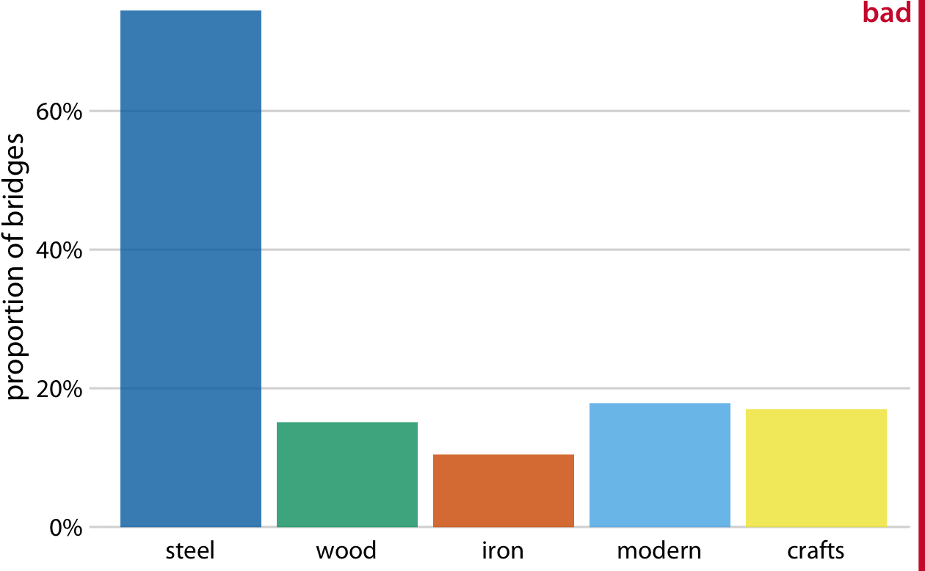
Nested Proportions Gone Wrong
A dataset of 106 bridges in Pittsburgh.
material from which they are constructed (steel, iron, or wood),
based on the year of erection, bridges are grouped into distinct categories, such as crafts and modern.
On which river?
Sum exceeds 100% due to double count
It does not clearly indicate the overlap

Slide 4
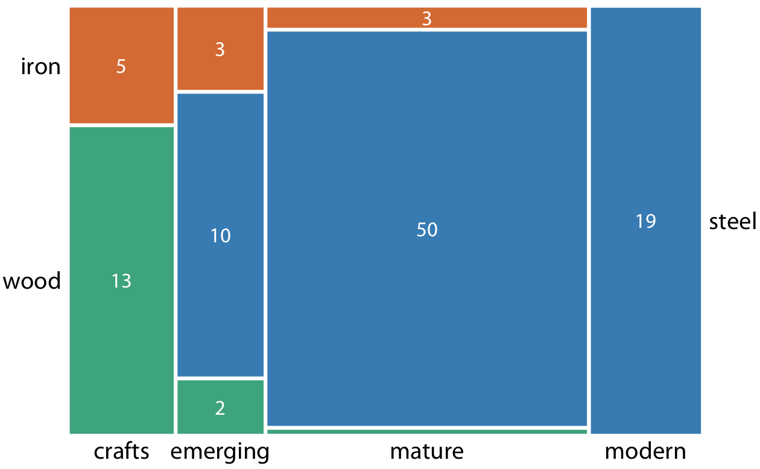
Nested Proportions-Mosaic Plot
When there are overlapping categories, it is best to show explicitly how they relate to each other.

Slide 5
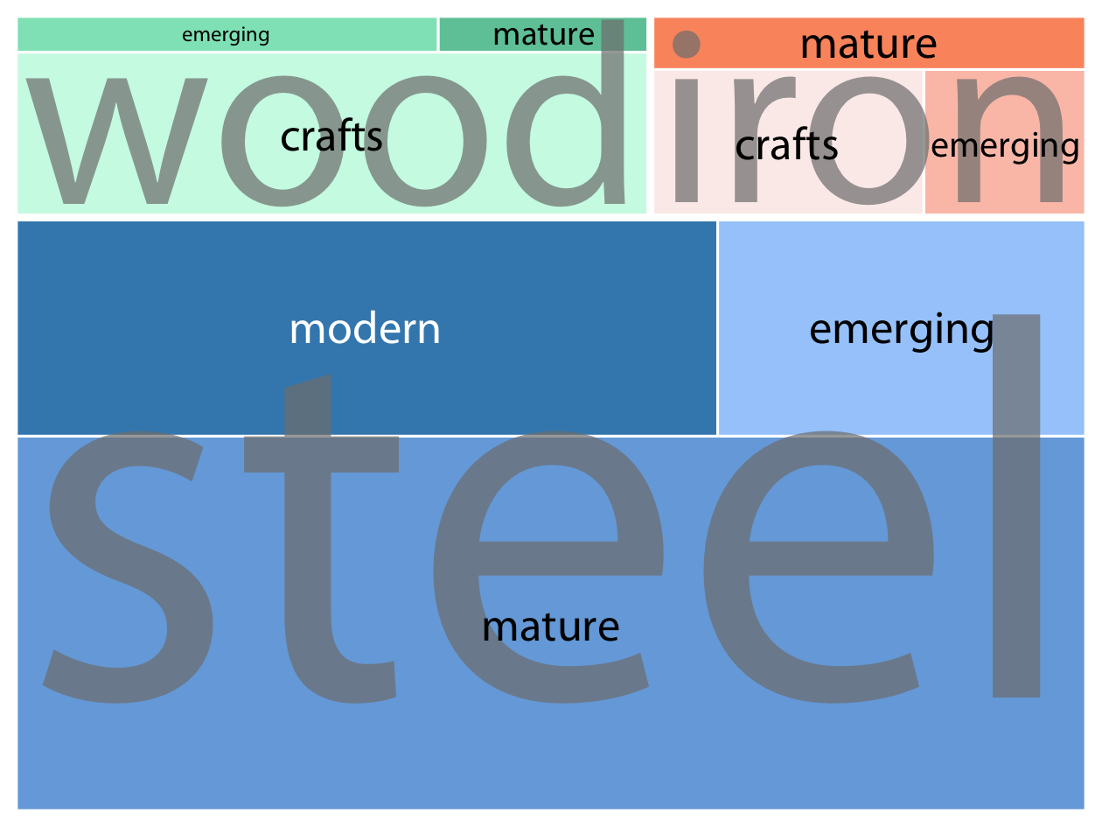
Nested Proportions-Treemap Plot
Shows the counts for every possible combination

Slide 6
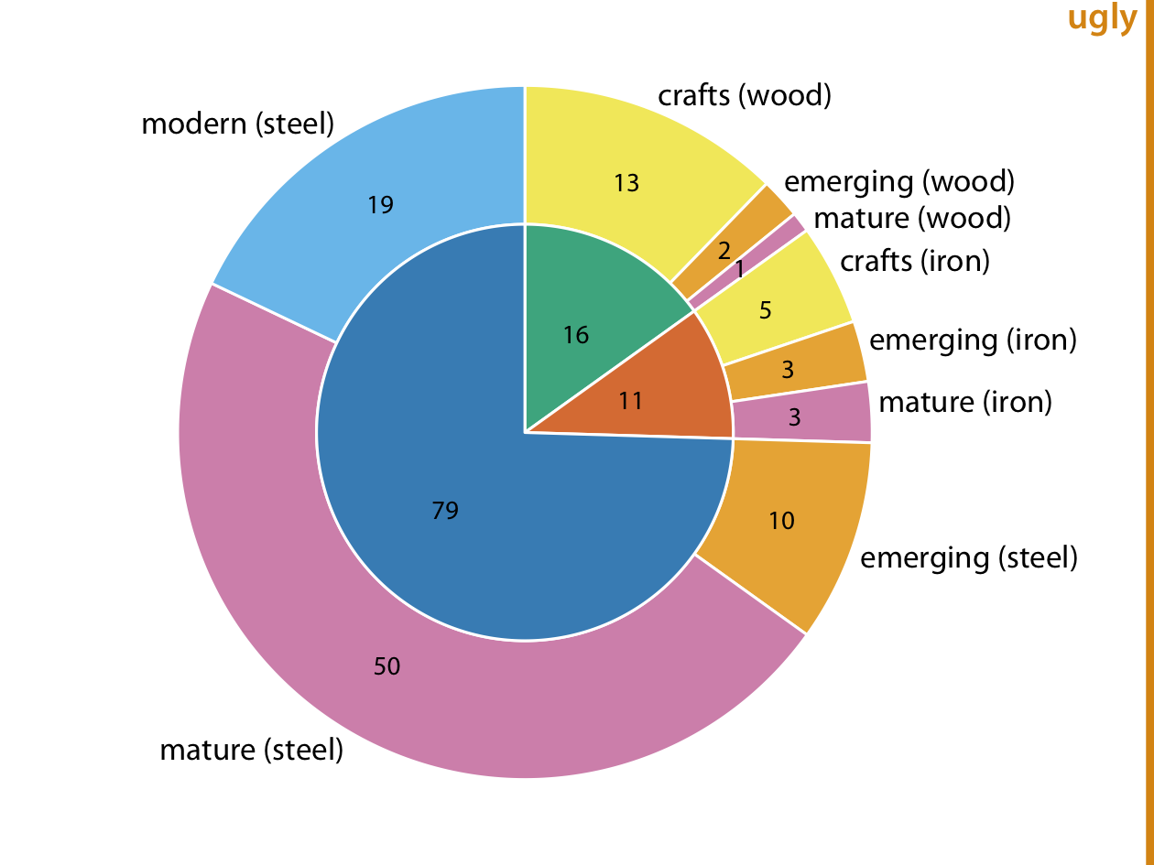
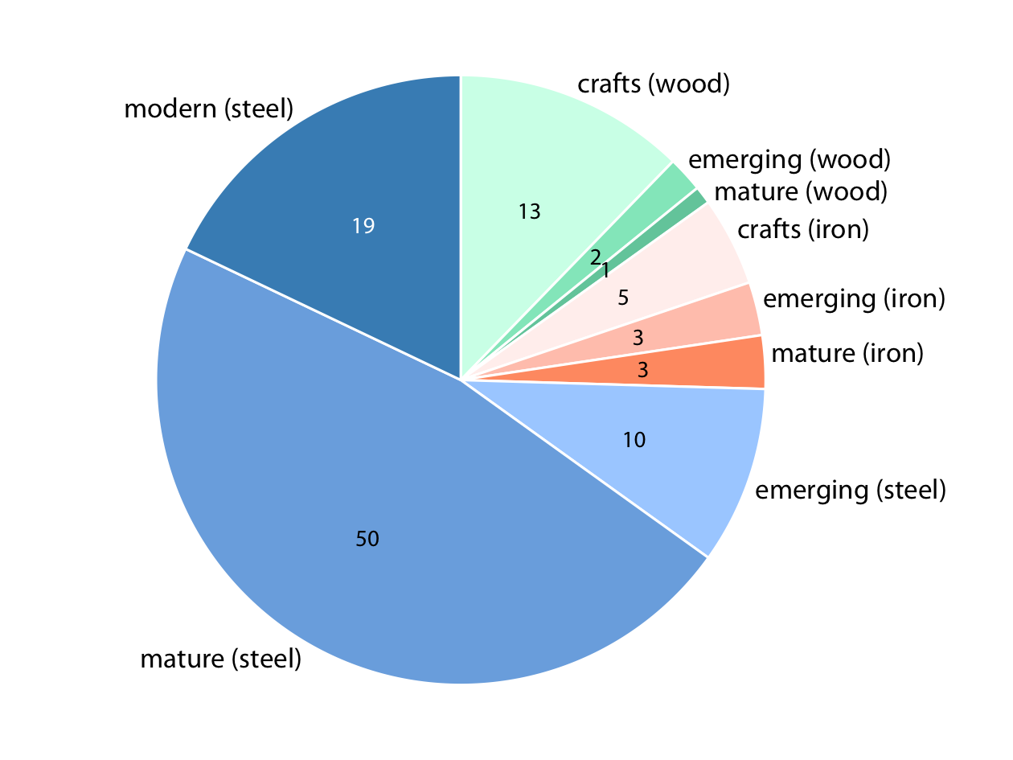
Nested Proportions-Nested Pies

Slide 7
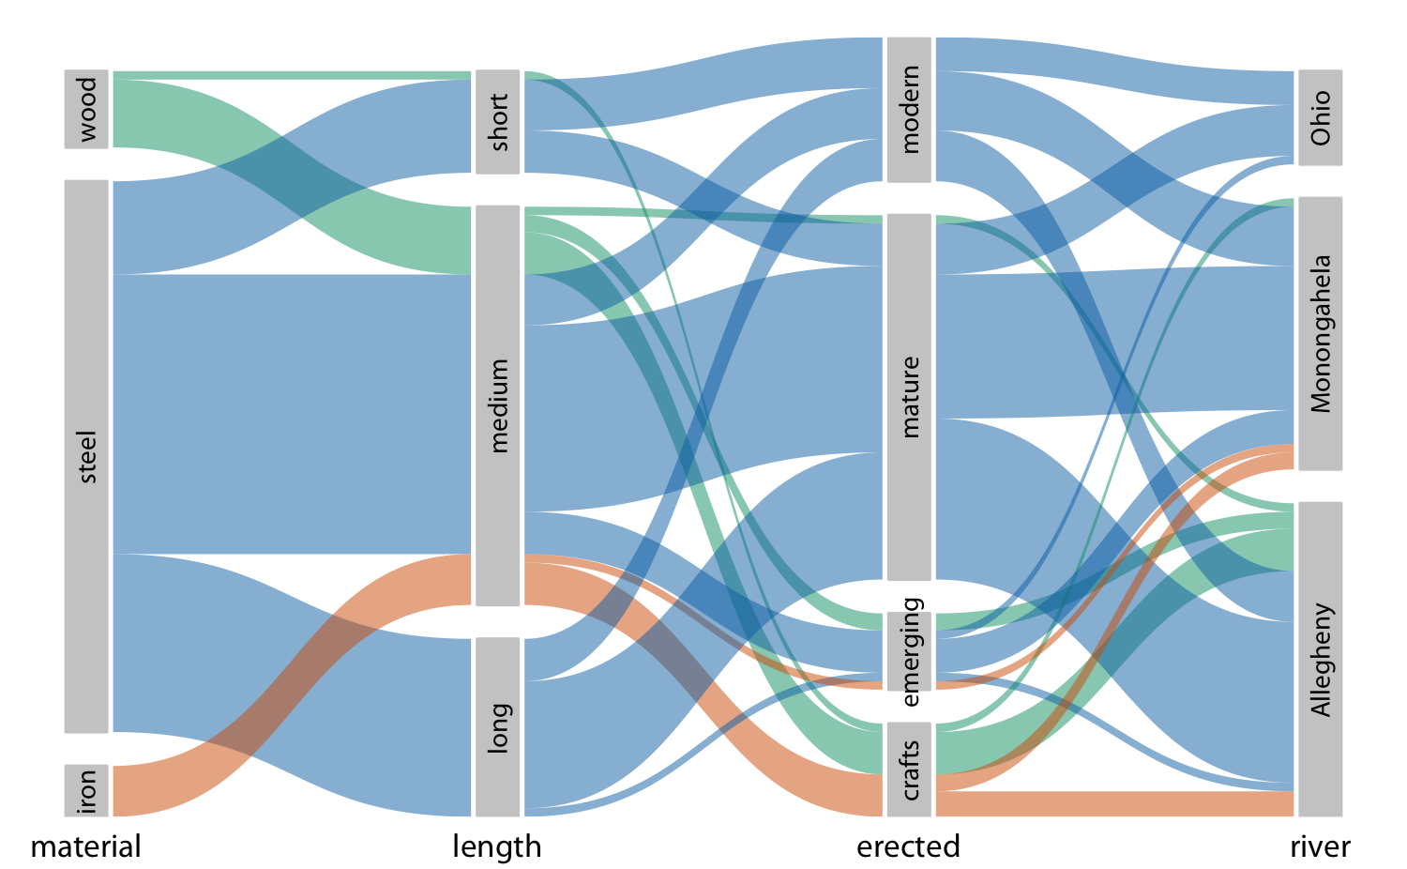
Nested Proportions-Parallel Sets
When more than two categorical variables, parallel sets plot can offer a less crowded view.
It shows how the total dataset breaks down by each individual categorical variable by using shaded bands.

Slide 8
x-y Relationships
Many datasets contain two or more quantitative variables, and we may be interested in how these variables relate to each other.
animals’ height, weight, length, and daily energy demands.
Two variables → scatterplot.
More than two variables → bubble chart, scatterplot matrix, correlogram.
For very high-dimensional datasets, it may be useful to perform dimension reduction,
Principal components analysis.

Slide 9
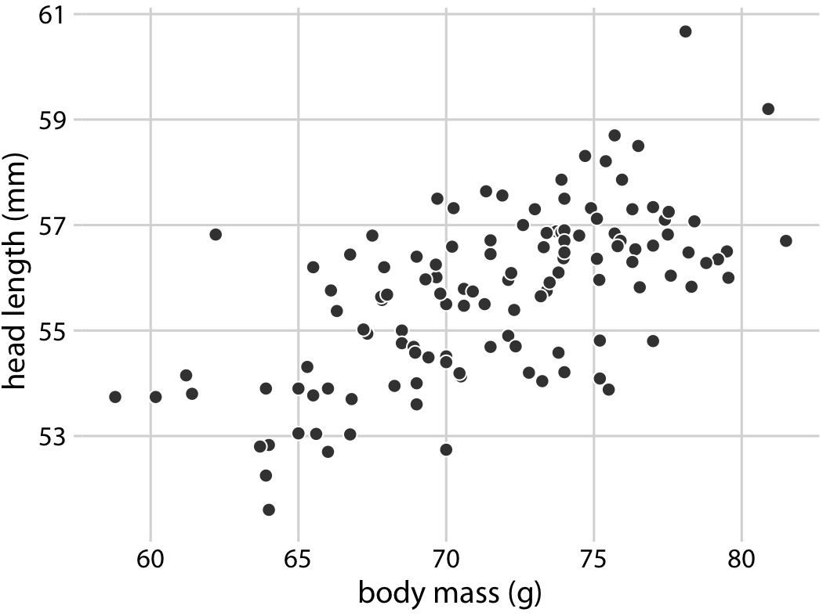
Scatterplots
The dataset of 123 blue jay birds
head length (measured from the tip of the bill to the back of the head)
the skull size (head length-bill length)
the body mass

Slide 10
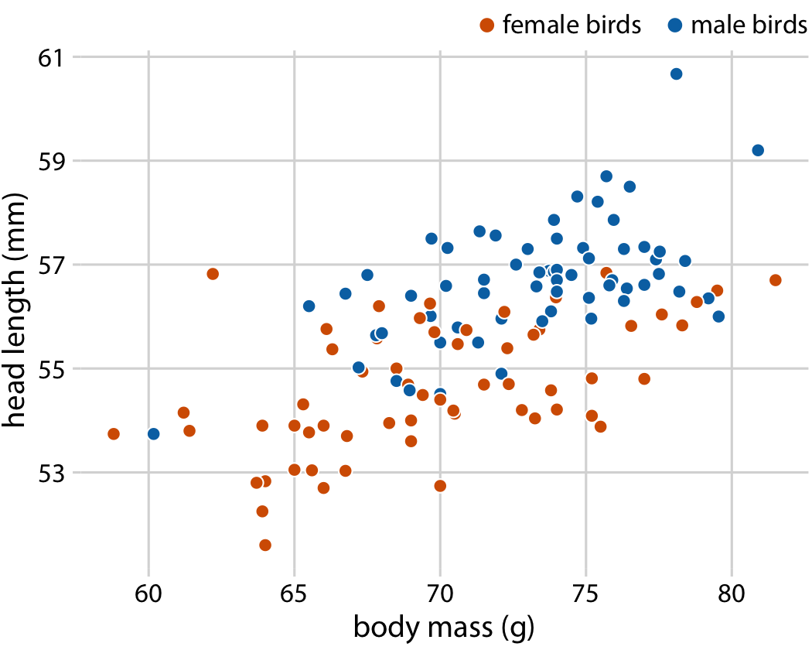
Scatterplots
The blue jay dataset contains both male and female birds
The relationship between head length and body mass for each sex.

Slide 11
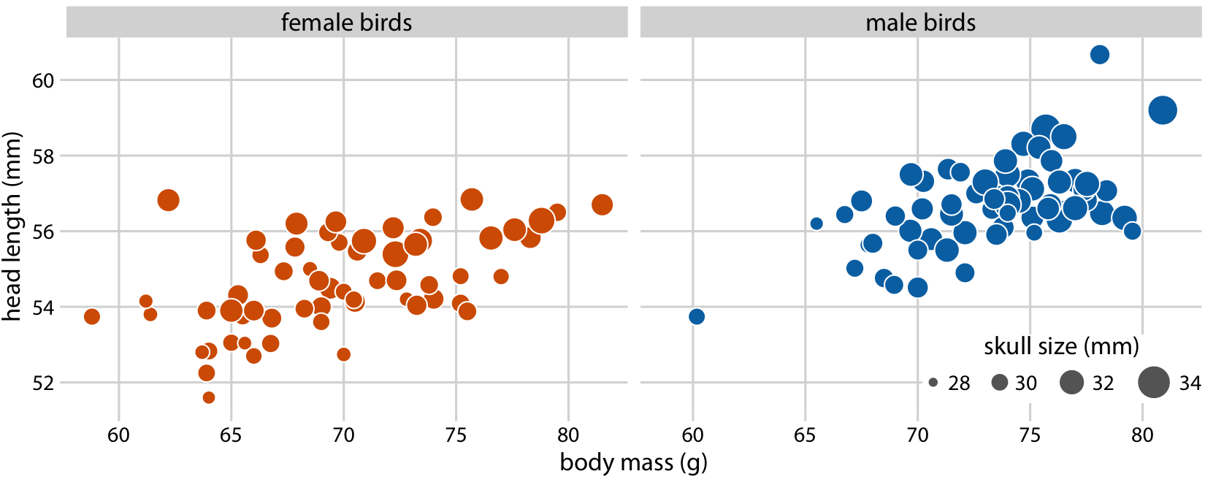
Bubble Chart
We can disentangle bill length and skull size by looking at another variable in the dataset, the skull size, which is similar to the head length but excludes the bill.

Slide 12
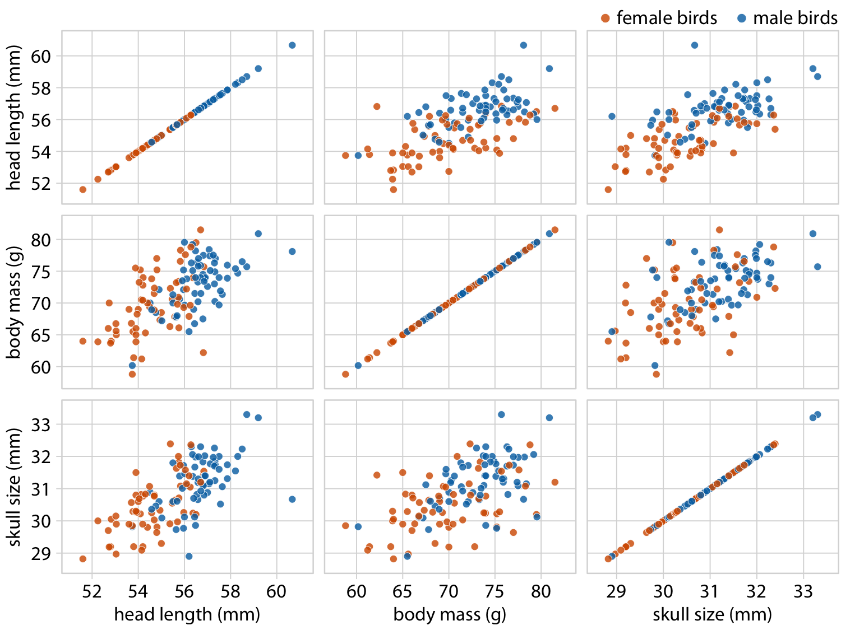
Pairwise plots
It may be preferable to show an all-against-all matrix of scatterplots.
Notes:
This figure shows clearly that the relationship between skull size and body mass is comparable for female and male birds, except that the female birds tend to be somewhat smaller.
However, the same is not true for the relationship between head length and body mass. There is a clear separation by sex. Male birds tend to have longer bills than female birds, all else being equal.

Slide 13
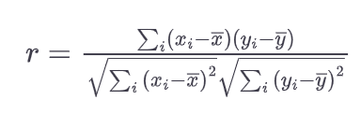
Correlograms
When there are more variables, it is more useful to quantify the amount of association between pairs of variables and visualize these quantities rather than the raw data.
Calculate correlation coefficients (r).
Between –1 and 1 that measures to what extent two variables covary.
r = 0 means there is no association whatsoever, 1 or –1 indicates a perfect association.
r indicates whether the variables are correlated (larger values in one variable coincide with larger values in the other) or anticorrelated (larger values in one variable coincide with smaller values in the other)

Slide 14
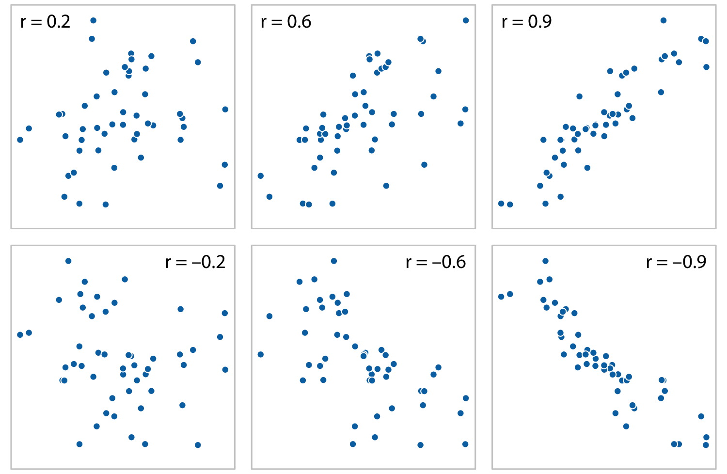
Correlograms
Examples of correlations of different magnitude and direction, with associated correlation coefficient r

Slide 15
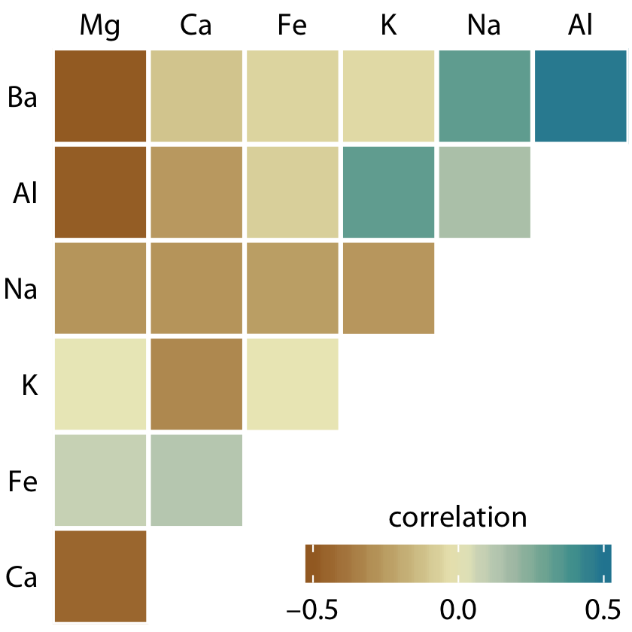
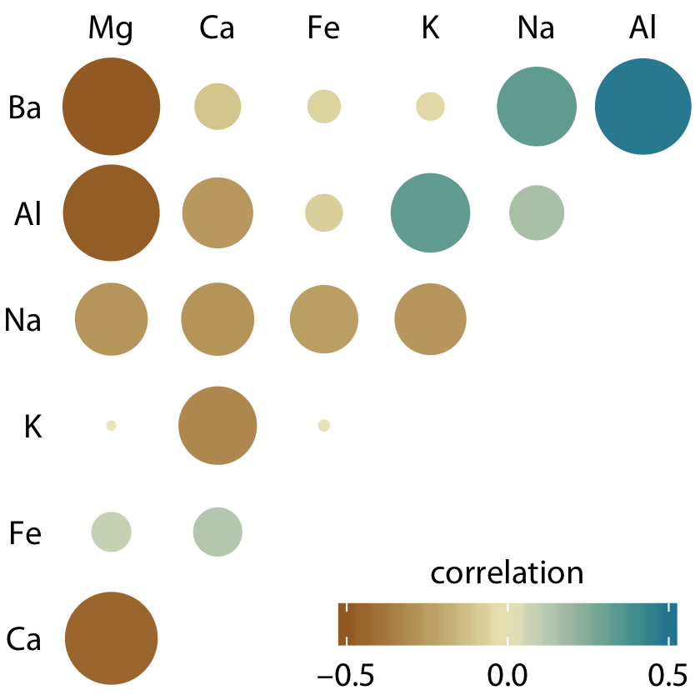
Correlograms
Dataset of over 200 glass fragments obtained during forensic work.
Correlations between minerals.
→
Not visually suppressed

Slide 16
Dimension Reduction
Most high-dimensional datasets have multiple correlated variables that convey overlapping information.
Such datasets can be reduced to a smaller number of key dimensions without loss of much critical information.
dataset of multiple physical traits of people, including quantities such as each person’s height and weight, the lengths of their arms and legs, the circumferences of their waist, hips, and chest, etc.

Slide 17
Dimension Reduction-PCA
Principal components analysis (PCA)
PCA introduces a new set of variables, called principal components (PCs), by linear combination of the original variables in the data, standardized to zero mean and unit variance
The PCs are uncorrelated, and ordered such that the first component captures the largest possible amount of variation and subsequent components capture increasingly less.
Usually, key features in the data can be seen from only the first two or three PCs.

Slide 18
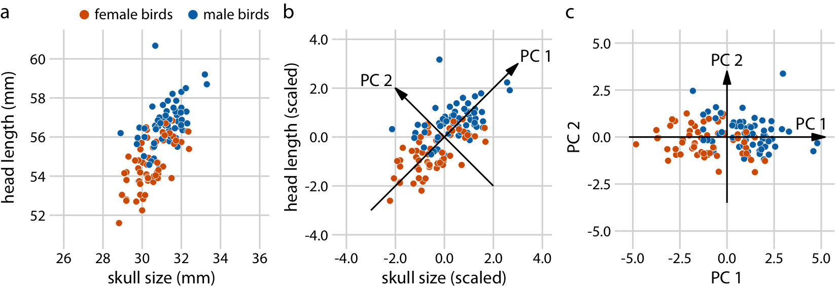
Dimension Reduction-PCA
The original data
Values scaled to zero mean and unit variance
Data projected into the new coordinates (equivalent to a rotation of the data points around the origin.)

Slide 19
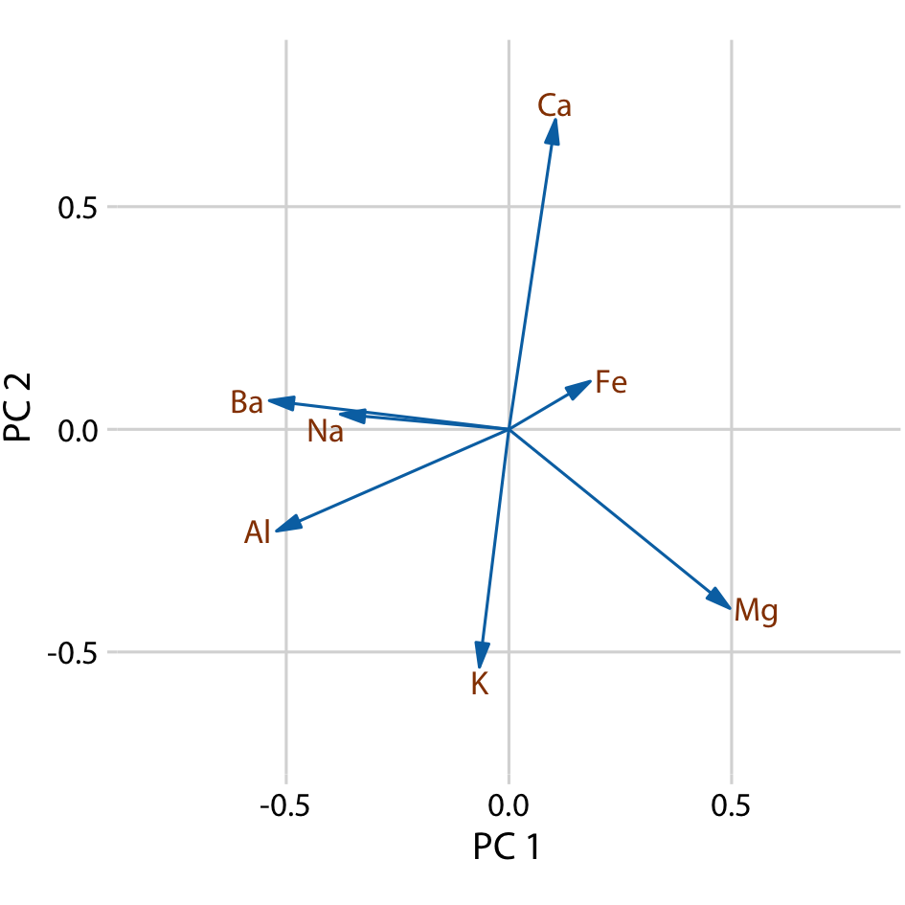
Dimension Reduction-PCA
PCs are linear combinations of the original variables.
We can represent the original variables as arrows indicating to what extent they contribute to the PCs.
Barium and sodium contribute primarily to PC 1 and not to PC 2
Calcium and potassium contribute primarily to PC 2 and not to PC 1,
Other variables contribute in varying amounts to both components.

Slide 20
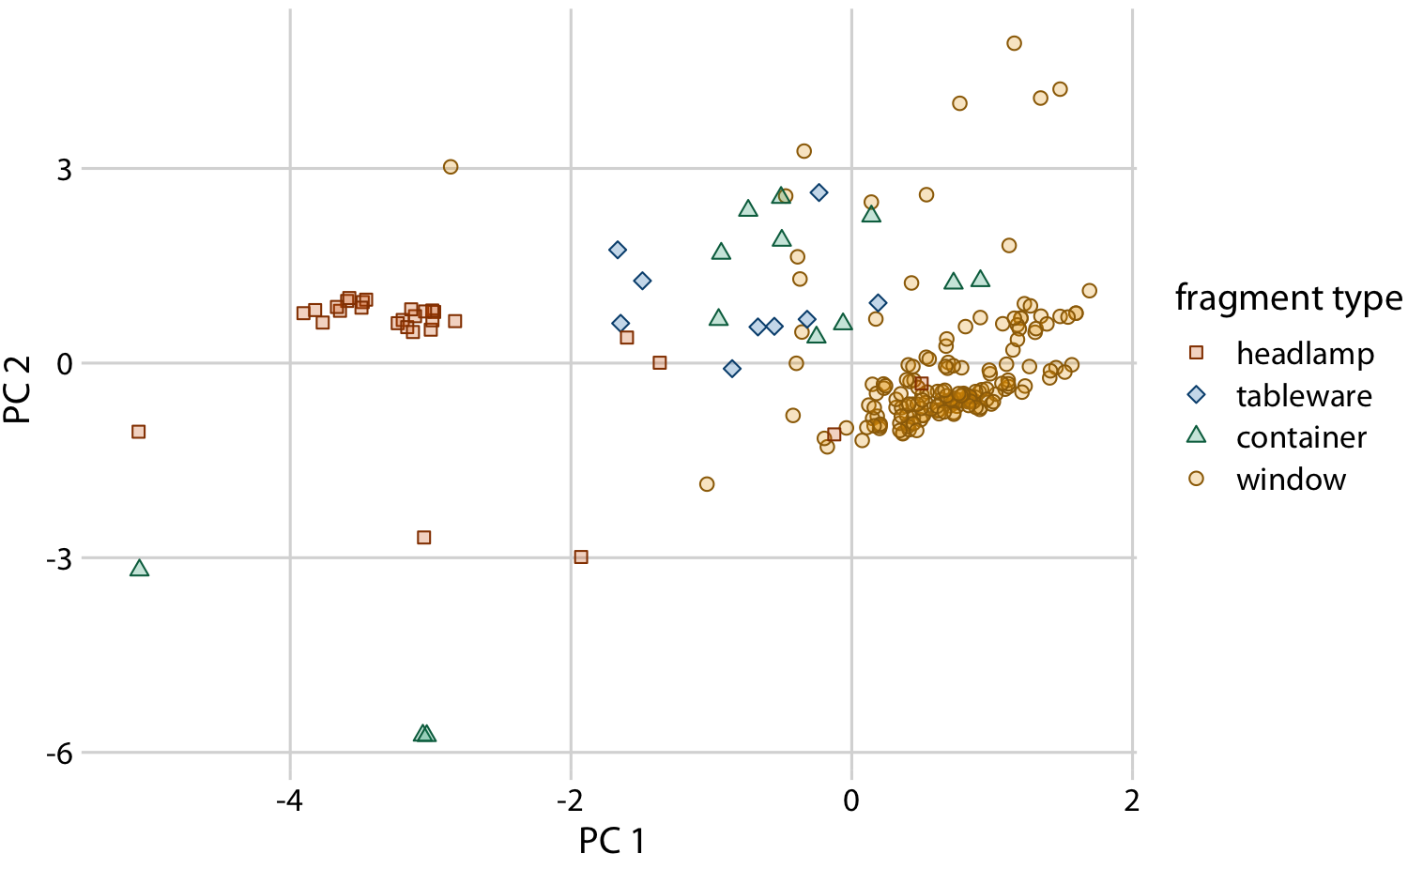
Dimension Reduction-PCA
We project the original data into the PC space
We see a defined clustering of distinct types of glass fragments.
Fragments from both headlamps and windows fall into clearly delineated regions in the PC plot
Fragments from tableware and from containers are a little more spread out
Notes:
, but nevertheless clearly distinct from both headlamp and window fragments. By comparing Figure 12-10 with Figure 12-9, we can conclude that window samples tend to have higher than average magnesium content and lower than average barium, aluminum, and sodium content, whereas the opposite is true for headlamp samples.

Slide 21
Paired Data
A special case of multivariate quantitative data is paired data: data where there are two or more measurements of the same quantity under slightly different conditions.
Two comparable measurements on each subject (e.g., the length of the right and the left arm of a person)
repeat measurements on the same subject at different time points (e.g., a person’s weight at two different times during the year)
measurements on two closely related subjects (e.g., the heights of two identical twins).
An excellent choice in this case is a simple scatterplot on top of a diagonal line marking x = y.

Slide 22
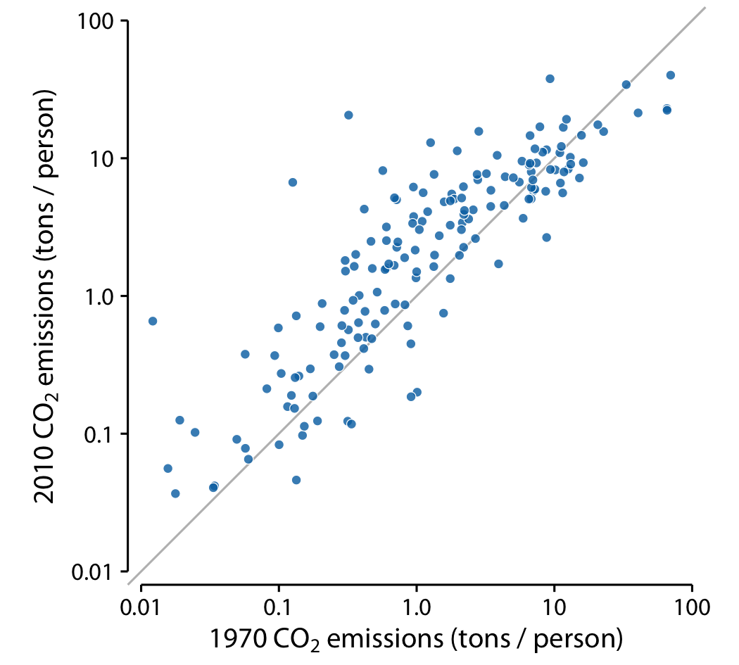
Paired Data
The carbon dioxide (CO2) emissions per person, measured for 166 countries both in 1970 and in 2010
Most points are relatively close to the diagonal line.
Points are systematically shifted upwards relative to the diagonal line.
The majority of countries have seen an increase in CO2 emissions.
Notes:
Even though CO2 emissions vary over nearly four orders of magnitude among countries, they are fairly consistent within each country over a 40-year time span.

Slide 23
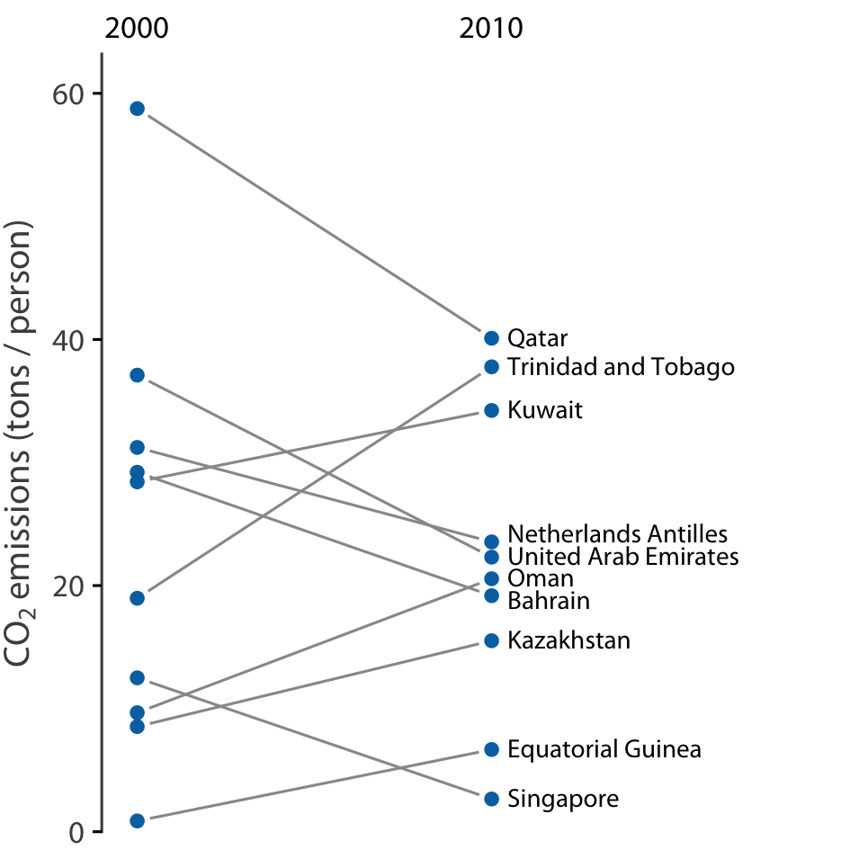
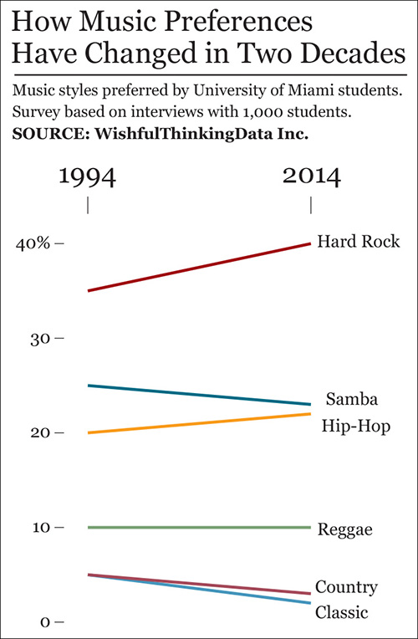
slopegraph
If we have only a small number of observations, we can draw individual measurements as dots arranged into two columns.
Paired dots connected with a line.
Slopes highlight the magnitude & direction of change.

Slide 24
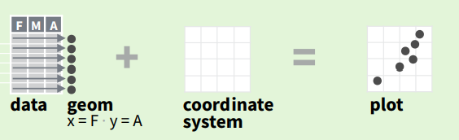
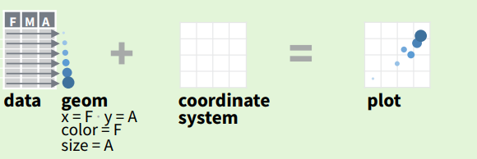
ggplot2
ggplot2 is based on the grammar of graphics,
the idea that you can build every graph from the same components: a data set, a coordinate system, and geoms—visual marks that represent data points
To display values, map variables in the data to visual properties of the geom (aesthetics) like size, color, and x and y locations.

Slide 25
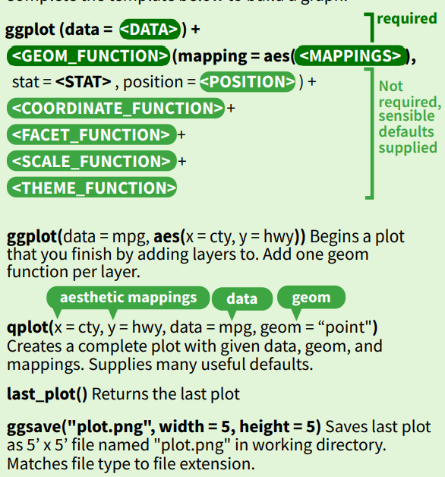
ggplot2
Complete the template below to build a graph.

