Slide 1
Introduction to Data Visualization
Multipanel Figures
Halil Bisgin, Ph.D.

Slide 2
Multipanel figures
Large and complex datasets often contain much more information to show in a single figure panel.
We need multipanel figures where each figure shows some subset of the data.
Small multiples have multiple panels arranged in a regular grid. Each panel shows a different subset of the data but all panels use the same type of visualization.
Compound figures consist of separate figure panels assembled in an arbitrary arrangement (doesn’t have to be grid-based) and showing entirely different visualizations (possibly even different datasets.)

Slide 3
Small Multiples
The term “small multiple” was popularized by Tufte.
An alternative term, “trellis plot,” was popularized around the same time at Bell Labs.
The idea is
to slice the data into parts according to one or more data dimensions,
visualize each data slice separately
arrange the individual visualizations into a grid
Columns, rows, or individual panels in the grid are labeled by the values of the data dimensions that define the data slices.

Slide 4
Faceting
Small multiples technique is also sometimes referred to as “faceting,” named after the methods that create such plots in the widely used ggplot2 plot library
e.g., the ggplot2 function facet_grid()
Dimension 1
Dimension 1 | Dimension 2 | Value
Dim1_v1 | Dim2_v1 | v1
Dim1_v1 | Dim2_v1 | v2
Dim1_v1 | Dim2_v2 | v3
Dim1_v2 | Dim2_v1 | v4
Dim1_v2 | Dim2_v2 | v5
Dim1_v2 | Dim2_v1 | v6
Dim1_v1
Dim1_v2
Dim2_v1
Dimension 2
Dim2_v2

Slide 5
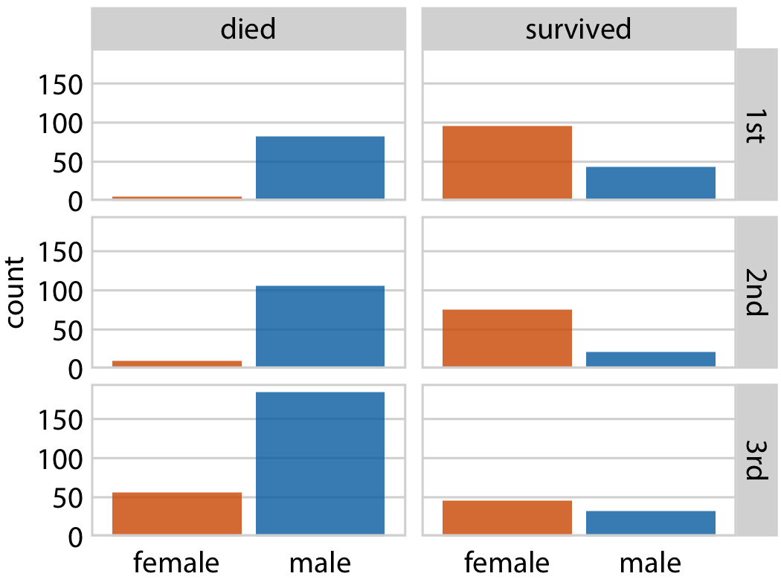
Faceting-example 1
We can subdivide Titanic dataset by the class in which each passenger traveled and by whether a passenger survived or not.
3 (classes) x 2 (survival status) = 6 panels (slices of data).
Color can be used for gender-based visualization
facet_grid(class ~ surv)
Notes:
Within each of these six slices of data, there are both male and female passengers, and we can visualize their numbers using bars. The result is six bar plots, which we arrange in two columns (one for passengers who died and one for those who survived) of three rows (one for each class) (Figure 21-1). The columns and rows are labeled, so it is immediately obvious which of the six plots corresponds to each combination of survival status and class.

Slide 6
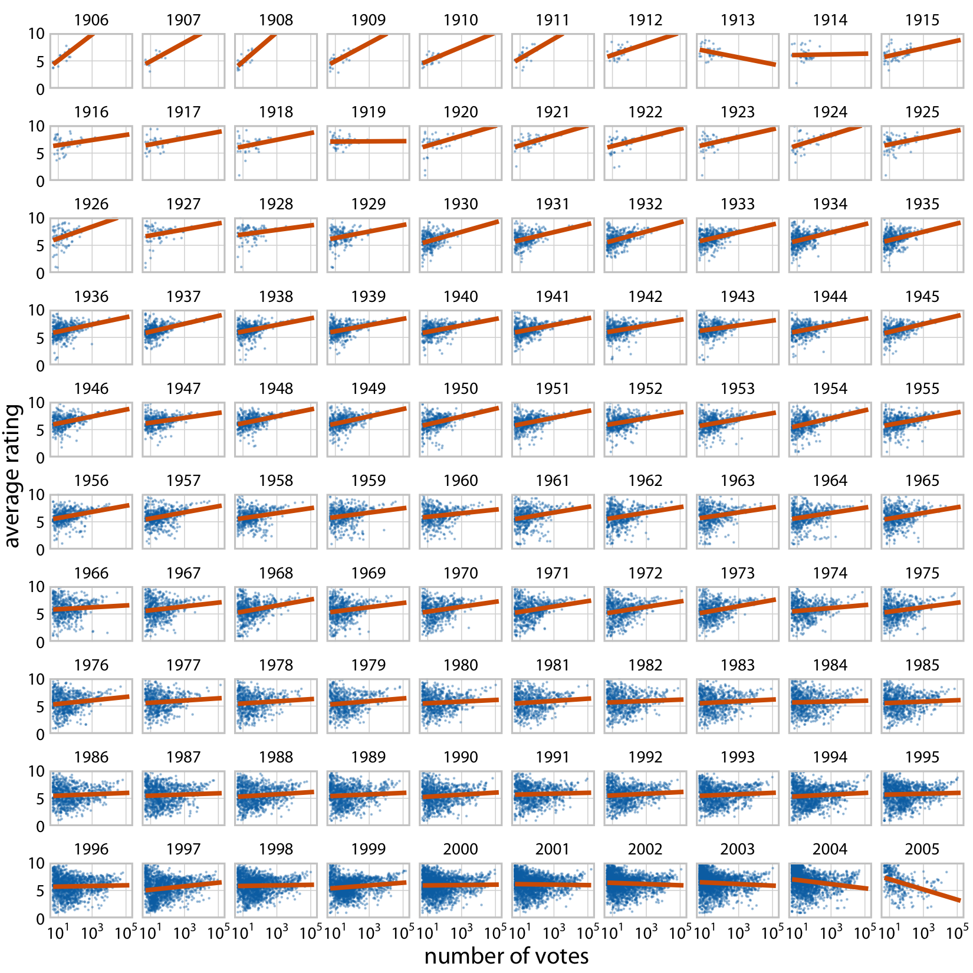
Faceting-example 1I
The Internet Movie Database (IMDB)
Relationship between the average ranking of a movie and the number of votes the movie has received.
For movies released over a 100-year time period.
One dimension: year.
More votes more ratings?

Slide 7
Faceting-example 1I
Dataset is sliced by only one dimension, the year, and panels for each year are arranged in rows from top left to bottom right. This visualization shows that there is an overall relationship between average ranking and number of votes, such that movies with more votes tend to have higher rankings.

Slide 8
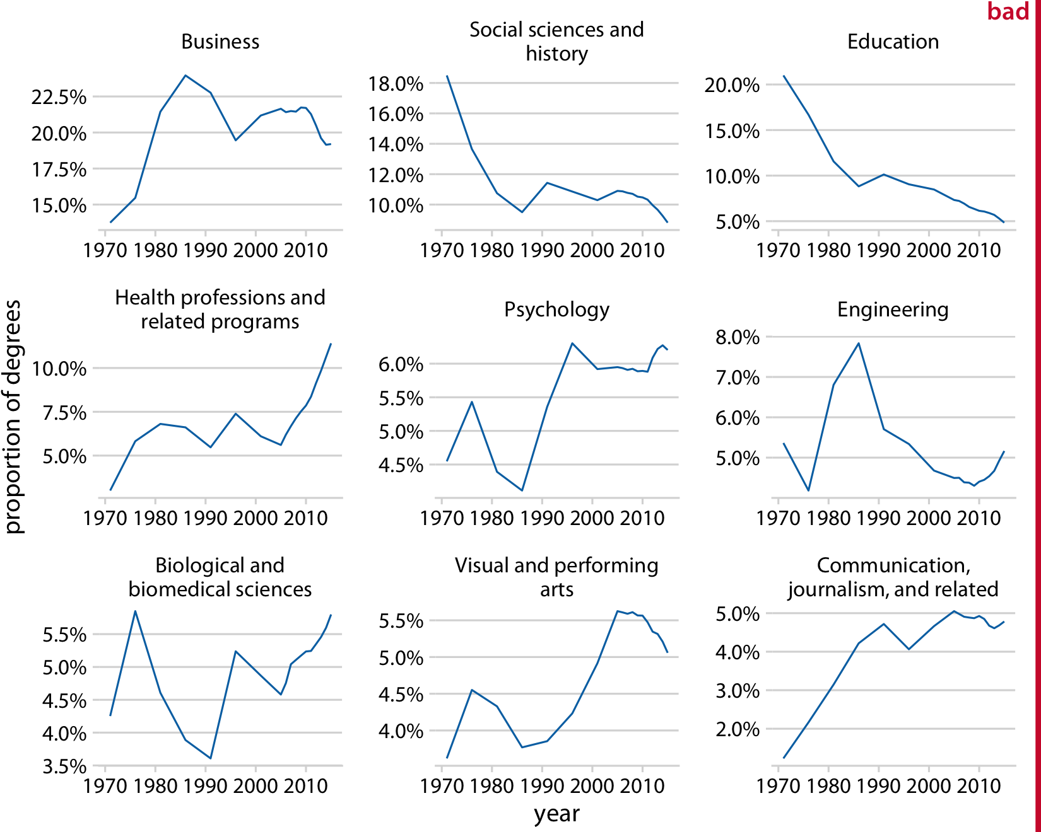
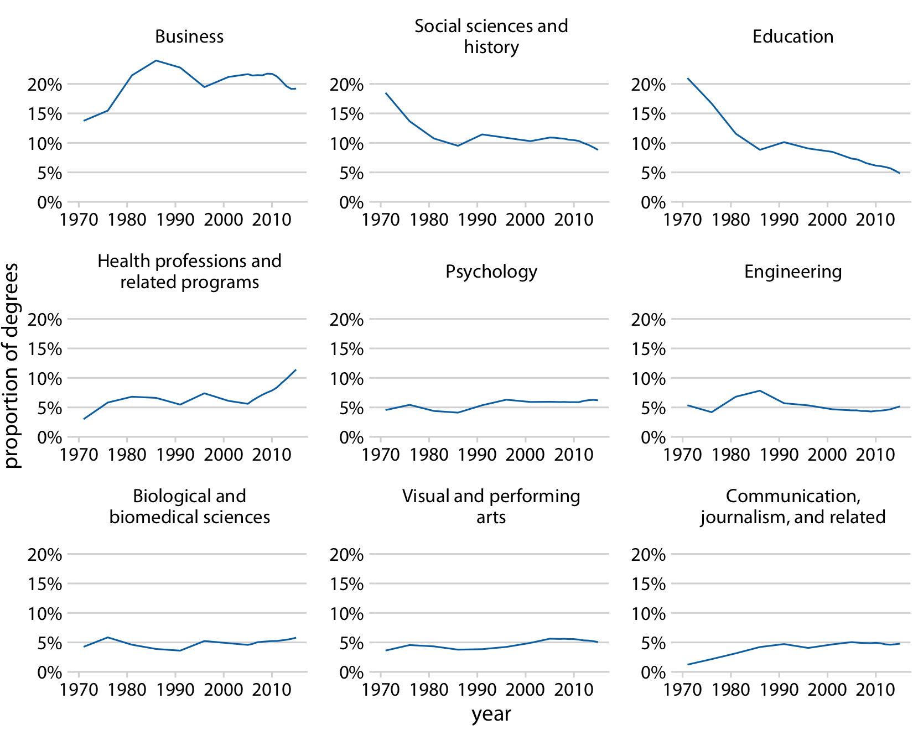
Multipanel Remarks
It is important that each panel uses the same axis ranges and scaling, which the human mind expects.
Otherwise, there is a good chance that a reader will misinterpret what the figure shows.
You can add a note to the caption.

Slide 9
Panels in a meaningful and logical order
It is also important to think about the ordering of the individual panels in a small multiples plot.
The plot will be easier to interpret if the ordering follows some logical principle.
Titanic: rows from the highest class (1st) to the lowest class (3rd).
IMDB: years increasing from the top left to the bottom right.
BA Degrees: arranged the panels by decreasing average degree popularity, such that the most popular degrees are in the top row and/or to the left and the least popular degrees are in the bottom row and/or to the right.

Slide 10
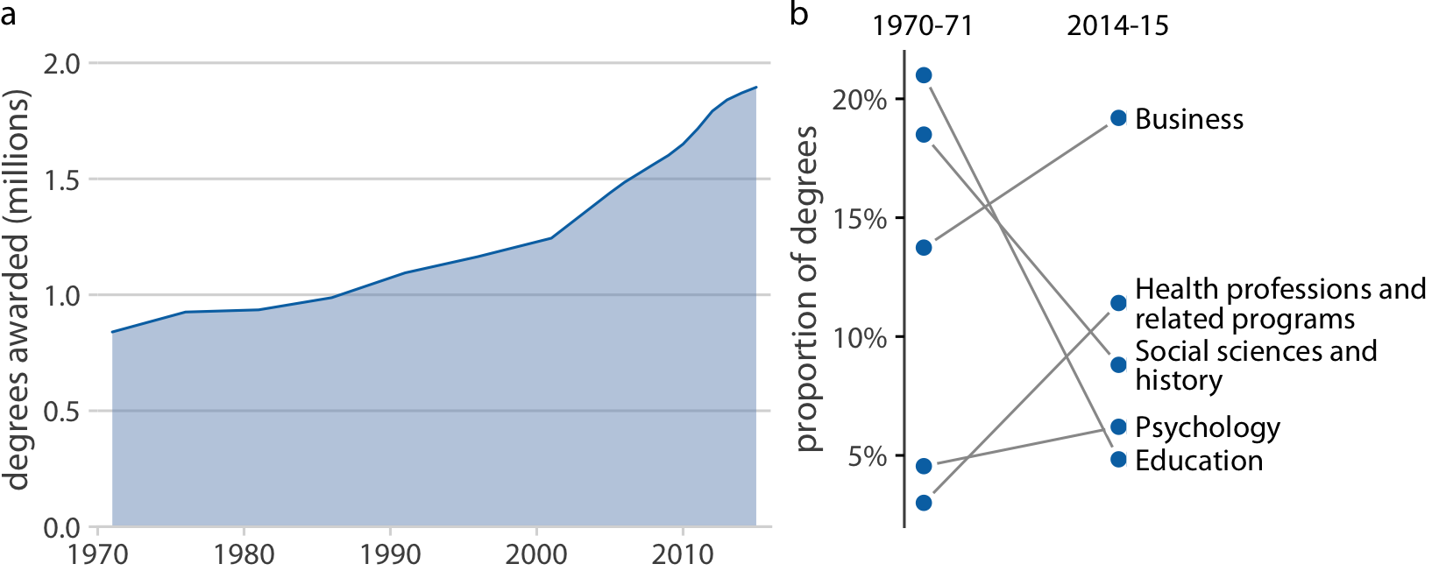
Compound Figures
Not every figure with multiple panels fits the pattern of small multiples
We can take the individual plots and arrange them in rows, columns, or other ways, and call the entire arrangement one figure.
Figure labels
Notes:
Panel (a) shows the growth in total number of degrees awarded from 1971 to 2015, a time span during which the number approximately doubled.
Panel (b) instead shows the change in the percent of degrees awarded over the same time period in the five most popular degree areas.

Slide 11
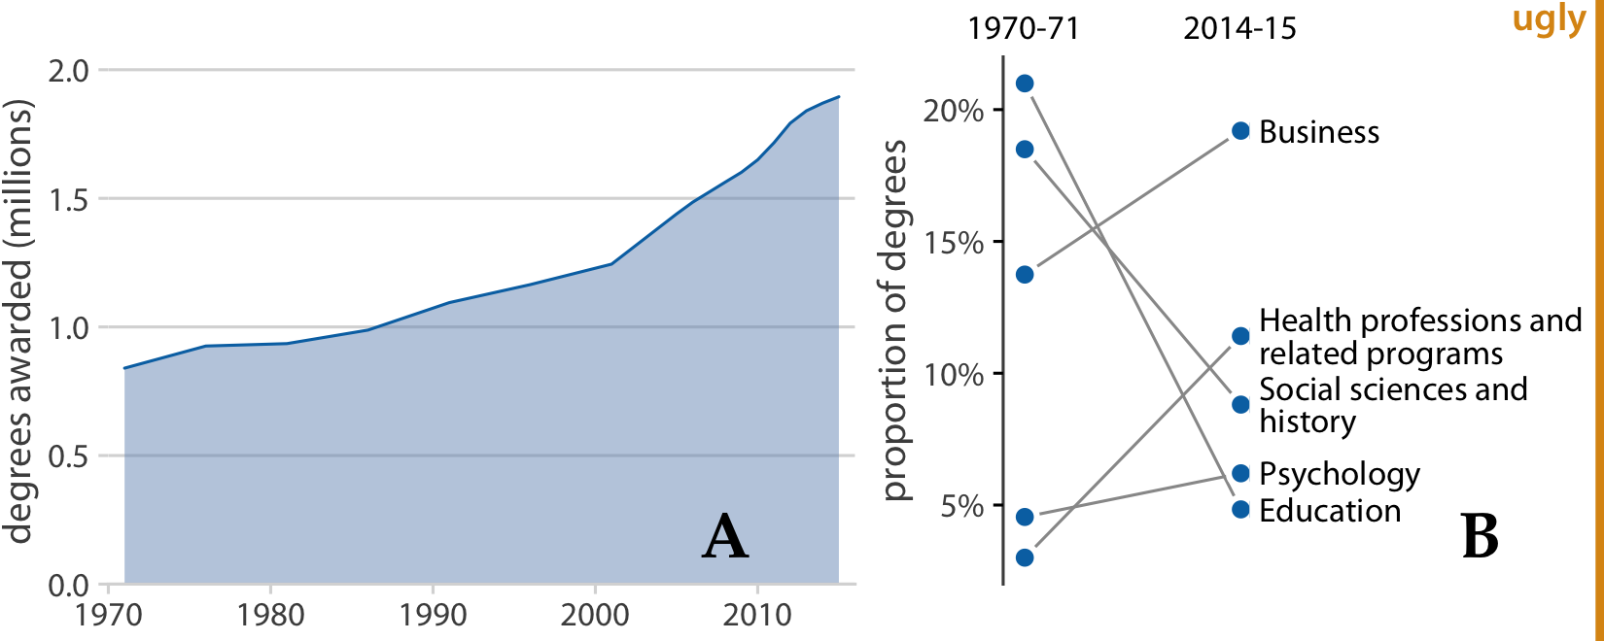
Compound figures-Remarks
The labels should not be the first thing you see when you look at a compound figure.
The convention is to start in the top-left corner with “a” and label consecutively from left to right and top to bottom.

Slide 12
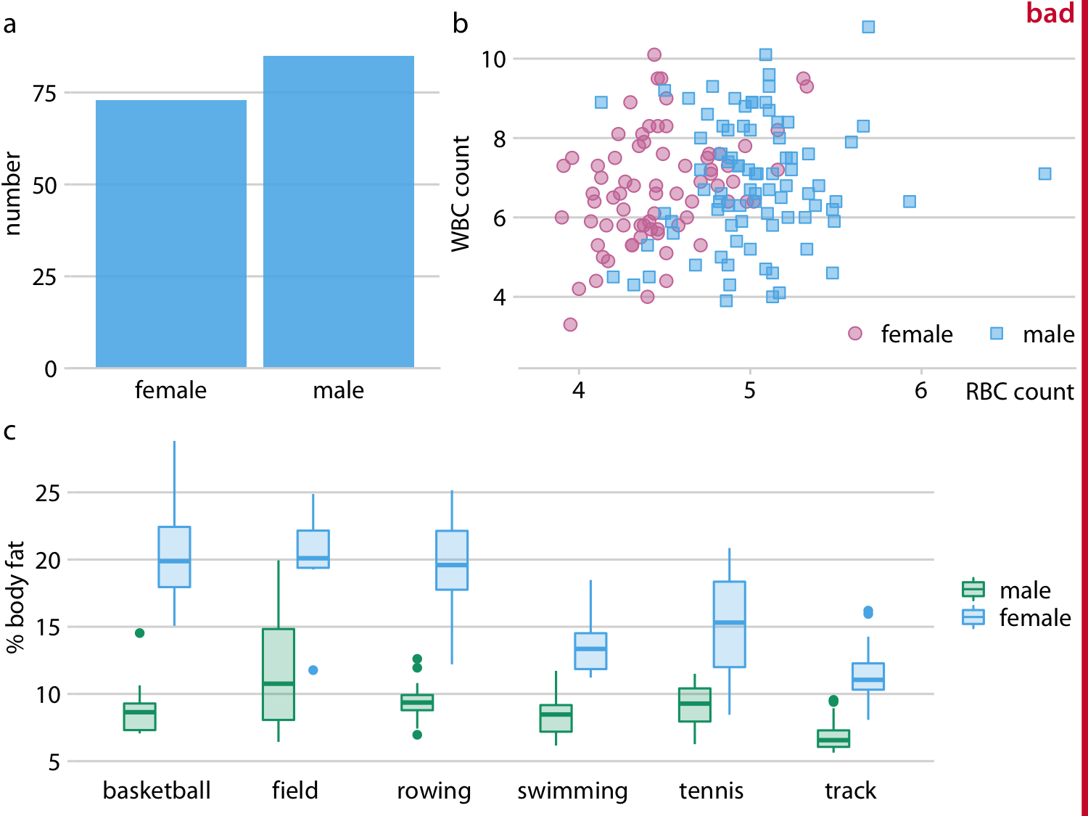
Compound figures-Remarks
How do the individual panels fit together?
They may be individually fine but jointly don’t work.
We need to employ a consistent visual language.
What inconsistencies you can see?

Slide 13
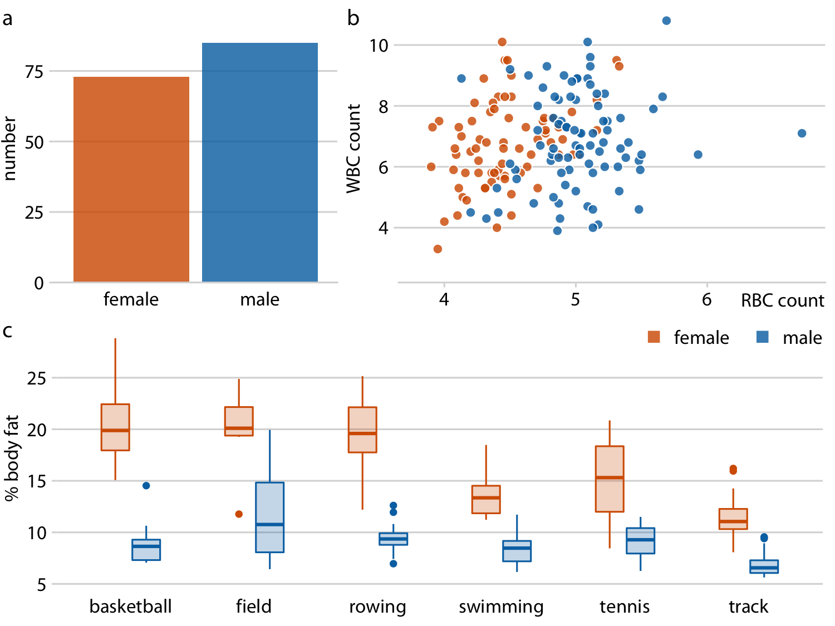
Compound figures-Remarks
Female athletes are consistently shown in orange and to the left of male athletes, who are shown in blue.
It doesn’t take much mental effort to determine.
Single legend works for all three.

Slide 14
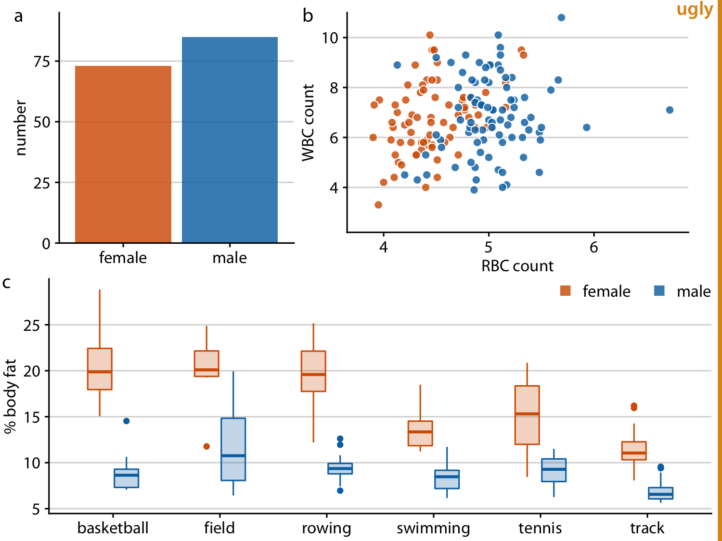
Compound figures-Remarks
We need to pay attention to the alignment of individual figure panels in a compound figure.
The axes and other graphical elements of the individual panels should all be aligned to each other.

