Slide 1
Introduction to Data Visualization Visualizing Data: Mapping Data onto Aesthetics Coordinate Systems and Axes
Halil Bisgin, Ph.D.

Slide 2
What is aesthetics?
Whenever we visualize data, we take data values and convert them in a systematic and logical way into the visual elements that make up the final graphic.
Even though there are many different types of data visualizations, all of them can be described with a common language that captures how data values are turned into colored pixels or ink.
All data visualizations map data values into quantifiable features of the resulting graphic.
We refer to these features as aesthetics.

Slide 3
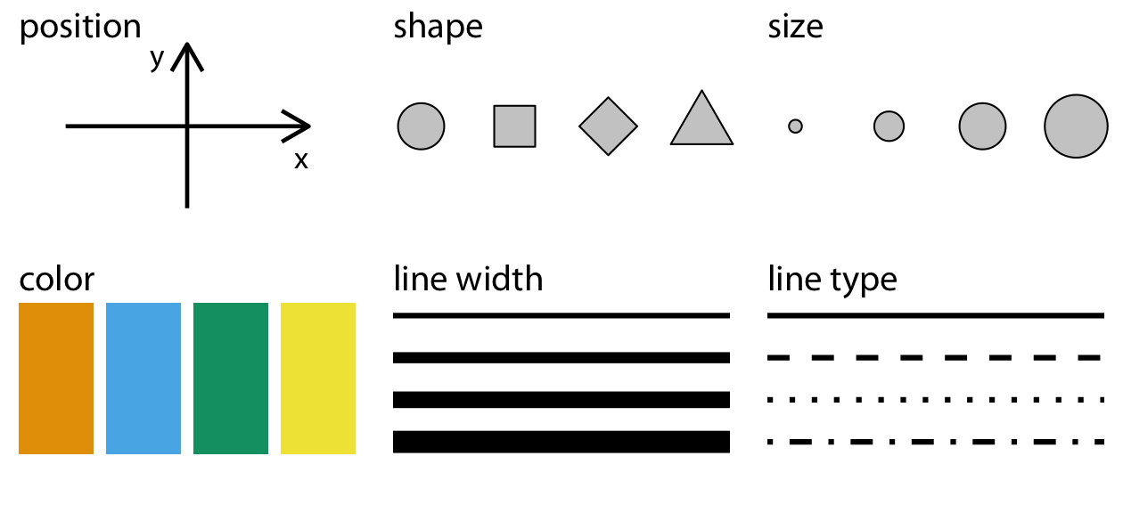
Aesthetics
Aesthetics describe every aspect of a given graphical element.

Slide 4
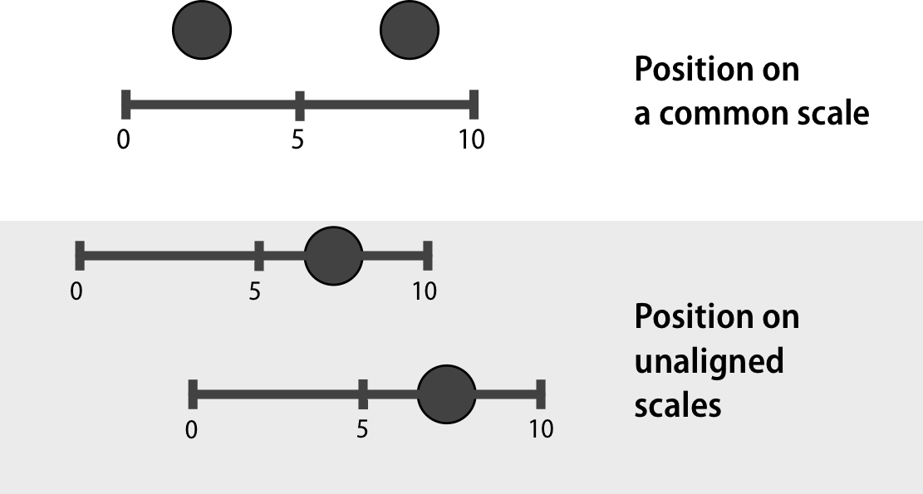
Components of graphical elements-1
A critical component of every graphical element is of course its position, which describes where the element is located.
In standard 2D graphics, we describe positions by an x and y value, but other coordinate systems and one- or three-dimensional visualizations are possible.

Slide 5
Components of graphical elements-2
All graphical elements have a shape, a size, and a color.

Slide 6
Components of graphical elements-3
Even if we are preparing a black-and-white drawing, graphical elements need to have a color to be visible: for example, black if the background is white or white if the background is black.
Finally, to the extent we are using lines to visualize data, these lines may have different widths or dash–dot patterns.

Slide 7
Components of graphical elements-4
There are many other aesthetics we may encounter in a data visualization.
For example, if we want to display text, we may have to specify font family, font face, and font size, and if graphical objects overlap, we may have to specify whether they are partially transparent.

Slide 8
Types of Data
All aesthetics fall into one of two groups: those that can represent continuous data and those that cannot.
Continuous data values are values for which arbitrarily fine intermediates exist.
Time duration is a continuous value. Between any two durations, say 50 seconds and 51 seconds, there are arbitrarily many intermediates, such as 50.5 seconds, 50.51 seconds, 50.50001 seconds, and so on.
By contrast, number of persons in a room is a discrete value. A room can hold 5 persons or 6, but not 5.5
Position, size, color, and line width can represent continuous data, but shape and line type can usually only represent discrete data.

Slide 9
Which of the followings can be considered continuous?
Temperature
Height
Weight
All of the above
None of the above

Slide 10
Beyond numerical data
Numerical values are only two out of several types.
Data can come in the form of discrete categories, in the form of dates or times, and as text.
When data is numerical we also call it quantitative and when it is categorical we call it qualitative.
Variables holding qualitative data are factors, and the different categories are called levels.
The levels of a factor are most commonly without order (dog, cat, fish),
factors can also be ordered (ordinal), when there is an intrinsic order among the levels of the factor (good, fair, poor).

Slide 11
Which variable can be ordered and considered ordinal?
Color, i.e., red, green, blue, yellow
Size of coffee cups, i.e., tall, medium, grande
Covid test result, i.e., positive, negative
All of the above
None of the above

Slide 12
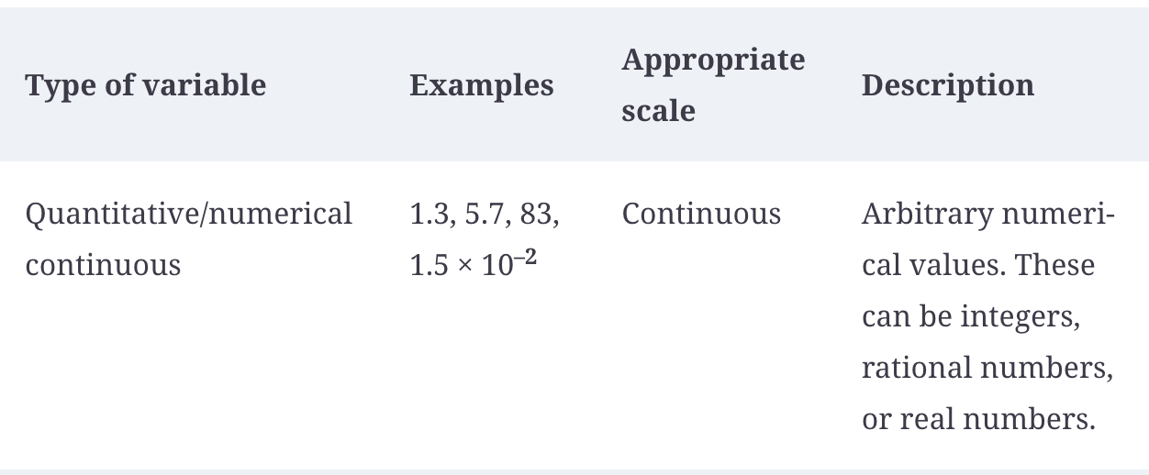
Types of variables

Slide 13
Types of variables
Type of variable | Examples | Appropriate Scale | Description
Quantitative/numerical discrete | 1, 2, 3, 4 … | Discrete | Numbers in discrete units. These are most commonly but not necessarily integers. For example, the numbers 0.5, 1.0, 1.5 could also be treated as discrete if intermediate values cannot exist in the given dataset.

Slide 14
Types of variables
Type of variable | Examples | Appropriate Scale | Description
Qualitative/categorical unordered | dog, cat, fish | Discrete | Categories without order. These are discrete and unique categories that have no inherent order. These variables are also called factors.

Slide 15
Types of variables
Type of variable | Examples | Appropriate Scale | Description
Date or time | Jan. 5 2018, 8:03am | Continuous or discrete | Specific days and/or times. Also generic dates, such as July 4 or Dec. 25 (without year).

Slide 16
Types of variables
Type of variable | Examples | Appropriate Scale | Description
Text | The quick brown fox jumps over the lazy dog. | None, or discrete | Free-form text. Can be treated as categorical if needed.

Slide 17
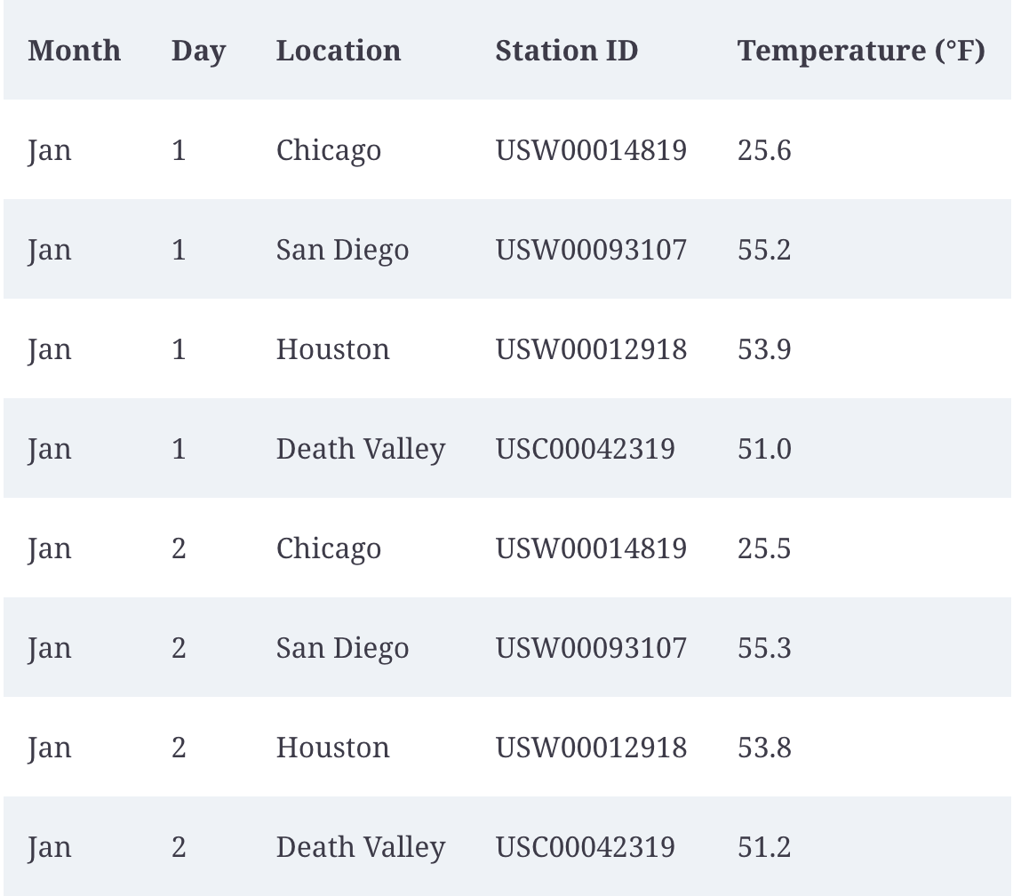
Types of variables-Example
The first few rows of a dataset providing the daily temperature normals (average daily temperatures over a 30-year window) for four US locations.
This table contains five variables:
Month: ordered factor,
Day: discrete numerical value,
Location: unordered factor,
Station ID: unordered factor,
Temperature: a continuous numerical

Slide 18
Scales map data values onto aesthetics
To map data values onto aesthetics, we need to specify which data values correspond to which specific aesthetics values.
If our graphic has an x axis, then we need to specify which data values fall onto particular positions along this axis.
We may need to specify which data values are represented by particular shapes or colors.
This mapping is created via scales, which defines a unique mapping between data and aesthetics
A scale must be one-to-one, such that for each specific data value there is exactly one aesthetics value and vice versa.
If a scale isn’t one-to-one, then the data visualization becomes ambiguous.

Slide 19
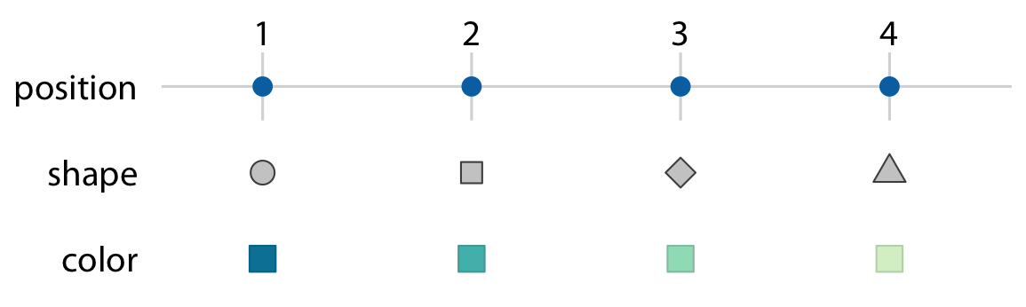
Scales map data values onto aesthetics
Scales link data values to aesthetics (mapping).
The numbers 1 through 4 have been mapped onto
a position scale,
a shape scale, and
a color scale.
For each scale, each number corresponds to a unique position, shape, or color, and vice versa.

Slide 20
How would you decide on axis …
if want to explore temperature over time for a given Location ?

Slide 21
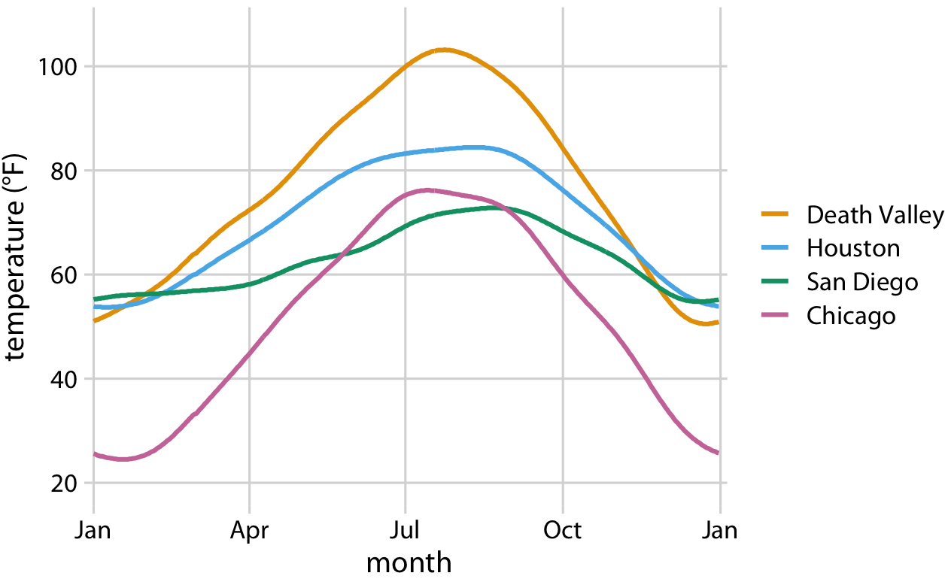
Mapping temperatures-1
Let’s map temperature onto the y axis, day of the year onto the x axis, and location onto color, and visualize these aesthetics with solid lines.
The result is a standard line plot showing the temperature normals at the four locations as they change during the year.

Slide 22
Mapping temperatures-2
It is up to us which variables we map onto which scales.
Instead of mapping temperature onto the y axis and location onto color, we can do the opposite.
Because now the key variable of interest (temperature) is shown as color, we need to show sufficiently large colored areas for the colors to convey useful information.
We can also choose squares instead of lines, one for each month and location which can be colored by the average temperature normal for each month.

Slide 23
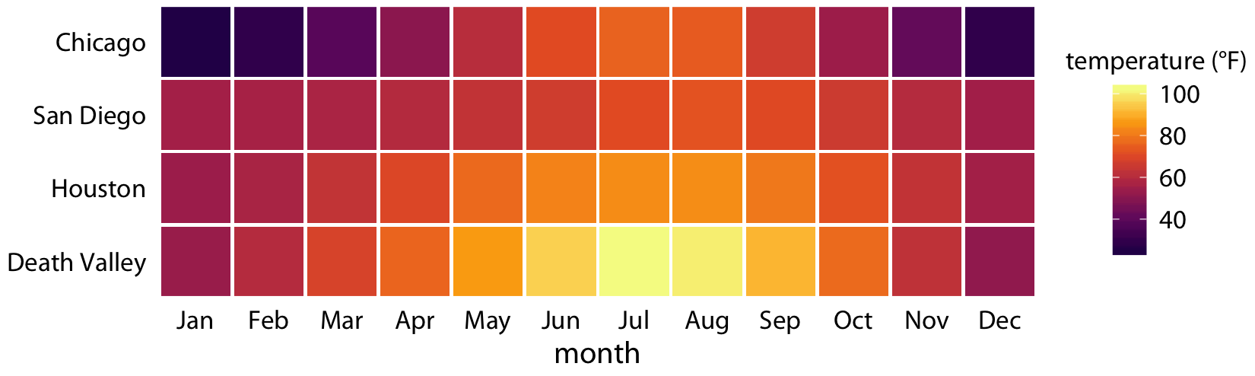
Mapping temperatures-3
Two position scales (month: x-axis and location: y-axis), but neither is a continuous scale.
Month is an ordered factor with 12 levels and location is an unordered factor with 4 levels. Position scales are both discrete
The different levels of the factor at an equal spacing on the axis.
If the factor is ordered (month), levels follow appropriate order.
If the factor is unordered (location), then the order is arbitrary.

Slide 24
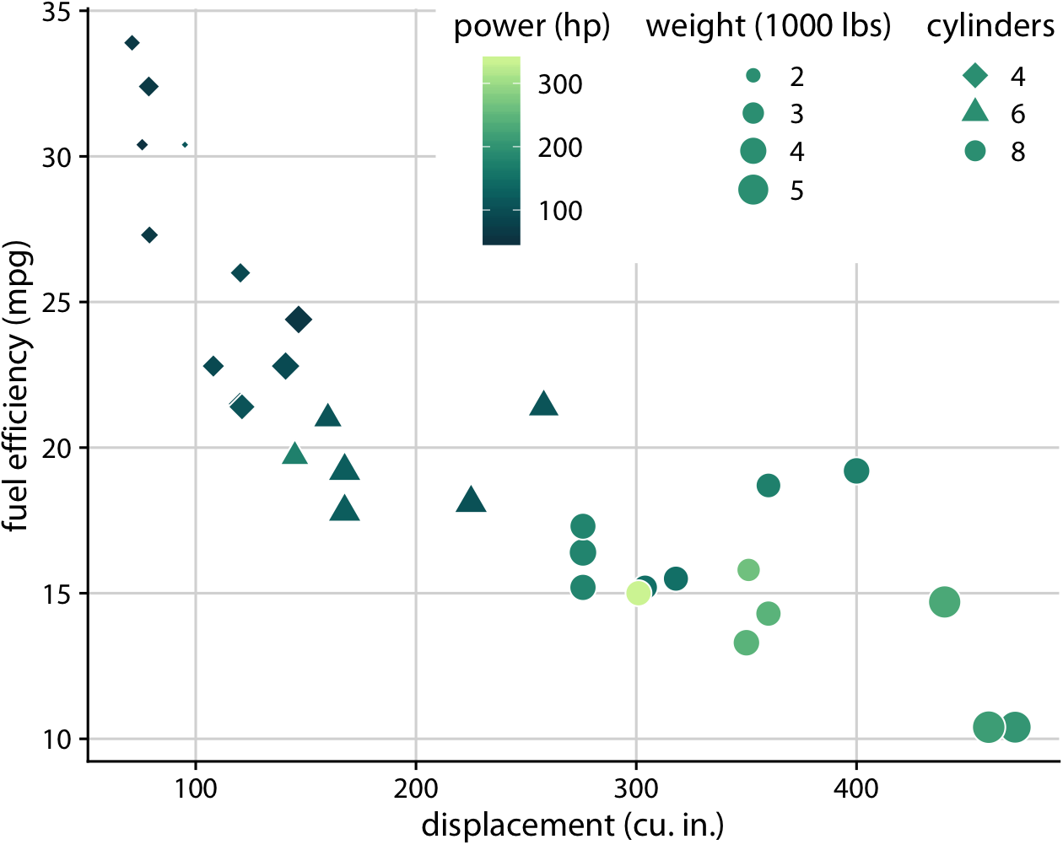
More scales
Earlier had two position & one color scales (typical)
Five separate scales to represent data:
x axis (displacement)
y axis (fuel efficiency)
color (power)
size (weight)
shape (number of cylinders).
Notes:
five scales
two position scales,
one color scale,
one size scale, and
one shape scale,
and each scale represents a different variable from the dataset.

Slide 25
Question
If our variable is continuous, it would be better to represent it as a series of shapes.
True
False

Slide 26
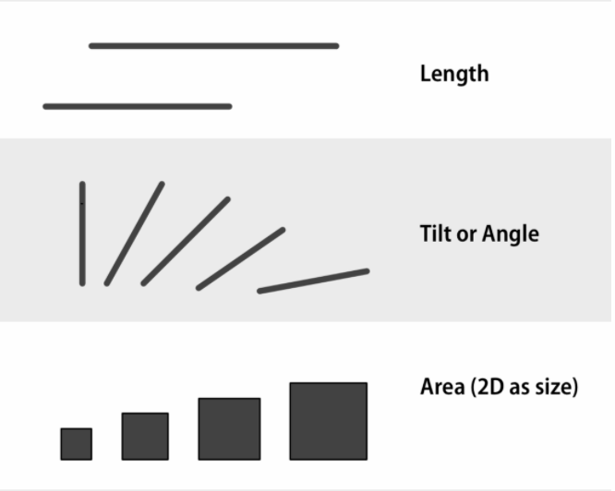
Channels for representing data
If we have ordered data, then we should try to encode it as a position on a common scale
Encoding numbers as lengths (absent a scale) works too, but not as effectively.
Encoding them as areas will make comparisons less accurate again, and so on.

Slide 27
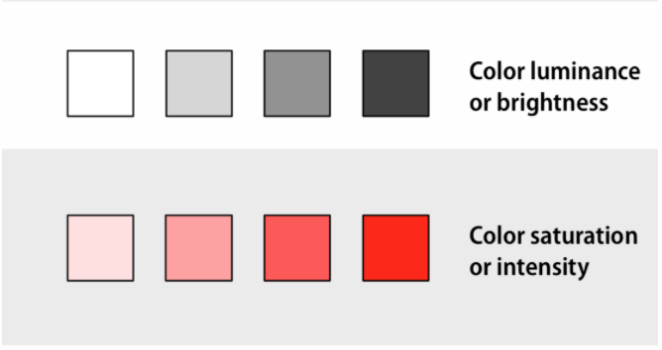
Channels for representing data
Perceptual details impact the effectiveness.
If we have a measure with four categories ordered from lowest to highest, we might correctly decide to represent it using a sequential gradient.
Wrong sequence of colors is hard to interpret, or actively misleading.
Bad set of hues for an unordered categorical variable, might result in both unpleasant and misleading.

Slide 28
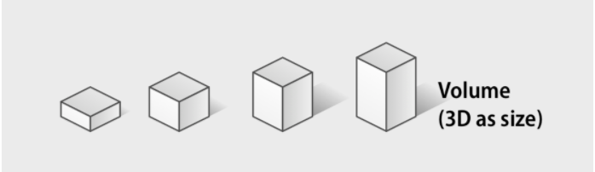
Channels for representing data
Least preferred approach, even discouraged!
3D

Slide 29
A note on aesthetics
Different channels or mappings are not in themselves kinds of graphs, but are just the elements or building blocks for graphs.
When we choose how to encode a variable as a position, a length, an area, a shade of grey, or a color, we have made an important decision that narrows down what the resulting plot can look like.
This is not the same as deciding what type of plot it will be, in the sense of choosing whether to make a dot plot or a bar chart, a histogram or a frequency polygon, and so on.

Slide 30
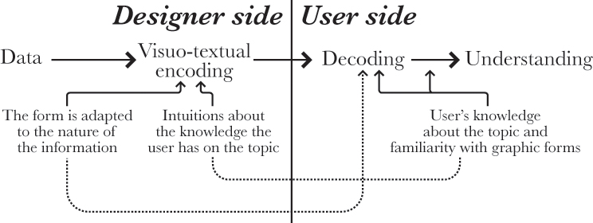
Visual tasks and decoding graphs
To understand a graph, the viewer needs to know a lot of general information, such as
what a variable is,
what an x-y coordinate plane looks like,
why we might want to compare two variables on one, and
the convention of putting the supposed cause or “independent” variable on the x-axis.
Even if the viewer understands all these things, they must still perform the visual task of interpreting the graph.
Even well-informed viewers may do worse than we think when connecting the picture to the underlying data
Recall

Slide 31
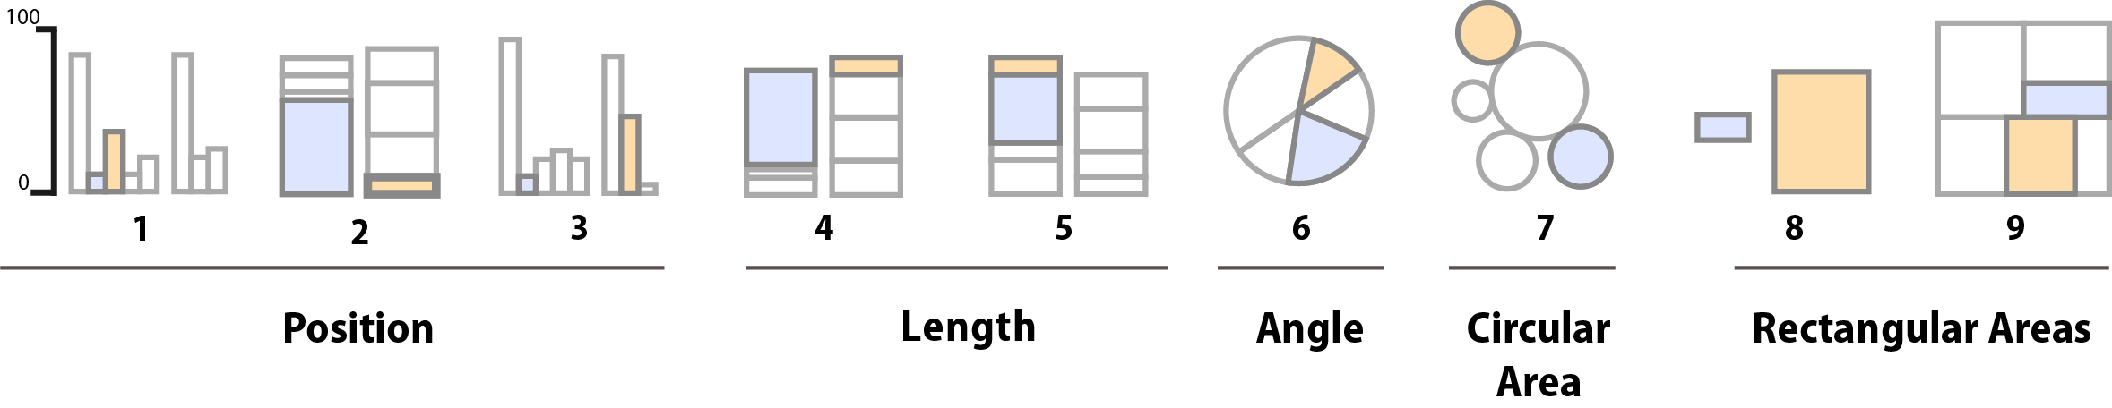
Visual tasks and decoding graphs
Participants were asked to make comparisons of highlighted portions of each chart type, and say which was smaller. (by Heer and Bostock, following Cleveland and McGill)

Slide 32
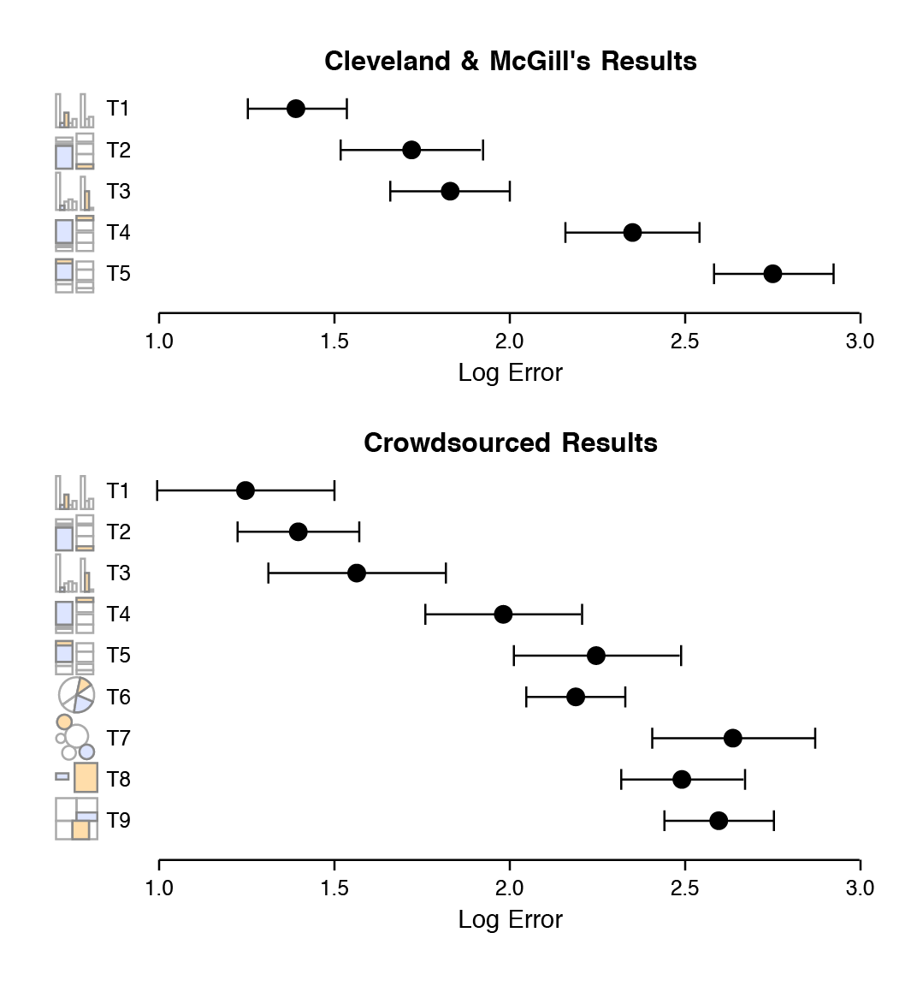
Visual tasks and decoding graphs
Most often, research subjects were asked to
estimate two values within a chart
compare values between charts
Area comparisons perform even worse than the (justifiably) much-maligned pie chart
There are better and worse ways when user must estimate and compare.

Slide 33
Coordinate Systems and Axes
To make any sort of data visualization, we need to define position scales, which determine where in a graphic different data values are located.
We cannot visualize data without placing different data points at different locations, even if we just arrange them next to each other along a line.
For regular 2D visualizations, two numbers are required to uniquely specify a point, and therefore we need two position scales. These two scales are usually but not necessarily the x and y axes of the plot.

Slide 34
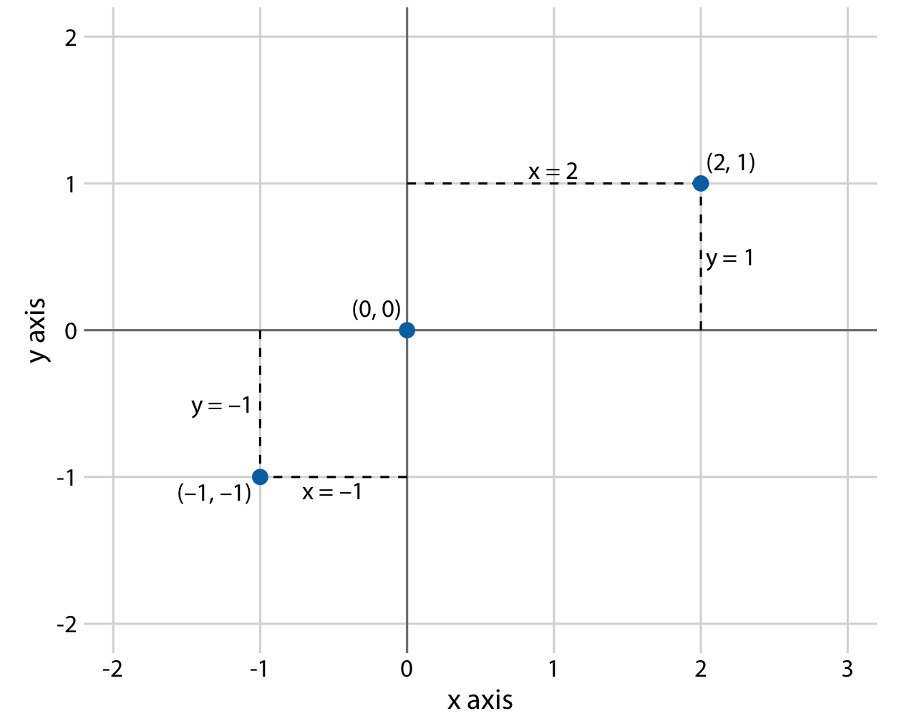
Cartesian Coordinates
The most widely used coordinate system.
The x and y axes run orthogonally to each other, data values are placed in an even spacing.
The two axes are continuous position scales, and they can represent both positive and negative real numbers.
Not just numbers, but also units

Slide 35
Cartesian Coordinates
Can have two axes representing two different units.
If in different units, we can stretch or compress one relative to the other to maintain a valid visualization.
Which version is preferable may depend.
A tall and narrow figure emphasizes change along the y axis and a short and wide figure does the opposite.
Ideally, we want to choose an aspect ratio that ensures that any important differences in position are noticeable.

Slide 36
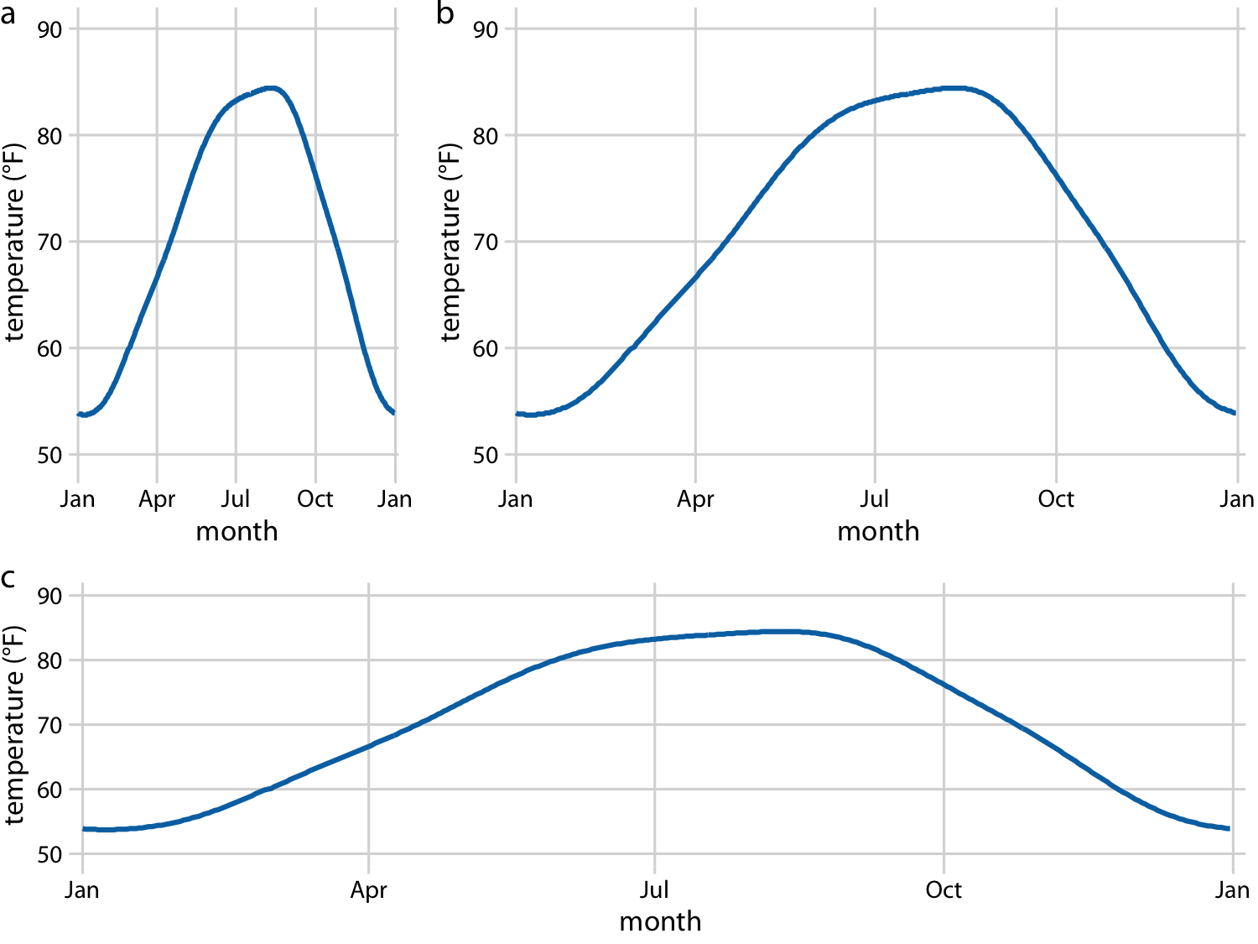
Cartesian Coordinates
All three parts are valid. (Data source: NOAA)

Slide 37
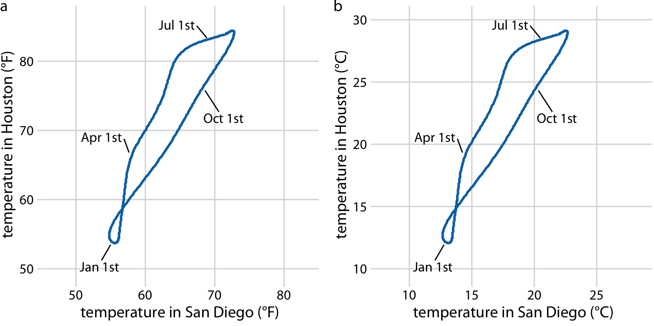
Cartesian Coordinates
If the x and y axes are measured in the same units, then the grid spacings for the two axes should be equal.
We can plot the temperature in Houston vs. in San Diego.
We need to make sure that the grid lines form perfect squares.

Slide 38
Nonlinear Axes
There are scenarios where nonlinear scales are preferred.
In a nonlinear scale, even spacing in data units corresponds to uneven spacing in the visualization, or conversely even spacing in the visualization corresponds to uneven spacing in data units.
The most commonly used nonlinear scale is the logarithmic (log) scale.
Need to log-transform the data values while exponentiating the numbers that are shown along the axis grid lines.

Slide 39
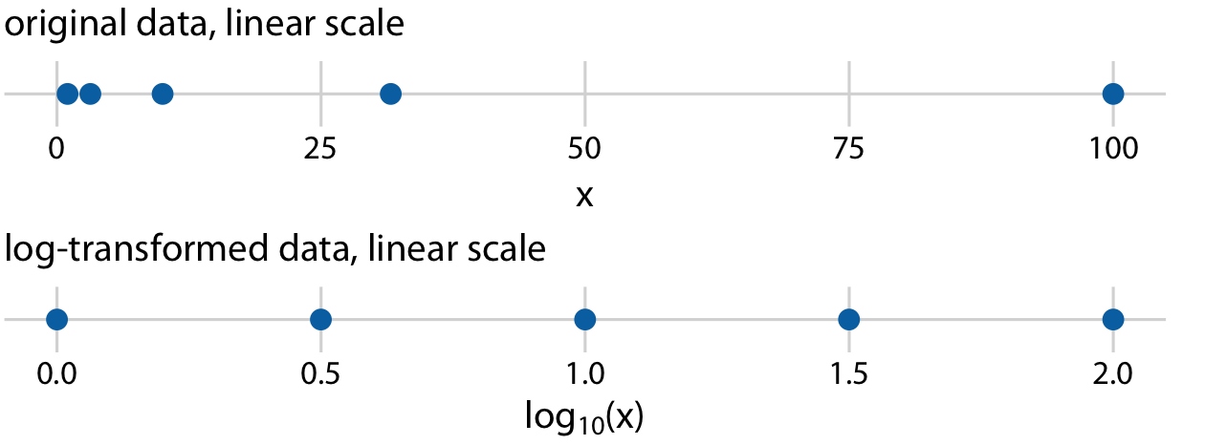
Nonlinear Axes
The numbers 1, 3.16, 10, 31.6, and 100 placed on linear and log scales.
The labeling for a logarithmic scale is preferable

Slide 40
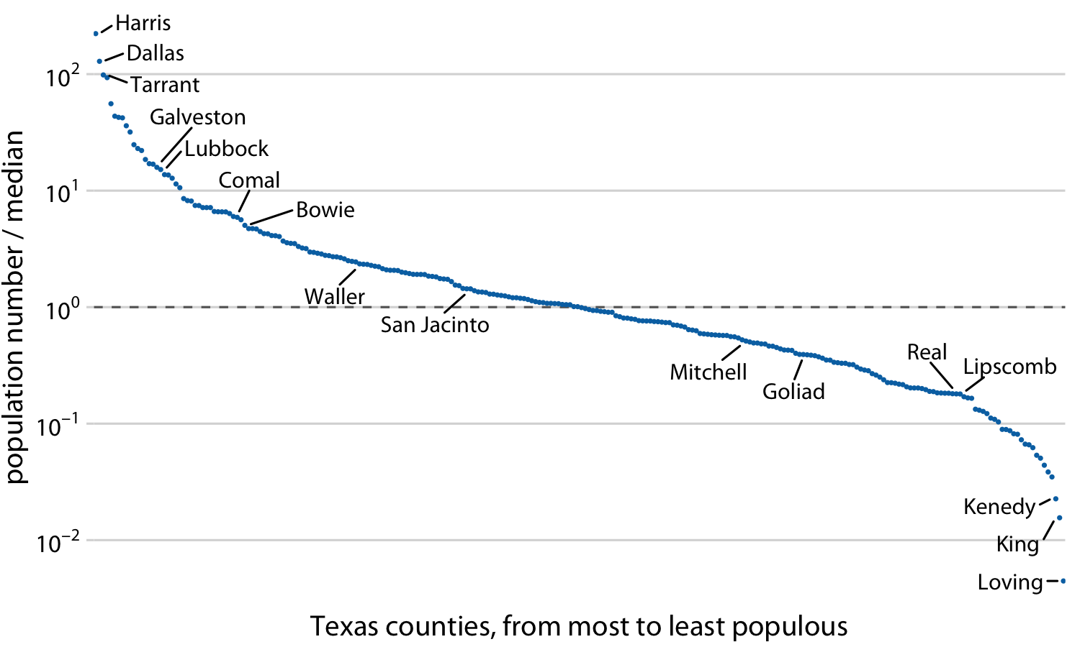
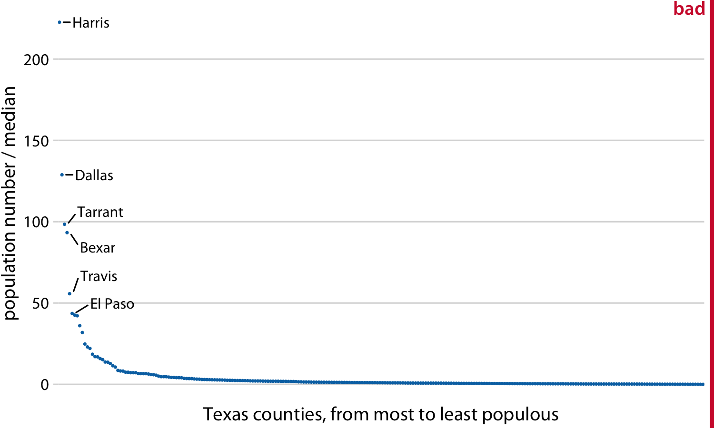
Ratio data w/ log and linear scale
obscures the differences!

Slide 41
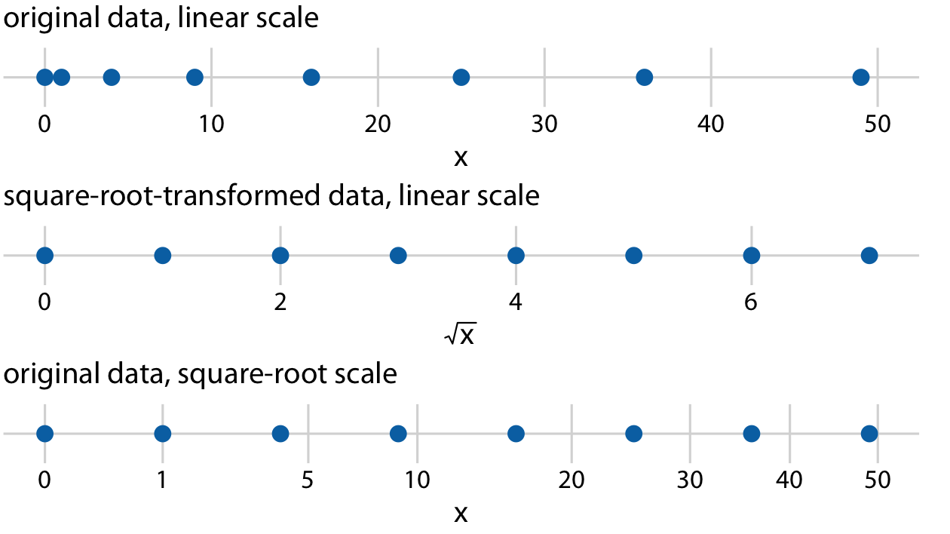
Square-root scale
A square-root scale compresses larger numbers into a smaller range, but unlike a log scale, it allows for the presence of 0.
There may some flaws, but appropriate applications exist.

Slide 42
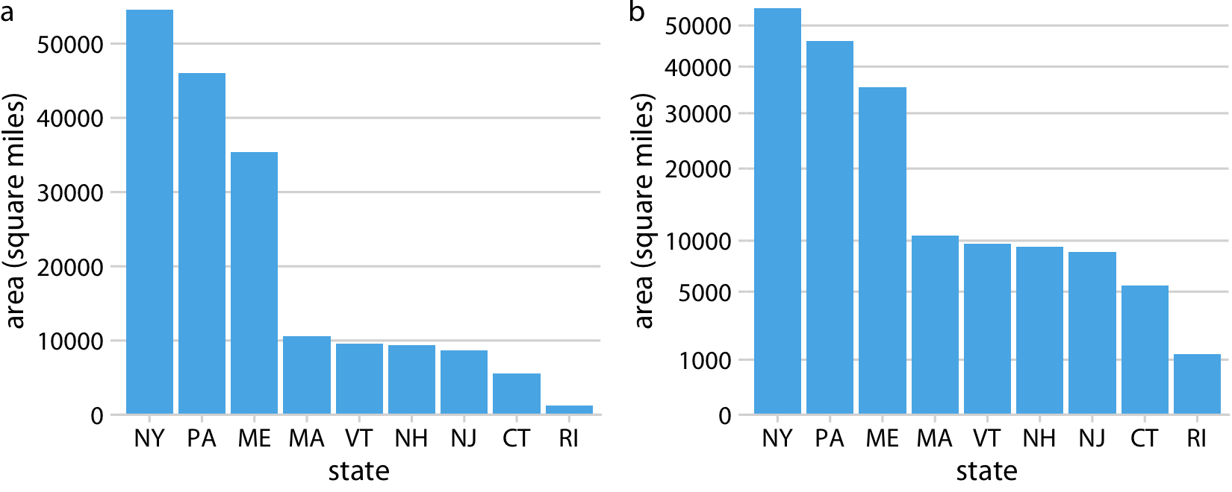
Square-root scale
The relative time it will take to drive across each state is more accurately represented by the figure on the square-root scale than the figure on the linear scale

Slide 43
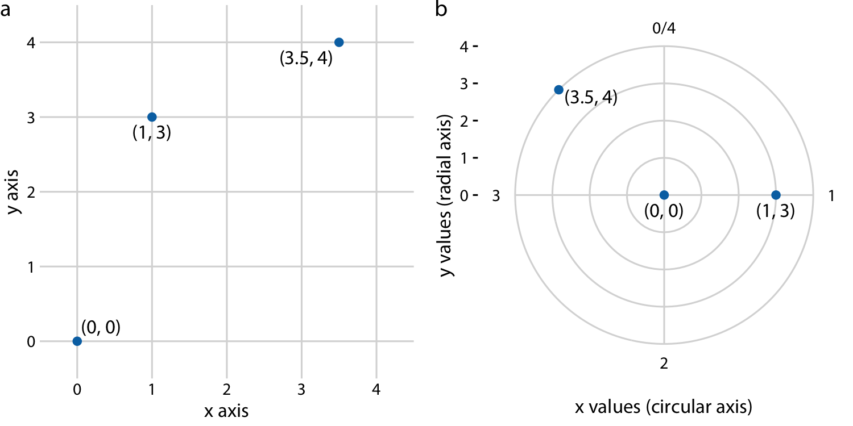
Coordinate Systems with Curved Axes
In the polar coordinate system, we specify positions via an angle and a radial distance from the origin, and therefore the angle axis is circular.
Polar coordinates can be useful for data of a periodic nature, such that data values at one end of the scale can be logically joined to data values at the other end.
Dec 31 is the last day & one day before the first day.

Slide 44
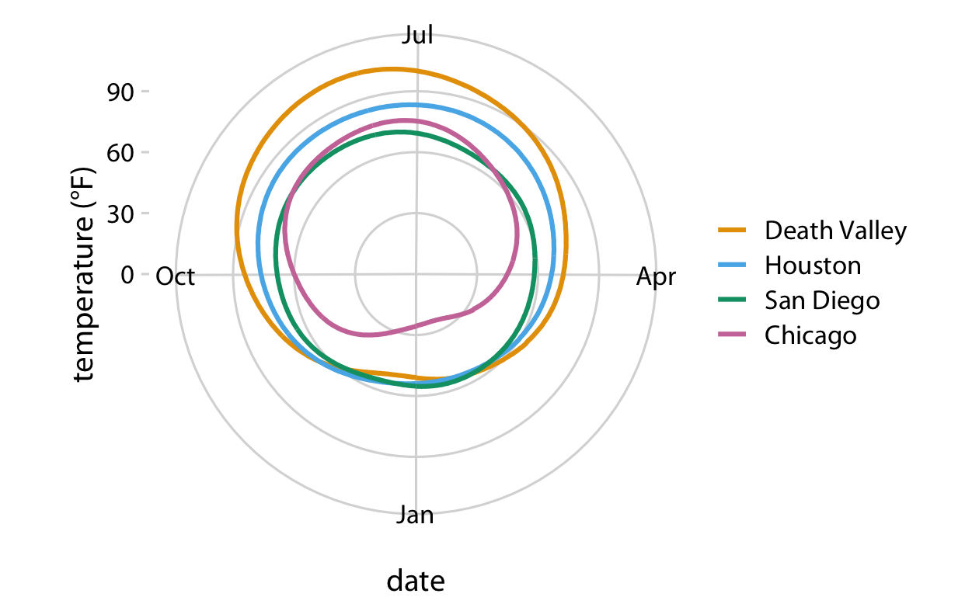
Coordinate Systems with Curved Axes
December 31st is the last day of the year, but it is also one day before the first day of the year.
The radial distance from the center point indicates the daily temperature in Fahrenheit, and the days of the year are arranged counterclockwise starting with Jan. 1st at the 6:00 position

Slide 45
Coordinate Systems with Curved Axes
We also encounter curved axes is in geospatial data.
The earth is a sphere and drawing latitude and longitude as Cartesian axes is misleading.
Nonlinear projections are used to minimize artifacts and strike different balances between conserving areas relative to the true shape lines on the globe

Slide 46
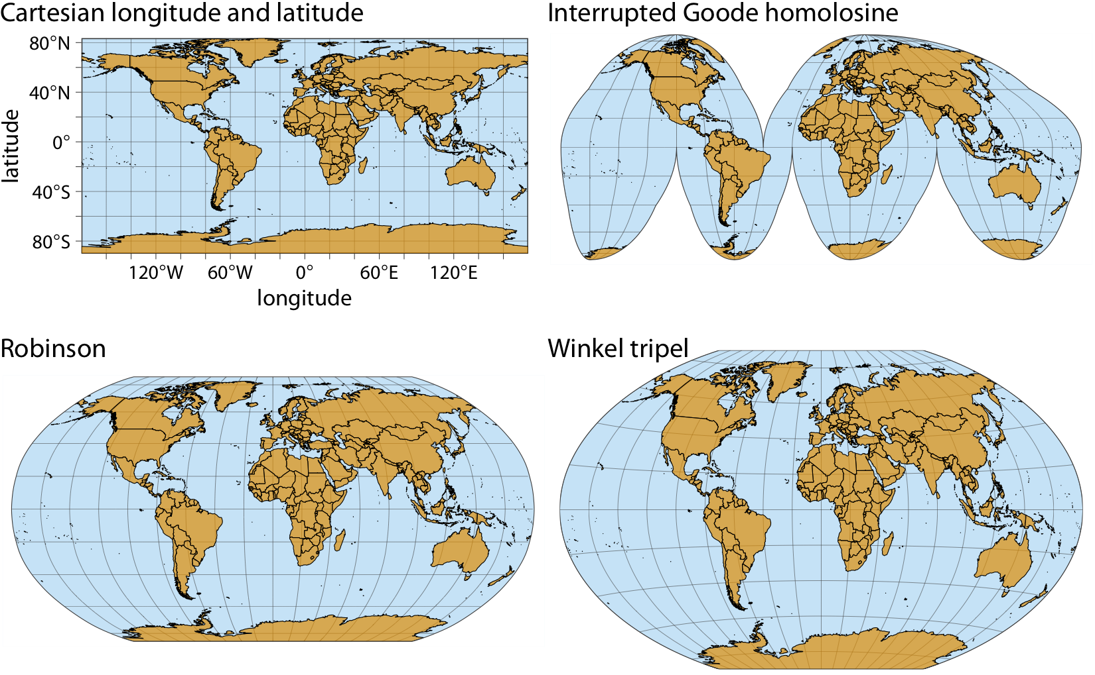
Coordinate Systems with Curved Axes
Interrupted Goode homolosine projection perfectly represents true surface areas, at the cost of dividing some land masses into separate pieces.
The Robinson and Winkel tripel projections both strike a balance between angular and area distortions, and they are commonly used for maps of the entire globe.
Notes:
, most notably Greenland and Antarctica.

Slide 47
In-class Assignment
Please see the mtcars data with the descriptions below:
Which two variables would you visualize to make a comparison? Why?
Choose 4 variables and state which visualization components you would use for them? Line, color, shape?
mpg Miles/(US) gallon
cyl Number of cylinders
disp Displacement (cu.in.)
hp Gross horsepower
drat Rear axle ratio
wt Weight (1000 lbs)
qsec 1/4 mile time
vs Engine (0 = V-shaped, 1 = straight)
am Transmission (0 = automatic, 1 = manual)
gear Number of forward gears

