Slide 1

Introduction to Data Visualization
Titles, Captions, and Tables
Halil Bisgin, Ph.D.

Slide 2
Complementing the aesthetic
A data visualization is not a piece of art meant to be looked at only for its aesthetically pleasing features.
The goal is to convey information and make a point.
We have to place the data into context and provide accompanying titles, captions, and other annotations.
Notes:
Very useful and at other times quite misleading.

Slide 3
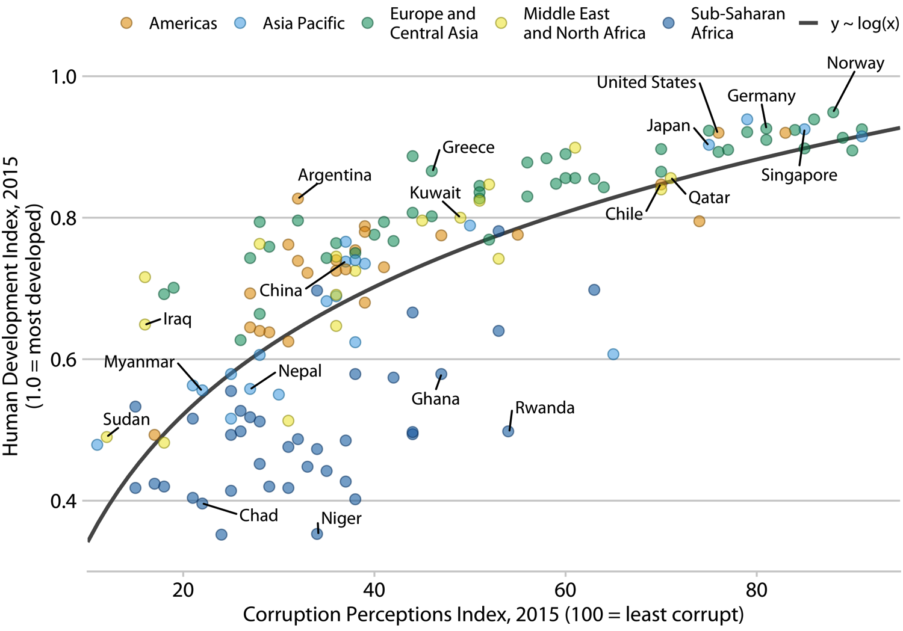
Every figure needs a title
The job of the title is to accurately convey to the reader what the figure is about, what point it makes.
Figure title may not necessarily appear where you were expecting to see it though.
Where’s the title?

Slide 4
Figure without integrated titles
The title is not above the figure, but provided as the first part of the caption block, underneath the figure display.
Caption
Title

Slide 5
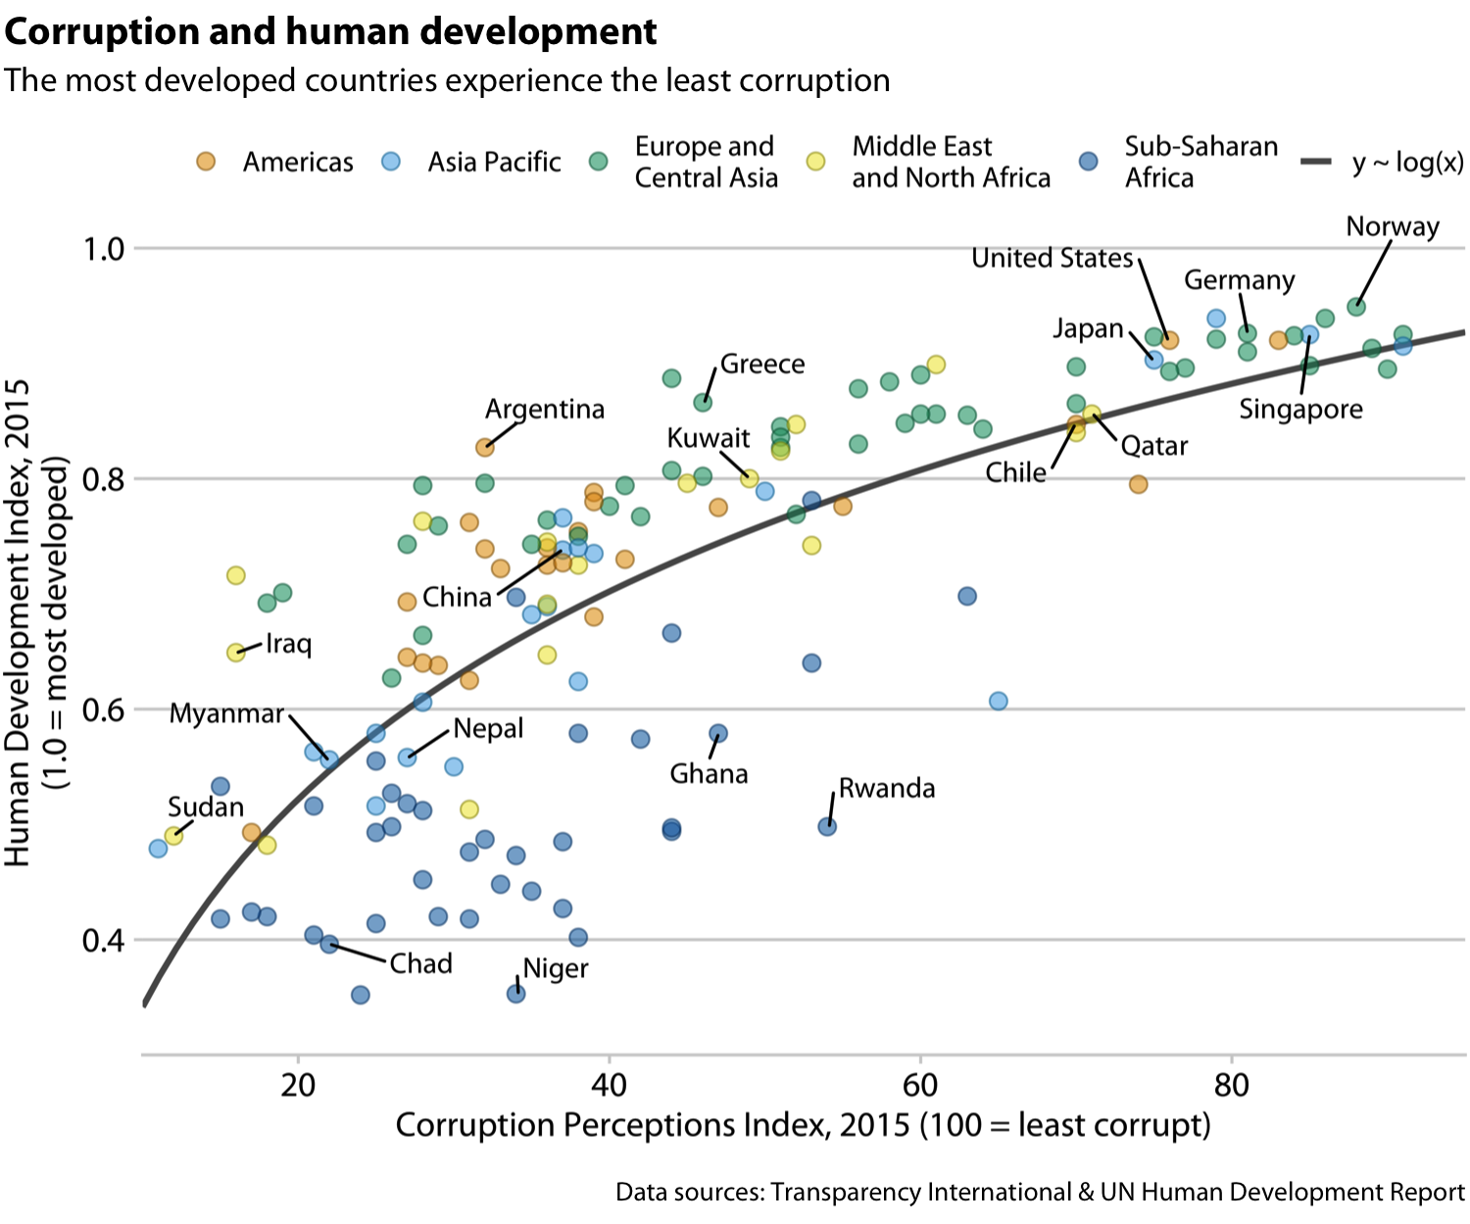
Figure title integrated
You can incorporate the figure title—as well as other elements of the caption, such as the data source statement—into the main display

Slide 6

To integrate or not to integrate
If standalone infographics or
to be posted on social media or
on a web page without accompanying
caption text → integrate
If a publication is laid out such that
each figure has a regular caption block
underneath the display item,
then the title must be provided in
that block of text → don’t integrate

Slide 7
Title in a caption
A title does not have to be a complete sentence.
“Corruption and human development.”
“This figure shows how corruption is related to human development.”
Though short sentences making a clear assertion can serve as titles.
“The most developed countries are the least corrupt”

Slide 8

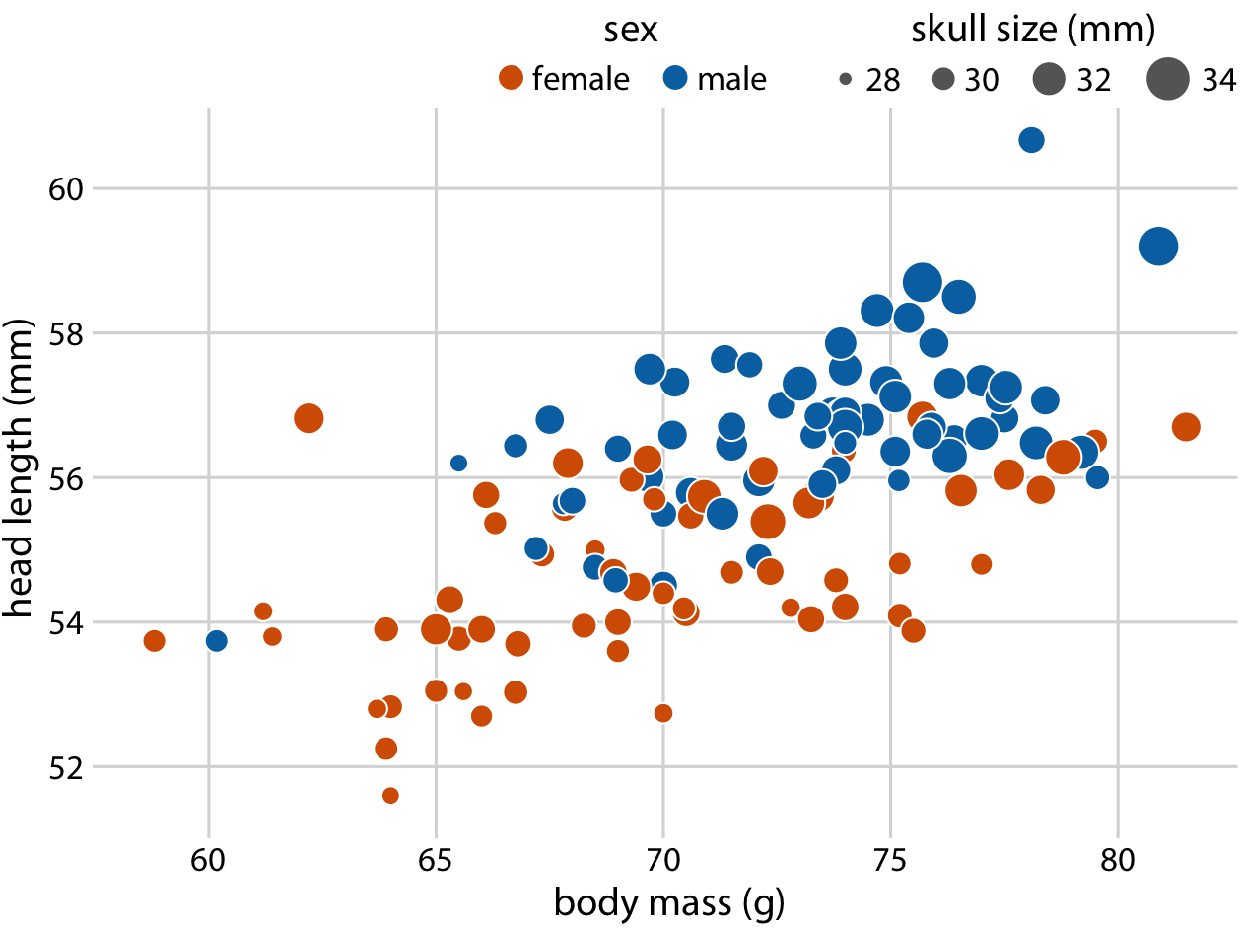
Axes and legends need titles, too
Axis titles ~ axis labels
x axis shows body mass in grams (g)
y axis shows head length in millimeters (mm).
Notes:
Units units units…

Slide 9
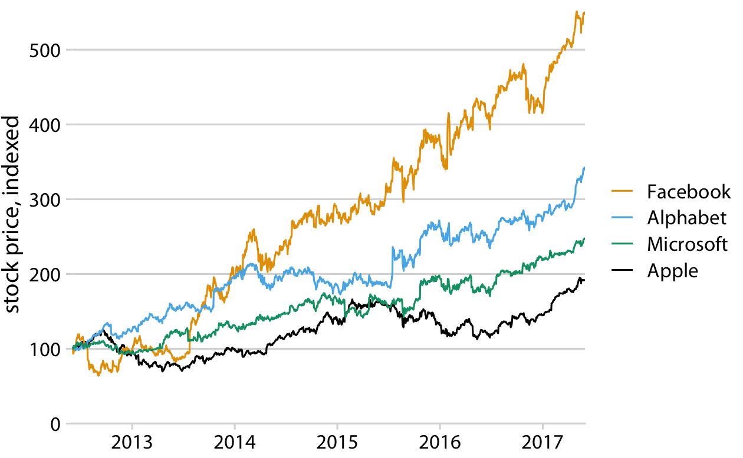
Yes, you can omit (sometimes)
When the labels themselves are fully explanatory…
A legend showing two differently colored dots labeled “female” and “male” already indicates that color encodes sex
Country names will generally not require a title stating what they are, nor will movie titles.
What are these?

Slide 10
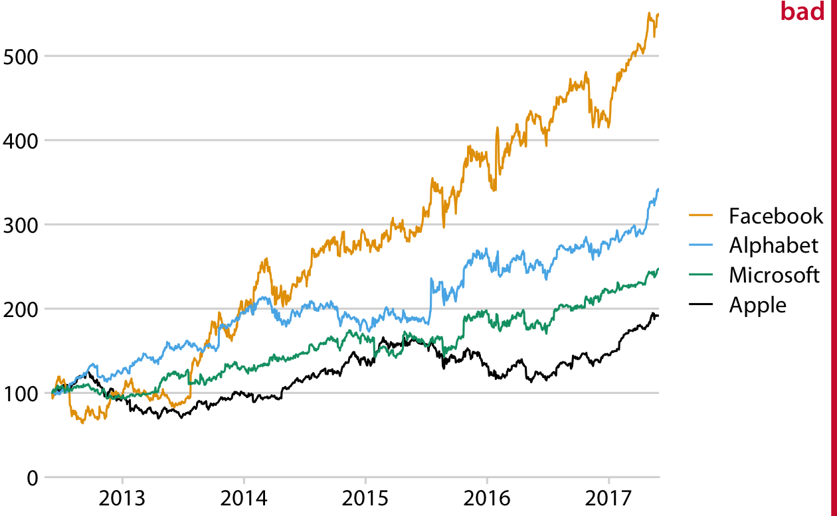
Is the context always enough or obvious?
Be careful;
It is easy to misjudge what is and isn’t obvious from the context.
The context doesn’t always define the axes.
It is a bad practice to make your readers guess what you mean.
Why is this a bad figure?

Slide 11
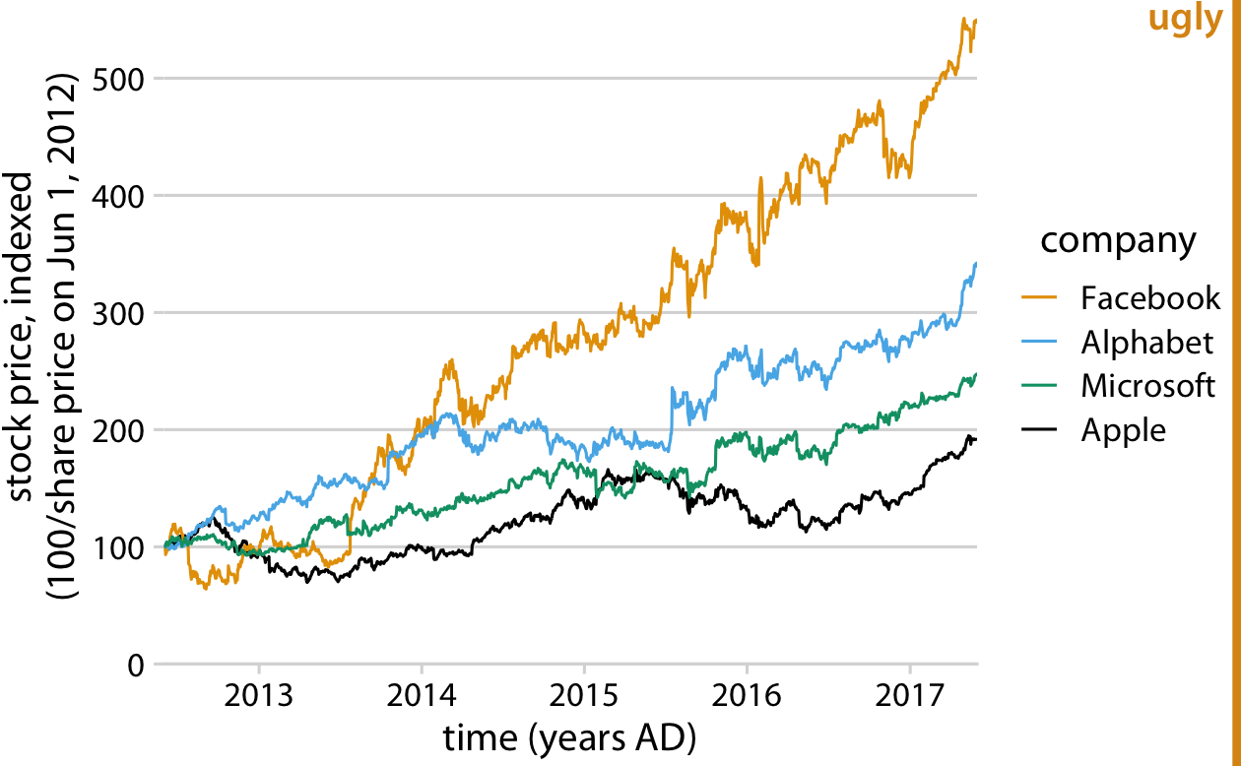
Overdoing labeling
If the legend lists the names of four well-known companies, the legend title “company” is redundant.
Units are good, but titling x as “time (years AD)”?

Slide 12
Entire axis can be omitted
In some cases, it is acceptable to omit not only the axis title but the entire axis.
Pie charts typically don’t have explicit axes, and neither do treemaps.
Mosaic plots or bar charts can be shown without one or both axes if the meaning of the plot is otherwise clear.
Omitting explicit axes with axis ticks and tick labels signals to the reader that the qualitative features of the graph are more important than the specific data values.

Slide 13
Tables
There are key rules for table formatting, but most software violate them ☺
If you pick a Microsoft Word table layout at random, you have an approximately 80% chance of picking one that has issues.

Slide 14
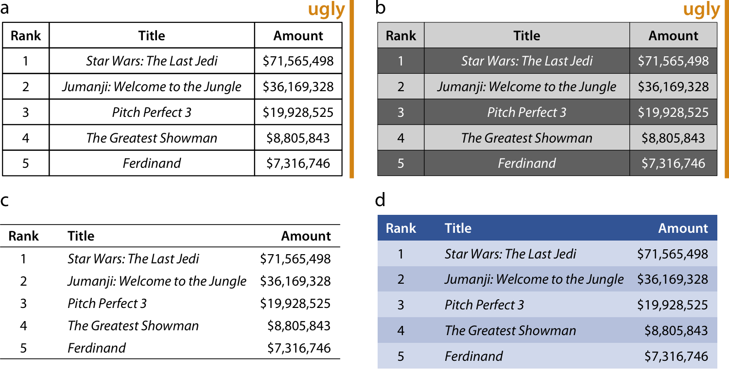
Some key rules for table layout-I
Do not use vertical lines.
Do not use horizontal lines between data rows.
Horizontal lines as a separator between the title row and the first data row or as a frame for the entire table are fine.
Text columns should be left aligned.
The cost of horizontal (or vertical) lines is visual clutter

Slide 15
Some key rules for table layout-II
Number columns should be right aligned and should use the same number of decimal digits throughout.
Columns with single characters should be centered.
The header fields should be aligned with their data
i.e., the heading for a text column will be left aligned and the heading for a number column will be right aligned.
Alternate lighter and darker shading of rows for a visual aid to separate rows

Slide 16
Table vs. Figure Captions
For figures, it is customary to place the caption underneath, whereas for tables it is customary to place it above.
Readers tend to first look at the graphical display and then read the caption for context, hence the caption makes sense below the figure.
Tables tend to be processed like text, from top to bottom, and reading the table contents before reading the caption will frequently not be useful. Hence, captions are placed above the table.

Slide 17
In-class Assigment
Read the flights.csv file from the DATA folder in R.
Generate line plots for each month over the available years.
Give names to x and y axes.

