Slide 1
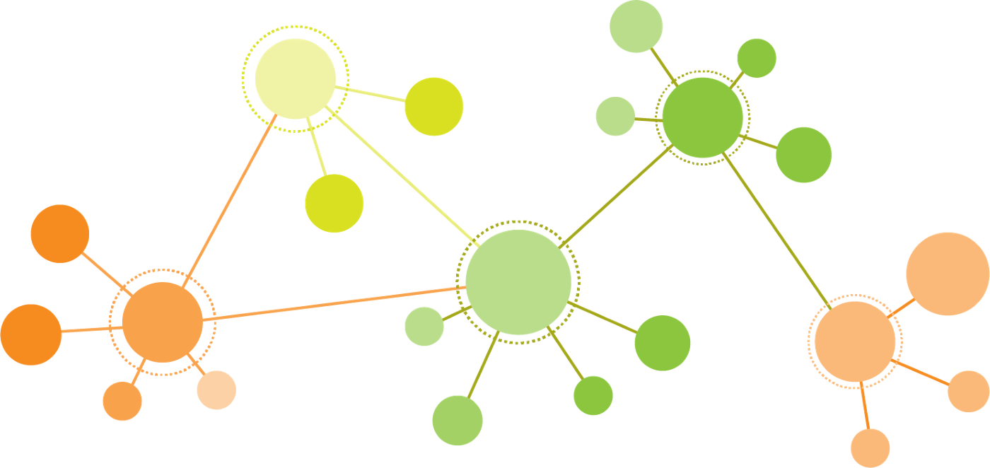
Introduction to Data Visualization
Network Visualization
Cytoscape
Halil Bisgin, Ph.D.
image: https://towardsdatascience.com/python-interactive-network-visualization-using-networkx-plotly-and-dash-e44749161ed7

Slide 2
What is a network?
A network consists of nodes (vertices) which are linked to each through well-defined relationships.
friend – friend (social networks)
gene – gene (gene interaction network)
protein – protein (protein interaction network)
Graph theory provides a formal definition for networks structure. (G(V, E))
V₂
V₁
E₂
E₁
V₃
E₃
V₄
Notes:
Network analysis is a collection of techniques for examining the relationships between entities, and depicting the structure of those relationships. Network analysis spans a number of domains, including social networks, bibliometrics, epidemiology, bioinformatics, complex systems, and text analysis.
Network visualization involves the visualization of the relationships (edges or links) between data elements (nodes).

Slide 3
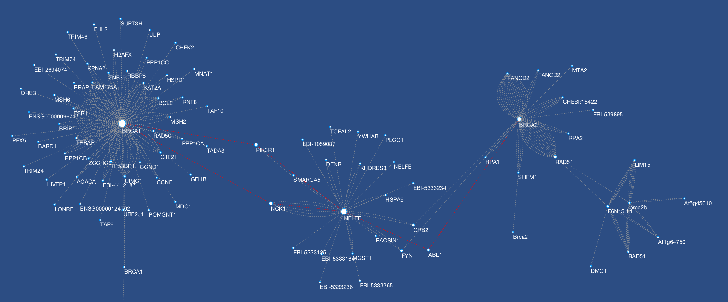
Network Visualization
Network analysis: we can perform a series of analyses on a network (graph) through several algorithms.
However, visualizing a network offers more.
We can use specialized tools, to visualize the relationships between nodes and add more features for a more informative image.

Slide 4
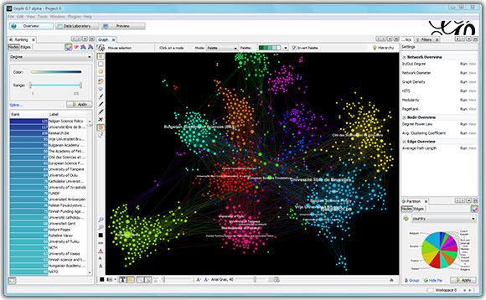

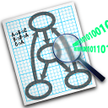
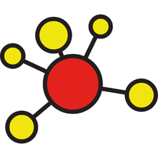
Network Visualization Softwares-1
Gephi is the leading visualization and exploration software for all kinds of graphs and networks.
Cytoscape is an open source software platform for visualizing complex networks and integrating these with any type of attribute data.
Graphviz is open source graph visualization software with web and interactive graphical interfaces, and auxiliary tools, libraries, and language bindings.
igraph: a collection of network analysis tools with connectors in R, Python, Mathematica and C/C++.

Slide 5

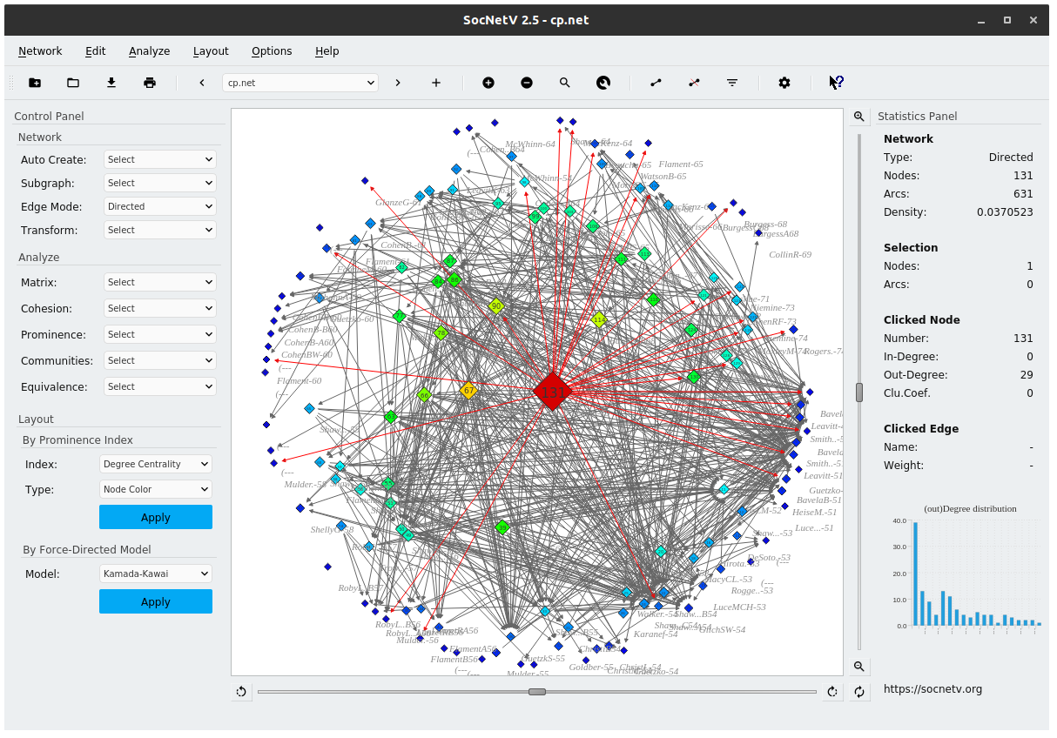

Network Visualization Softwares-2
UCINET 6 for Windows is a software package for the analysis of social network data. UCINET comes with the NetDraw network visualization tool.
The Social Network Analysis and Visualization Software (SocNetV).
Pajek Analysis and visualization of very large networks on Windows

Slide 6
Cytoscape
Cytoscape is an open source software platform for visualizing molecular interaction networks and biological pathways and integrating these networks with annotations, gene expression profiles and other state data.
Although Cytoscape was originally designed for biological research, now it is a general platform for complex network analysis and visualization. .
Notes:
Cytoscape core distribution provides a basic set of features for data integration, analysis, and visualization. Additional features are available as Apps (formerly called Plugins). Apps are available for network and molecular profiling analyses, new layouts, additional file format support, scripting, and connection with databases. They may be developed by anyone using the Cytoscape open API based on Java™ technology and App community development is encouraged. Most of the Apps are freely available from Cytoscape App Store

Slide 7
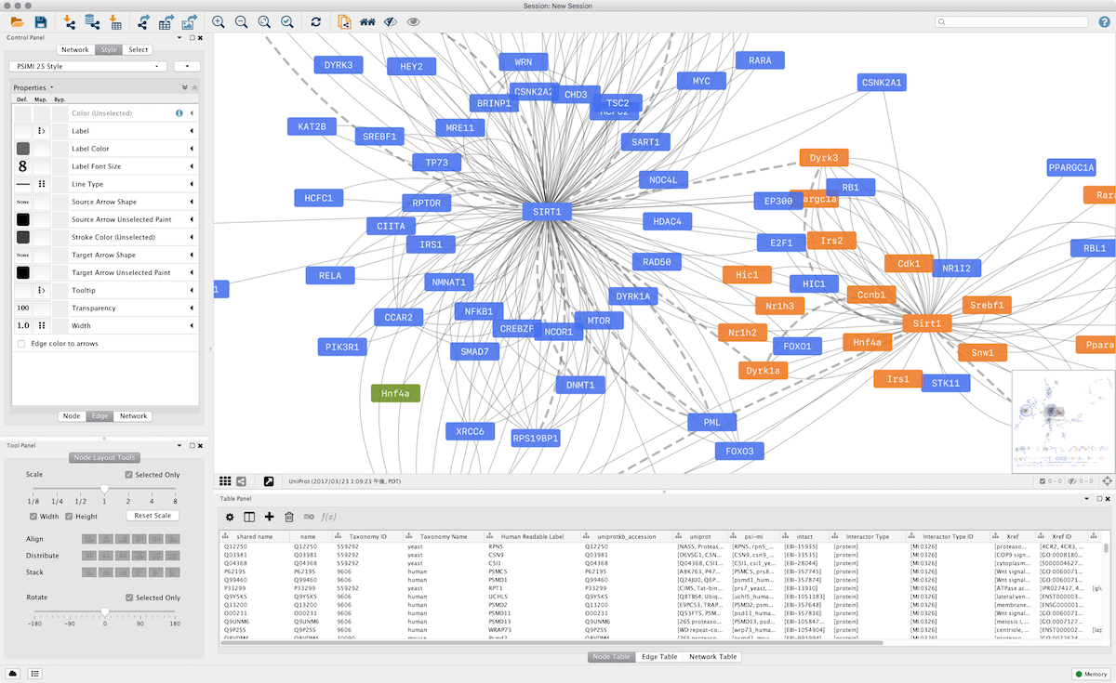
Cytoscape Desktop

Slide 8
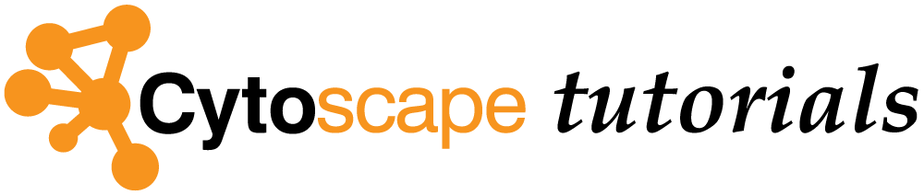
Cytoscape Tutorial
The following content can also be found at https://github.com/cytoscape/cytoscape-tutorials/wiki

