Slide 1

Introduction to Data Visualization
How to refine our plots?
“colors & text”
Halil Bisgin, Ph.D.

Slide 2
The default look with ggplot
The default settings in ggplot should be pretty good to work with.
It’s only when we have some specific plot in mind that the question of polishing the results comes up.
Notes:
Very useful and at other times quite misleading.

Slide 3
Refining a plot can mean several things
We might want to get the look of it just right, based on our own tastes and our sense of what needs to be highlighted.
We might want to format it in a way that will meet the expectations of a journal, or of a conference audience, or the general public.
We might want to tweak this or that feature of the plot or add an annotation or additional detail not covered by the default output.
We might want to completely change the look of the entire thing, without distorting the original plot.

Slide 4
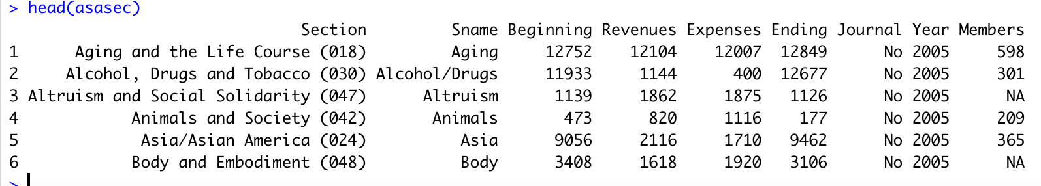
Use case- American Sociological Association
Data becomes available when you install socviz in case you don’t have it on your system.
Membership data for each section over a ten year period, but the data on section reserves and income (the Beginning and Revenues variables) is for the 2015 year only.

Slide 5
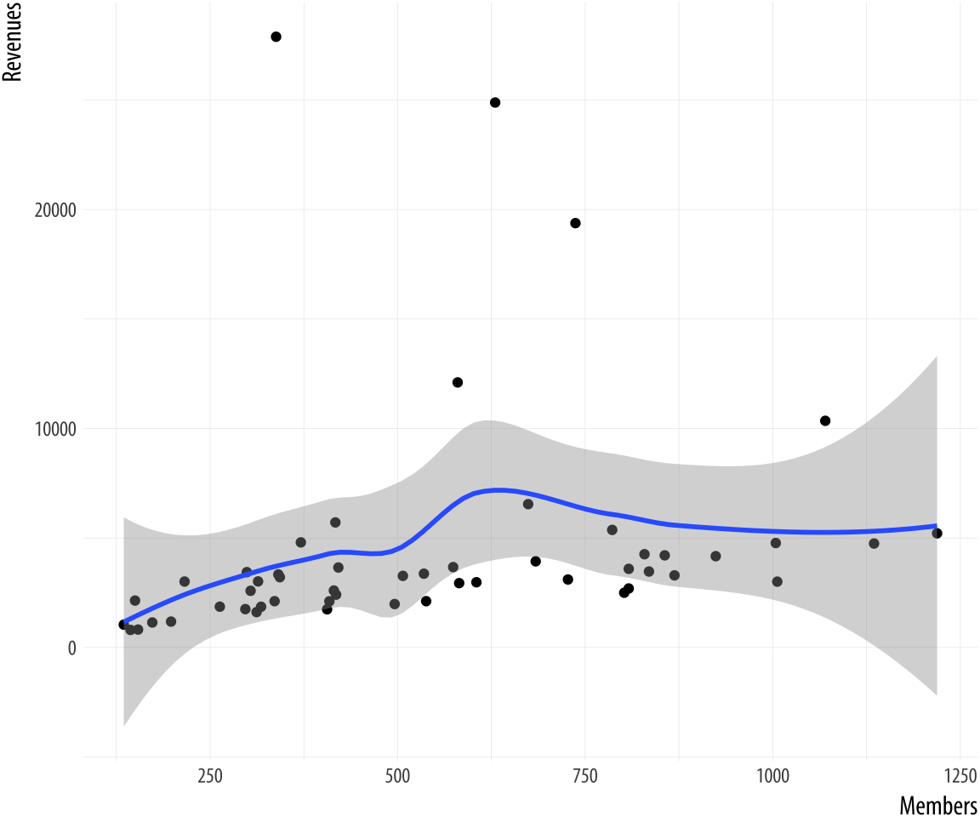
Basic plot w/ ggplot
Let’s look at the relationship between section membership and section revenues for a single year, 2014.
geom_point()
smooth with loess

Slide 6
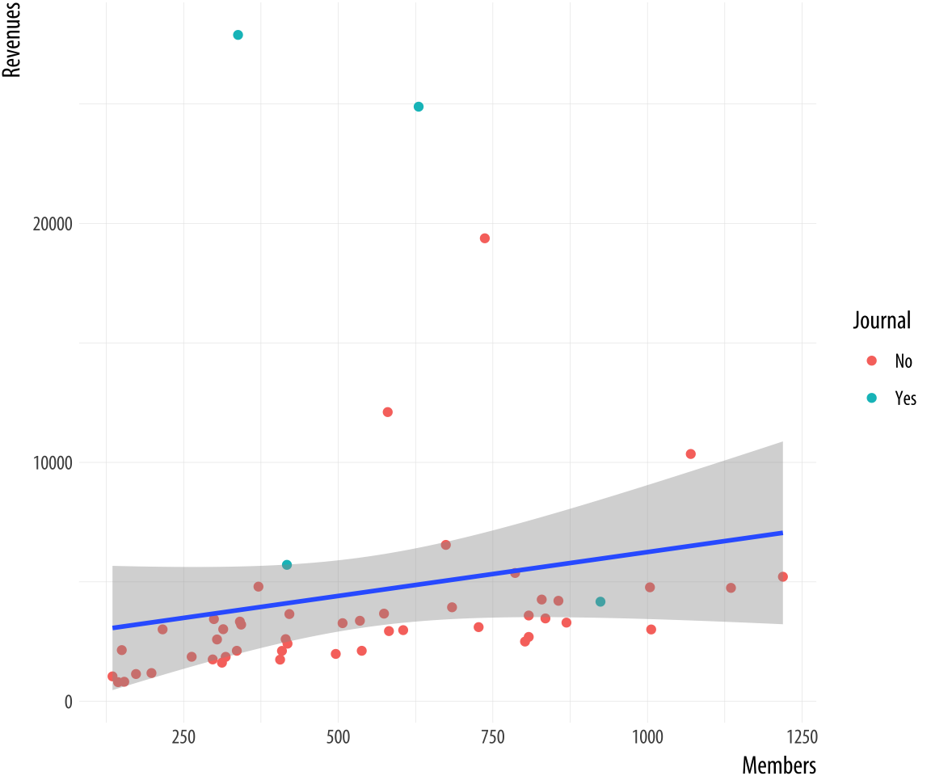
Refinement 1-color
Change the smooth parameter, and add a third variable journal by using color.

Slide 7
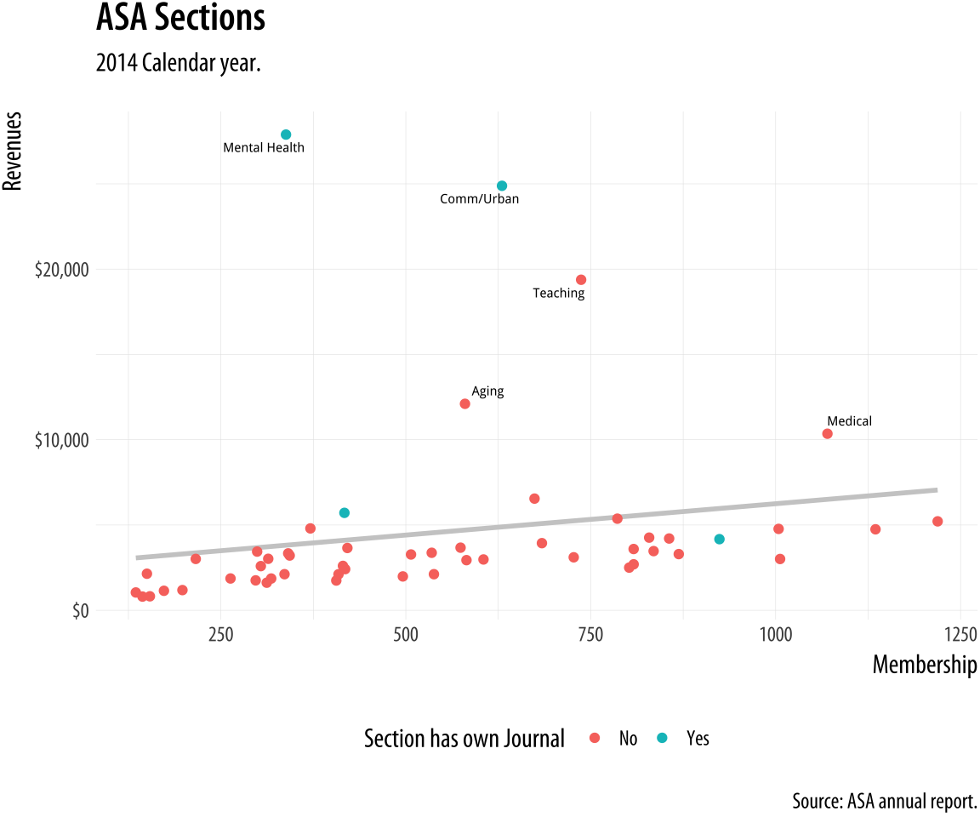
Refinement II-adding annotations
geom_text_repel () for point annotations.
labs and scale_y_continuous() to add labels.
theme() for legend

Slide 8
Use color to your advantage
You should choose a color palette in the first place based on its ability to express the data you are plotting.
An unordered categorical variable like “Country” or “Sex”, for example, requires distinct colors that won’t be easily confused with one another.
An ordered categorical variable like “Level of Education”, on the other hand, requires a graded color scheme of some kind running from less to more or earlier to later.

Slide 9
There are other considerations
If your variable is ordered, is your scale centered on a neutral midpoint with departures to extremes in each direction, as in a Likert scale?
These questions are about ensuring accuracy and fidelity when mapping a variable to a color scale.
Take care to choose a palette that reflects the structure of your data.
For example, do not map sequential scales to categorical palettes, or use a diverging palette for a variable with no well-defined midpoint.

Slide 10
Palettes
We choose color palettes for mappings through one of the scale_ functions for color or fill.
While it is possible to use scale_color_hue(), or scale_fill_hue(), in general this is not recommended.
Instead we should use the RColorBrewer package to pick a palette.
When used in conjunction with ggplot, you access these colors by specifying the scale_color_brewer() or scale_fill_brewer() functions, depending on the aesthetic you are mapping

Slide 11
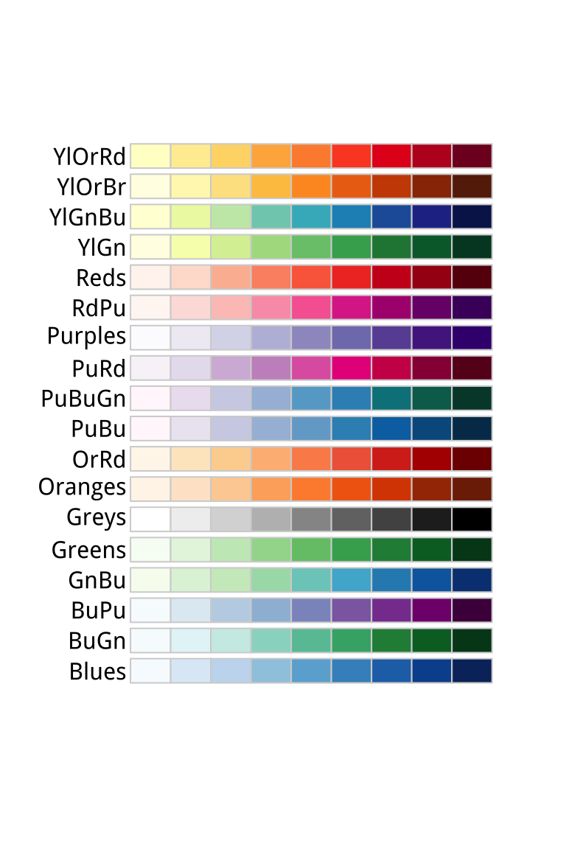
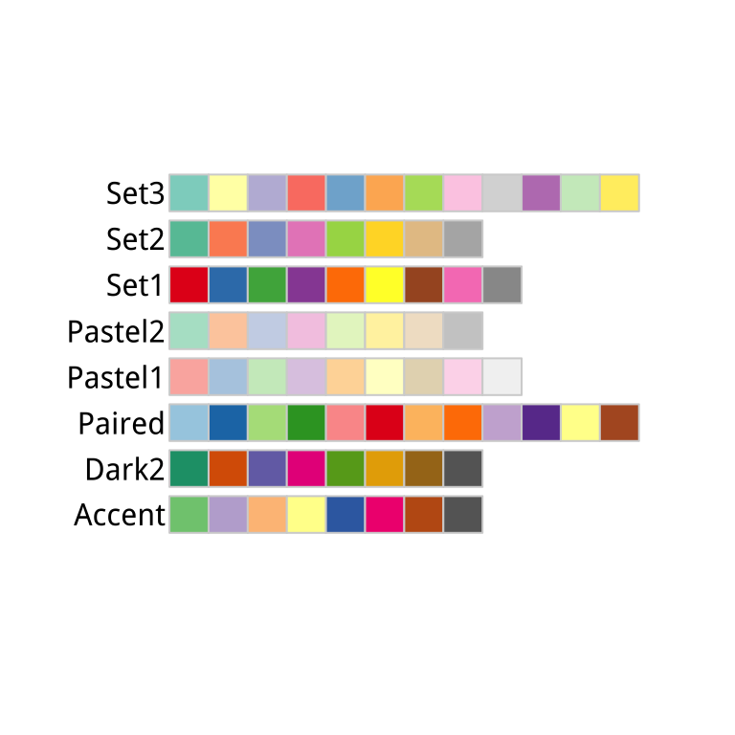
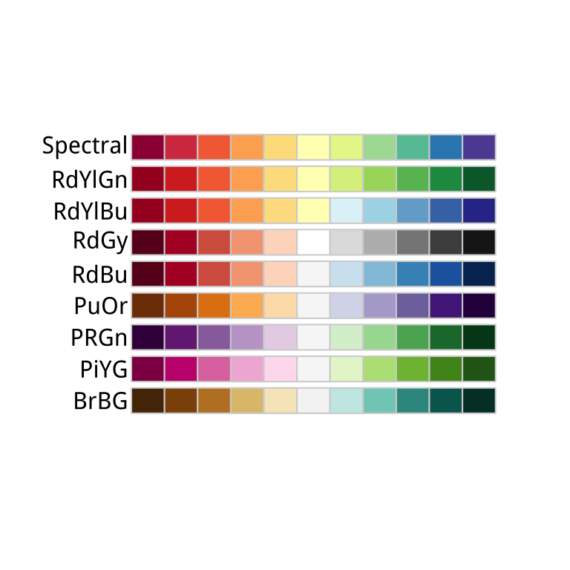
RColorBrewer’s palettes
sequential
diverging
qualitative

Slide 12
You can always color manually
scale_color_manual() or scale_fill_manual()
Take a value argument that can be specified as vector of color names or color values that R knows about
demo('colors’)
Colors can be set via their hexadecimal RGB value.
Letters represent numbers 10 to 15 in base 16
# | r | r | g | g | b | b
# | C | C | 5 | 5 | D | D
221
85
204
Notes:
This is a way of encoding color values in the RGB colorspace, where each channel can take a value from 0 to 255 like this.
A color hex value begins with a hash or pound character, #, followed by three pairs of hexadecimal or “hex” numbers.
Hex values are in Base 16, with the first six letters of the alphabet standing for the numbers 10 to 15. This allows a two-character hex number to range from 0 to 255. You read them as #rrggbb, where rr is the two-digit hex code for the red channel, gg for the green channel, and bb for the blue channel. So #CC55DD translates in decimal to CC = 204 (red), 55 = 85 (green), and DD = 221 (blue). It gives a strong pink color.

Slide 13
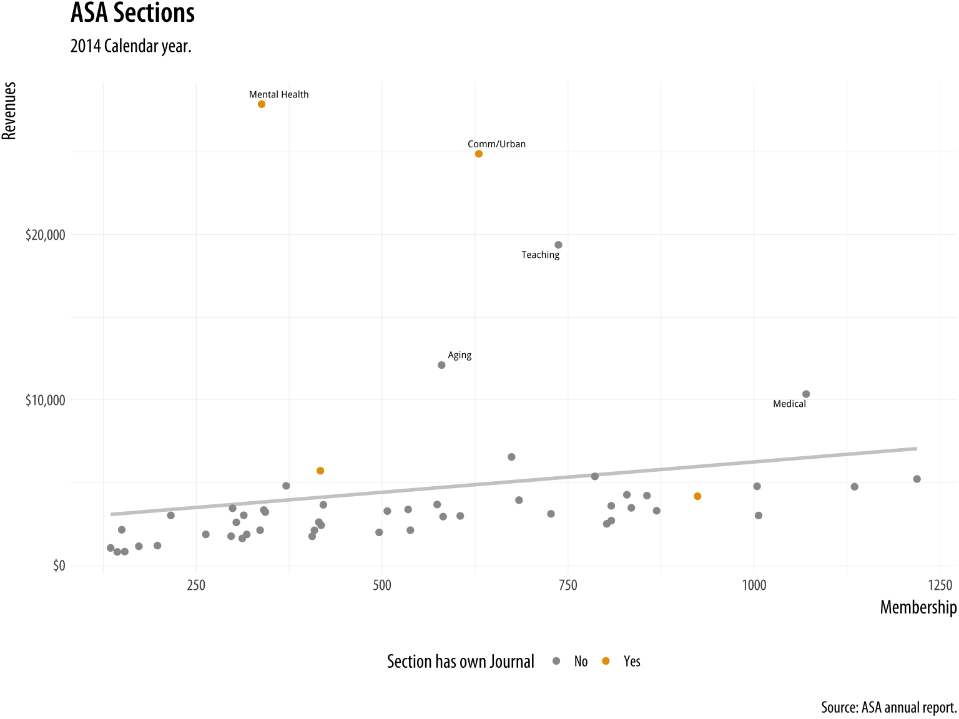
Manually setting colors-example
Useful when the meaning of a category itself has a strong color association (e.g., Political parties)
A color-blind-friendly palette (Chang, 2013)
cb_palette <- c("#999999", "#E69F00", "#56B4E9", "#009E73", "#F0E442", "#0072B2", "#D55E00", "#CC79A7")
… + scale_color_manual(values = cb_palette)
Notes:
"#999999”: gray
"#E69F00”: orange

Slide 14
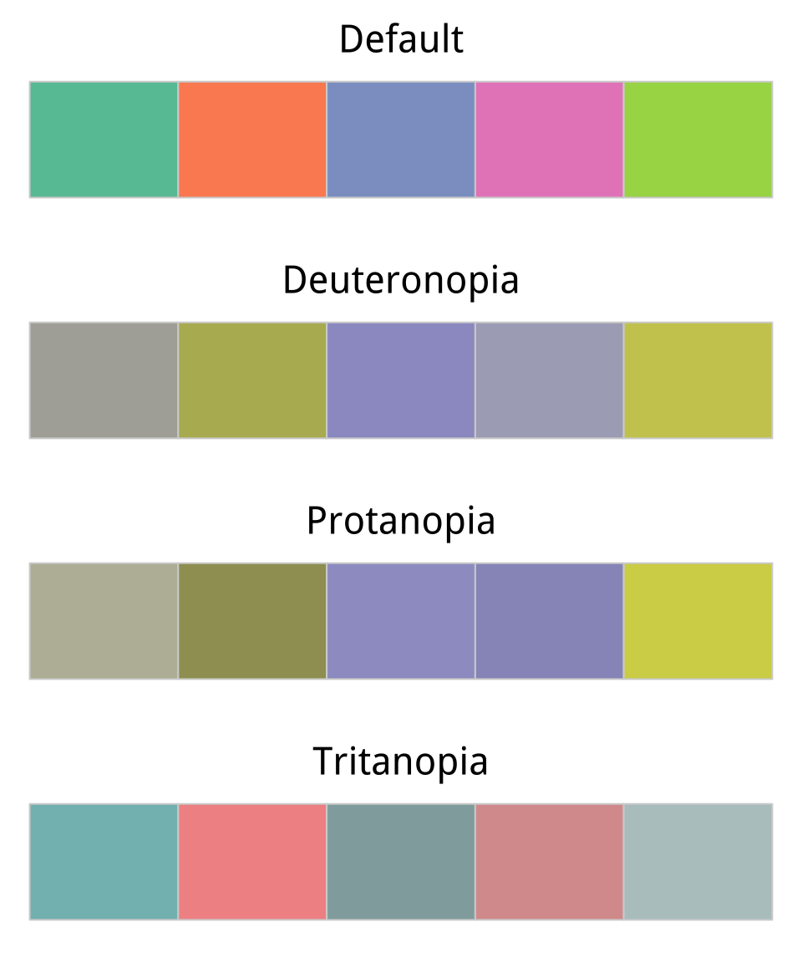
More we can do for color-blind viewers
dichromat package
Let’s choose 5 colors from sequential palette
Default <- brewer.pal(5, "Set2")
Default <- brewer.pal(5, "Set2")
library(dichromat)types <- c("deutan", "protan", "tritan")
names(types) <- c("Deuteronopia", "Protanopia", "Tritanopia")
color_table <- types %>%purrr::map(~ dichromat(Default, .x)) %>% as_tibble() %>%add_column(Default, .before = TRUE)
color_comp(color_table)

Slide 15
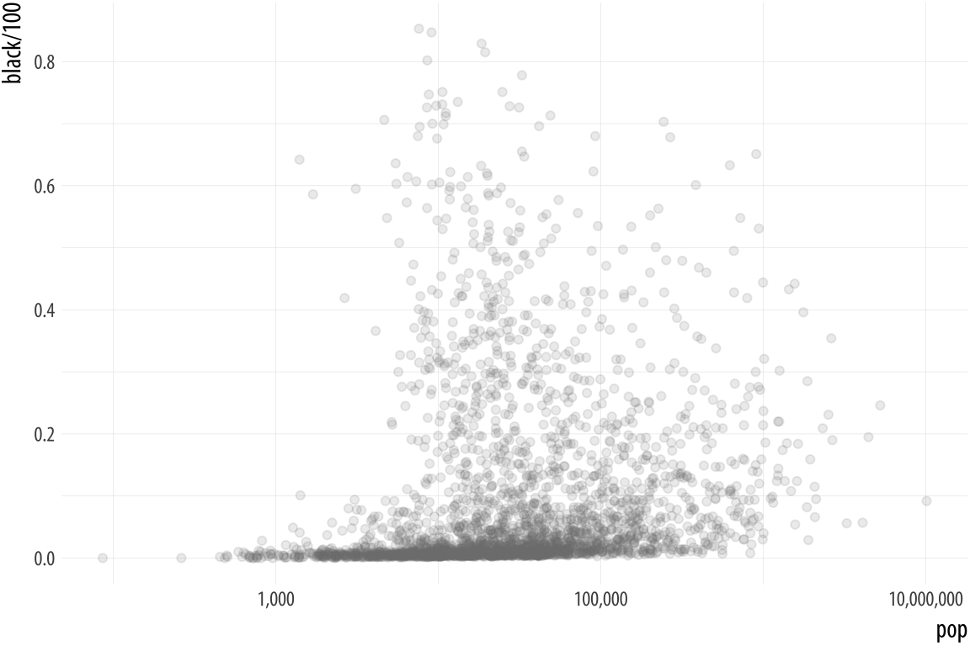
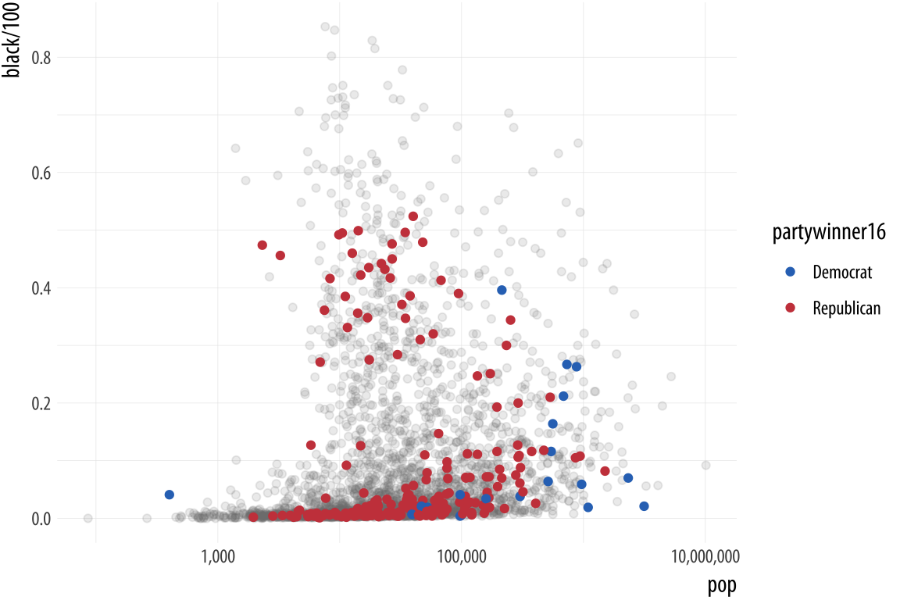
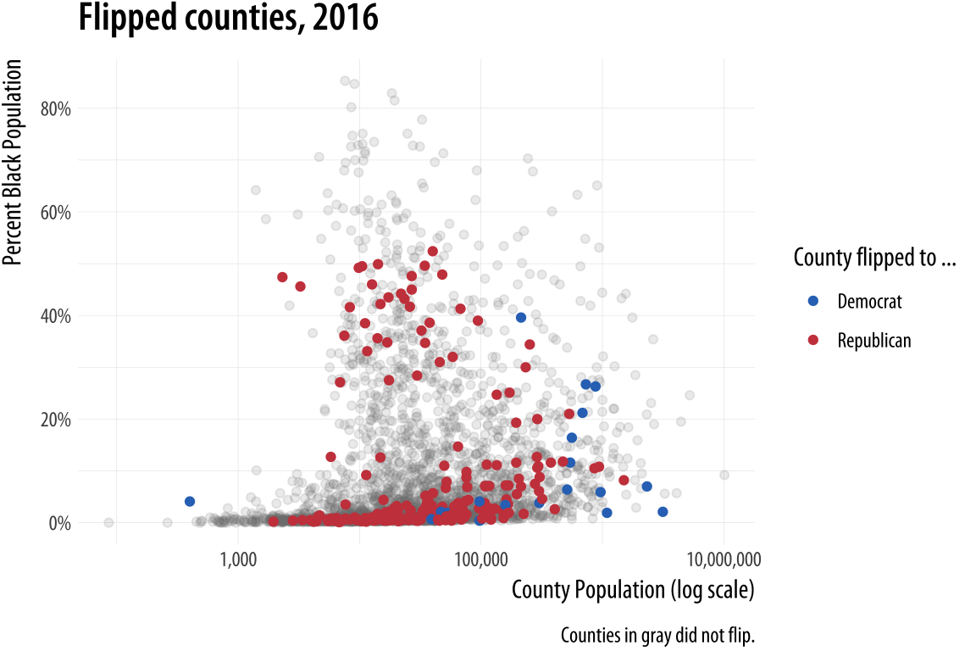
Layer color and text together - 1
Color is also very useful when we want to pick out or highlight some aspect of our data.
The layered approach of ggplot can really work to our advantage.
Counties not flipped
Counties flipped w/ color
Titles and labels added

Slide 16
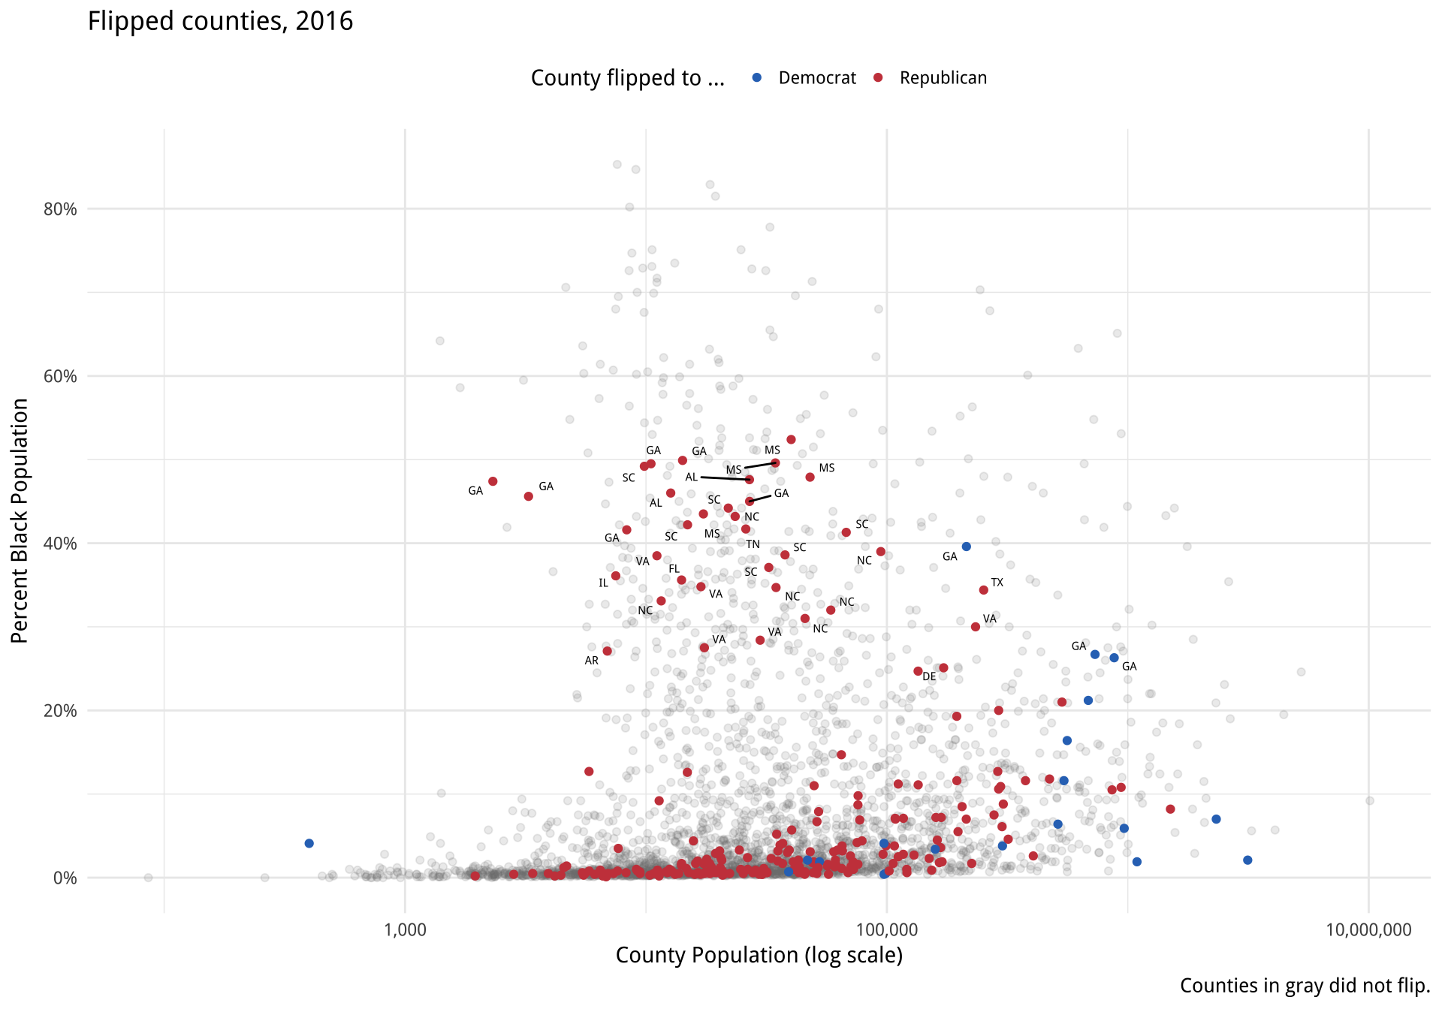
Layer color and text together - 2
p4 <- p3 + geom_text_repel(data = subset(county_data, flipped == "Yes" & black > 25),mapping = aes(x=pop,y = black/100,label = state), size = 2)
p4 + theme_minimal() + theme(legend.position="top")

Slide 17
What to pay attention?
When looking at good plots, we should be able to see the implicit or explicit structure.
The mappings that form the basis of the plot, picking out which variables are mapped to x and y, and which to to color, fill, shape, label, and so on. What geoms were used to produce them?
How have the scales been adjusted? Are the axes transformed? Are the fill and color legends combined?
What is the base layer? What has been drawn on top of it, and in what order? Which upper layers are formed from subsets of the data? Which are new datasets? Are there annotations? The ability to evaluate plots in this way, to apply the grammar of graphics in practice, is useful both for looking at plots and for thinking about how to make them.

Slide 18
Demonstration
RefineColorTextThemeIntro.R

