Slide 1

Introduction to Data Visualization
How to refine our plots?
“themes”
Halil Bisgin, Ph.D.

Slide 2
Changing appearances w/ themes
Themes can be turned on or off using the theme_set() function
theme_set(theme_bw())
theme_set(theme_dark())
Once set, a theme applies to all subsequent plots and it remains active until it is replaced by a different theme.
You can still use the theme() function to fine-tune any aspect of your plot

Slide 3
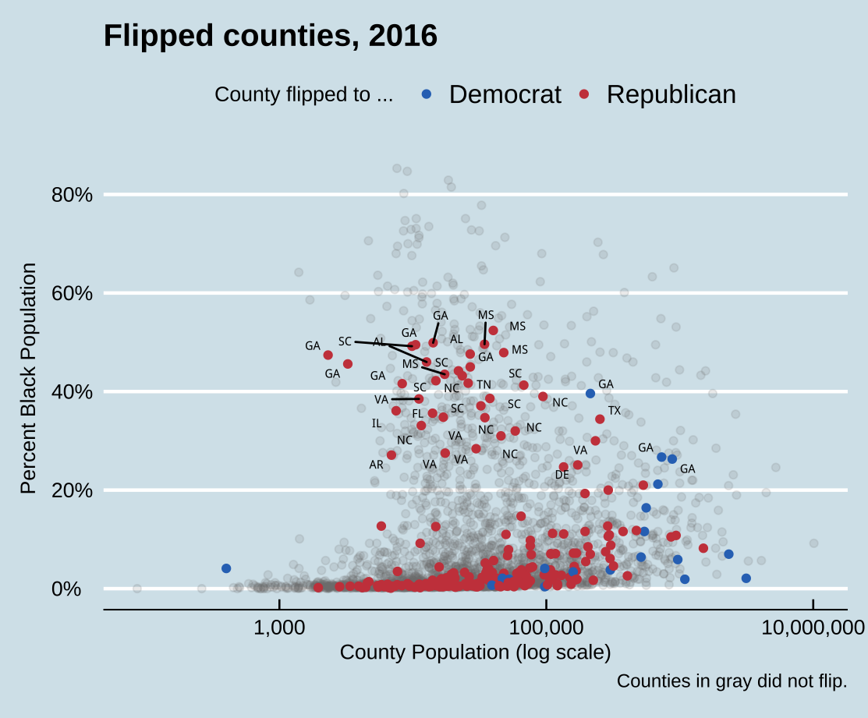
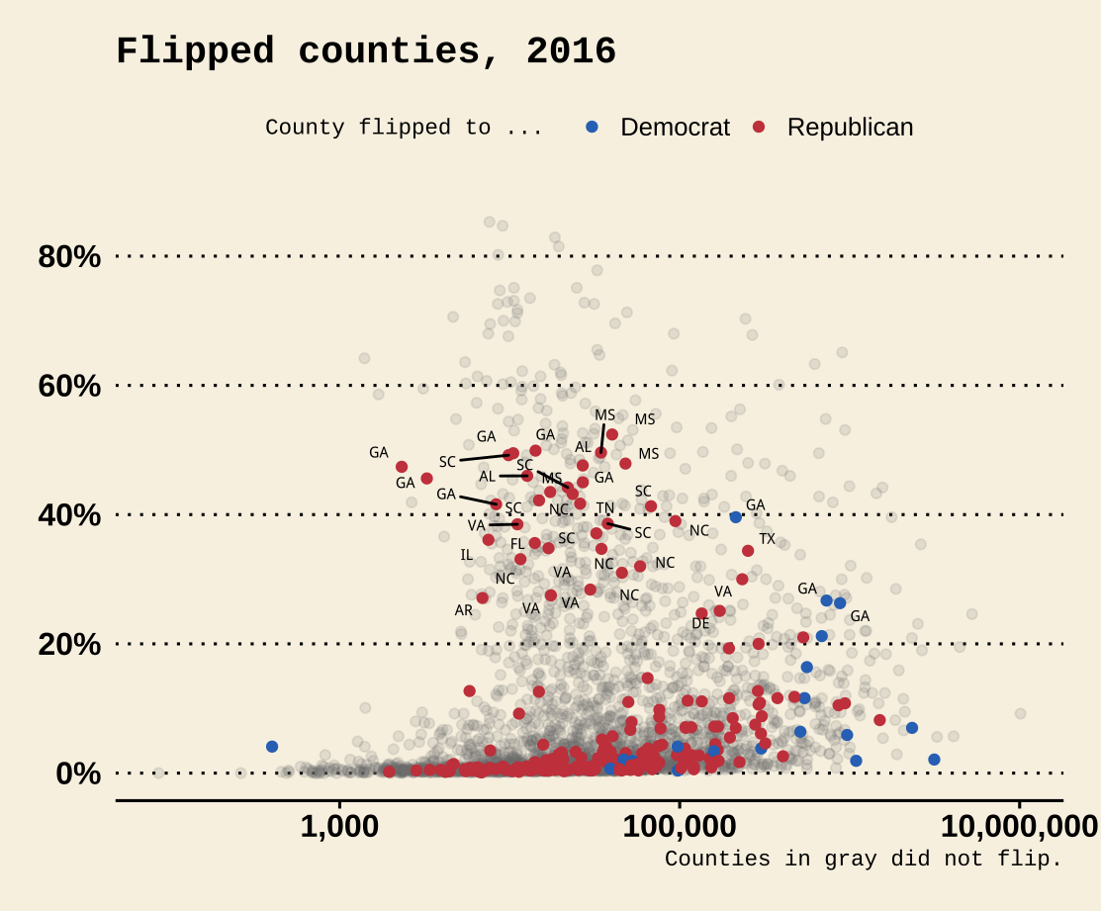
More theme options
ggplot comes with several built-in themes:
theme_minimal()
theme_classic()
theme_gray()
theme_grey() as the default
Install the ggthemes for many more options
theme_set(theme_economist())
theme_set(theme_wsj())

Slide 4
Themes are like aesthetic
The choices you make should harmonize with the broader printed or displayed material.
When starting out it can be wisest to stick to the defaults or consistently use a suitable theme.

Slide 5
Which theme?
Themes with colored backgrounds customized typefaces are best used
when making one-off graphics or posters,
when preparing figures to integrate into a slide presentation, or
when conforming to a house or editorial style for publication
Journal publications need a different set of themes:
Claus O. Wilke’s cowplot package
Alternatively:
Bob Rudis’s hrbrthemes

Slide 6
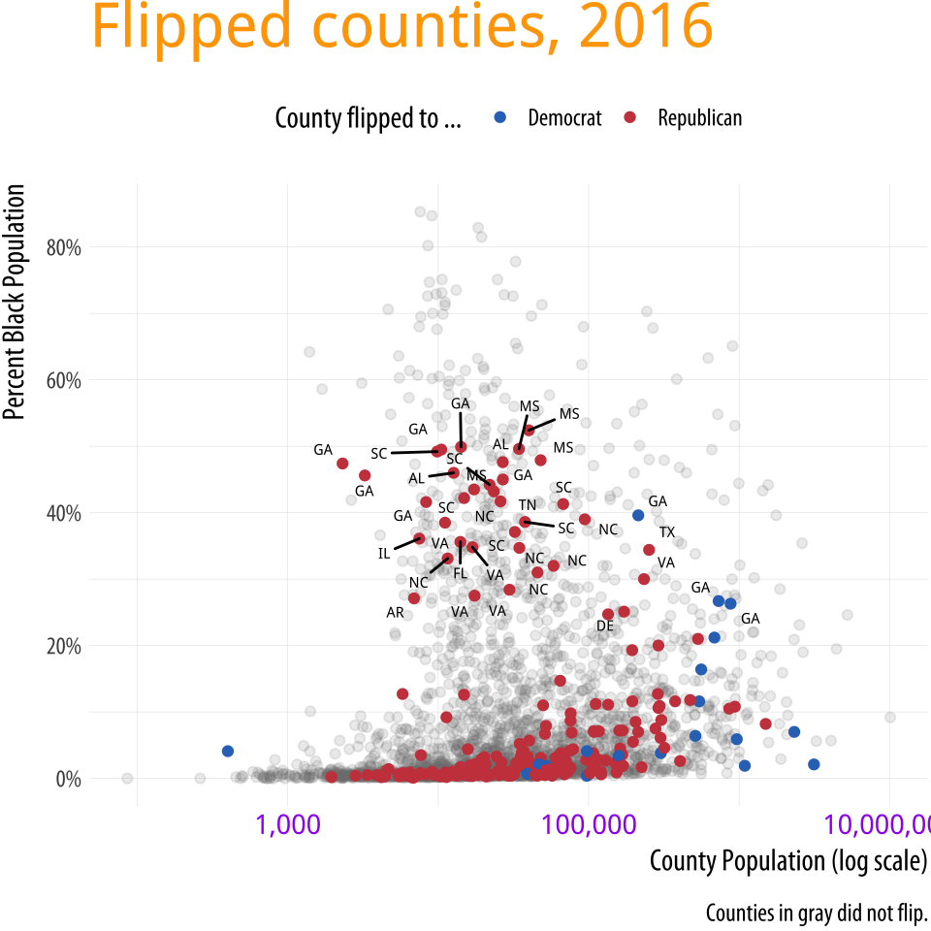
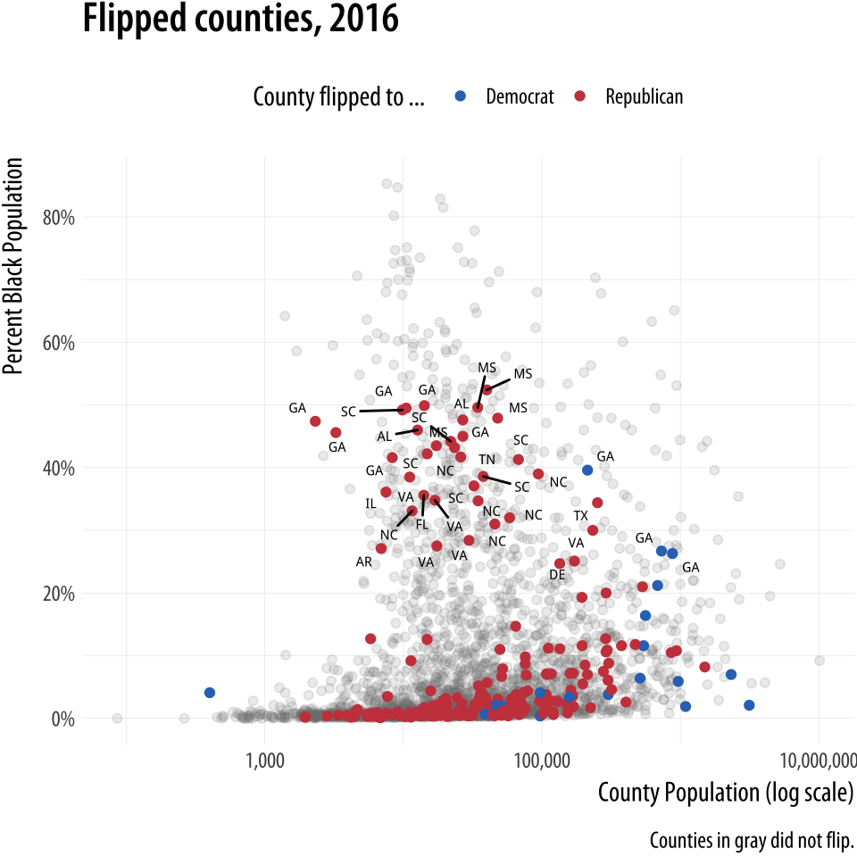
theme() function gives more options
The theme() function allows you to change the color, typeface, and font weight of text.
… + theme(legend.position = "top",
plot.title = element_text(size=rel(2), lineheight=.5,
family="Times",
face="bold.italic",
colour="orange"),
axis.text.x = element_text(size=rel(1.1), family="Courier",
face="bold",
color="purple"))

Slide 7
Using theme elements for design
It makes good sense use themes as a way to fix design elements:
you can subsequently ignore them, and
focus instead on the data you are examining.
It is also worth remembering that ggplot’s theme system is very flexible.
It permits a wide range of design elements to be adjusted in order to create custom figures.
element_text() and element_blank() are useful
to tweak the appearance of various text elements such as titles.
to remove several of them altogether.

Slide 8
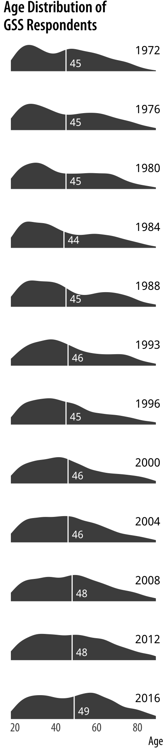
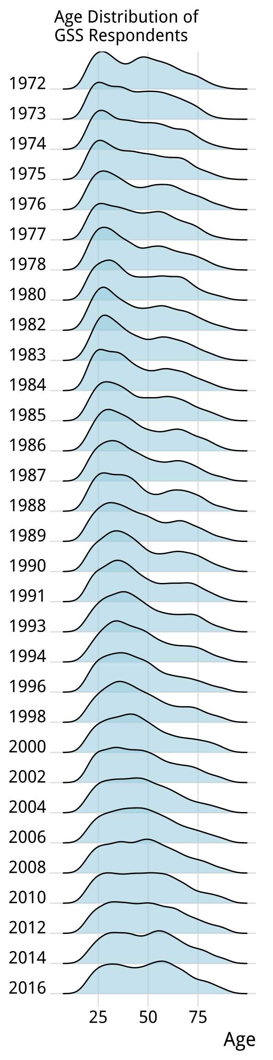
Manual vs. ggridges
Removing some elements manually
Using ggridges

Slide 9
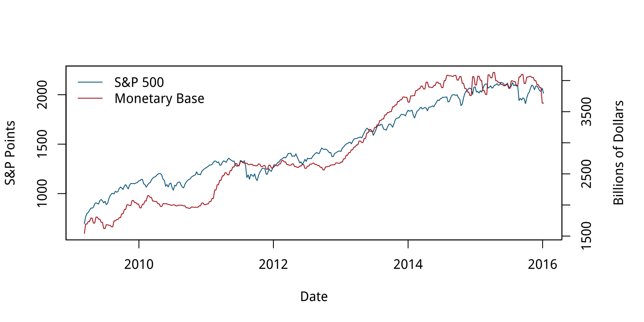
Case study 1-Two y-axes
In January of 2016, Liz Ann Sonders, Chief Investment Strategist with Charles Schwab, Inc, tweeted about the apparent correlation between two economic time series:
the Standard and Poor’s 500 stock market index
the Monetary Base, a measure of the size of money supply
Problem?
Look at the ranges!
Notes:
The S&P is an index that ranges from about 700 to about 2,100 over the period of interest (about the last seven years).
The Monetary Base ranges from about 1.5 trillion to 4.1 trillion dollars over the same period.
This means that we can’t plot the two series directly.
The Monetary Base is so much larger that it would meake the S&P 500 series appear as a flat line at the bottom.
While there are several reasonable ways to address this, people often opt instead to have two y-axes.

Slide 10
Two y-axes are dangerous
People tend to use two y-axes with a desire to have close lines and a belief of a substantive association.
However, using two y-axes makes it even easier than usual to mislead about the degree of association.
It allows to adjust the scaling of the axes to relative to one another in way that moves the data series around more or less however you like!

Slide 11
How were we fooled?
For the first half of the graph, the red Monetary Base line tracks below the blue S&P 500 and is above it for the second half.

Slide 12
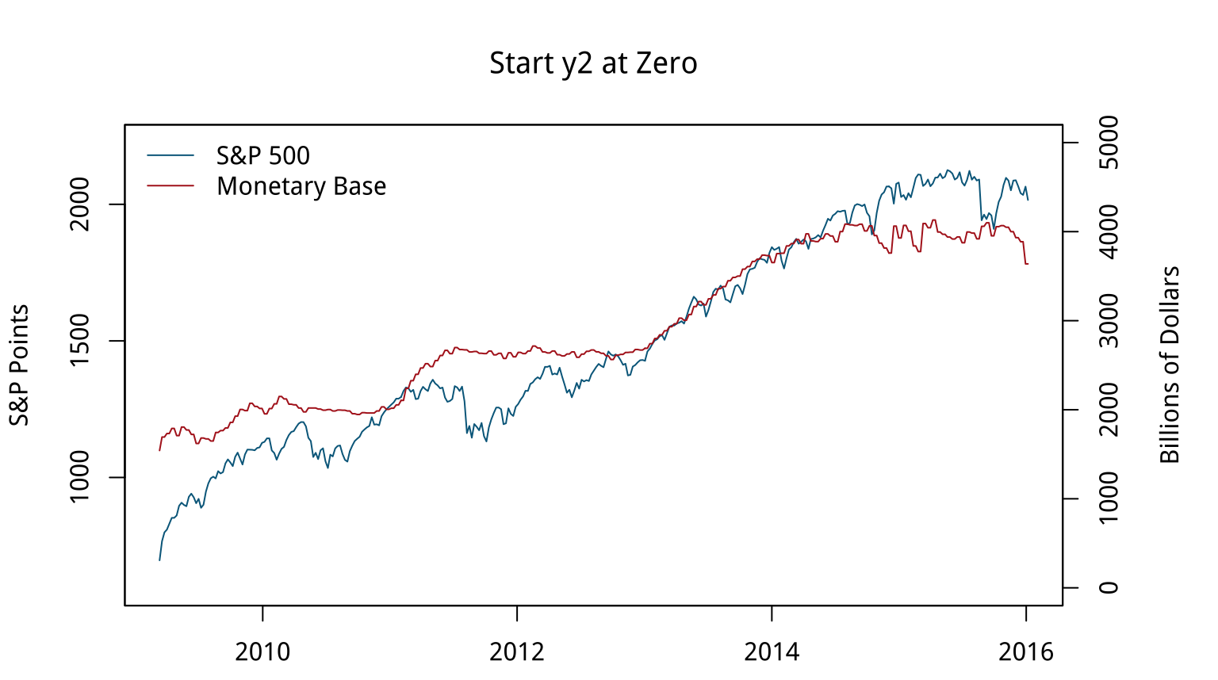
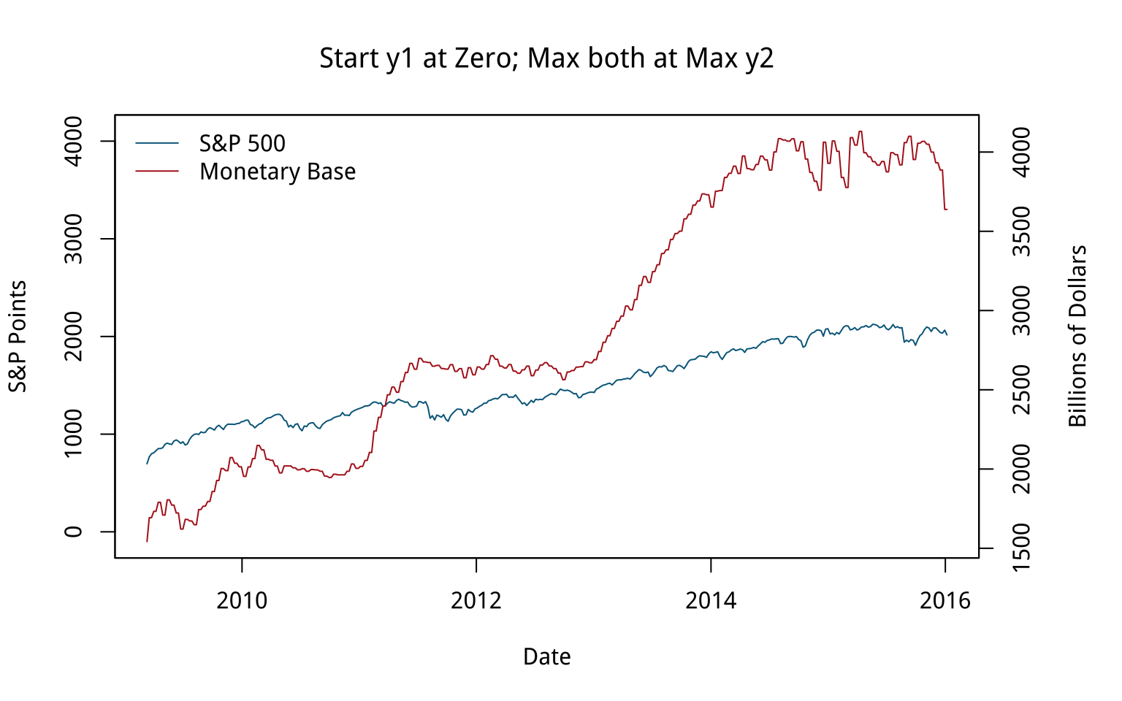
How to ”fix” then?
Start the second y-axis at zero, which shifts the Monetary Base line above the S&P line for the first half of the series and below it later on.
Adjust the axes so that the axis tracking the S&P starts at zero.
Muted the association between the two variables.

Slide 13
How else might we draw this data?
We could use a split- or broken-axis plot to show the two series at the same time.
better perceptual properties than overlayed charts w/ dual axes
useful in cases where the series are of the same kind, but of very different magnitudes. (not the case here)
If the series are not in the same units (or of widely differing magnitudes), is to rescale one of the series
dividing or multiplying it by a thousand
to index each of them to 100 at the start of the first period, and then plot them both.
Notes:
Index numbers can have complications of their own, but here they allow us use one axis instead of two, and also to calculate a sensible difference between the two series and plot that as well

Slide 14
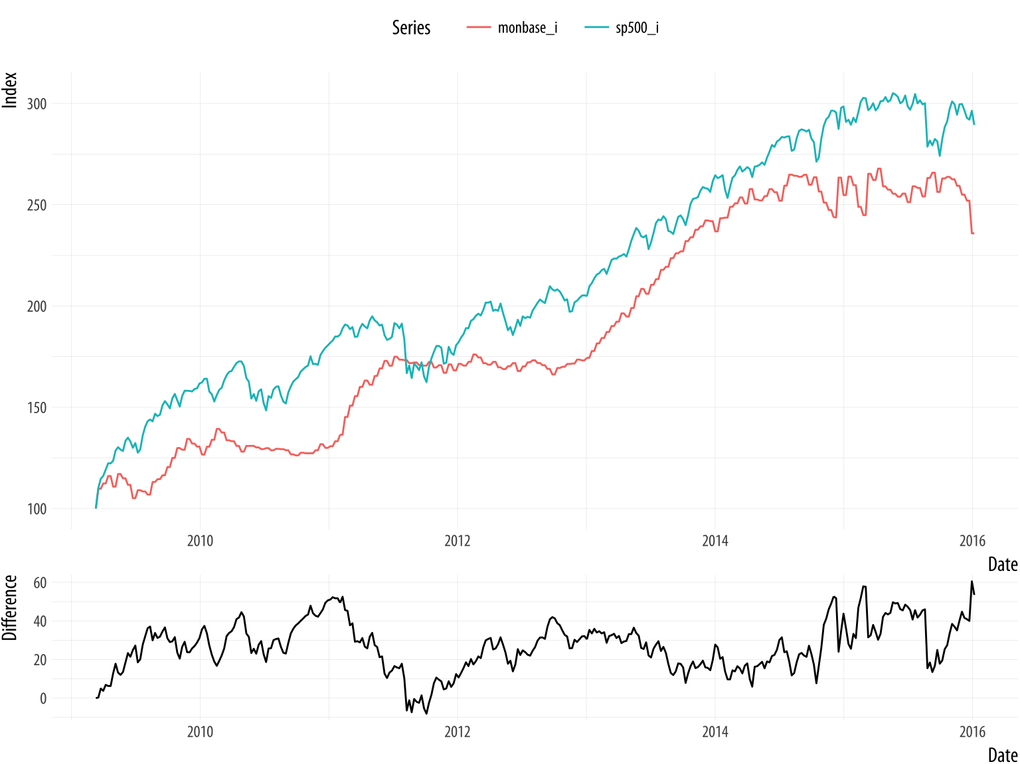
Redrawing transformed data
Two plots: i) two series in one, ii) their difference
The S&P index runs above the Monetary Base for almost the whole series as opposed to the original

Slide 15
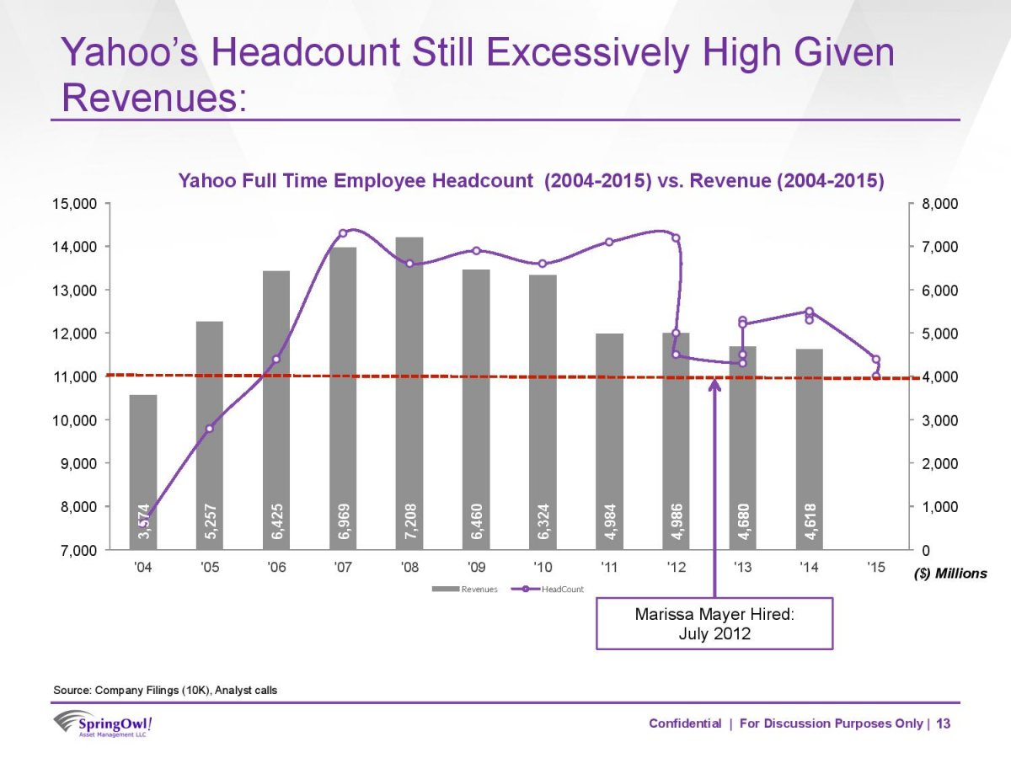
Case study 2-A bad slide
Marissa Mayer’s performance as CEO of Yahoo was being criticized by many observers.
One of them, Eric Jackson, an investment fund manager, sent a 99-slide presentation to Yahoo’s board outlining his best case against Mayer
Dual axis sin.
What else?
Notes:
connecting line segments are just manually added or if there’s some principle underlying the wiggles?
The revenue values are used as labels within the bars.
The points are not labeled.
Employee data goes to 2015 but revenue data only to 2014.
An arrow points to the date Mayer was hired as CEO, and a red dotted line seems to indicate what?

Slide 16
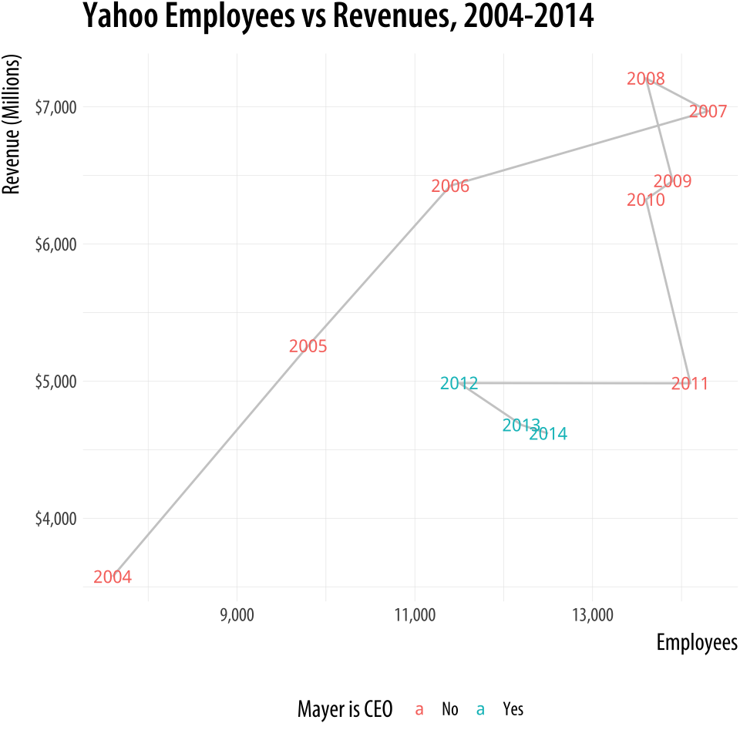
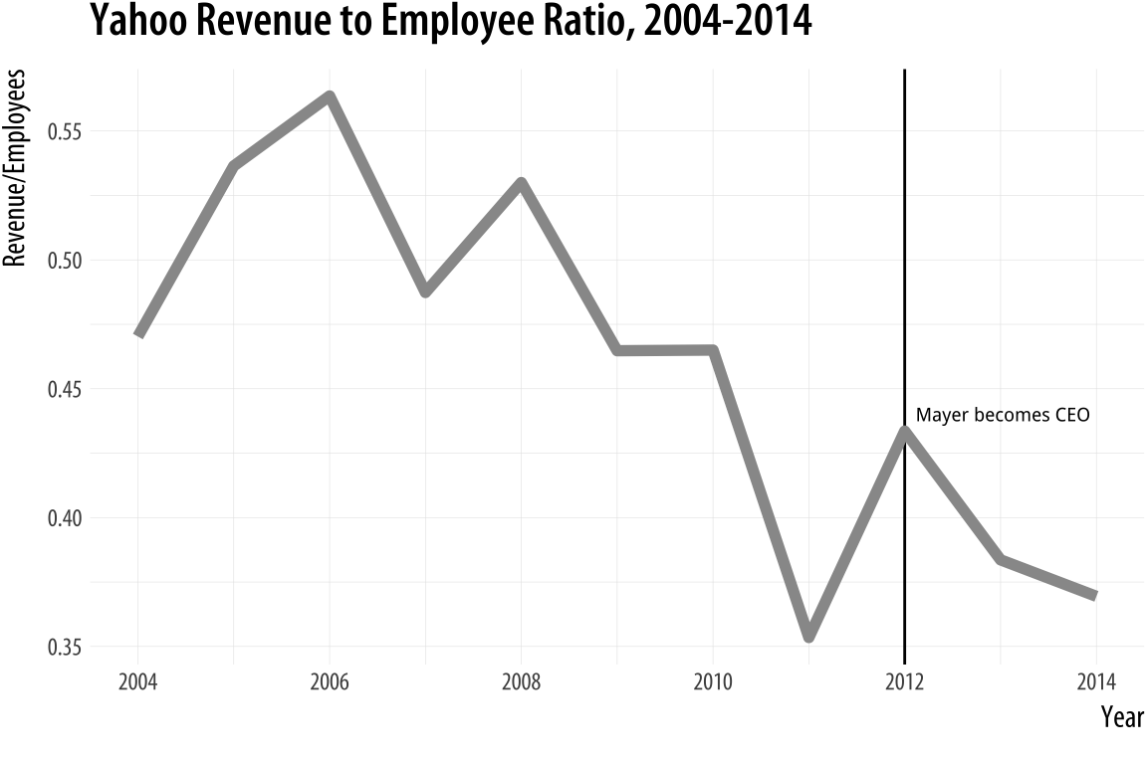
So Mayer performed poorly?
Connected plot
Performance: revenue/employee

Slide 17
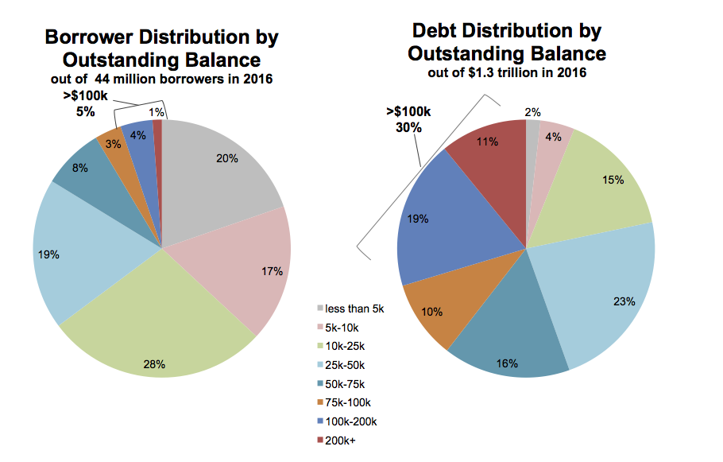
Use Case 3-Saying no to pie
Two charts from a New York Federal Reserve Bank briefing on the structure of debt in the United States.
Harder to compare values.
Clockwise, but hard to follow still
Ordered, but colors not sequential
Too much annotation like a table

Slide 18
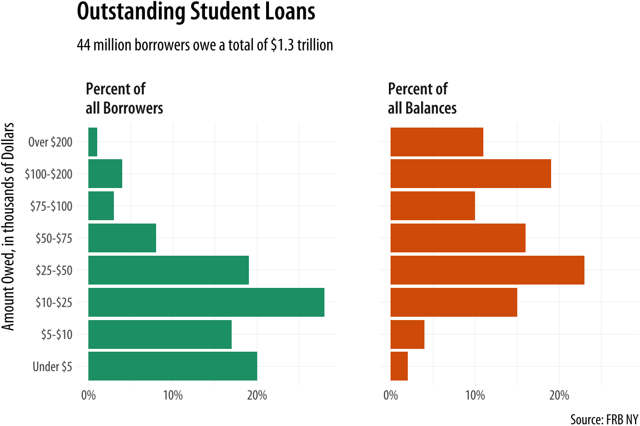
Alternatively-1
Split the data into the two categories, and showed the percentage shares as bars.
The percent scores are on the x-axis. Instead of coloring to distinguish the debt categories, put their values on the y-axis instead.
We can compare within a category just by looking down the bars.
fill is redundant, and portion info lost!

Slide 19
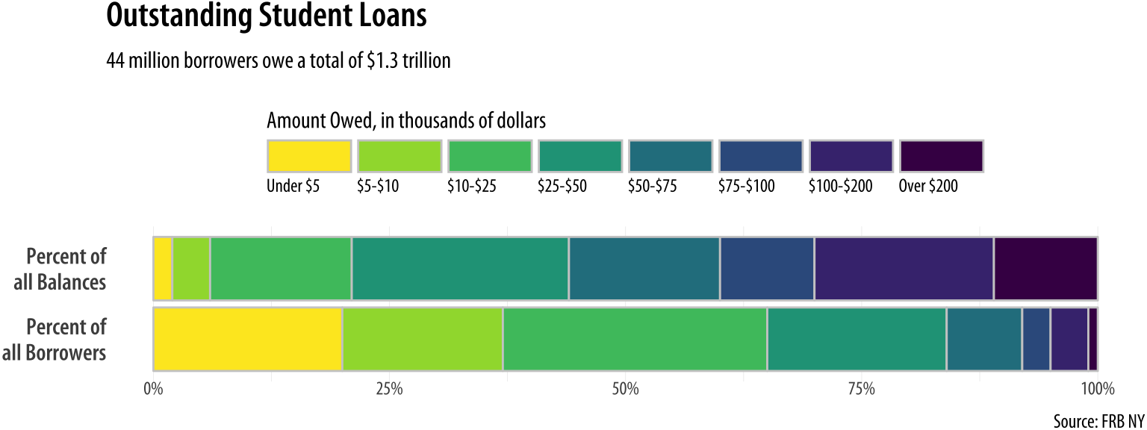
Alternatively-2
Instead of having separate bars distinguished by heights, we can array the percentages for each distribution proportionally within a single bar.
We will make a stacked bar chart with just two main bars, and lie them on their side for comparison.

