Slide 1



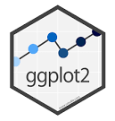





Introduction to Data Visualization
Choosing the Right Visualization Software
Halil Bisgin, Ph.D.

Slide 2
What is the best visualization tool?
People have strong emotional bonds to the specific tools they are familiar with.
Instead of investing time in learning a new approach, people vigorously tend to defend their preferences.
Sticking one tool is not an unreasonable choice since learning new one will require time and effort.
Finally, if you can make the figures you want to make, without excessive effort, then that’s all that matters.

Slide 3
How to assess a tool?
We can assess any new approach through some principles.
These principles roughly break down by
how reproducible the visualizations are
how easy it is to rapidly explore the data
to what extent the visual appearance of the output can be tweaked

Slide 4
Reproducibility and Repeatability
A work is reproducible if the overarching scientific finding of the work will remain unchanged if a different research group performs the same type of study.
A drug being tested by two different group and results remain the same
A work is repeatable if very similar or identical measurements can be obtained by the same person repeating the exact same measurement procedure on the same equipment.
Me weighing my cat in two different occasions on the same scale and finding it 9lbs.

Slide 5
Reproducibility in visualization
A visualization is reproducible if the plotted data is available and any data transformations that may have been applied before plotting are exactly specified.
If you make a figure and then share the exact data that you plotted, then anyone else can prepare a figure that looks substantially similar.
Fonts or colors or point sizes may differ, so the figures may not be exactly identical, but two figures convey the same message and therefore are reproductions of each other.

Slide 6
Repeatability in visualization
A visualization is repeatable, if it is possible to recreate the exact same visual appearance, down to the last pixel, from the raw data.
Repeatability requires that even if there are random elements in the figure, such as jitter, those elements were specified in a repeatable way and can be regenerated at a future date.
For random data, repeatability generally requires that we specify a particular random number generator for which we set and record a seed.

Slide 7
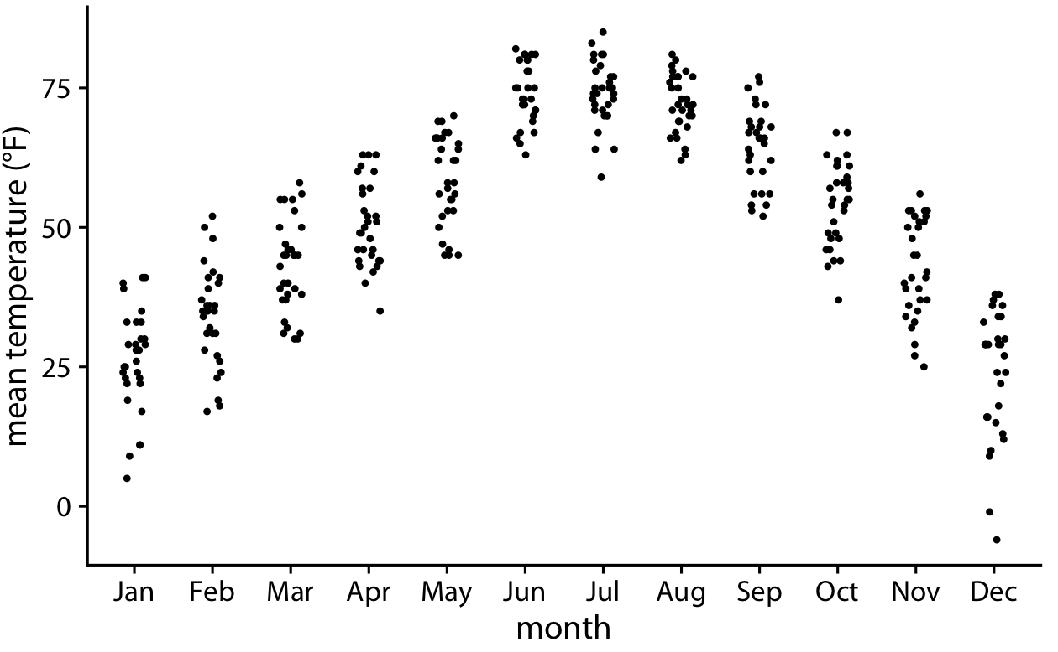
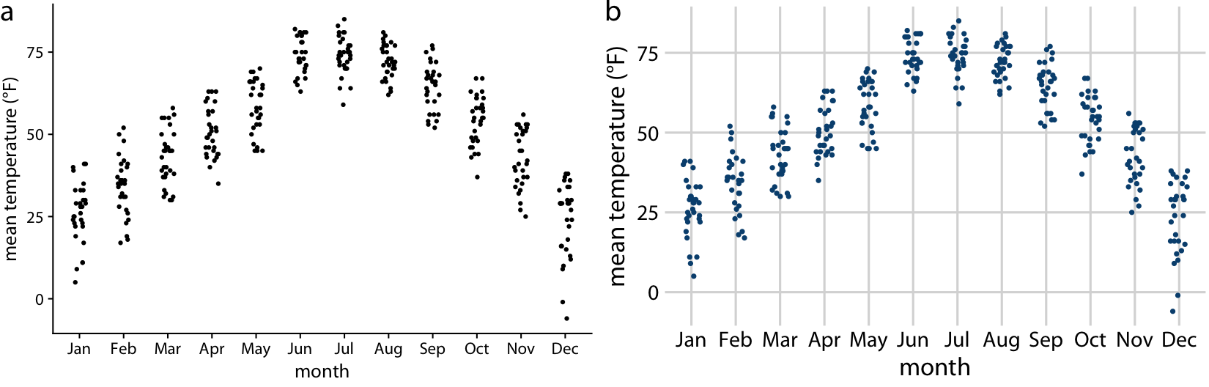
Repeated vs. Reproduced
Reproduced
Repeated

Slide 8
RR can be difficult w/ interactive tools
Many interactive programs allow you to transform or otherwise manipulate the data, but don’t keep track of every individual data transformation you perform, only of the final product.
E.g., Tableau
If you make a figure using this kind of program, and then somebody asks you to reproduce the figure or create a similar one with a different dataset, you might have difficulty doing so.

Slide 9
Data Exploration vs. Data Presentation
Two distinct phases of data visualization, and they have very different requirements.
Data exploration:
Looking at it from different angles and trying various ways of visualizing it, just to develop an understanding of the dataset’s key features
Trying different types of visualizations, different data transformations, and different subsets of the data
Data presentation:
The key objective to prepare a high-quality, publication-ready figure.

Slide 10
Primary focus in data exploration
Whether the figures look appealing is secondary.
It’s fine if the axis labels are missing, the legend is messed up, or the symbols are too small, as long as you can evaluate the various patterns in the data.
A well-designed data exploration tool will allow you to easily change which variables are mapped onto which aesthetics with a wide range of different visualization options.
Check whether your software allows for rapid data exploration or whether it tends to get in the way.

Slide 11
Different venues for representation
We can finalize the figure using the same software platform we used for initial exploration. (e.g., R→R)
We can switch to a platform that provides us finer control over the final product, even if that platform makes it harder to explore. (e.g., Python → R)
We can produce a draft figure with visualization software and then manually post-process it with an image manipulation program. (e.g., R→Photoshop)
We can manually redraw the entire figure from scratch, either with pen and paper or using an illustration program.

Slide 12
Be cautious about manual intervention
All these avenues are reasonable. However, manually sprucing up figures in routine data analysis pipelines or for scientific publications is not recommended.
Manual steps in the figure preparation pipeline make repeating or reproducing a figure inherently difficult and time-consuming.

Slide 13
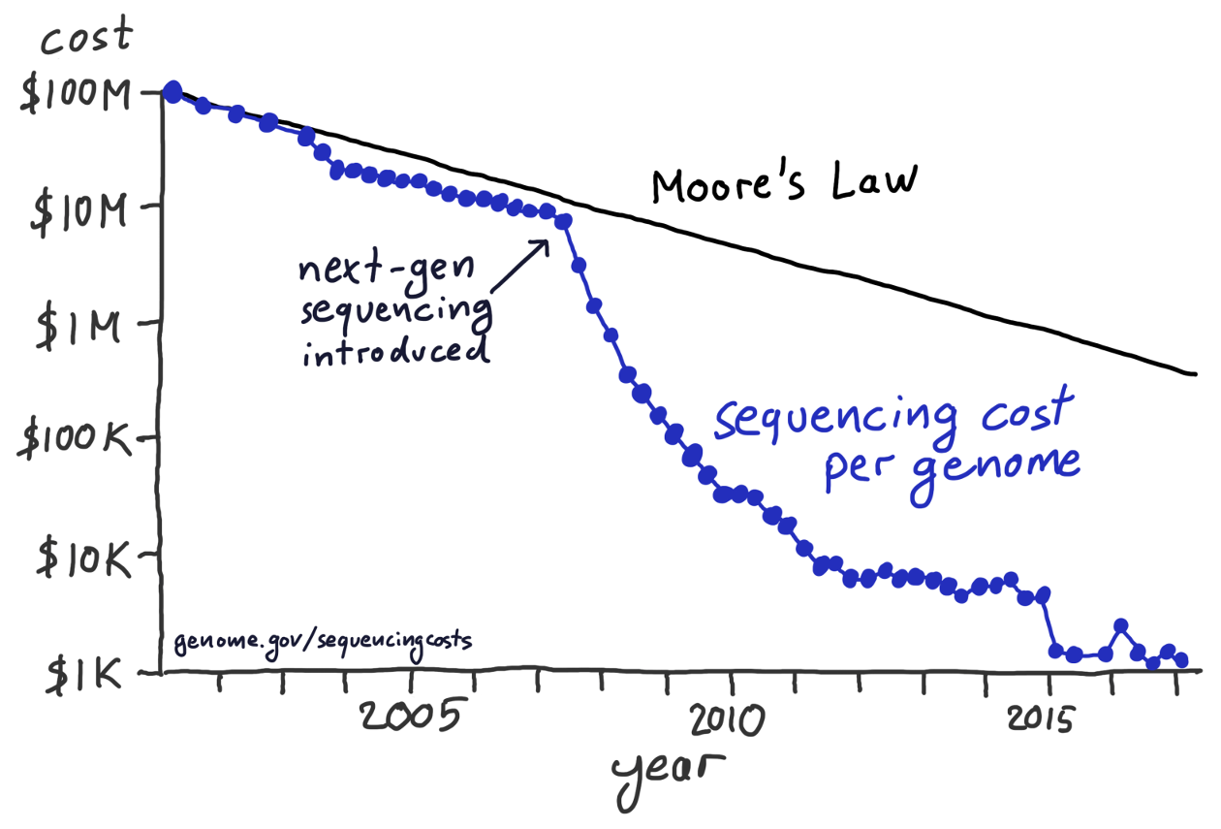
Hand-drawn and post-processed figures
Not totally against manual processing.
change axis labels, add annotations, or modify colors.
These approaches can yield beautiful and unique figures that couldn’t easily be made in any other way.

Slide 14
Separation of Content and Design
Good visualization software should allow you to think separately about the content and the design of your figures.
Content:
the specific dataset shown, the data transformations applied (if any), the specific mappings from data onto aesthetics, the scales, the axis ranges, and the type of plot (scatterplot, line plot, etc.)
Design:
features such as the foreground and background colors, font specifications (e.g., font size, face, and family), symbol shapes and sizes, whether or not the figure has a background grid, and the placement of legends, axis ticks, axis titles, and plot titles.

Slide 15
Content + Design
You can first determine what the content should be, using the kind of rapid exploration.
Once the content is set, you can tweak the design, or you can apply a predefined design that you like and/or that gives the figure a consistent look in the context of a larger body of work.

Slide 16
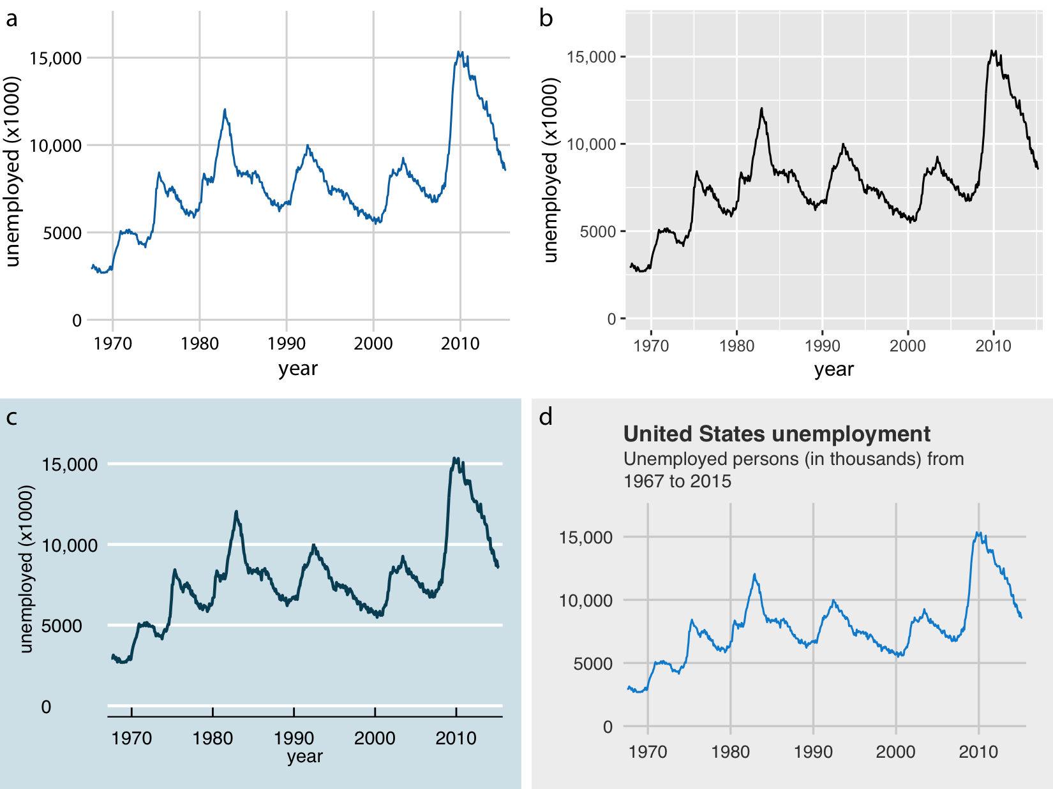
Separation example in ggplot2
Separation is achieved via themes.
A theme specifies the visual appearance of a figure.
It is easy to take a figure and apply different themes.

Slide 17
Separation helps focus
Most data scientists are not designers, and therefore their primary concern should be the data, not the design of a visualization.
Most designers are not data scientists, and they should be able to provide a unique and appealing visual language for figures without having to worry about specific data, appropriate transformations, and so on

Slide 18
Summary
Think about how easily you can reproduce and redo.
Consider if you can rapidly explore different visualizations of the same data, and to what extent you can tweak the visual design.
It may be beneficial to use different tools for the data exploration and data presentation stages.
You can do final visual tweaking interactively or by hand
If you have to make figures interactively, consider taking careful notes on how you make each figure for reproducibility.

