Slide 1
Introduction to Data Visualization
Story Telling with Your Data
Halil Bisgin, Ph.D.

Slide 2
Data visualization for communication
We have an insight about a dataset, and we have a potential audience, and we would like to convey our insight to our audience.
To communicate successfully, we will have to present the audience with a meaningful and exciting story.
The need for a story may seem disturbing to scientists and engineers, who may equate it with making things up, putting a spin on things, or overselling results.

Slide 3
Stories play in reasoning and memory
We get excited when we hear a good story, and we get bored when the story is bad or there is no story.
Any communication creates a story in audiences’ minds.
If we don’t provide a clear story ourselves, then our audience will make one up.
In the best-case scenario, the story they make up is reasonably close to our own view of the material presented. However, it can be and often is much worse: “this is boring,” “the author is wrong,” or “the author is incompetent.”

Slide 4
What Is a Story?
A story is a set of observations, facts, or events, true or invented, that are presented in a specific order such that they create an emotional reaction in the audience.
Tension at the beginning - some type of resolution toward the end.
“Stephen Hawking. was diagnosed with motor neuron disease at age 21—one year into his PhD—and was given two years to live. Hawking did not accept this predicament and started pouring all his energy into doing science. He ended up living to be 76, became one of the most influential physicists of his time, and did all of his seminal work while being severely disabled.”
Opening–Challenge–Action–Resolution

Slide 5
Story formats
Lead–Development–Resolution
Action–Background–Development–Climax–Ending
Opening–Challenge–Action–Resolution
“The influential physicist Stephen Hawking, who revolutionized our understanding of black holes and of cosmology, outlived his doctors’ prognosis by 53 years and did all of his most influential work while being severely disabled.”
Lead
The young Stephen Hawking, facing a debilitating disability and the prospect of an early death, decided to pour all his efforts into his science, determined to make his mark while he still could
Early connection

Slide 6
Your story in visuals
One visual rarely enough.
Story formats in visualizations.
Need multiple visualizations for a complete story.

Slide 7
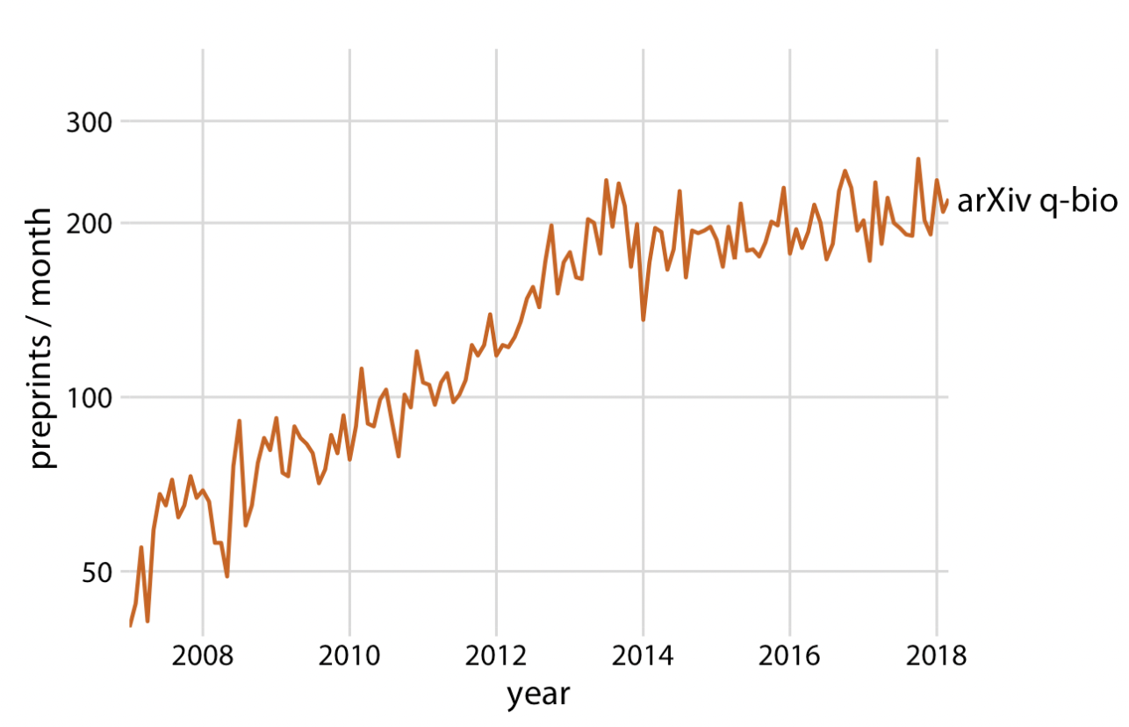
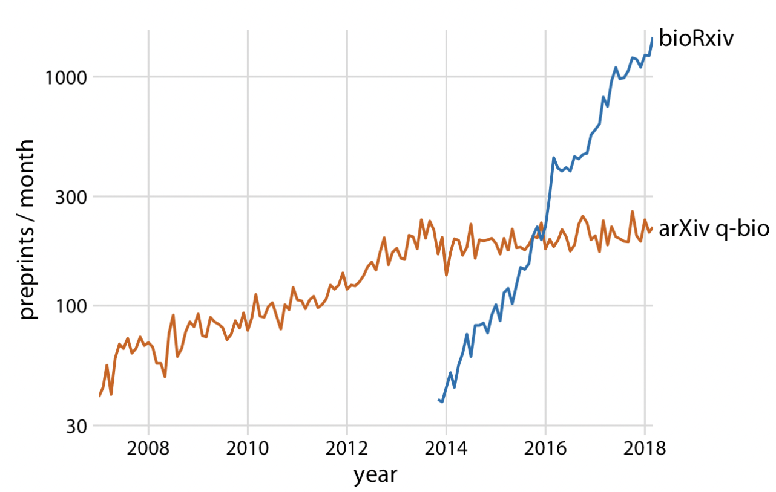
Challenge and resolution
Visualizing number of submissions to pre-print servers in a two-slide story.
Almost no growth after 2014 in arXiv.org
Introduction of the bioRxiv just before 2014

Slide 8
How to make a figure for the Generals?
You need to show your audience figures they can actually understand.
Never assume your audience can rapidly process complex visual displays.
Anyone outside your domain, especially those who don not have enough time, should be able to make inferences in a short time.

Slide 9
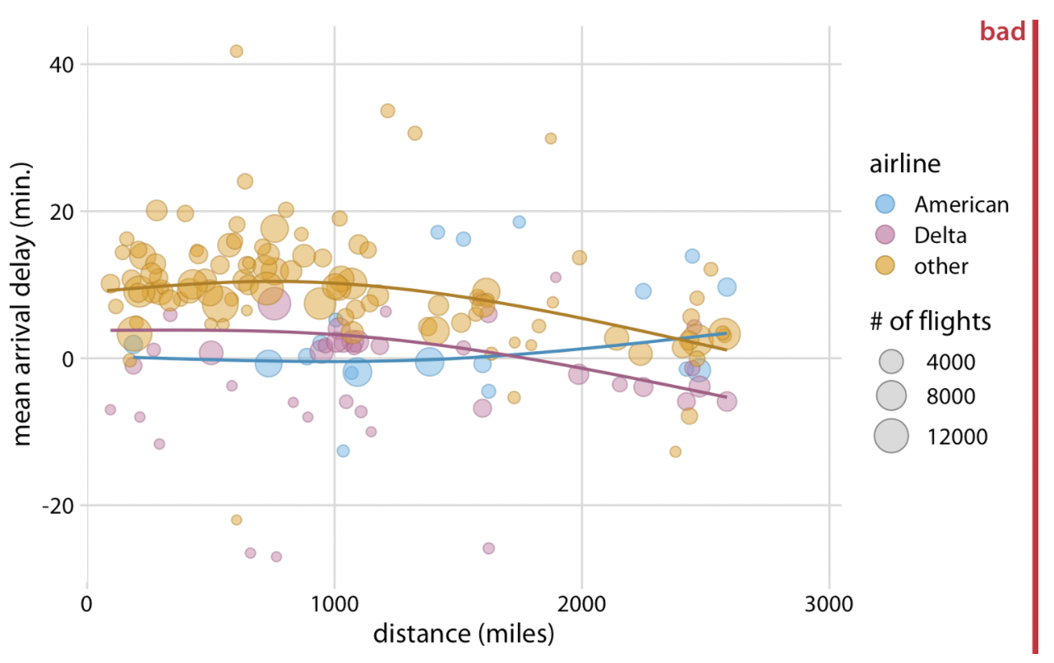
Impressive images may still be complex
Too much to process.

Slide 10
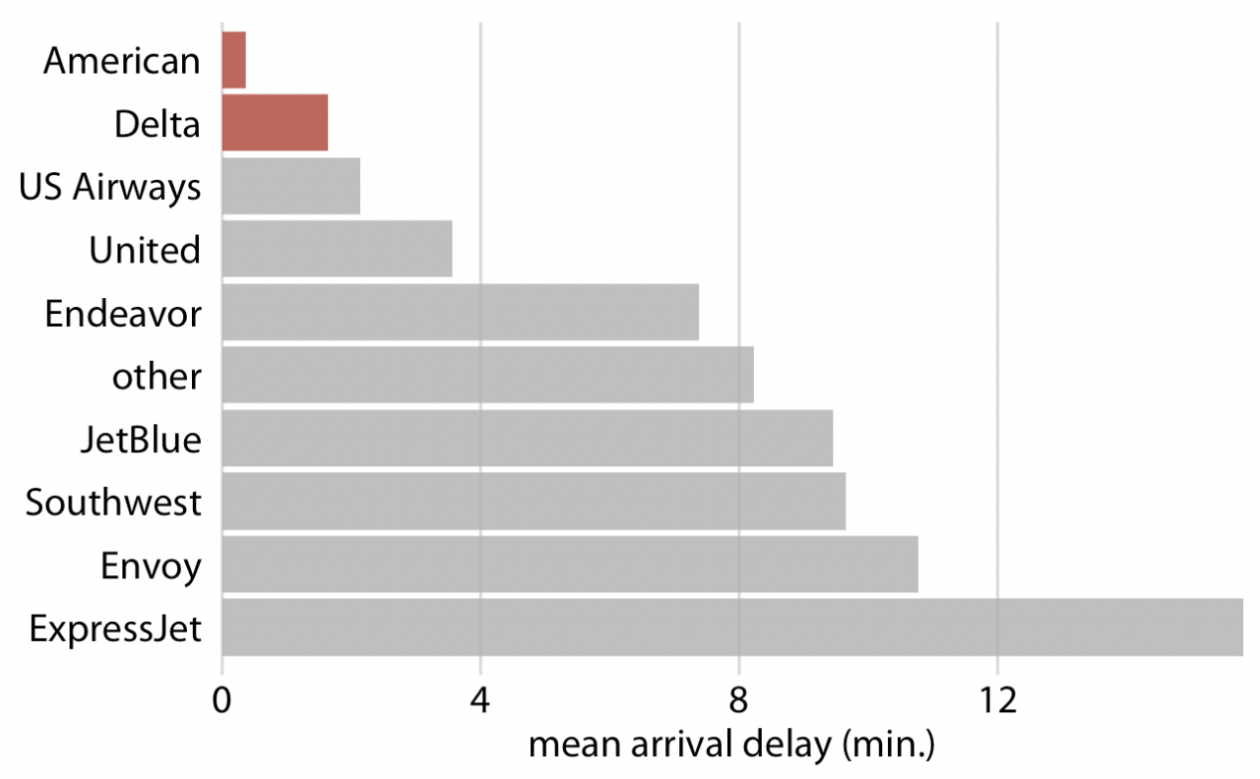
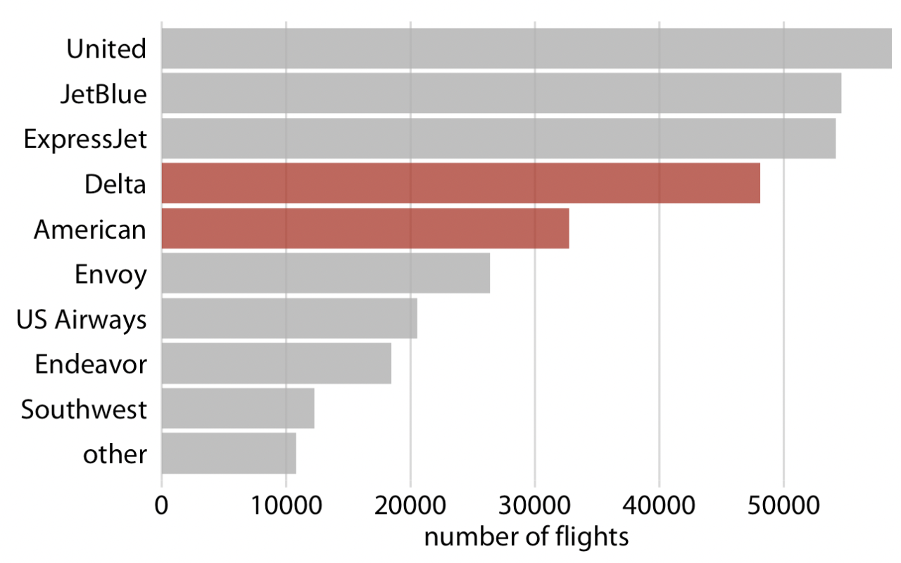
Simplified airline report
If you want to highlight the least delayed
If you wonder why these two. They fly only NYC area

Slide 11
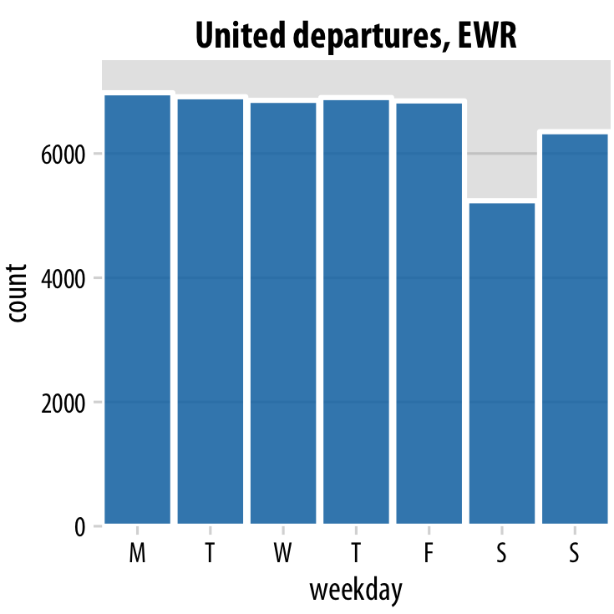
Build Up Toward Complex Figures
You may want to show more complex figures that contain a large amount of information at once.
Start a simplified version of the figure.
Start with only one airline and one airport

Slide 12
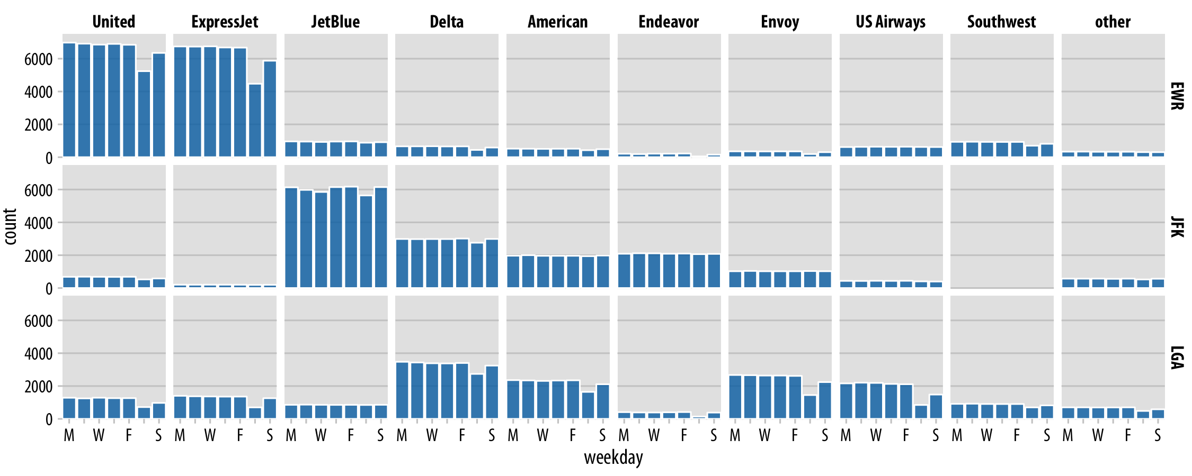
Then 10 airlines and 3 airports at once
Multi-panel plot for each airport and airline

Slide 13
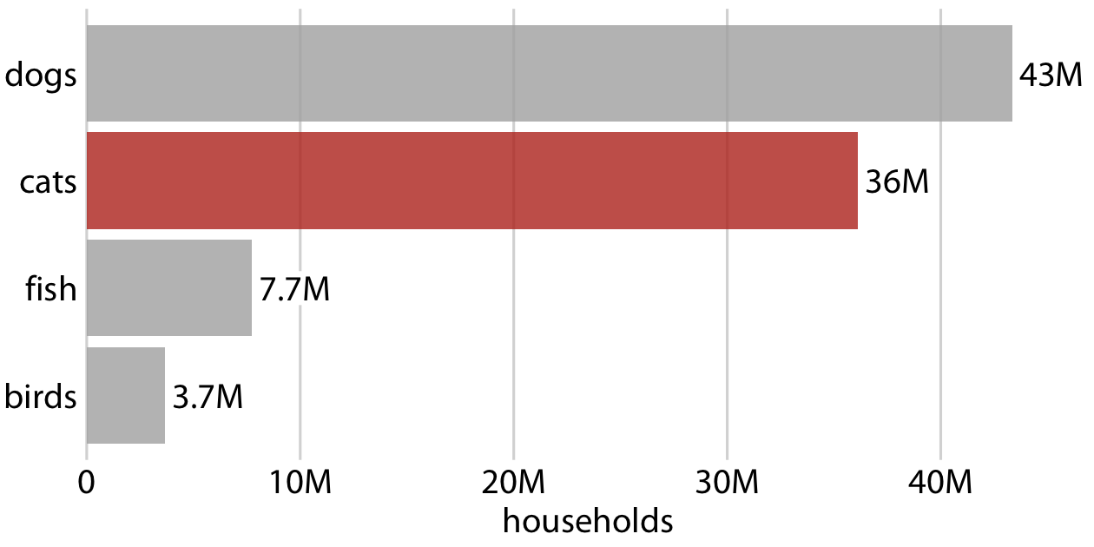
Make Your Figures Memorable
Simple is good, but people may easily forget something common.

Slide 14
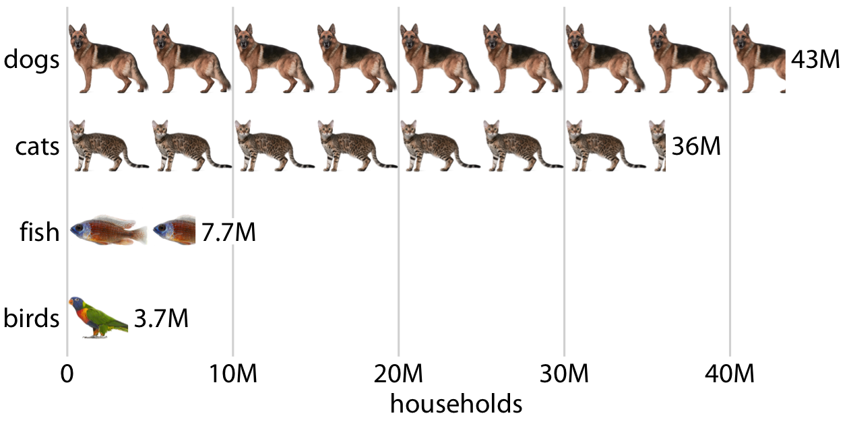
A modified “bar plot”
Strike a balance between the two extremes and make our figures both memorable and clear.
Memorability is not a concern for publications, but carry importance for other venues such as blogs.

Slide 15
Be Consistent but Don’t Be Repetitive
Using a consistent visual language does not mean everything should look exactly the same.
It is important that figures describing different analyses look visually distinct, so that your audience can easily recognize where one analysis ends and another one starts.
Use different visualization approaches for different parts of the overarching story.
If you have used a bar plot already, next use a scatterplot, or a boxplot, or a line plot.

Slide 16
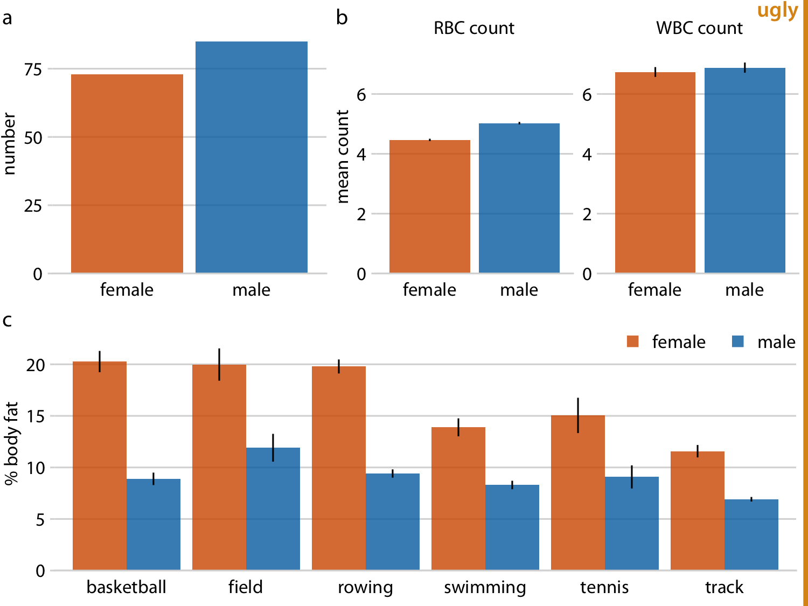
Repetitive visualization example
Uses consistent visual language, but all the subfigures use the same type of visualization (bar plots).
This makes it difficult for the reader to process that parts (a), (b), and (c) show entirely different results.

Slide 17
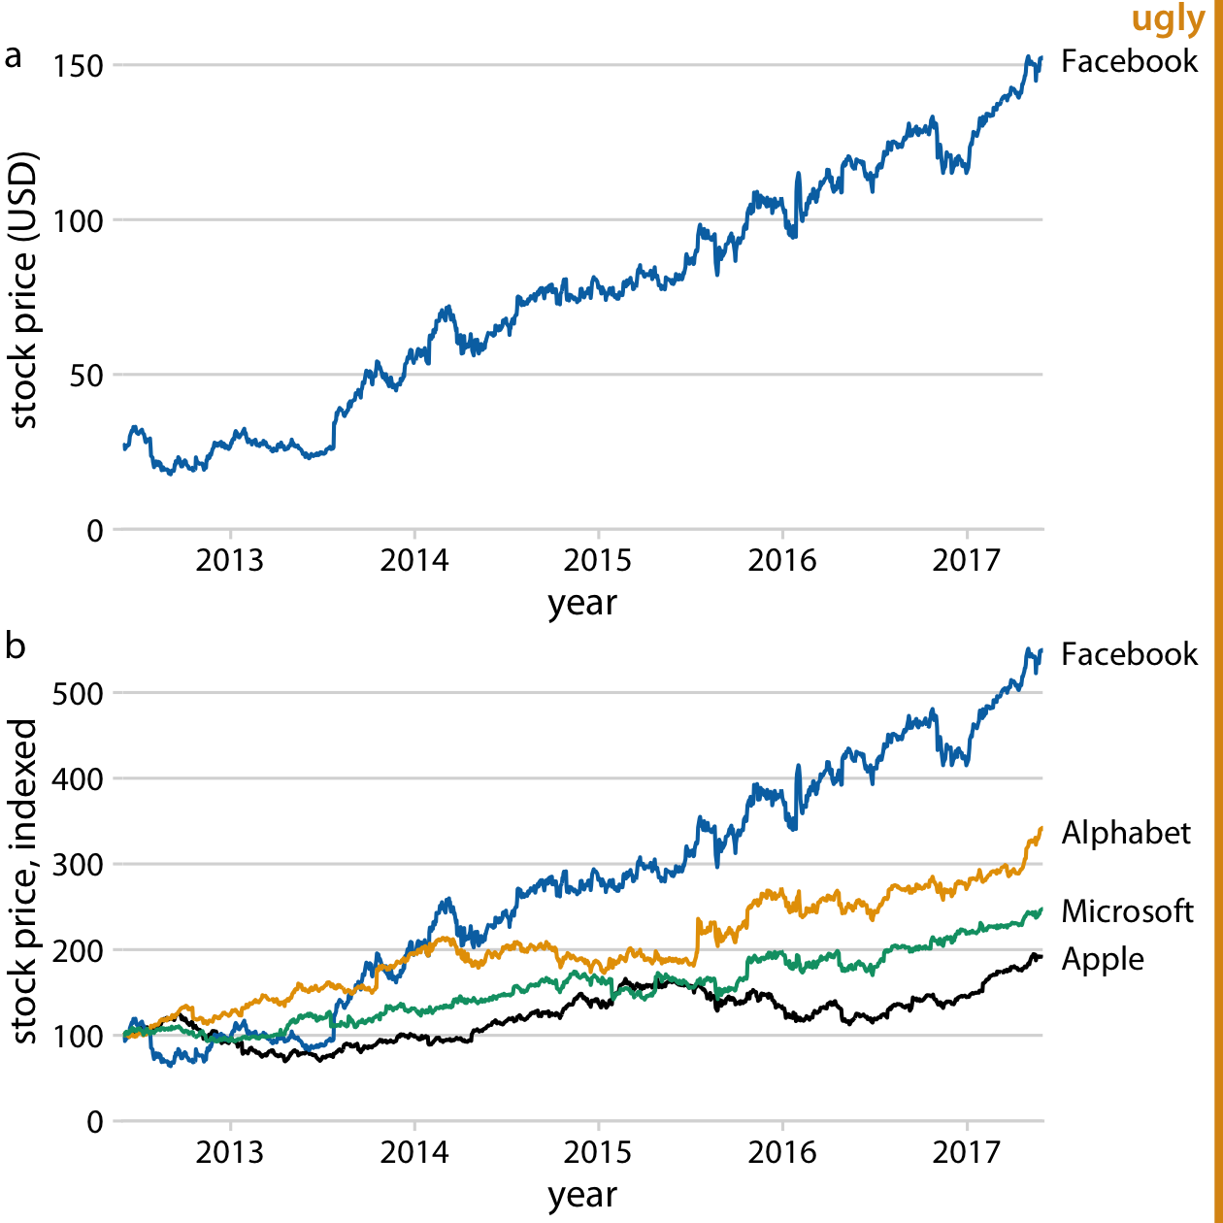
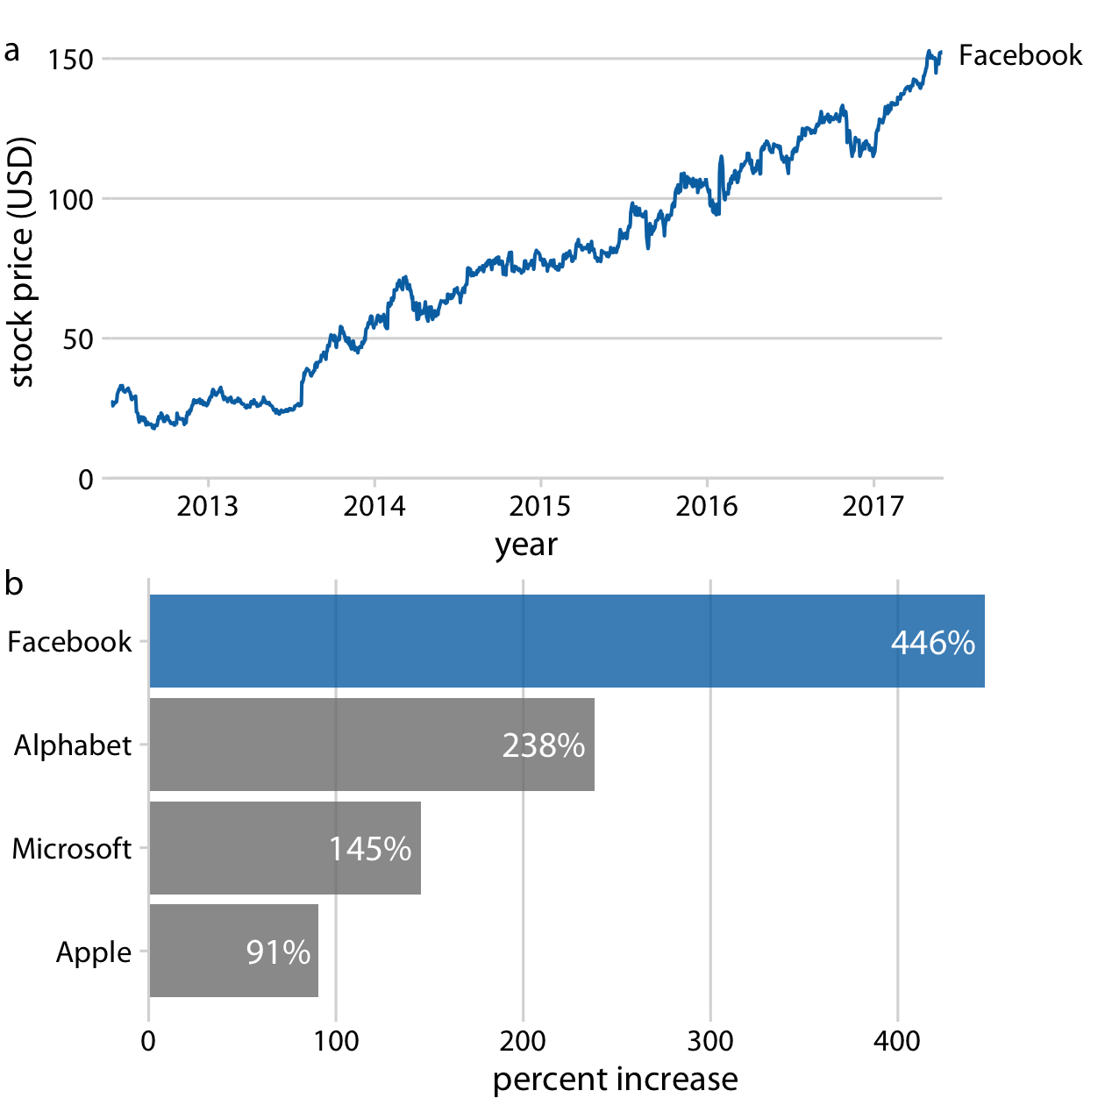
Diversify plot types to hold attention
Avoid repetition even for the same raw data
Facebook vs. other tech companies from the same data source

Slide 18
Thank you!

