Slide 1

Robo-Advisor
For peer-to-peer lending
Team Name - Z₃
Kris, Haile, Sushant
W207 - Applied Machine Learning
Professor: John Santerre
Fall 2021
Notes:
Intro and Demo Time Budget: 2 minutes
Sushant:
Hello, My name is Sushant and I am from Team Z3 which is working on building an application called RoboAdvisor. We imagine to be working for Lending Club Company.
I am joined today by Kris and Haile.. And we will now present our work on W207 Final Project.

Slide 2
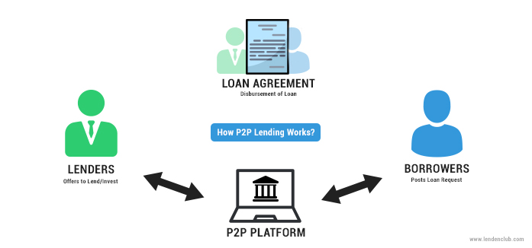
Lending Club
Peer-to-peer lending company, headquartered in San Francisco
Borrowers can obtain personal loans between $1,000 and $40,000
Investors are able to search , browse , and select the loan on webpage
Notes:
Sushant:
To recall from our last session, Lending Club is a peer to peer platform where one can borrow money up to 40K USD. On the other side, we have the lenders who earn interest by lending their capital.

Slide 3
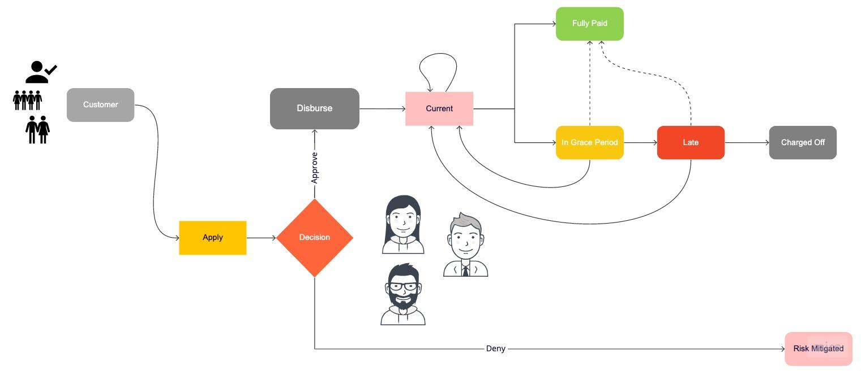
Business Goal
Business Question
Predict loan success on behalf of the investor
Project Objective
To build the model to predict loan success by borrowers
Future Implication
To build the system to auto-invest in loans based on model result
Solid Return, Save Time and Effort
Notes:
Sushant:
The business goal is to help the investors on the Lending Club Platform make informed decisions on which loans they should to put their money in.
We discussed the life cycle of the loan last time, so let us actually visualize the RoboAdvisor next

Slide 4
Robo-Advisor in Action !
Notes:
Sushant:
A fairly simplistic version of the Robo Advisor would be entering a loan application id from among the pool of available loans that are yet to be funded. The tool simply returns if the loan is likely to be paid off or not… However, the investor needs to be further empowered…
The second part of the application shows that an investor would be able to enter their risk level and the maximum amount that they are willing to invest. Then according to these selections, the Robo Advisor would automatically choose the best loans that match the criteria.
The loans that get shown is not a straight forward process. The ML algorithm that is running behind as a Flask Container is performing Real Time Inferencing to choose the best options available.
To stretch our thinking as Data Scientists - what should our algorithm look like ? Should it blindly select loans with highest interest rates for the High Risk taker ?? Ummm…. Our Data Science team that built this application will now take you behind the scenes...
Over to you Kris..

Slide 5
Exploratory Data Analysis
Notes:
Kris:
EDA Time Budget::6 minutes

Slide 6


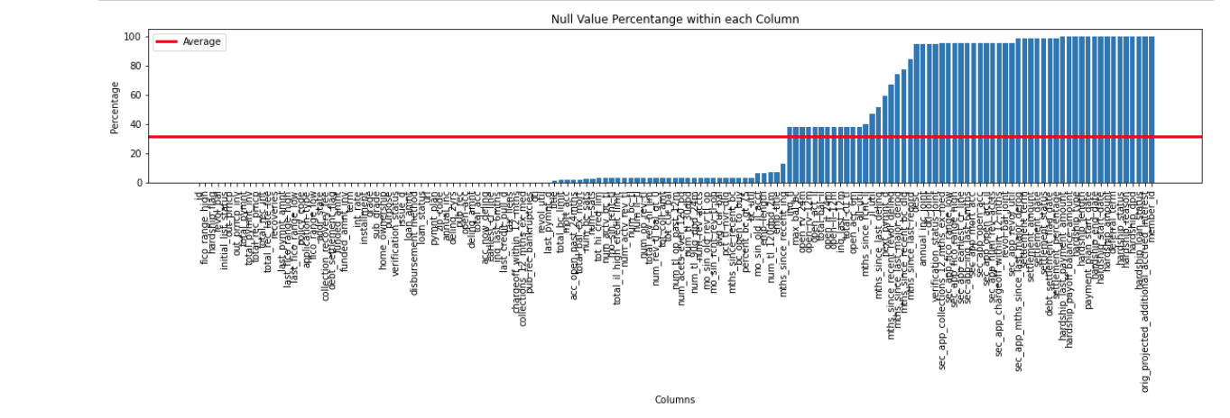
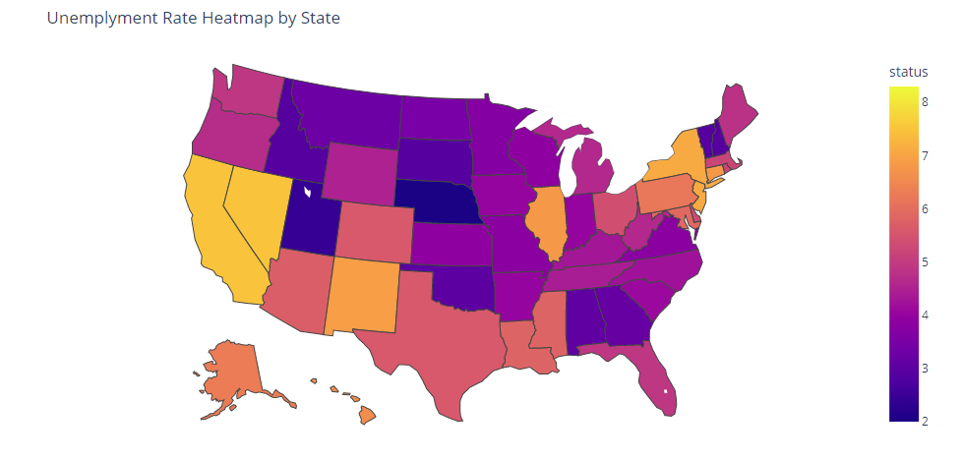
Data Source and Type
Main Source
External Source
Source: Unemployment Rate by State
# of Columns : 52
# of Columns : 173 (All Numeric) (From Jun-07 - Sept-21)
# of Rows: 2,260,701
# of Columns : 151
# of Numerical Columns : 113
# of Categorical Columns : 38
# of Columns having at least one Null value : 150
Unemployment Rate by State in Sept. 2021
Columns for Secondary applicants contained lots of Null Values!
Notes:
Kris:
mainly used the data files from lending club. very big file, over 2 million records.
151 columns consisting of 113 numerical, and 38 categorical columns.
Speaking of null value, almost all columns had at least one null value, This is because many of columns didn’t contain any value for specific columns related secondary applicants,
As an external source, we used the unemployment data from u.s. Bureau of labor statistics.
time series unemployment rate from June 2007 to Sep. 2021
used this data by joining with loaner’s state, and loan issued time.
the heatmap of 21 september’s unemployment data, you will see there is difference between state, you can see the CA has relatively high unemployment rate.

Slide 7
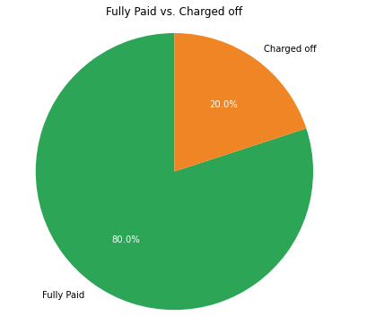
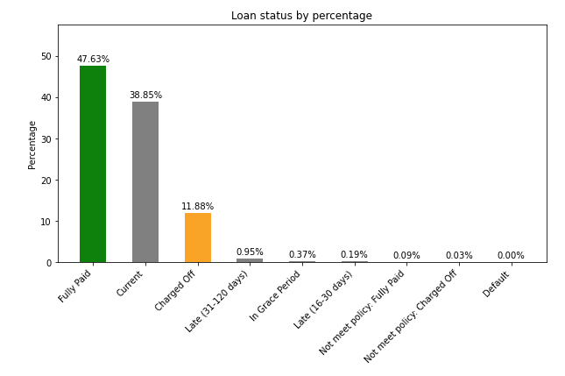
Target Variable Distribution
Notes:
Kris:
goal is to predict the whether the future loan will be ‘Fully Paid’ green bar or Charged off orange . Therefore, from the dataset, this green and orange bars are our target variables.
Removing others loans, we can see 80% loaners were fully paid, 20% were charged Off.

Slide 8
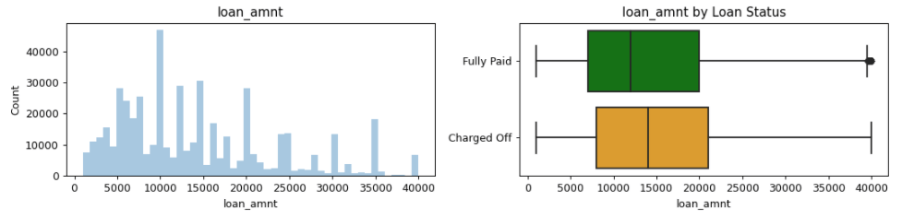
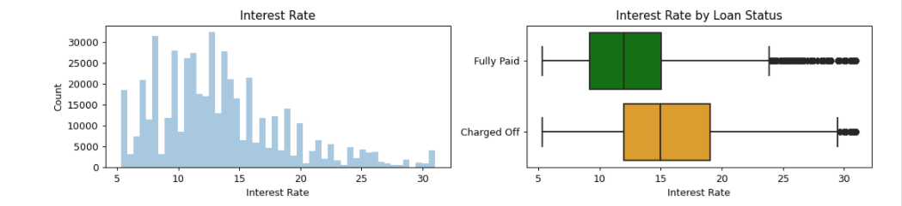
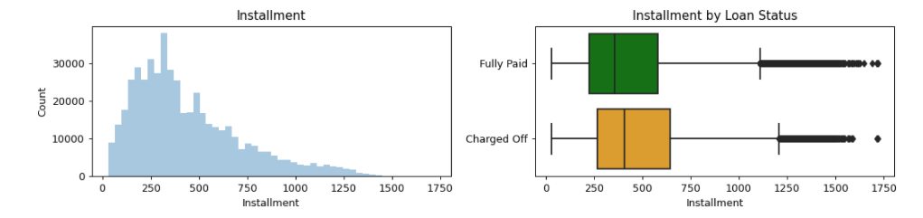
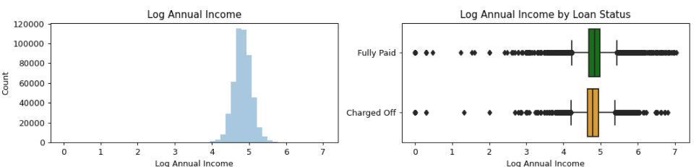
Full Paid vs. Charged off (1/2)
“Higher Loan Amount from Charged off”
“Higher Interest Rate from Charged off”
“Higher Installment amount from Charged off”
“Lower Annual Income from Charged off”
Notes:
Kris
We would like to examine the difference between fully paid and charged off in more detai.
For each aspects, there is pair chart, left is the distribution of total sample, and the right side is the two box plots to show the difference between fully paid and charged off
- By looking at the median value of box plot, we can see those who are charge off showed higher loan amount , higher interest, higher monthly installment but lower annual income

Slide 9
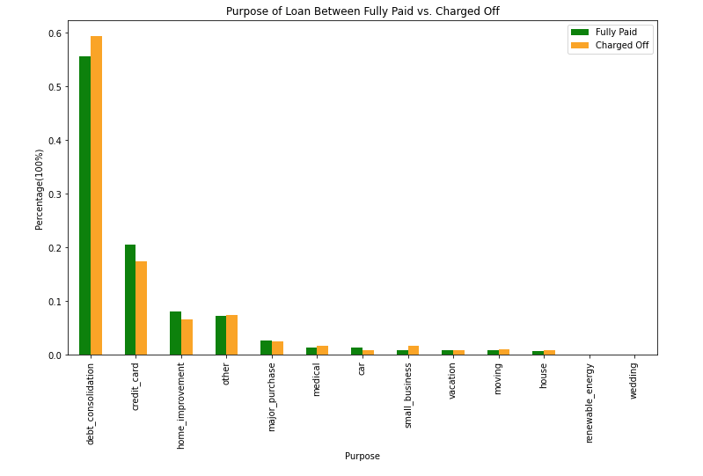
Full Paid vs. Charged off (1/2)
Due to Debt consolidation, especially higher rate from Charged off ...
Notes:
Kris
We also looked the purpose of loan.
We basilly normalize the purpose within each group as 100% full, and visualize them with same scale to show the relative difference.
Majority of people borrow the money due to dept consolidation You can see that the rate of borrowing money for dept consolidation found to be higher from charged off

Slide 10
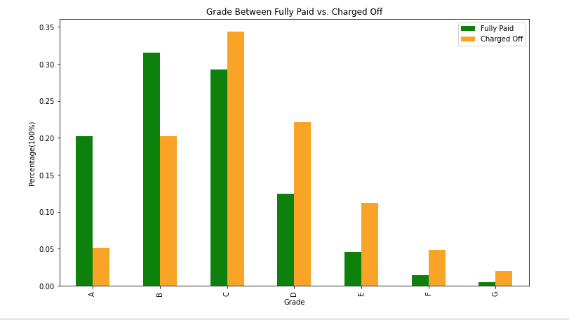

Full Paid vs. Charged off (2/2)
“After Grade C, Charged off is Higher ”
Notes:
Kris
Fully paid showed higher rate from good grade like A, B. but it got reversed from after grade C

Slide 11




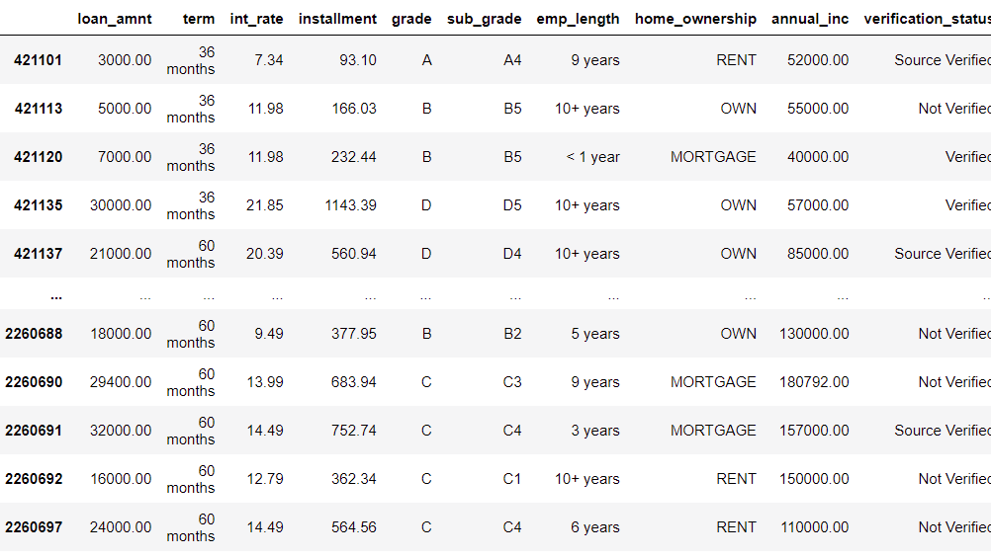



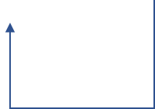

Profit Perspective
LOAN
AMOUNT
GRADE
INTEREST
RATE
Term
Length
PROFIT
Q. To whom are you going to lend your money?
Person A
Person B
$ 40,000
$ 40,000
$ Profit =(term * installment) - Loan amount
Profit
A (A1)
D (D4)
351.6
977.08
1367.84
19.99 %
5.31 %
11162.04
12656.40
36 months
36 months
4677.0
$ 3,359
$ 23,572
Notes:
Kris
we are representative of investors so we had to think about the profit perspective.
If we multiply the term length and the amount of monthly installment. Minus Loan amount it will be our profit. Below is from the actual data.
First the interest rate is affected by the grade
The monthly installment got affected by term length, and interest rate.
And monthly installment multiples term this is our profit
So here is our question. To whom are you going to lend your money?
There are person A, and person B.
Same loan amount as 4000 $
But different grade therefore different interest rate
Same term length.
However, huge difference of profit almost 7 times higher from person B.

Slide 12
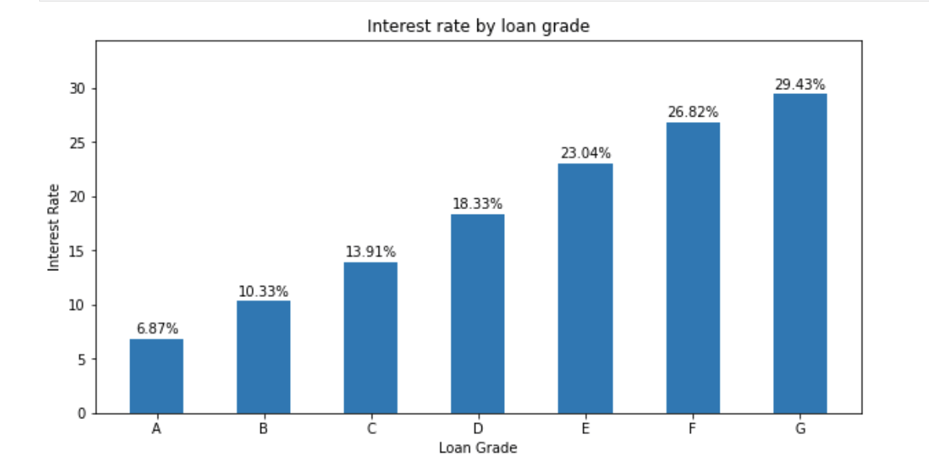
Higher Risk Higher Return ?...
“Higher Return ”
“Higher Risk & Higher Return”
“Higher Risk”
Notes:
Kris
So, as you just saw from previous page, the lower grade are showing higher interest rate in average.
Therefore, they are giving us higher interest, higher profit,
So can we invest our money based on just grade?

Slide 13
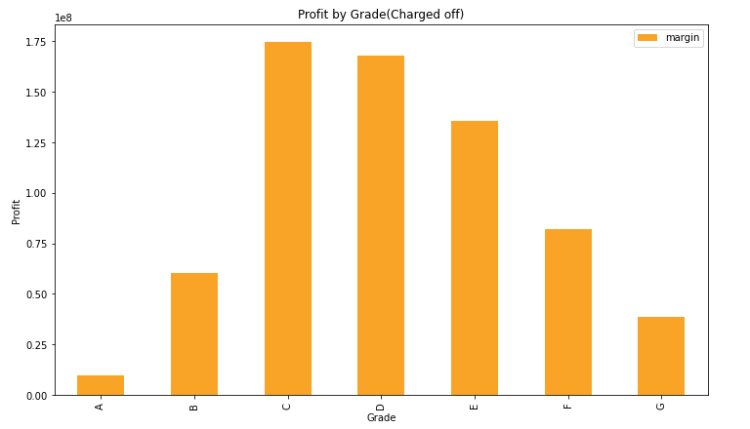

However, we cannot judge by the profit only
If we look below ...
“Robo-advisor will help you make better decision to
between Risk & Return ”
They should have paid More interest, given us more profit. But! charged off ...
Notes:
Kris
You will see the answer if you look at this chart. This orange bar chart is showing the expected profit if we had earned all interet from charged off.
As you can see there are more profit we could have gotten from grade C, and D. However, in reality, they are charged off..
So this is why we developed the robo advisor to help you to make better decision between risk and return.
At the end of the presentation, we will demonstrate how we minimize risks as we maximize returns by investing on lower grade loans which have a good return.
So please hold on until the end of presentation. Now I will hand it over to next part to sushant.

Slide 14
Feature Engineering
Notes:
Feature Engineering Time Budget -> 5 minutes
Sushant:
Thank you for setting the stage for us Kris,
Let’s talk about Feature Engineering..

Slide 15
NaNs and Encodings
NaNs
KNNImputer
Dropping rows
Dropping features
Feature Encoding
One Hot Encoding
Grade -> A, B, C, D, E, F
Sub-Grade -> A1, A2.. B1.. F5
Label Encoding
Example - “emp_length” -> <1 Year, 1 Year, 2 years… 10+ Years.
<1 year => 0, 1 year => 1, 2 years => 2, 3 years => 3…. 10+ years => 11
Notes:
Sushant:
We explored and applied different strategies in each stage of this project. Needless to say, we found ourselves take a step back and iterate multiple times during this process..
For NaNs - we explored taking Means/Medians initially but saw some unexpected results in initial modeling iterations. KNNImputers was an interesting strategy that helped us better handle the NaNs. For some features and data records though we either ended up dropping those features or dropping entire records as Kris mentioned earlier.
We applied One Hot Encoding for the Categorical - specifically nominal features - As an example Loans have Grades we applied OHE to the grade feature.. Another example where we applied a different type of encoding was the emp_length where lengths of <1, 1, 2 and up to 10+ years… is converted to 0, 1, 2, 3,... up to 11.
Since we attempted both regression and tree based models as we will later see - we had to be mindful of which encoding is being used for which type of algorithm.

Slide 16
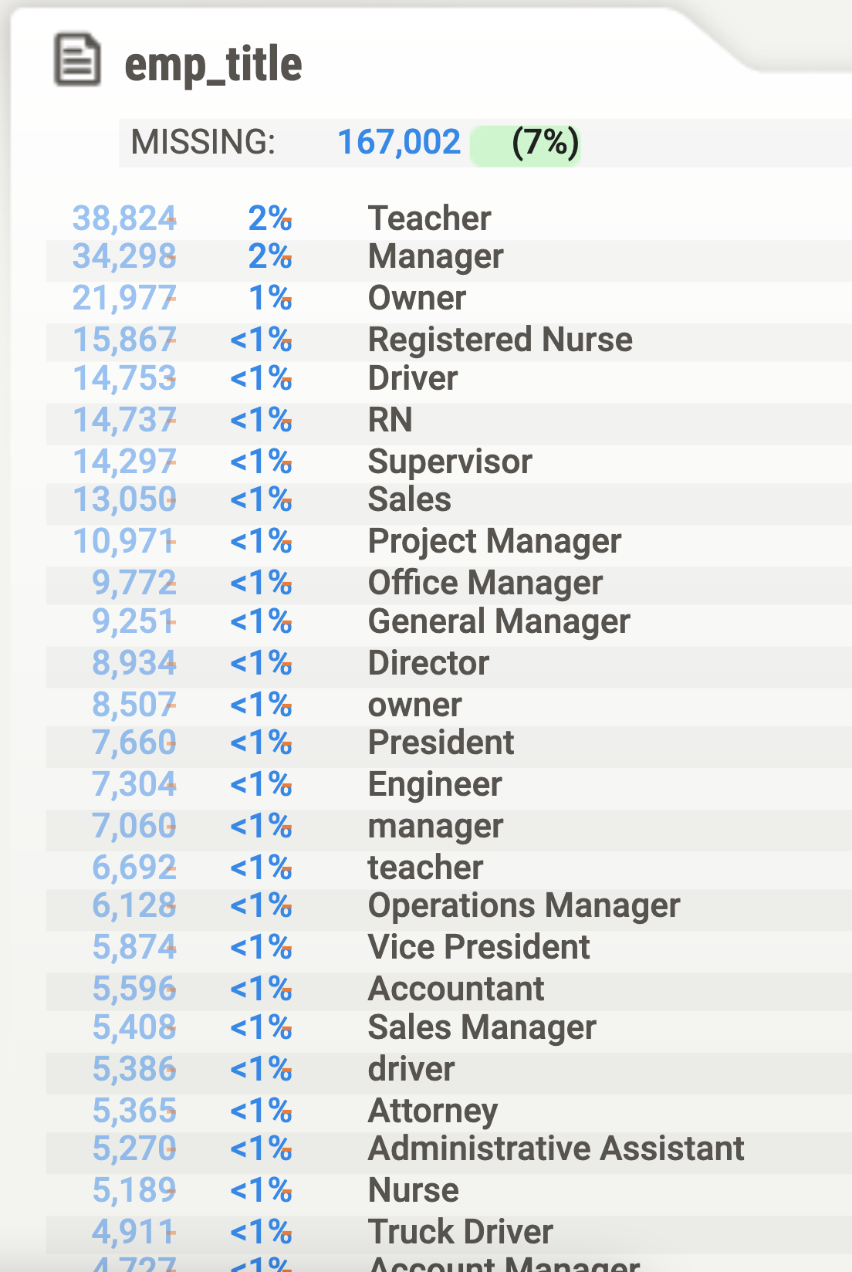
Text Features
emp_title | emp_title_p
corporate account mananager | corporate account manager
chemical operatore | chemical operator
diesel mechanis | diesel mechanic
material specialit | material specialist
babysittef | babysitter
babysitting | babysitter
machine operton | lead machine operator
recreation programm coordinator | recreation program coordinator
Notes:
Sushant:
Another area that we found fascinating was the text features.. Just looking at the table on the left … if you fixate long enough on the table - you would notice that Teachers and Managers are highest Loan Seekers on the platform.. However, look closer at the rows below.. There seem to be many more different categories of “Managers” embedded in our data..
This piqued our interest, but when we actually started processing the data, we found that the data is very error prone - as if it has been entered by users in a free form text box without any validations… So to go from the emp_title to a processed version of the emp_title was quite insightful..

Slide 17
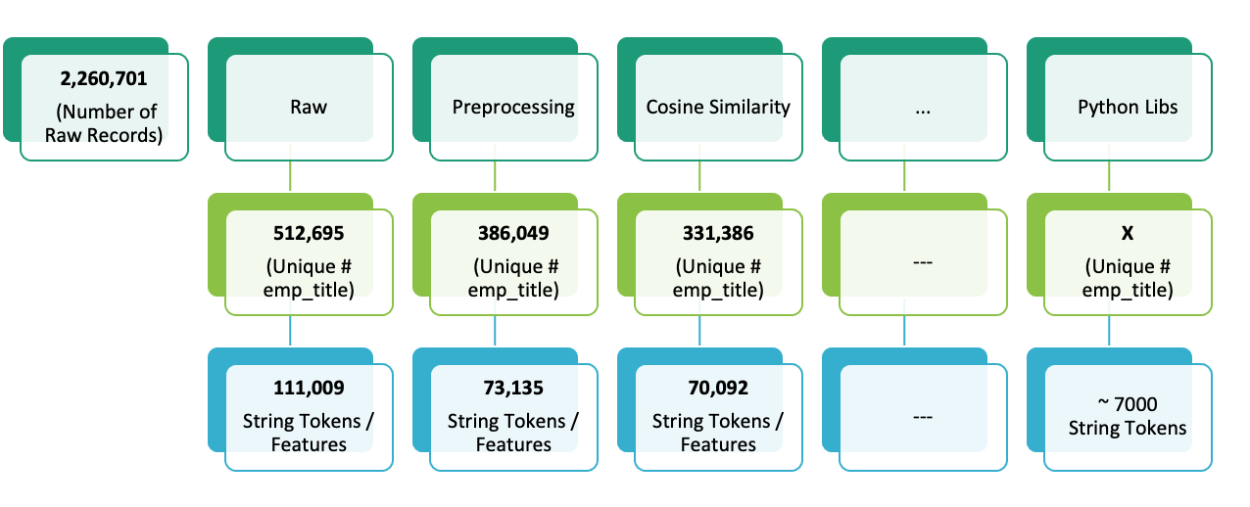
Approach
Notes:
Sushant:
As can be seen, we the raw data has about 512K unique emp titles formed by 111K string tokens… Just simple preprocessing like removing special characters, parentheses, slashes, dashes and Lemmatizing brought down the corpus of unique words to 73K…
Then we experimented different algo’s such as Cosine Similarity, Jaccard Distance, Levenshtein distance to further prune the titles…
We also tried some python libraries such as Spacy, TextBlob, and found that using SpellChecker we got the number of actual tokens to 7K - Thats a HUGE improvement !
Unfortunately, however, our models did not show much improvement in performance after including top 100 title based features and hence we ultimately excluded them from our model..

Slide 18
Additional and Derived Features
Additional Data Source:
Unemployment Data
Contains State wise unemployment rates by month since 2007
Extracting features from raw data
Date, Month, Year from features with Date Time Format
earliest_cr_line -> March-1999, March-2019, April-2001…
⇒ earliest_cr_line_months -> 273
Notes:
Sushant:
Kris already mentioned about the additional data source that we tapped into..
We also derived some features from the raw data.
Example… earliest_cr_line which is available as say March-1999 for a given customer, we transformed that into number of months since earliest_cr_line was opened…
Moving on..

Slide 19
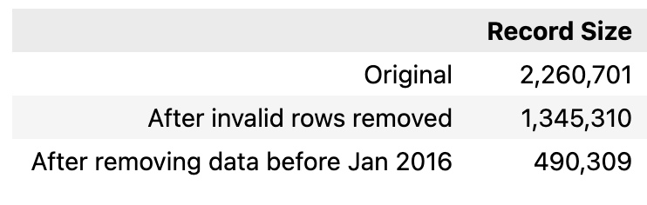
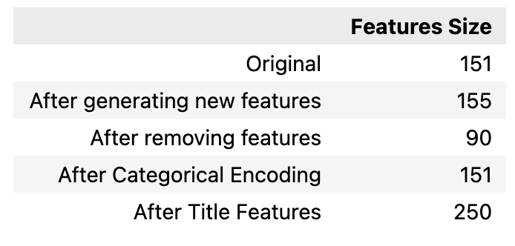
Final Data Set
Number of Data Points
Number of Features
Notes:
Sushant:
So from 2.2 Million, we are down to 1.3 records… Deep into the model hyper parameter tuning phase, Haile found a pattern that some features do not have data until a certain date, and that there are two such sets of features… Further exploration helped us link and identify these two sets of features were actually introduced - once in 2012 and then in 2016… We ultimately ended up dropping all the data prior to Jan 2016… and hence 490K records.
On the other hand.. After the feature engineering work and retaining all the valid features… we were left with 151 features in all...

Slide 20
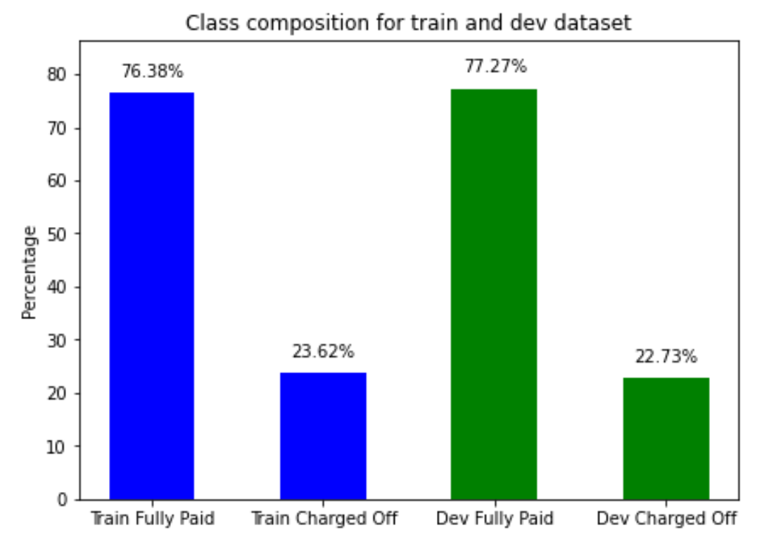
Imbalanced Target Variable
SMOTE
ADASYN
RandomOverSampler
sklearn.utils.resample
Notes:
We must chat about one important aspect that we had to deal with - Handling Imbalanced Distribution of the target variable...
If you recall - the last time we met - we had a recall of 1 for some of our models.. It turns out that the imbalanced target variable of Fully Paid Vs Charged off was the culprit..
Our problem of inherent imbalance is a severe one… with a ratio of almost 3:1 for our Majority Class vs Minority One. And our model was practically learning from the abundance of characteristics of the Majority Class only..
To deal with this, we explored options of oversampling the Minority Class as well as under sampling the Majority Class. We chose the former one since we did not want to leave out “Fully Paid” Samples in the training phase.
We also explored SMOTE and ADASYN to perform this job as well as the sklearns resample API and found that resample is faster and provides similar model performance. SMOTE and ADASYN both were observed to be very very slow.
It is now time to talk about Core Modeling and I will hand the presentation over to Haile..

Slide 21
Model Selection & Results
Notes:
Haile:
Model Selection Time Budget : 5 minutes

Slide 22
Model Building
Model | Training F1 | Dev F1
Gaussian Naive Bayes (GaussianNB) | 0.37 | 0.40 | High Bias
Logistic Regression - L2 | 0.65 | 0.75 | High Bias
Logistic Regression - L1 & L2 | 0.65 | 0.74 | High Bias
XGBoost | 1.00 | 0.87 | High Variance

Slide 23
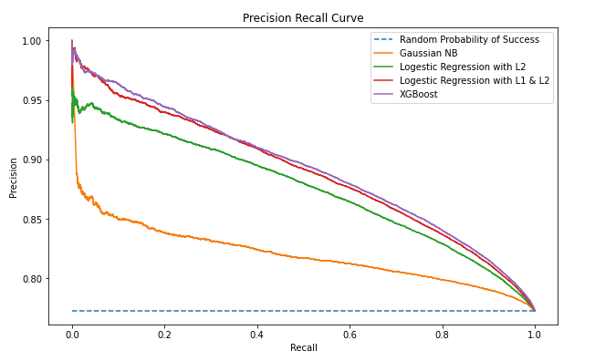
Model Selection

Slide 24
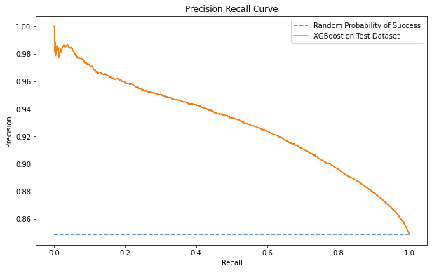
Test Result
Test F1 Score: 0.91

Slide 25
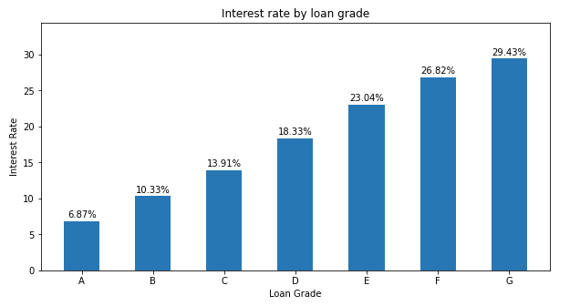
Investment Return

Slide 26
precision@k
 | Count | Random Chance | precision@3 | precision@10 | precision@100 | precision@500 | precision@1000
Feb-18 | 6,751 | 0.81 | 1 | 1 | 0.97 | 0.97 | 0.96
A | 1,488 | 0.93 | 1 | 1 | 0.97 | 0.97 | 0.96
B | 1,828 | 0.86 | 1 | 0.9 | 0.96 | 0.92 | 0.91
C | 1,845 | 0.77 | 1 | 0.9 | 0.88 | 0.87 | 0.82
D | 1,151 | 0.68 | 1 | 0.9 | 0.82 | 0.80 | 0.72
E | 337 | 0.63 | 1 | 0.9 | 0.75 | - | -
F | 91 | 0.56 | 0.67 | 0.6 | - | - | -
G | 11 | 0.45 | 0.33 | 0.4 | - | - | -
+0.14

Slide 27
Example
 |  |  |  | Investment Return
Loan Grade | Interest Rate | Principal | Term in Months | Random Chance | precision@100 | Difference
A | 7% | $100,000 | 36 | $10,376.52 | $10,822.82 | $446.30
B | 10% | $100,000 | 36 | $13,899.21 | $15,515.40 | $1,616.19
C | 14% | $100,000 | 36 | $17,740.39 | $20,274.73 | $2,534.34
D | 18% | $100,000 | 36 | $20,501.06 | $24,721.87 | $4,220.81
E | 23% | $100,000 | 36 | $24,793.65 | $29,516.25 | $4,722.60

Slide 28
Learnings along the Journey
Notes:
Haile:
Learnings Time Budget: 3 minutes

Slide 29
Lessons
1. Imbalance data
2. Inspect each feature
3. Imputing missing values
4. Caching speeds up
5. fit / transform / fit_transform pattern

Slide 30
Thank you

