Slide 1
What kind of Product Manager are You?
High Abstraction
3rd Party Developer PM
Growth PM
Engineering
Focussed
Business Focussed
Developer Platform/API
Enterprise Software in Speciality Area
Low Abstraction

Slide 2



Architecture to Business Type
Core Infrastructure
API/Services
View Layer/UI

Slide 3
Collaboration Triangle
Narrative Collaboration
Small Batches
Experimentation Culture

Slide 4
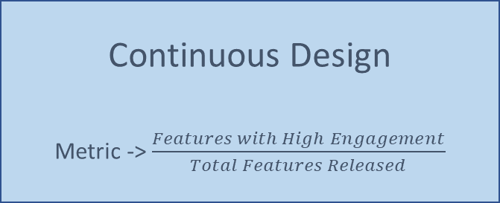
Product Pipeline
Observations
Released Product
Ideas
Design
Execution/Coding
Testing
Deployment
Continuous Design
Metric -> $\frac{Features with High Engagement}{Total Features Released}$
Agile Development
Metric -> Total Features Released
Continuous Deployment
Metric -> Frequency of Releases
Amazon famously releases code every 11.6 seconds

Slide 5
Motivation vs Ability/(Usability)
Ex. Interplanetary Travel
Action ☺
Motivation
Action Line
Inaction ☹
Ex. Having a cookie
Ability/(Usability)
Source: Adapted from BJ Fogg’s Behavioural Model

Slide 6
Continuous Design Process
Finding the Right Problem
Finding the Right Solution
Persona Hypothesis
Problem/Job to de Done (JTBD) Hypothesis
Demand/Value Hypothesis
Usability Hypothesis

Slide 7
The Business of Software Development
General Management
Software Development
Product Design
Product/System Support
Proposition Design

