Slide 1

North Western University, Khulna
Department of
Computer Science & Engineering
A Presentation on
Course Title: Database Systems Sessional
Course Code: CSE-3108
Project Name: Blood Bank Management
System
Presented By
Md. Hasanul Banna Khan Abir | 20181004010
Tarek Ahmed | 20181023010
Erina Momtaz | 20181054010

Slide 2

Why we need Blood Bank Management System?
A Blood Bank management system will enable to find Donor in crucial time of patient in a better way.
Efficiency
Readily donor availability
Security
Easy Integration

Slide 3
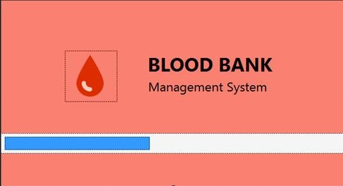
Features of our Application
Fig: Animated Splash Screen

Slide 4
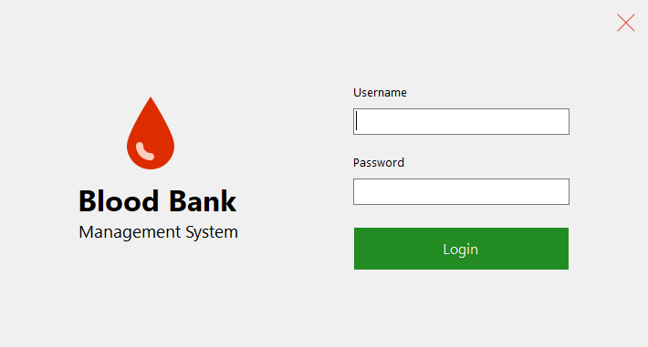
Features of our Application
Provide Their Login Details
Fig: Administration Login

Slide 5
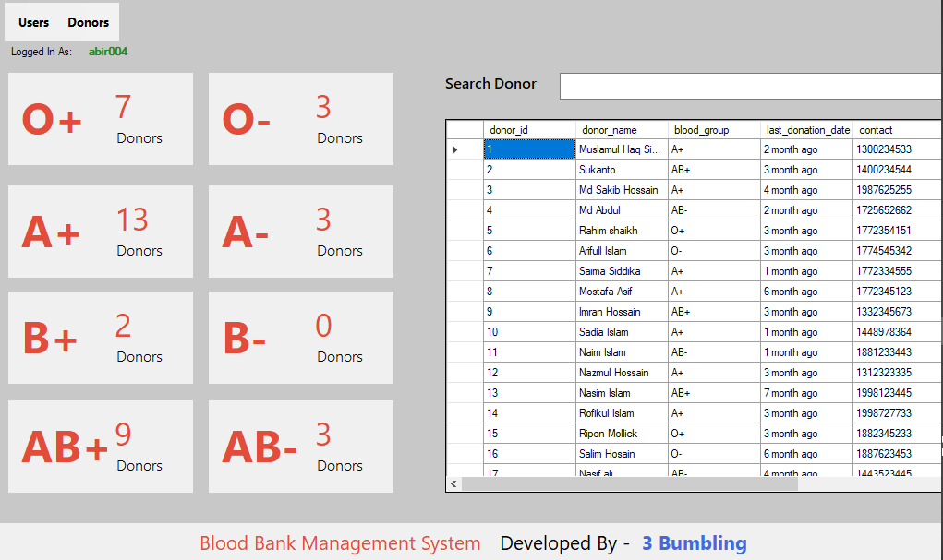
Features of our Application
Donor Availability: We can see the Donor availability according to their blood group on the home screen. It is auto calculated from the Donor list of current Databases.
Amount of Donors according to their Blood Groups
Fig: Donor Availability

Slide 6
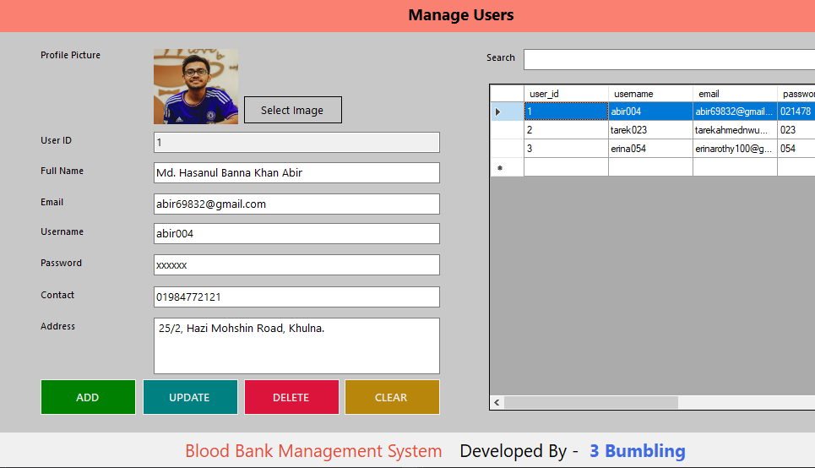
Features of our Application
User Access: Only the users can access the database and manage systems. The system is password protected. All the users have their individual username and password. The system has the details of its users. New user can be added and user can be deleted also.
Fig: User Access

Slide 7
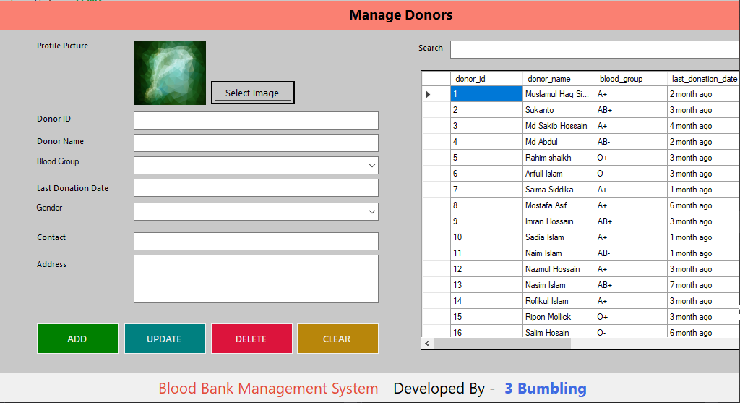
Features of our Application
Donor Management: Only the users can manage the donors in this system. They can add, update, delete the donor info. There is also a option to clear specific info of donor. From the donor list the user can easily know the ins and outs of the donor.
Fig: Donor Management

Slide 8
Conclusion and Future Work
We will add BMI calculator for checking donation probability.
Our final trial will be Auto update Donation date for the better management.

Slide 9

Any Question ?

