Slide 1


Ibrahim El khalil Harrane
09NOV26

Slide 2

Outline
Executive Summary
Introduction
Methodology
Results
Conclusion
Appendix

Slide 3
Executive Summary
Goal: predict whether a Falcon 9 first stage will land, to estimate launch cost
Data collected from the SpaceX REST API and scraped from Wikipedia
Data wrangling, EDA (visualization and SQL), Folium maps and a Plotly Dash dashboard
Results: launch success improves over time and depends on site, orbit and payload
Classification models were compared and the most accurate one selected

Slide 4
Introduction
SpaceX advertises Falcon 9 launches at about $62M, versus $165M+ from other providers
The savings come from reusing the first stage, so landing success drives cost
Questions: which factors affect landing success, and how has success changed over time?
Can we predict landing success with a classification model?

Slide 5

Section 1

Slide 6
Methodology
Project workflow
Data collection methodology:
  SpaceX REST API and Wikipedia web scraping
Perform data wrangling
  Cleaned data and created a landing outcome label
Perform exploratory data analysis (EDA) using visualization and SQL
Perform interactive visual analytics using Folium and Plotly Dash
Perform predictive analysis using classification models
  Standardize, split, tune with GridSearchCV, compare accuracy

Slide 7
Data Collection
Two sources: the SpaceX REST API and Wikipedia launch tables
API: requested past launches, then looked up rocket, launchpad, payload and core details
Web scraping: parsed Falcon 9 launch tables with BeautifulSoup into a DataFrame
Both datasets were saved as CSV files for wrangling

Slide 8
Data Collection – SpaceX API
Requested past launch records from the SpaceX REST API.
Resolved rocket, launchpad, payload and core references; kept Falcon 9 launches and enriched missing payload masses.
1. GET past launches (JSON)
2. Normalize into a DataFrame
3. Look up rocket, launchpad, payload and core IDs
4. Keep Falcon 9 launches only
5. Fill missing payload mass and save to CSV
Open API collection notebook

Slide 9
Data Collection - Scraping
Scraped Falcon 9 launch history tables from Wikipedia with requests and BeautifulSoup.
Extracted table headers and rows into a DataFrame for cleaning and analysis.
1. HTTP GET the Wikipedia launch list page
2. Parse the HTML with BeautifulSoup
3. Find launch tables and extract column names
4. Parse each row into a dictionary
5. Convert to a DataFrame and export to CSV
Open web-scraping notebook

Slide 10
Data Wrangling
Checked missing values and column types; summarized launches by site, orbit and outcome.
Created the landing-success label and exported the cleaned data for analysis.
Open data-wrangling notebook

Slide 11
EDA with Data Visualization
Explored flight number, payload, launch site and orbit against landing outcome.
Compared success rates by orbit and year; see the EDA figures later in this deck.
Open EDA and ML notebook

Slide 12
EDA with SQL
Queried the cleaned launch table for site, payload, mission and landing-outcome summaries.
The result panels reproduce outputs saved in the executed SQL notebook.
Open SQL analysis notebook

Slide 13
Build an Interactive Map with Folium
Mapped launch-site locations and launch outcomes with Folium.
Measured straight-line distances to a selected coastline point and Cape Canaveral city center; road and rail distances are not reported because coordinates were not provided.
Open launch-site map notebook

Slide 14
Build a Dashboard with Plotly Dash
Added launch-site filtering, success summaries and a payload-range control.
The payload-versus-outcome chart uses booster family to distinguish launch records.
Open Plotly Dash source

Slide 15
Predictive Analysis (Classification)
Standardized features, split the data and tuned Logistic Regression, SVM, Decision Tree and KNN.
All models were evaluated on the same held-out test set and compared with 10-fold cross-validation.
Open ML prediction notebook

Slide 16
Results
Exploratory data analysis (visualization and SQL) results
Interactive analytics: Folium maps and Plotly Dash dashboard
Predictive analysis: model accuracy and confusion matrix

Slide 17

Section 2

Slide 18
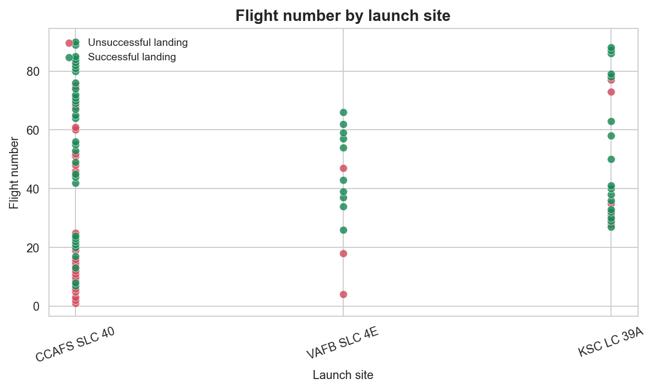
Flight Number vs. Launch Site
Show a scatter plot of Flight Number vs. Launch Site
Later flights at each site are mostly successful, so success rises with experience

Slide 19
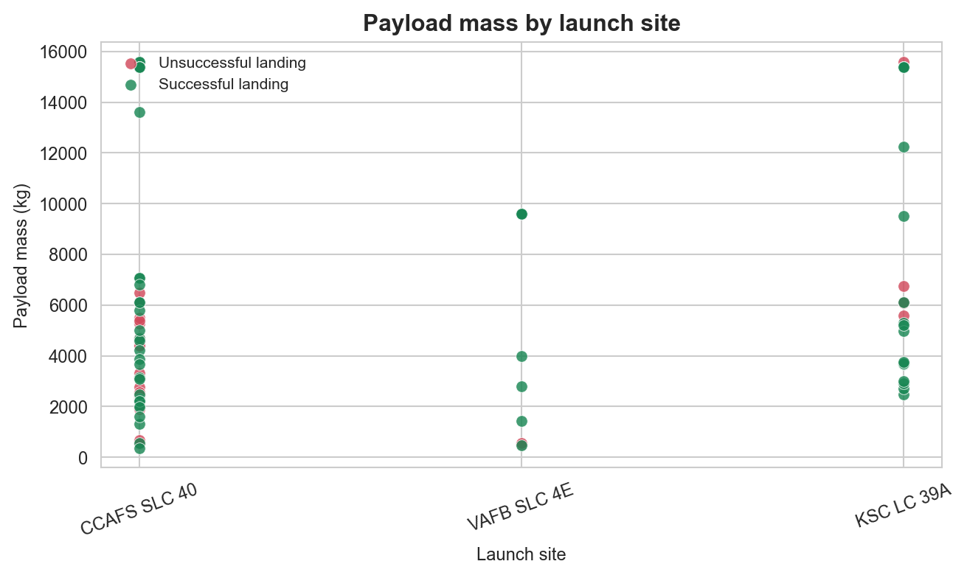
Payload vs. Launch Site
Show a scatter plot of Payload vs. Launch Site
Shows which sites carry heavy payloads and whether payload affects success at each site

Slide 20
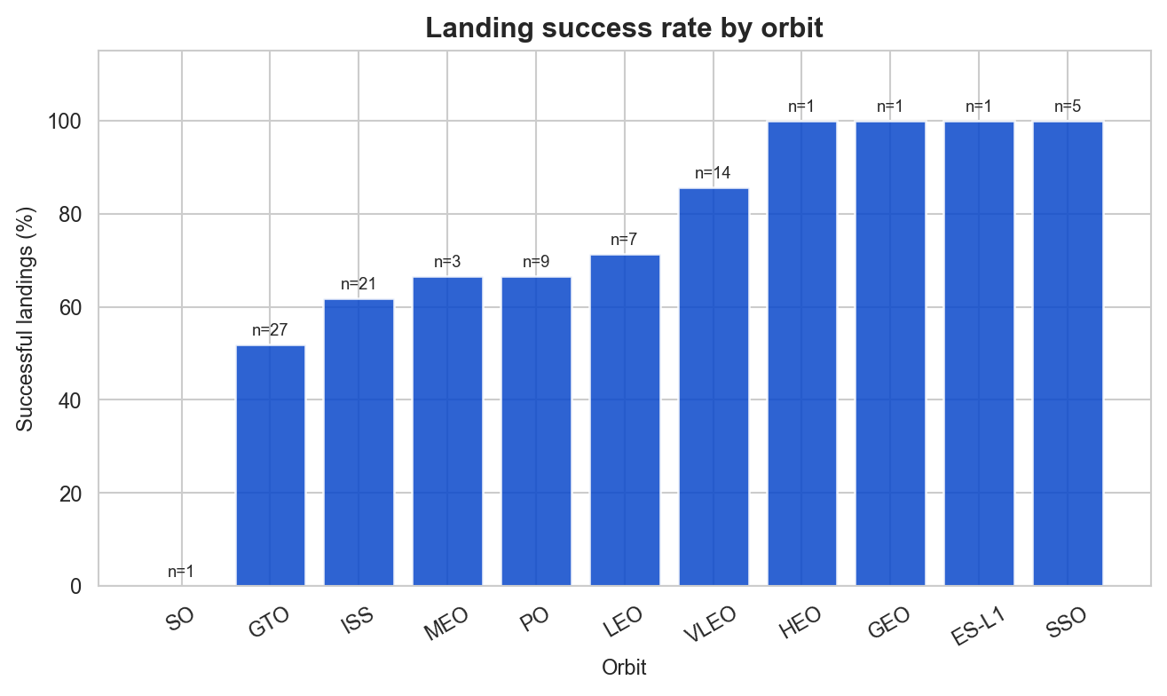
Success Rate vs. Orbit Type
Bar chart of the mean success rate for each orbit type
Highlights which orbits have the highest and lowest success rates

Slide 21
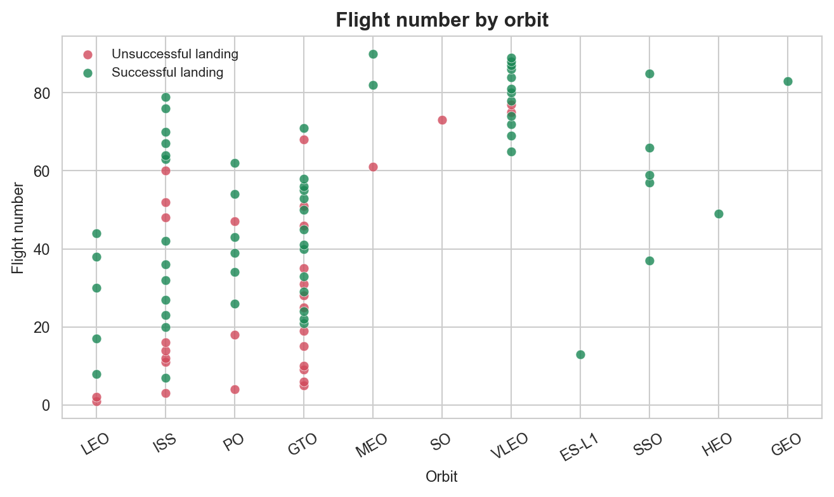
Flight Number vs. Orbit Type
Scatter plot of Flight Number vs. Orbit type, colored by outcome
Shows whether success in an orbit grows with the number of flights

Slide 22
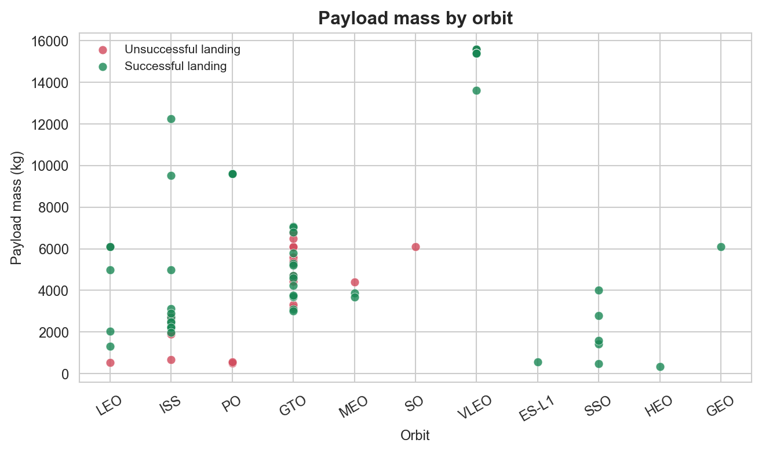
Payload vs. Orbit Type
Scatter plot of Payload Mass vs. Orbit type, colored by outcome
Shows how payload mass relates to success within each orbit

Slide 23
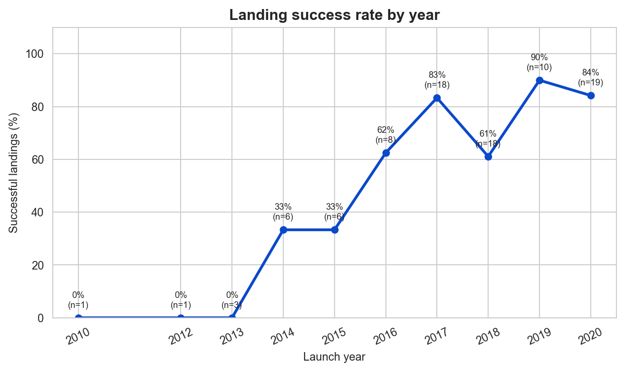
Launch Success Yearly Trend
Line chart of the average launch success rate by year
Shows the trend over time: the success rate generally increases as the technology matures

Slide 24
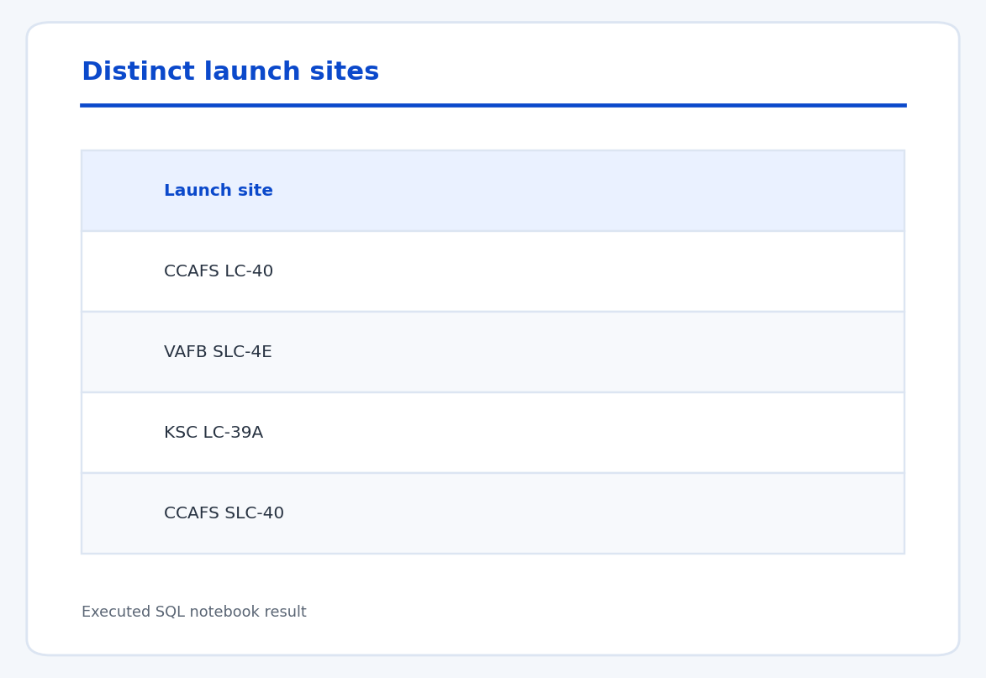
All Launch Site Names
SELECT DISTINCT Launch_Site
FROM SPACEXTABLE;
Returns the four distinct launch-site labels in the date-filtered table.

Slide 25
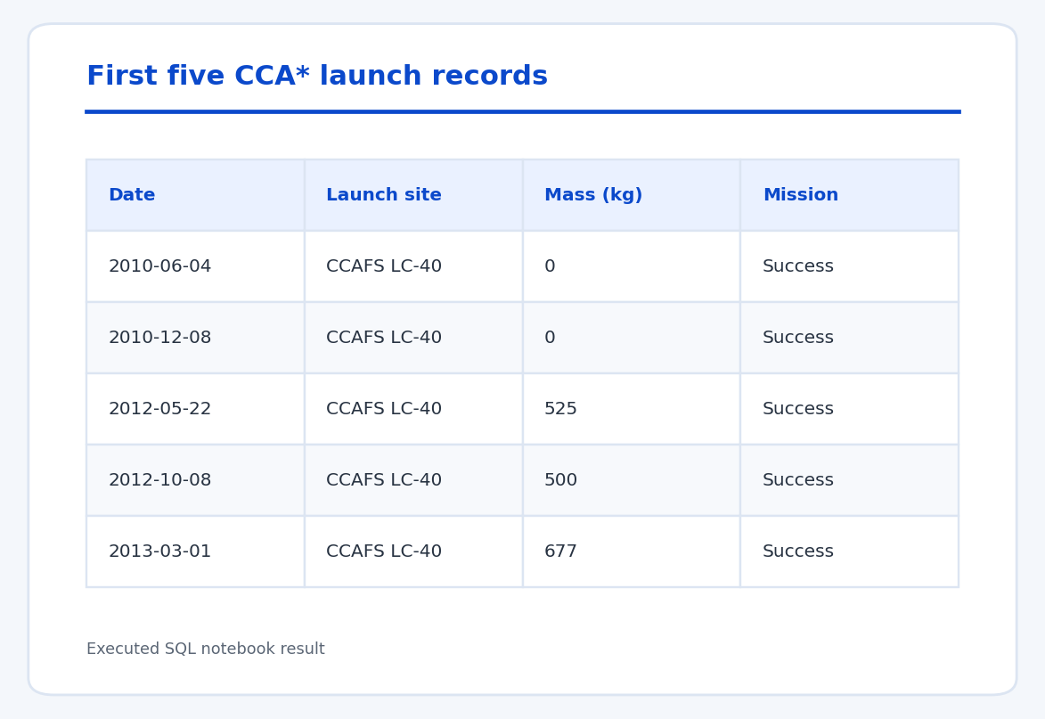
Launch Site Names Begin with 'CCA'
SELECT *
FROM SPACEXTABLE
WHERE Launch_Site LIKE 'CCA%'
LIMIT 5;
Shows the first five records for launch sites whose names begin with CCA.

Slide 26
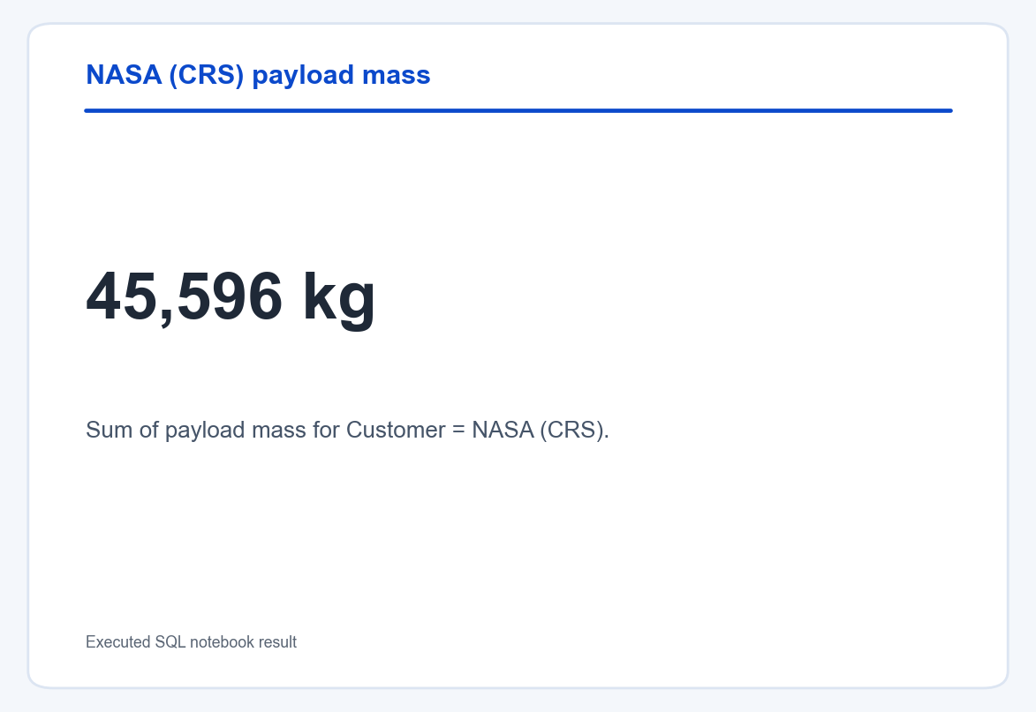
Total Payload Mass
SELECT SUM(PAYLOAD_MASS__KG_)
FROM SPACEXTABLE
WHERE Customer = 'NASA (CRS)';
NASA (CRS) missions carried 45,596 kg of payload in this dataset.

Slide 27
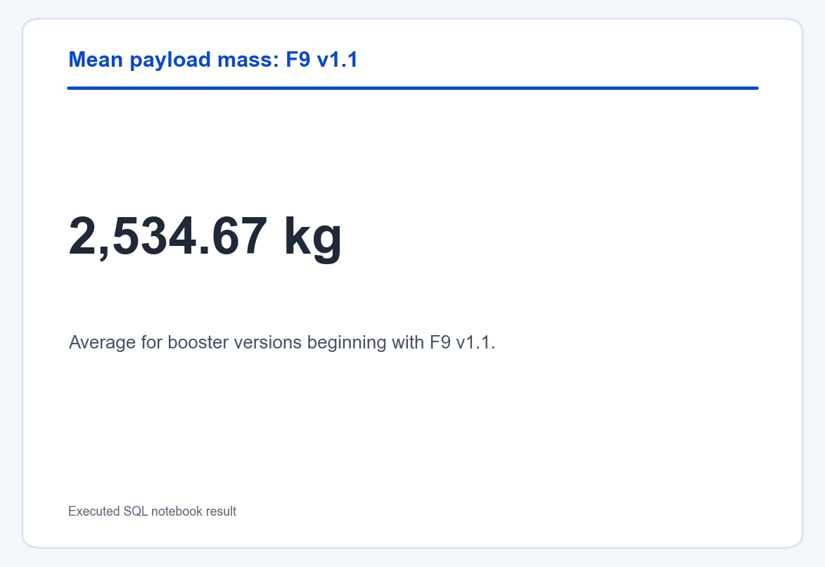
Average Payload Mass by F9 v1.1
SELECT AVG(PAYLOAD_MASS__KG_)
FROM SPACEXTABLE
WHERE Booster_Version LIKE 'F9 v1.1%';
The average payload mass for F9 v1.1 booster versions is 2,534.67 kg.

Slide 28
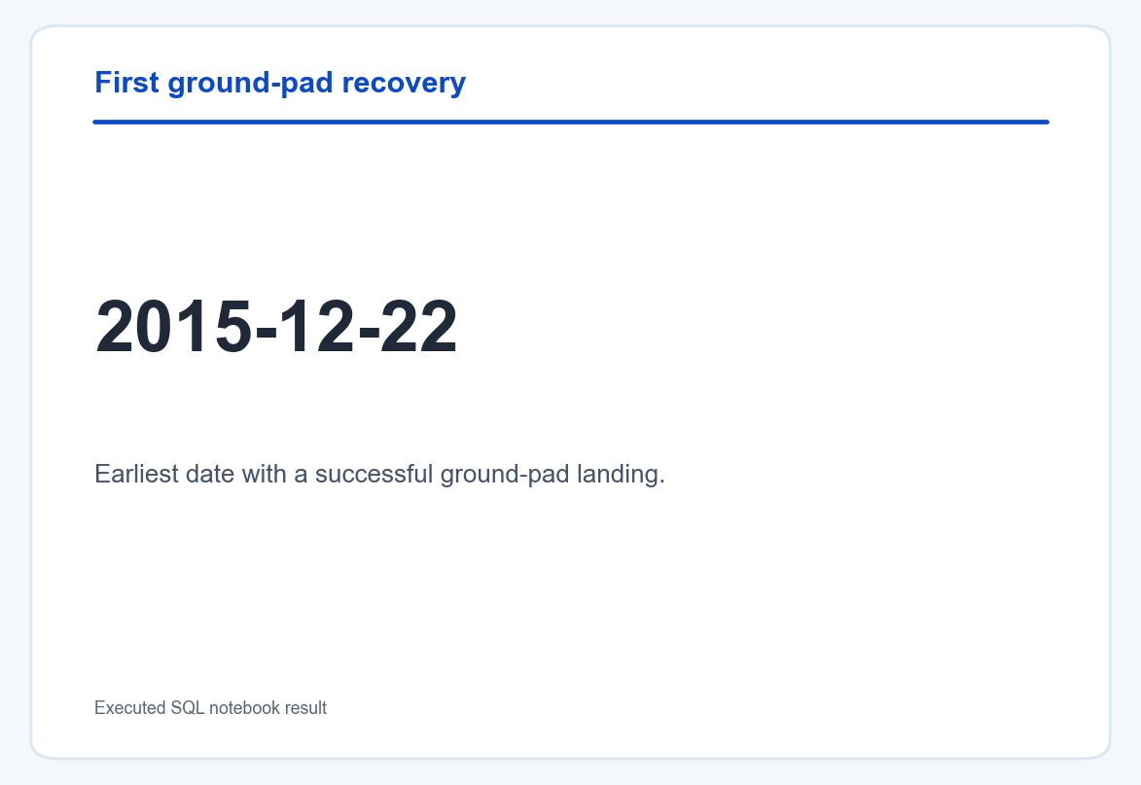
First Successful Ground Landing Date
SELECT MIN(Date)
FROM SPACEXTABLE
WHERE Landing_Outcome = 'Success (ground pad)';
The first successful ground-pad landing in the table was on 2015-12-22.

Slide 29
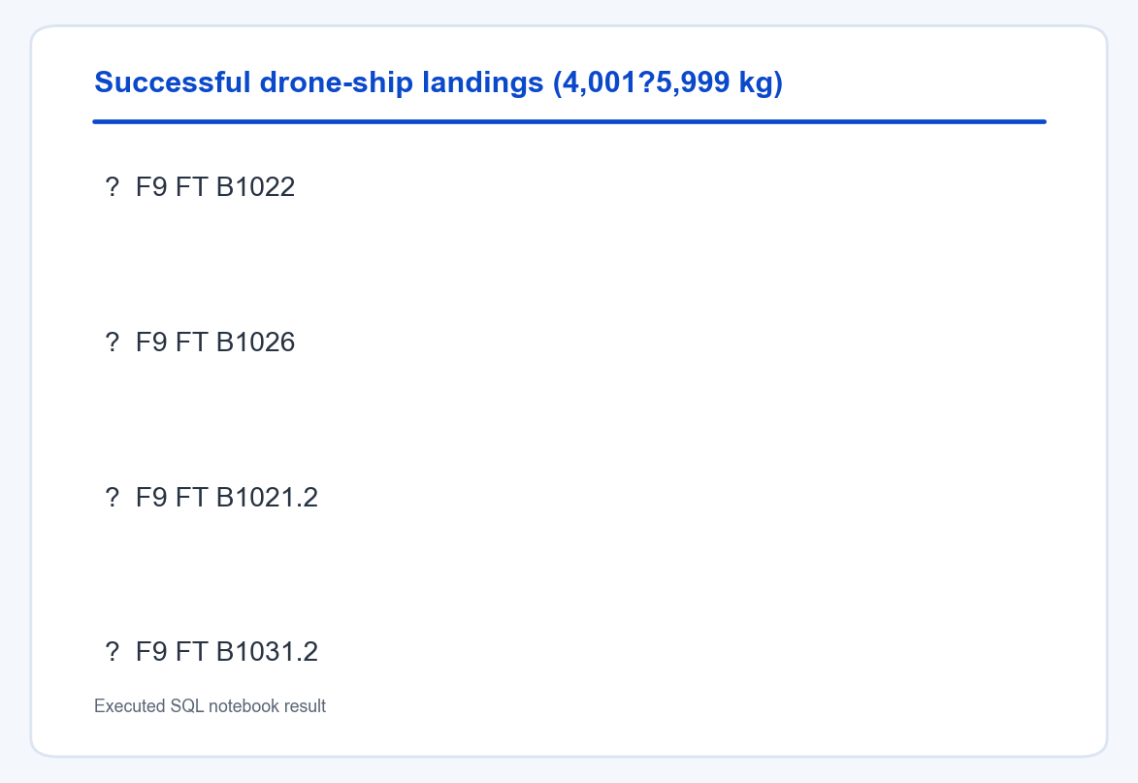
Successful Drone Ship Landing with Payload between 4000 and 6000
SELECT DISTINCT Booster_Version
FROM SPACEXTABLE
WHERE Landing_Outcome = 'Success (drone ship)'
AND PAYLOAD_MASS__KG_ > 4000
AND PAYLOAD_MASS__KG_ < 6000;
Four booster versions match the successful drone-ship landing and payload filters.

Slide 30
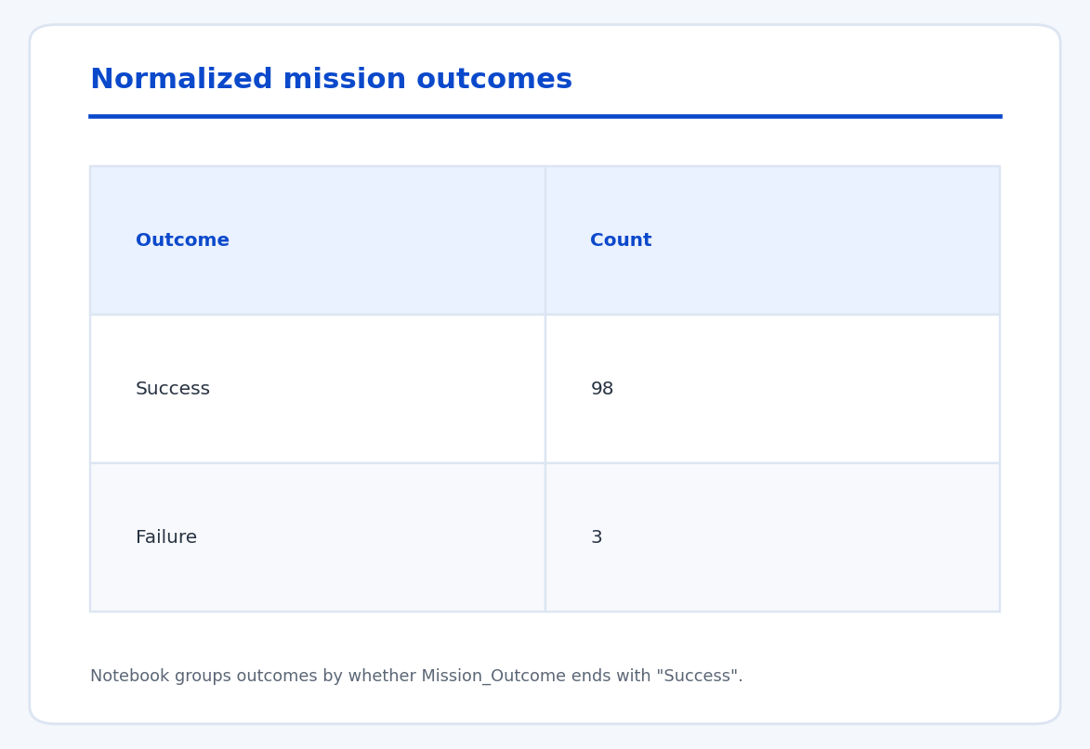
Total Number of Successful and Failure Mission Outcomes
WITH outcomes AS (
SELECT CASE WHEN Mission_Outcome LIKE '%Success'
THEN 'Success' ELSE 'Failure' END AS Outcome
FROM SPACEXTABLE
)
SELECT Outcome, COUNT(*)
FROM outcomes GROUP BY Outcome;
The notebook normalizes mission outcomes by whether the value ends with Success: 98 successes and 3 failures.

Slide 31
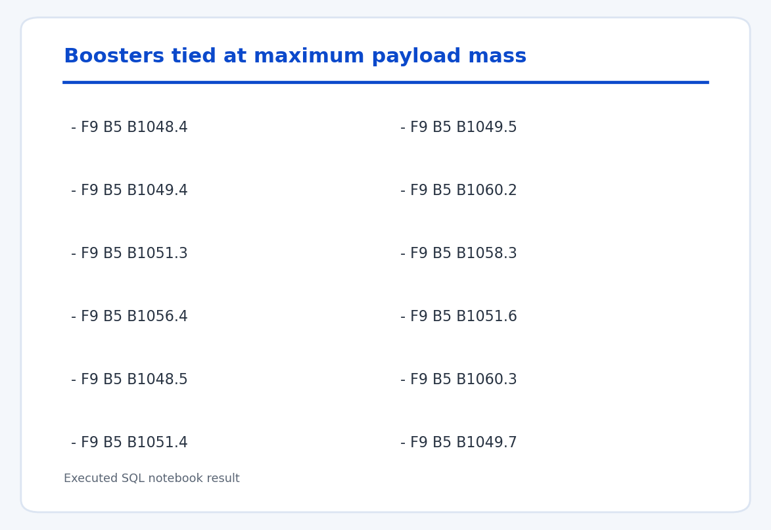
Boosters Carried Maximum Payload
SELECT Booster_Version
FROM SPACEXTABLE
WHERE PAYLOAD_MASS__KG_ = (
SELECT MAX(PAYLOAD_MASS__KG_) FROM SPACEXTABLE
);
Twelve booster records are tied at the maximum payload mass.

Slide 32
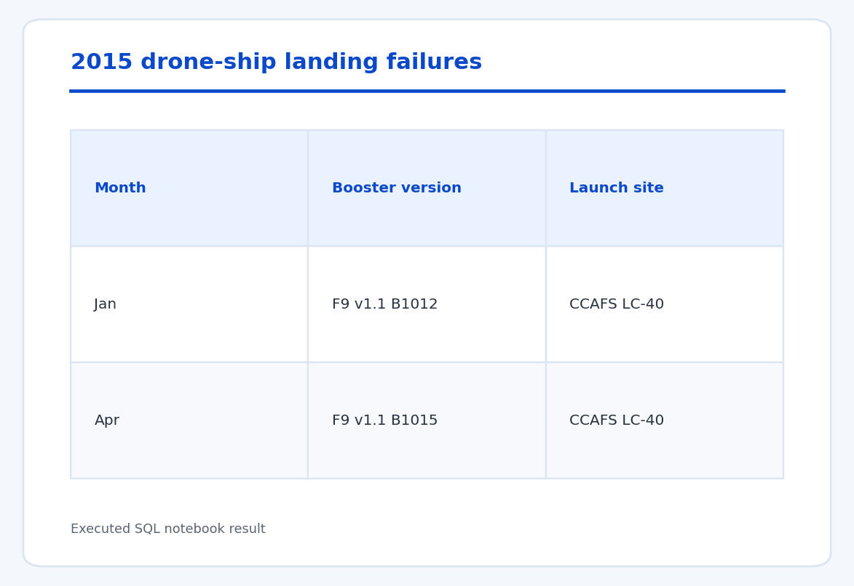
2015 Launch Records
SELECT substr(Date, 6, 2) AS Month, Booster_Version, Launch_Site
FROM SPACEXTABLE
WHERE Landing_Outcome = 'Failure (drone ship)'
AND substr(Date, 0, 5) = '2015';
The query returns two 2015 drone-ship failures: January (B1012) and April (B1015), both at CCAFS LC-40.

Slide 33
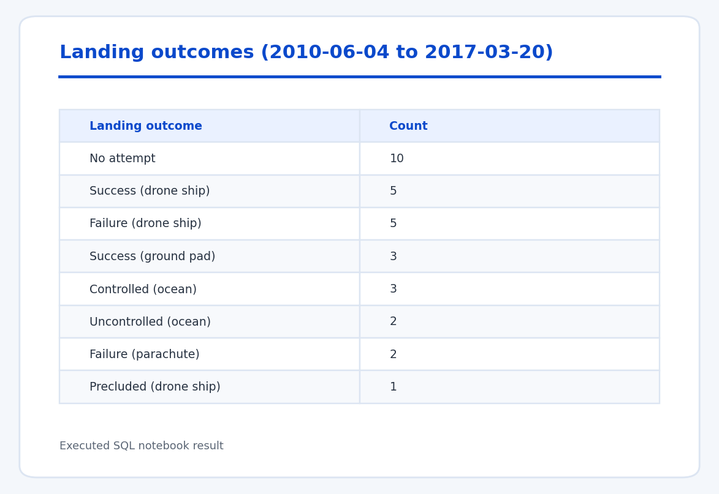
Rank Landing Outcomes Between 2010-06-04 and 2017-03-20
SELECT Landing_Outcome, COUNT(*) AS Total
FROM SPACEXTABLE
WHERE Date BETWEEN '2010-06-04' AND '2017-03-20'
GROUP BY Landing_Outcome
ORDER BY Total DESC;
Ranks landing outcomes by count for the specified date range.

Slide 34

Section 3

Slide 35
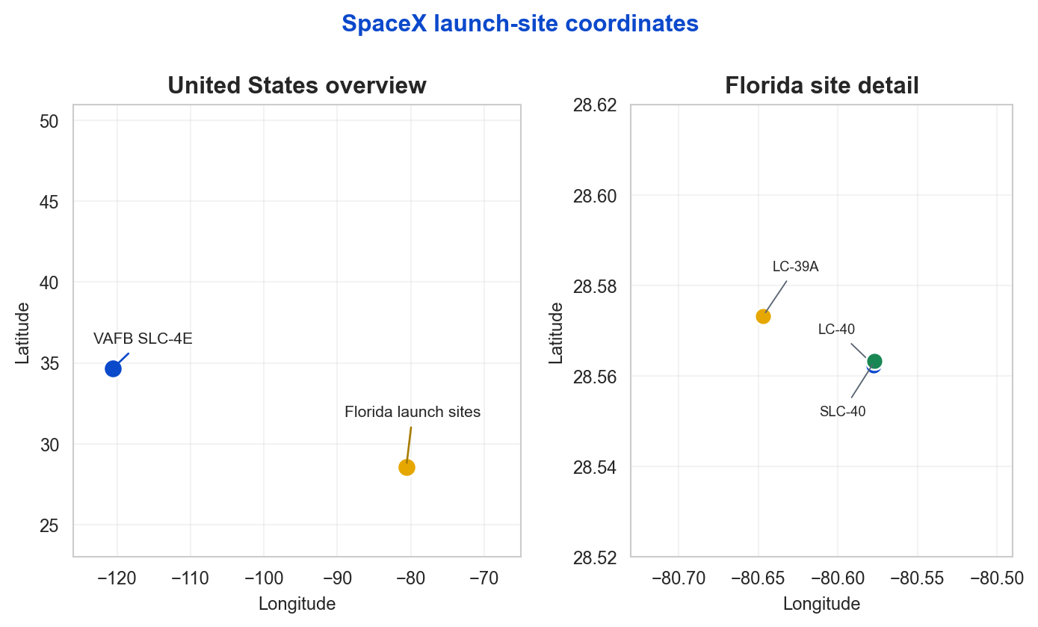
Launch Site Locations on a Global Map
Four launch-site labels form two regional clusters: three Florida pads and VAFB in California.
CCAFS LC-40 and SLC-40 coordinates are close but distinct in the dataset; Florida pads lie near 28.6 degrees north.

Slide 36
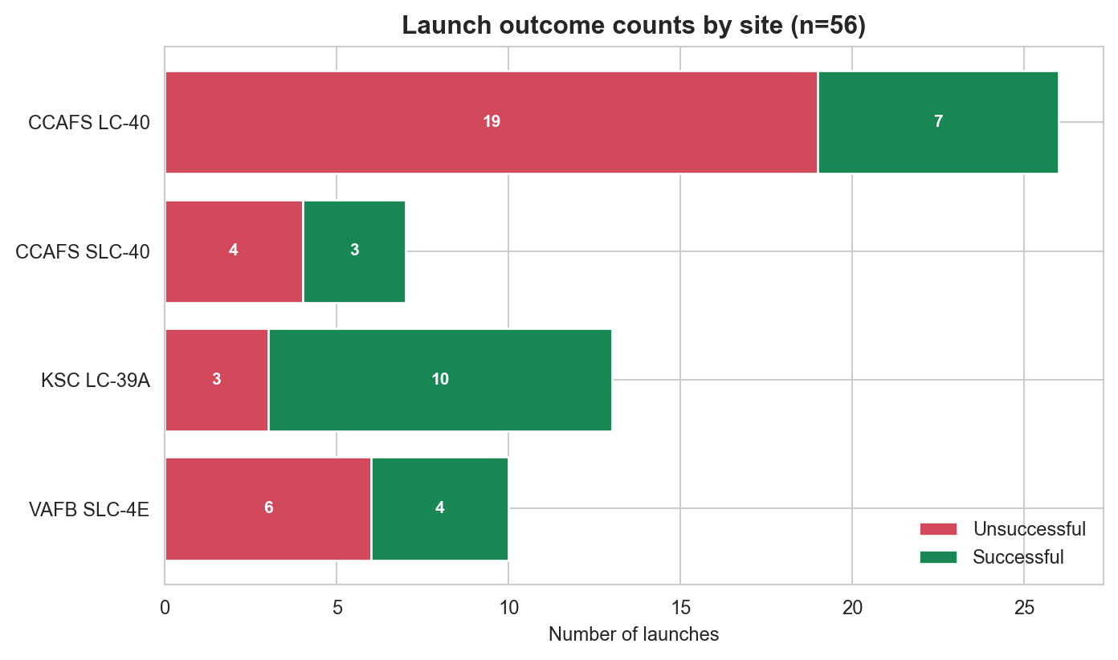
Launch Outcomes by Site
Green indicates successful outcomes; red indicates unsuccessful outcomes.
Counts are from the 56-row geospatial dataset and are grouped by site label.

Slide 37
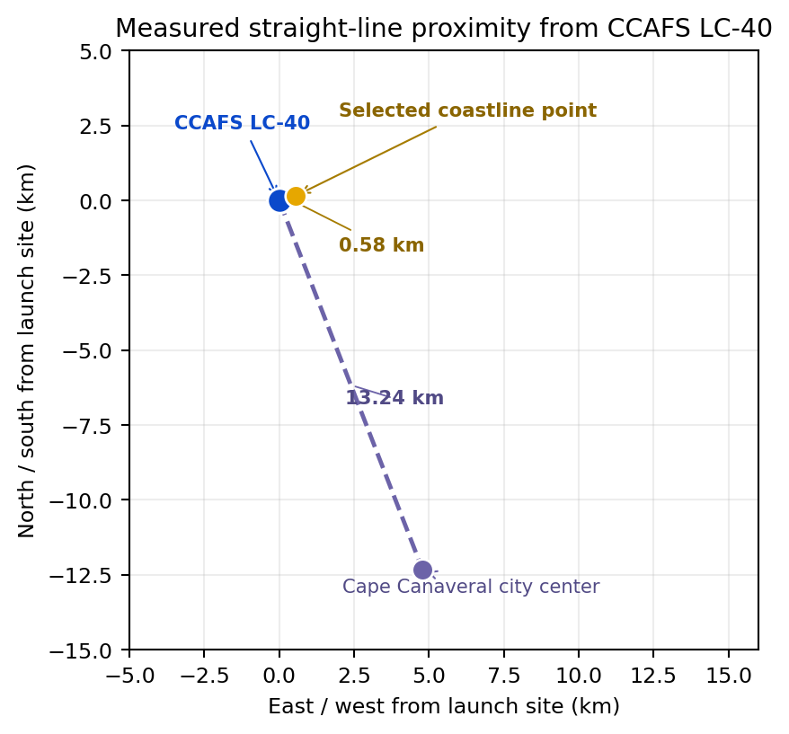
Launch Site Proximities
CCAFS LC-40 measured examples:
Selected coastline point: 0.58 km. Cape Canaveral city center: 13.24 km.
These are straight-line distances. Road and rail distances are not computed because coordinates were not provided.

Slide 38

Section 4

Slide 39
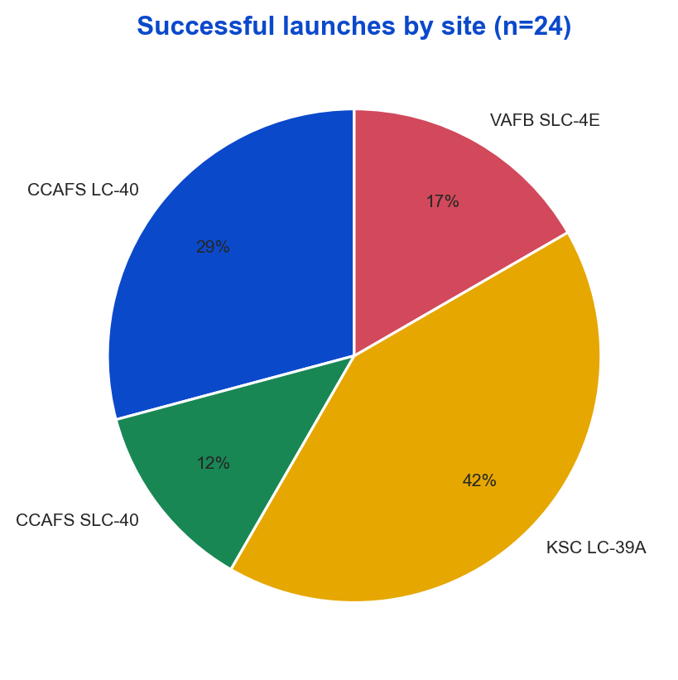
Launch Success Count by Site
Successful launches by site in the 56-row geospatial subset.
The chart shows each site's share of 24 successful outcomes.

Slide 40
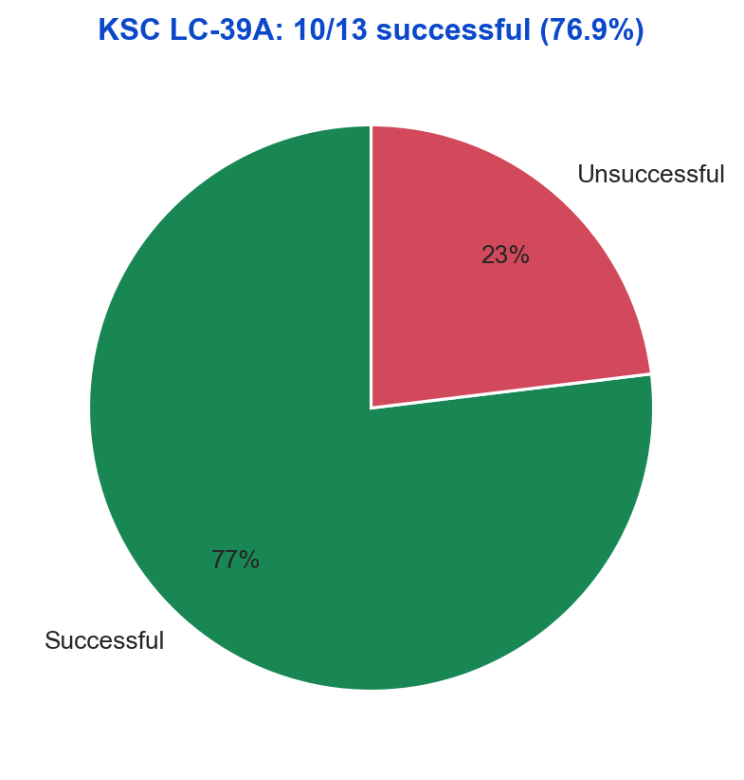
Site with the Highest Success Ratio
KSC LC-39A has the highest observed success rate in the geospatial subset: 10 of 13 launches (76.9%).

Slide 41
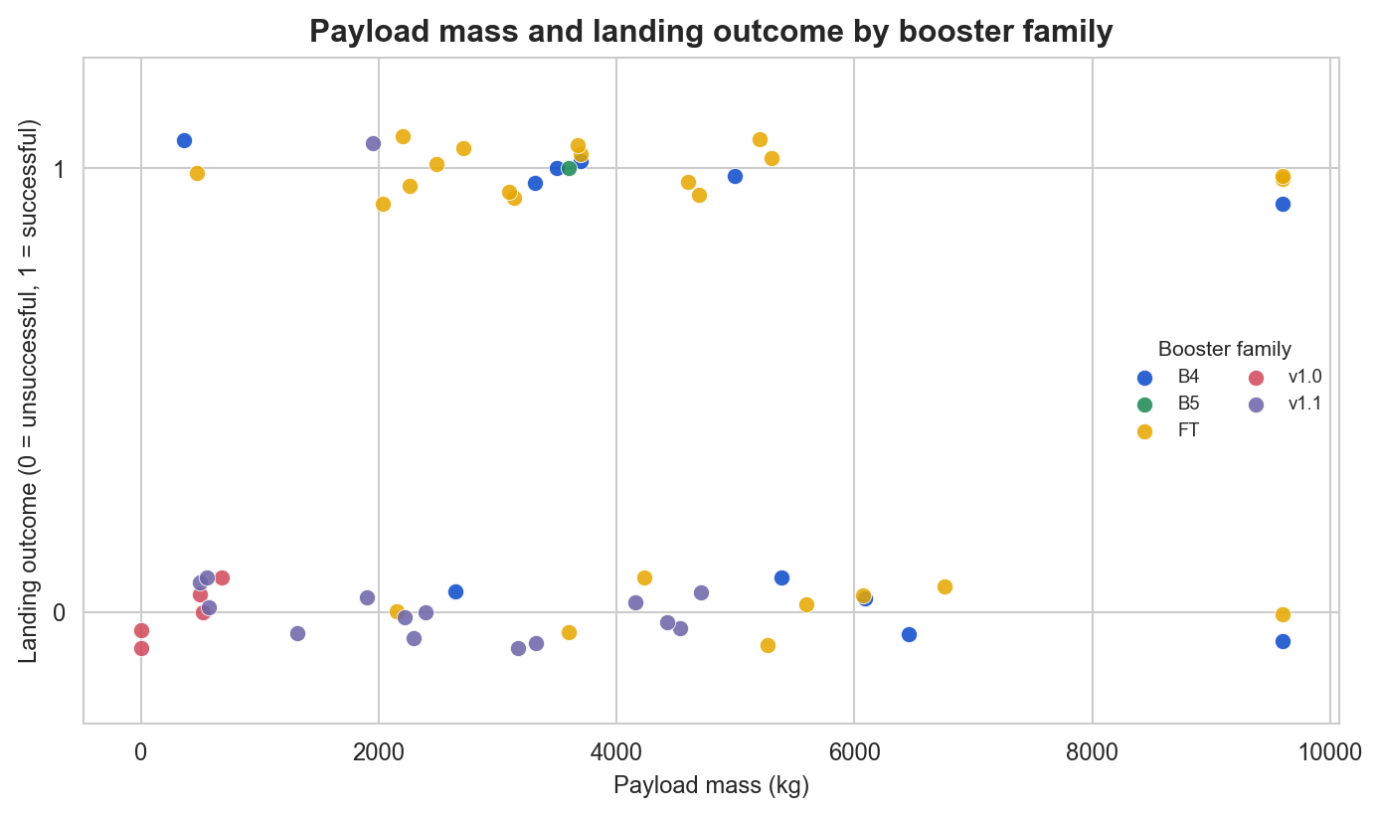
Payload vs. Launch Outcome
Payload mass versus landing outcome in the 56-row dashboard dataset.
Color indicates booster family; 1 = successful landing and 0 = unsuccessful landing.

Slide 42

Section 5

Slide 43
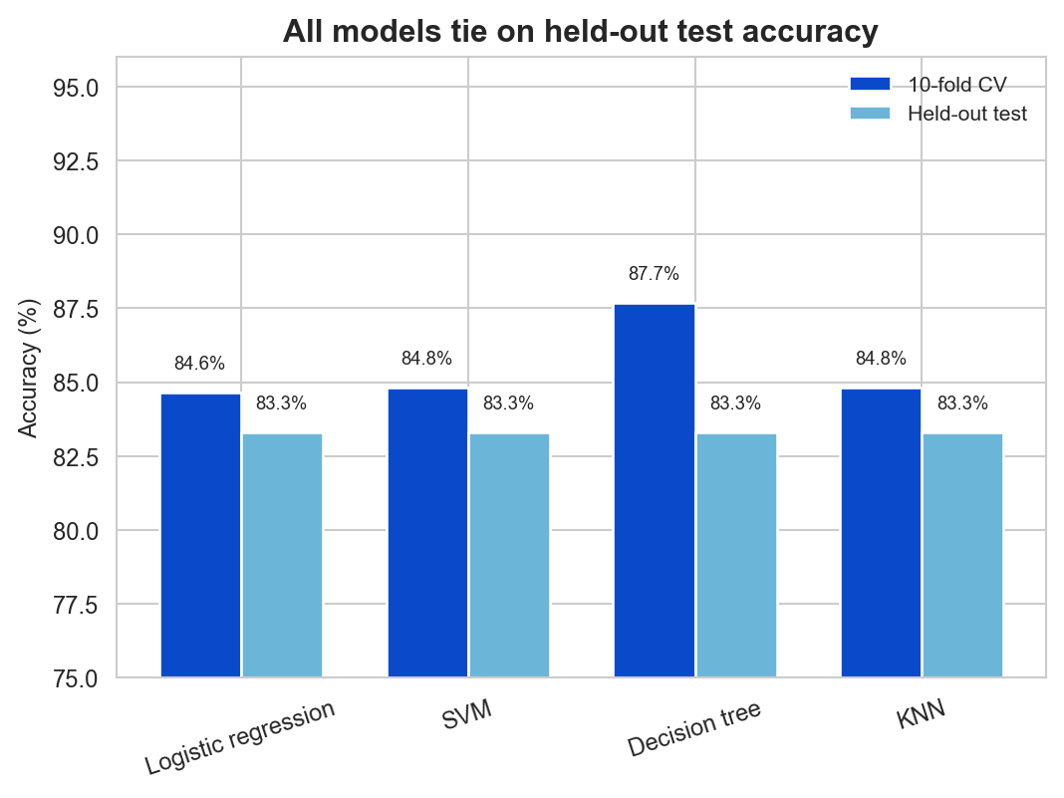
Classification Accuracy
All four models scored 83.3% on the held-out test set.
Decision Tree had the highest 10-fold cross-validation accuracy (87.7%), so it was selected for the confusion-matrix view.

Slide 44
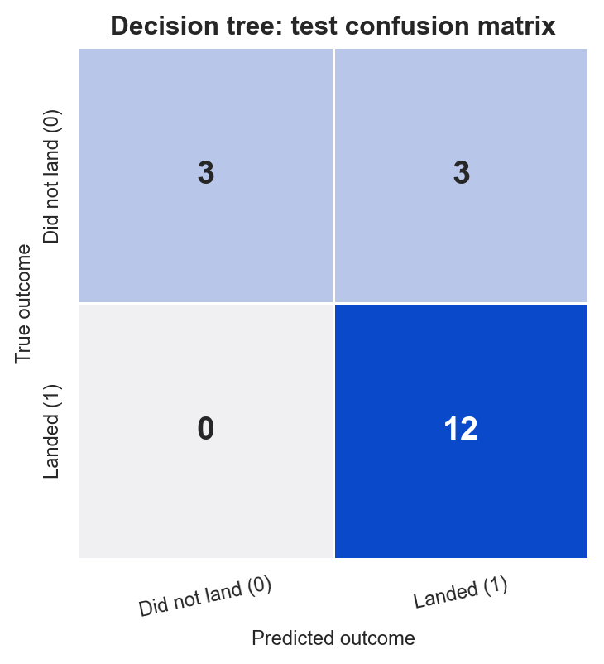
Confusion Matrix
Decision Tree: highest cross-validation score; held-out test accuracy tied at 83.3%.
Rows are true classes and columns are predicted classes. It correctly identified 3 of 6 non-landings and 12 of 12 landings.

Slide 45
Conclusions
Launch success generally improved over time in the analyzed records.
Launch site, orbit, payload mass and flight number show associations with landing outcome; small orbit groups should be interpreted cautiously.
All four models tied at 83.3% test accuracy. Decision Tree was selected by its highest 10-fold cross-validation score (87.7%), not by a unique test-set win.

Slide 46
Appendix
Project files
API collection notebook
Wikipedia scraping notebook
Data-wrangling notebook
EDA / ML notebook
SQL analysis notebook
Launch-site map notebook
Plotly Dash app source
Data and references
Course launch dataset (CSV)
Geospatial launch dataset (CSV)
Enriched launch dataset (CSV)
Wikipedia launch history
Notebooks: API calls, web scraping, wrangling, EDA, Folium, Dash and ML
Datasets: launch data exported to CSV; SQL queries and charts

Slide 47


